Slide 1
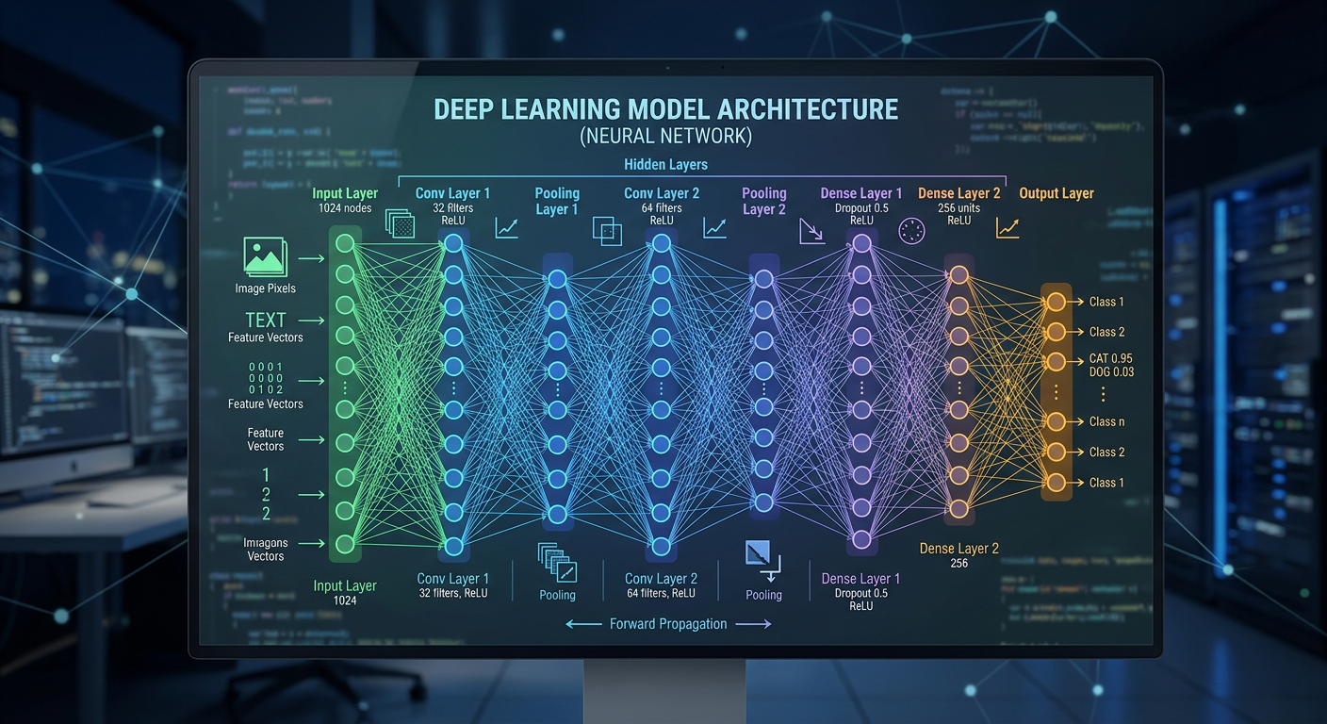

Introduction to Deep Learning for Chemistry
J. Schleinitz · Monday, August 10, 2026 · RSC 275, Caltech
AI4ChemicalSciences BootCamp 2026

Slide 2
Timeline
Rumelhart, Hinton
message passing for
380k+ new stable
& Williams
quantum chemistry
crystals predicted
Backpropagation
MPNNs
GNoME
1958
2012
2021
2024
1986
2017
2023
Perceptron
AlexNet
AlphaFold2
Two Nobel Prizes
Rosenblatt builds the
15.3% vs 26.2% error
Physics: neural networks
first trainable neuron
on ImageNet
Chemistry: protein design
AI4ChemicalSciences BootCamp 2026

Slide 3
Outline
•
Deep Learning Definition
•
Limitations of Linear Models
•
The Perceptron
•
Neural Networks:
Example
Weights fitting
Importance of weights initialization
Model Capacity
Regularization
•
Architectures: convolution, pooling, message passing
•
Physics-infused networks: putting chemistry into the model
•
Conclusion
AI4ChemicalSciences BootCamp 2026

Slide 4
Deep learning
•
Machine learning: supervised learning a function between input and labels
ARTIFICIAL INTELLIGENCE
•
Deep learning: many-layer neural networks.
MACHINE LEARNING
DEEP
LEARNING
AI4ChemicalSciences BootCamp 2026

Slide 5
Deep learning and chemistry
Breakthrough | What it did | Why it mattered
AlphaFold2 (2021) | predicted protein structures to ~1 Å backbone accuracy | ~200M structures released — a 50-year-old problem largely solved
MPNNs for quantum chemistry (2017) | learned DFT-level molecular properties from the molecular graph | molecular property prediction at a fraction of the DFT cost
GNoME (2023) | screened candidate crystals, DFT-verified only the promising ones | 380,000+ new stable materials; 736 experimentally realised
Retrosynthesis & reaction prediction | learned reaction rules from millions of literature reactions | route planning that competes with expert chemists
Jumper et al. Nature 596, 583 (2021) · Gilmer et al. ICML (2017) · Merchant et al. Nature 624, 80 (2023) · Segler et al. Nature 555, 604 (2018)
AI4ChemicalSciences BootCamp 2026

Slide 6
2024: two Nobel Prizes for neural networks
Physics 2024
Chemistry 2024
John Hopfield · Geoffrey Hinton
David Baker · Demis Hassabis · John Jumper
“for foundational discoveries and inventions that enable machine learning with artificial neural networks”
“for computational protein design” and “for protein structure prediction”
The methods came from statistical physics — Hopfield networks and the Boltzmann machine.
AlphaFold2 predicted structures for essentially every protein known to science.
The tools of this lecture are now mainstream chemistry — and they were recognised in both physics and chemistry in the same year.
AI4ChemicalSciences BootCamp 2026

Slide 7
Timeline
Rumelhart, Hinton
message passing for
380k+ new stable
& Williams
quantum chemistry
crystals predicted
Backpropagation
MPNNs
GNoME
1958
2012
2021
2024
1986
2017
2023
Perceptron
AlexNet
AlphaFold2
Two Nobel Prizes
Rosenblatt builds the
15.3% vs 26.2% error
Physics: neural networks
first trainable neuron
on ImageNet
Chemistry: protein design
AI4ChemicalSciences BootCamp 2026
Notes:
Add GPU availability and add datasets availability for images, PDB

Slide 8
Outline
•
Deep Learning Definition
•
Limitations of Linear Models
•
The Perceptron
•
Neural Networks:
Example
Weights fitting
Importance of weights initialization
Model Capacity
Regularization
•
Architectures: convolution, pooling, message passing
•
Physics-infused networks: putting chemistry into the model
•
Conclusion
AI4ChemicalSciences BootCamp 2026

Slide 9
Training a linear model
AI4ChemicalSciences BootCamp 2026

Slide 10
Non linear data
Linear model — 48% accuracy
Neural Network: one hidden layer (2→8→1) — 100% accuracy
•
XOR pattern. The best possible straight line gets ~50%.
•
Non-linear model can make the predictions.
The solution comes from changing the model class.
AI4ChemicalSciences BootCamp 2026

Slide 11
Outline
•
Deep Learning Definition
•
Limitations of Linear Models
•
The Perceptron
•
Neural Networks:
Example
Weights fitting
Importance of weights initialization
Model Capacity
Regularization
•
Architectures: convolution, pooling, message passing
•
Physics-infused networks: putting chemistry into the model
•
Conclusion
AI4ChemicalSciences BootCamp 2026

Slide 12
The perceptron
inputs
x₁
bond length
partial charge
x₂
Δ electronegativity
x₃
Three numbers for molecular representation.
AI4ChemicalSciences BootCamp 2026

Slide 13
The perceptron
inputs
x₁
bond length
w₁
x₂
w₂
partial charge
w₃
Δ electronegativity
x₃
Each input gets its own weight. w_{i} are the numbers that get learned.
AI4ChemicalSciences BootCamp 2026

Slide 14
The perceptron
inputs
weighted sum
x₁
bond length
w₁
x₂
w₂
Σ
partial charge
w₃
Δ electronegativity
x₃
b
bias input
1
z = w₁x₁ + w₂x₂ + w₃x₃ + b
AI4ChemicalSciences BootCamp 2026

Slide 15
The perceptron: add the activation function
inputs
weighted sum
activation
output
x₁
bond length
w₁
x₂
w₂
Σ
a
partial charge
w₃
σ(z)
Δ electronegativity
x₃
a = σ(z)
b
bias input
1
z = w₁x₁ + w₂x₂ + w₃x₃ + b
Without a nonlinear σ, stacking layers collapses back to a single linear model.
AI4ChemicalSciences BootCamp 2026

Slide 16
Activation function: non linearity
ReLU max(0, z)
tanh(z)
sigmoid 1/(1+e⁻ᶻ)
•
ReLU often default
•
tanh and sigmoid other examples, often slower.
•
The only hard requirement is that σ be nonlinear otherwise the whole network reduces to a linear model y = w·x + b.
AI4ChemicalSciences BootCamp 2026

Slide 17
Outline
•
Deep Learning Definition
•
Limitations of Linear Models
•
The Perceptron
•
Neural Networks:
Example
Weights fitting
Importance of weights initialization
Model Capacity
Regularization
•
Architectures: convolution, pooling, message passing
•
Physics-infused networks: putting chemistry into the model
•
Conclusion
AI4ChemicalSciences BootCamp 2026

Slide 18
Non-linear example: is the molecule electron count odd or even?
molecule | nH | nC | nN | nO | electrons | parity
CH₄ | 4 | 1 | 0 | 0 | 10 | even
H₂O | 2 | 0 | 0 | 1 | 10 | even
NH₃ | 3 | 0 | 1 | 0 | 10 | even
NO | 0 | 0 | 1 | 1 | 15 | odd
•CH₃ | 3 | 1 | 0 | 0 | 9 | odd
C₆H₆ | 6 | 6 | 0 | 0 | 42 | even
electrons = 1·nH + 6·nC + 7·nN + 8·nO
→ parity = (nH + nN) mod 2
•
Inputs: the counts nH, nC, nN, nO — four numbers per molecule.
•
Target: is the total electron count odd or even? (odd ⇒ an unpaired electron ⇒ a radical)
A linear model scores 48% here. Chance is 50%.
AI4ChemicalSciences BootCamp 2026

Slide 19
The network: 4 inputs → 5 hidden units → 1 output
Before training: weights initialization is chosen at random
inputs
hidden (5)
output
nH
•
teal line = positive weight
•
orange line = negative weight
nC
•
thickness = magnitude of the weight
ŷ
nN
Weights start as small random numbers
nO
•
Every hidden unit computes its own weighted sum of the four inputs + bias, then applies activation function tanh.
•
The output unit combines the five hidden values into a single probability of “odd”.
•
Accuracy before any training: 50.2%.
AI4ChemicalSciences BootCamp 2026

Slide 20
Outline
•
Deep Learning Definition
•
Limitations of Linear Models
•
The Perceptron
•
Neural Networks:
Example
Weights fitting
Model Capacity
Regularization
•
Architectures: convolution, pooling, message passing
•
Physics-infused networks: putting chemistry into the model
•
Conclusion
AI4ChemicalSciences BootCamp 2026

Slide 21
Training = learning weights
initial (random)
trained
training loss
inputs
hidden (5)
output
inputs
hidden (5)
output
nH
nH
nC
nC
ŷ
ŷ
nN
nN
nO
nO
•
Trained on 1,492 molecules (up to 3 of each element), tested on 699 unseen ones.
•
Test accuracy climbs from 50.2% → 93.3%, while the linear model stays at 48.5%.
•
Notice the loss curve: a long plateau, then a sudden drop. The network sits stuck before it finds an approximate parity rule.
AI4ChemicalSciences BootCamp 2026

Slide 22
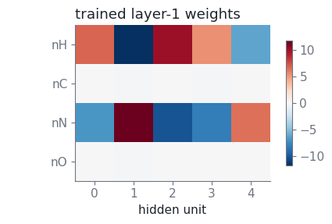
Training = learning weights
trained
inputs
hidden (5)
output
nH
nC
y
nN
nO
AI4ChemicalSciences BootCamp 2026

Slide 23
Training weights
W_{i+1} ← W_{i} − η · ∂L/∂w
AI4ChemicalSciences BootCamp 2026

Slide 24
Importance of the learning rate η
•
In practice η is scheduled, adaptive optimizers like Adam tune an effective step size per weight.
AI4ChemicalSciences BootCamp 2026

Slide 25
Importance of the learning rate η
η too small (η = 0.035)
η ~ right (η = 0.35)
η too large (η = 1.02)
W_{i+1} ← W_{i} − η · ∂L/∂w
•
In practice η is scheduled — warm up, then decay — and adaptive optimizers like Adam tune an effective step size per weight.
AI4ChemicalSciences BootCamp 2026

Slide 26
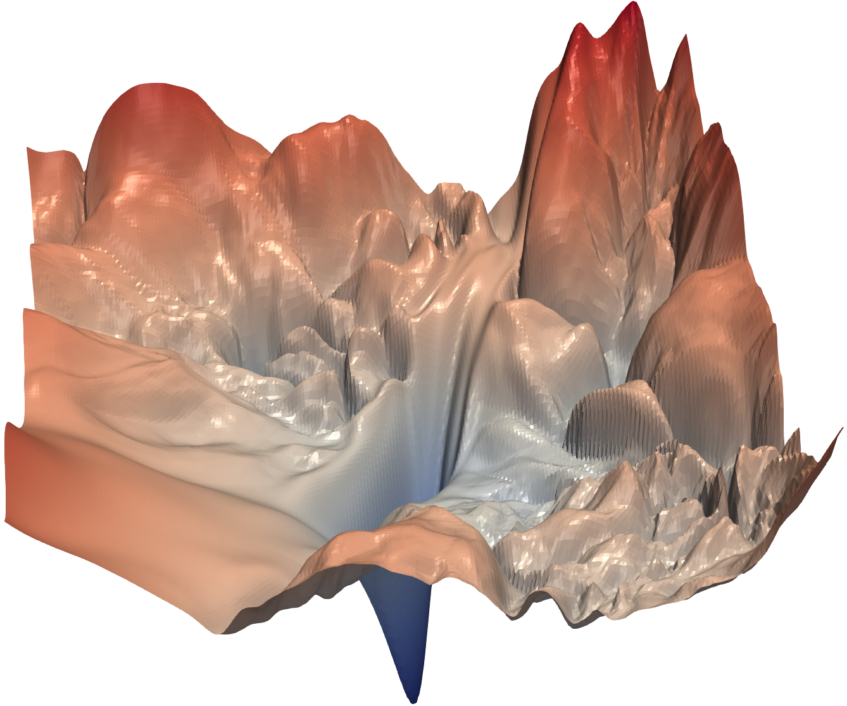
Gradient descent is not guaranteed to work
Same network, different starting weights
https://ar5iv.labs.arxiv.org/html/1712.09913
AI4ChemicalSciences BootCamp 2026

Slide 27
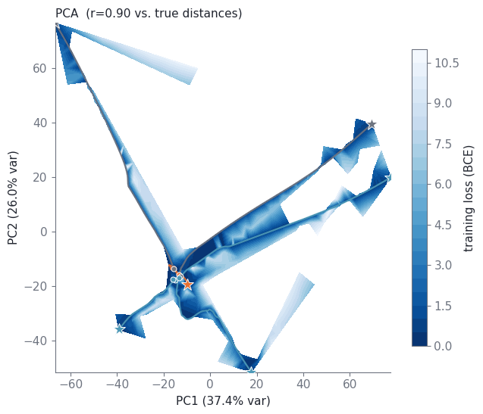
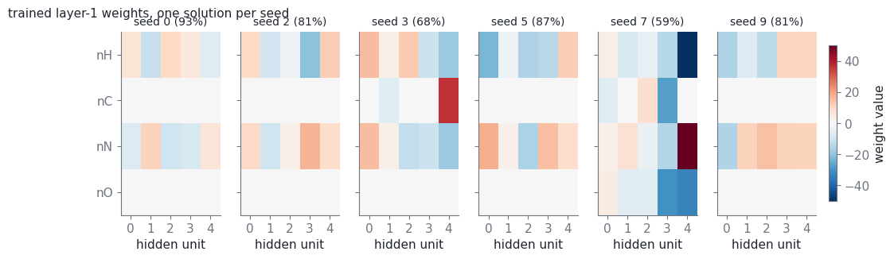
Gradient descent is not guaranteed to work
Same network, different starting weights
AI4ChemicalSciences BootCamp 2026

Slide 28
Outline
•
Deep Learning Definition
•
Limitations of Linear Models
•
The Perceptron
•
Neural Networks:
Example
Weights fitting
Model Capacity
Regularization
•
Architectures: convolution, pooling, message passing
•
Physics-infused networks: putting chemistry into the model
•
Conclusion
AI4ChemicalSciences BootCamp 2026

Slide 29
How many parameters does my model have?
inputs
hidden (5)
output
nH
parameter block | shape | count
layer 1 weights | 4 x 5 | 20
layer 1 biases | 5 | 5
layer 2 weights | 5 x 1 | 5
layer 2 bias | 1 | 1
total trainable parameters | — | 31
nC
ŷ
nN
nO
•
Our little network: (4×5 + 5) + (5×1 + 1) = 31 parameters. Training = 1,492 molecules.
•
For scale: AlexNet had ~60 million parameters; today's largest have billions.
Try to have parameters < data points.
AI4ChemicalSciences BootCamp 2026

Slide 30
Overfitting: polynomial approximation
degree 1 — underfits
degree 3 — about right
degree 13 — overfits
AI4ChemicalSciences BootCamp 2026

Slide 31
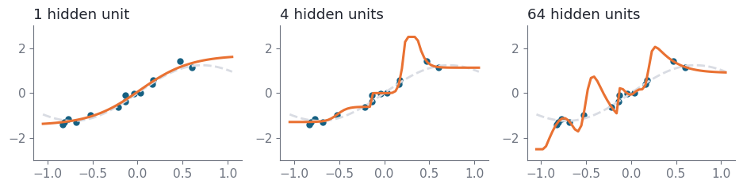
Overfitting: neural network complextity
AI4ChemicalSciences BootCamp 2026

Slide 32
Outline
•
Deep Learning Definition
•
Limitations of Linear Models
•
The Perceptron
•
Neural Networks:
Example
Weights fitting
Model Capacity
Regularization
•
Architectures: convolution, pooling, message passing
•
Physics-infused networks: putting chemistry into the model
•
Conclusion
AI4ChemicalSciences BootCamp 2026

Slide 33
How to spot overfitting: watch a held-out set
•
Split the data: train to fit, validation to make decisions, test touched once at the very end.
AI4ChemicalSciences BootCamp 2026

Slide 34
Three ways to fight overfitting
Early stopping
Weight decay (L2)
Dropout
inputs
hidden (5)
output
nH
nC
ŷ
nN
nO
•
Early stopping — keep the weights from the validation minimum. Free, and always worth doing.
•
Weight decay (L2) — add λ·Σwᵢ² to the loss so large weights must justify themselves.
•
Dropout — randomly silence a fraction of units at each step, so the network cannot depend on any single pathway. One of the tricks that made AlexNet work.
AI4ChemicalSciences BootCamp 2026

Slide 35
Outline
•
Deep Learning Definition
•
Limitations of Linear Models
•
The Perceptron
•
Neural Networks:
Example
Weights fitting
Model Capacity
Regularization
•
Complex architectures: convolution, pooling, message passing
•
Physics-infused networks: putting chemistry into the model
•
Conclusion
AI4ChemicalSciences BootCamp 2026

Slide 36
An architecture is a set of built-in assumptions
•
A dense layer: every input touches every output.
•
If you already know something about your data's structure: build the network accordingly then spends its capacity on chemistry rather than on rediscovering geometry.
Structure in the data | Architecture | Chemistry example
values on a regular grid | convolution + pooling | spectra (IR, NMR, XRD), microscopy images
an ordered sequence | RNN / Transformer | SMILES strings, reaction procedures
atoms and bonds | message passing (GNN) | molecules, crystals, catalyst surfaces
nothing in particular | dense layers | a handful of computed descriptors
See lecture on MLIPs/GNNs and Transformers
AI4ChemicalSciences BootCamp 2026

Slide 37
Convolution and pooling
Convolution: one shared filter, slid
Pooling: keep the strongest response
1
3
2
4
5
6
1
2
6
4
7
8
3
1
8
9
4
2
9
5
•
Convolution: one small filter is slid across the whole input, reusing the same weights everywhere.
•
Pooling: summarise each neighbourhood by its strongest response — shrinking the map and buying tolerance to small shifts.
AI4ChemicalSciences BootCamp 2026

Slide 38
Message passing: convolution for graphs
Round 1
Round 2
•
Each round, every atom collects a message from each of its neighbours and updates its own representation. After k rounds an atom knows about its k-bond neighbourhood.
Gilmer et al. (2017) unified these models as MPNNs and reached DFT-level accuracy on QM9 molecular properties.
AI4ChemicalSciences BootCamp 2026

Slide 39
Outline
•
Deep Learning Definition
•
Limitations of Linear Models
•
The Perceptron
•
Neural Networks:
Example
Weights fitting
Model Capacity
Regularization
•
Complex architectures: convolution, pooling, message passing
•
Physics-infused networks: putting chemistry into the model
•
Conclusion
AI4ChemicalSciences BootCamp 2026

Slide 40
Including Symmetries
original molecule
rotated molecule
energy E = −152.3 kcal/mol
energy E = −152.3 kcal/mol (unchanged → invariant)
the force vectors rotate with the molecule → equivariant
•
Invariant — rotate or translate a molecule and its energy does not change.
•
Equivariant — rotate a molecule and its force vectors rotate with it.
•
A plain network fed raw coordinates has to learn this from data, wasting capacity — or worse, it never quite learns it and predicts different energies for the same molecule.
AI4ChemicalSciences BootCamp 2026

Slide 41
Ways to put physics into a neural network
•
Symmetry in the architecture — invariant or equivariant layers. This is what modern interatomic potentials do, and it buys enormous data efficiency: equivariant models have matched earlier architectures with up to ~1000× less training data.
•
Physics in the loss (PINNs) — add the residual of a governing equation to the loss, so the network is penalised for violating known physics. Widely used for PDE-constrained problems in transport, kinetics and spectroscopy.
•
Conservation by construction — predict the energy, then obtain forces as −∂E/∂r. Energy conservation then holds by construction rather than by hope.
Batzner et al. Nat. Commun. 13, 2453 (2022) · Raissi, Perdikaris & Karniadakis, J. Comput. Phys. 378, 686 (2019)
AI4ChemicalSciences BootCamp 2026

Slide 42
Where this is heading
•
Graph neural networks treat the molecule as atoms and bonds — the natural representation. Adding rotational equivariance on top is what makes today's machine-learned interatomic potentials work.
•
Foundation potentials trained on millions of DFT calculations can now be fine-tuned to your own system with a few hundred extra data points.
•
The trade-off is real: more built-in physics means better data efficiency and generalization, but more engineering effort — and it hurts if the assumed symmetry is only approximate for your system.
Next lecture: graph neural networks and machine-learned interatomic potentials
AI4ChemicalSciences BootCamp 2026

Slide 43
Parameter/Data ratio
Dataset size | Models
< ~1,000 points | classical ML (random forest, GP, kernel ridge)
~1,000 – 10,000 | small networks, or architectures with physics built in
> ~10,000, or a pretrained model you can fine-tune | deep learning
AI4ChemicalSciences BootCamp 2026

Slide 44
Four questions before you train a network
1
Is the relationship actually nonlinear? Fit a linear or kernel baseline first. If it does the job, you are finished — and you have something interpretable.
2
Do you need gradients? If you need forces or want to run dynamics, a differentiable network gives them for free via backpropagation.
3
Will you run it many times? Screening thousands of candidates amortizes the training cost. A one-off analysis does not.
4
Can you check it? Hold out a genuinely independent test set. For a surrogate of DFT, spot-check against DFT on new chemistry before you trust it.
Compare to a baseline
AI4ChemicalSciences BootCamp 2026

Slide 45
Take-home messages
1
A neural network is layers of weighted sums glued together by nonlinear activations — nothing more mysterious than that.
2
Training means following the gradient of the loss downhill. It works well, but it is not guaranteed: initialization, learning rate and plateaus all matter.
3
Capacity cuts both ways. Count your parameters, watch a validation set, and regularize with early stopping, weight decay and dropout.
4
Choose the architecture that matches the structure of your data — and in chemistry, build the symmetry in.
AI4ChemicalSciences BootCamp 2026

Slide 46
Further reading
•
dmol.pub — Deep Learning for Molecules & Materials, A. D. White. Chemistry-first, with runnable notebooks.
•
introtodeeplearning.com — MIT 6.S191. Excellent lectures on the perceptron, training and regularization.
•
Krizhevsky, Sutskever & Hinton, AlexNet, NeurIPS (2012).
•
Gilmer et al., Neural Message Passing for Quantum Chemistry, ICML (2017); arXiv:1704.01212.
•
Jumper et al., AlphaFold2, Nature 596, 583 (2021).
•
Merchant et al., GNoME, Nature 624, 80 (2023).
•
Batzner et al., NequIP (equivariant potentials), Nat. Commun. 13, 2453 (2022).
•
Raissi, Perdikaris & Karniadakis, Physics-informed neural networks, J. Comput. Phys. 378, 686 (2019).
AI4ChemicalSciences BootCamp 2026

