Slide 1
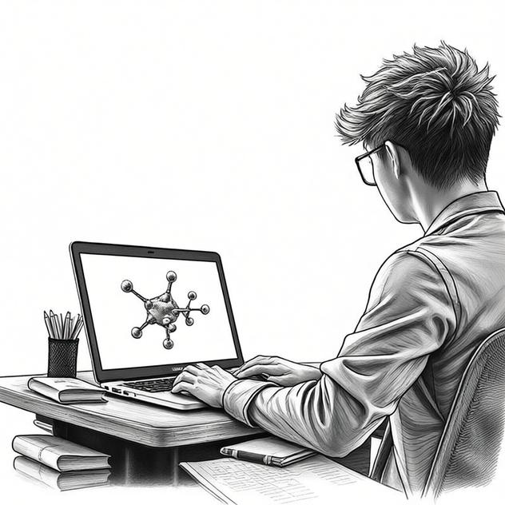

AI4Chemical Sciences Bootcamp — Introduction
An introduction to AI for the Chemical Sciences — Bootcamp overview
J. Schleinitz · Monday, August 10, 2026 · RSC 275, Caltech
AI4ChemicalSciences BootCamp 2026

Slide 2
Morning Agenda
AI & ML today
Bootcamp Overview
Bootcamp Objectives & Roadmap
Logistics
AI4ChemicalSciences BootCamp 2026

Slide 3
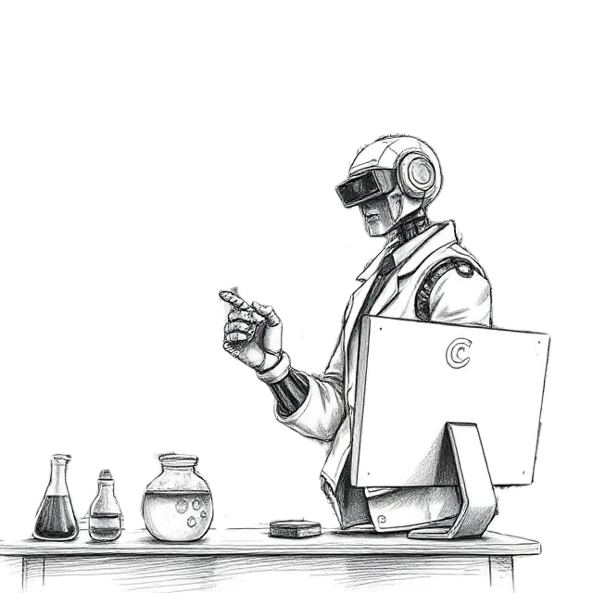
Artificial Intelligence – Definition
AI is the capability of computational systems to perform tasks typically associated with human intelligence, such as:
Learning
Reasoning
Planning
Perception
Communication
…
AI4ChemicalSciences BootCamp 2026

Slide 4
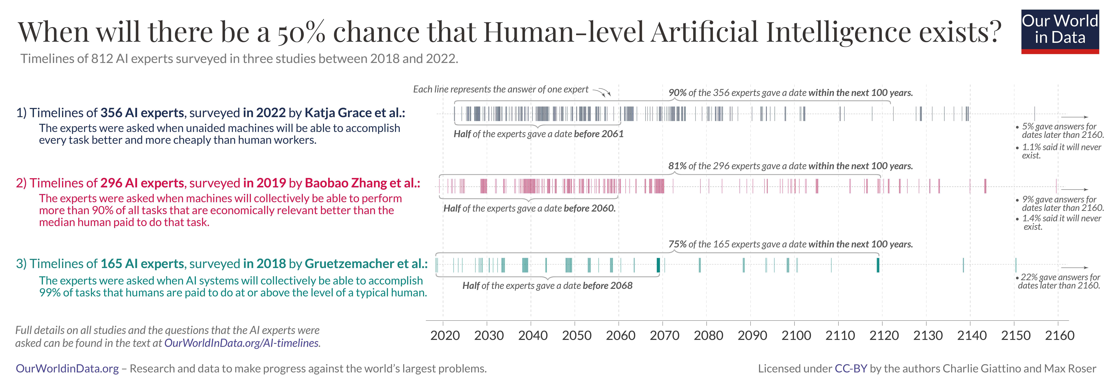
Artificial Intelligence Forecasts?
https://ourworldindata.org/ai-timelines
AI4ChemicalSciences BootCamp 2026

Slide 5
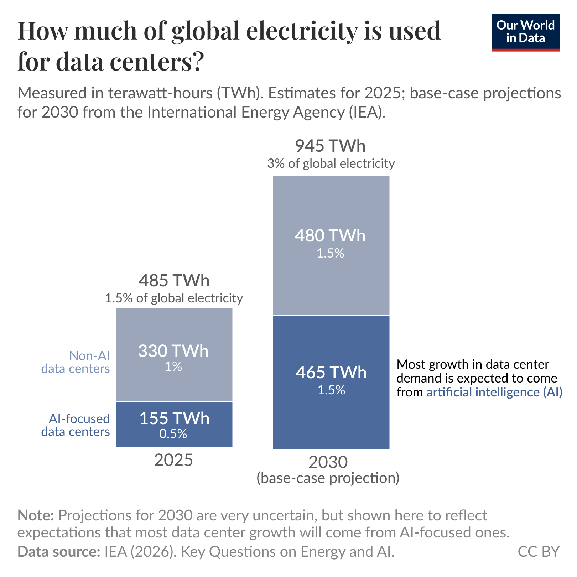
Artificial Intelligence and Society
Economic growth
Energy Consumption
Benchmark against human performance
https://ourworldindata.org/artificial-intelligence
https://ourworldindata.org/how-much-energy-do-data-centers-and-artificial-intelligence-use
AI4ChemicalSciences BootCamp 2026

Slide 6
Artificial Intelligence & Machine learning
Artificial Intelligence
Machine Learning
Data Science
Chemical Sciences
AI4ChemicalSciences BootCamp 2026

Slide 7
Morning Agenda
AI & ML today
Bootcamp Overview
Bootcamp Objectives & Roadmap
Logistics
AI4ChemicalSciences BootCamp 2026

Slide 8

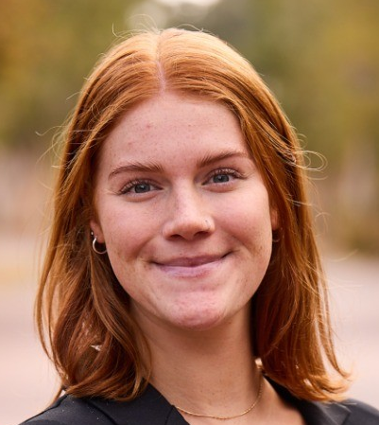
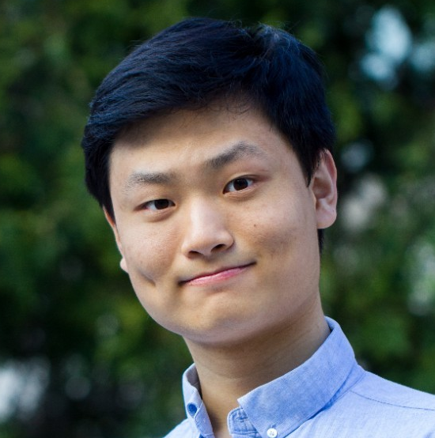



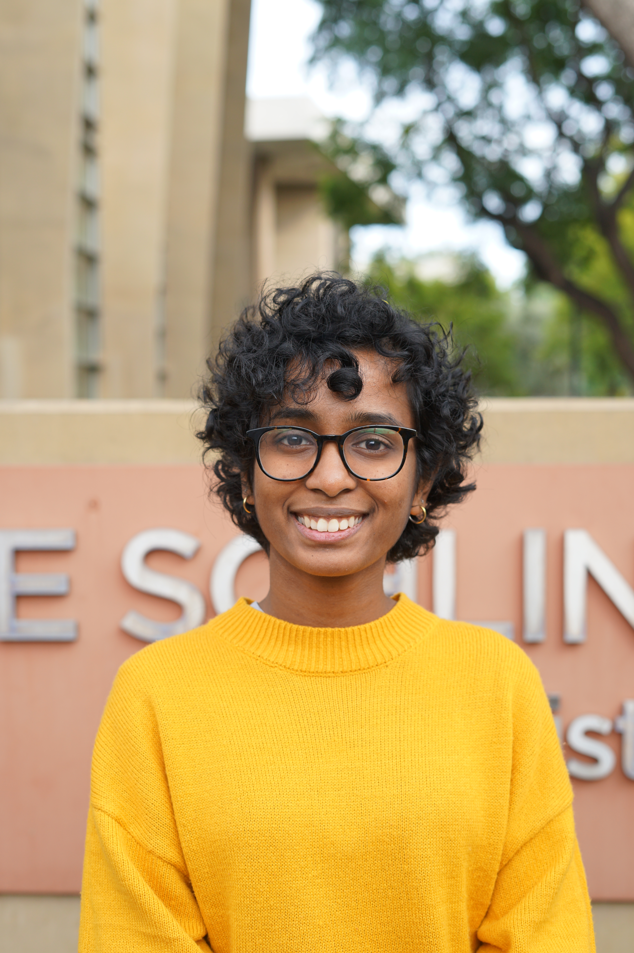
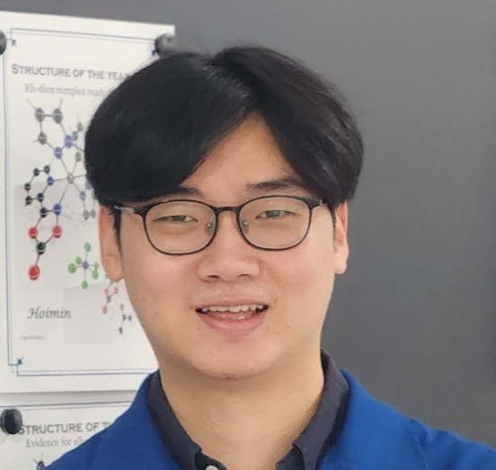
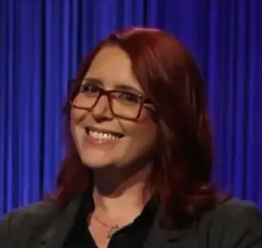

Bootcamp Team
J. SCHLEINITZ
Bootcamp lead & organizer
S. WAHLER
M. MURPHY
C. LIU
M. YUSOV
A. SCHMIDT
Supervised Learning · LLM Assistants
MLIPs & Graph Neural Networks
Diffusion & Generative Models
Model Interpretability
Design of Experiments · Data Stewardship
B. REINER
A. GURAJAPU
H. JUNG
R. FOX
T. KANO
Agentic AI
Hackathon Facilitation, MLIPs
Tutorials Preparation
Logistics
Logistics
AI4ChemicalSciences BootCamp 2026

Slide 9

Attendance to the bootcamp
Classification done by Claude based on your responses to the Questionnaire
AI4ChemicalSciences BootCamp 2026

Slide 10
Coding Experience
Python experience
Familiarity with chemistry/ML tools
Based on Bootcamp Questionnaire
AI4ChemicalSciences BootCamp 2026

Slide 11
LLM assistant usage
~80%
already use an AI coding assistant day to day.
We will discuss how to use them efficiently
Based on responses to the Questionnaire
AI4ChemicalSciences BootCamp 2026

Slide 12
Morning Agenda
AI & ML today
Bootcamp Overview
Bootcamp Objectives & Roadmap
Logistics
AI4ChemicalSciences BootCamp 2026

Slide 13
Your expectations
“Automate the literature review & summarization”
“Machine-learned interatomic potentials (MLIPs) for MD”
“Ligand design & reaction-yield optimization”
“Understand the “back-end” — which algorithm, why, how it's validated”
“Docking, virtual screening & binding-pose prediction”
“Multi-agent workflows / model selection guidance”
Based on Bootcamp Questionnaire
AI4ChemicalSciences BootCamp 2026

Slide 14

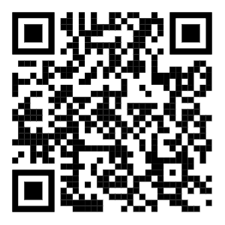
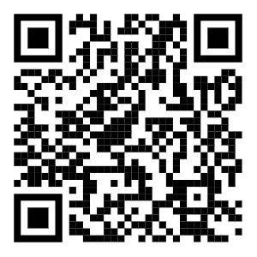
AI – ML – Data Science and Chemical Sciences
Artificial Intelligence
Machine Learning
AI4ChemicalSciences BOOTCAMP
Data Science
Chemical Sciences
AI4ChemicalSciences BootCamp 2026

Slide 15
Building Machine Learning Models – What’s needed?
DATA
REPRESENTATIONS
ALGORITHMS
The measurements and observations that ground everything a model learns.
How a molecule or reaction becomes numbers a model can actually use.
How we learn patterns from those numbers — and trust what comes out.
Models = understanding or black box for optimization
AI4ChemicalSciences BootCamp 2026

Slide 16
AI4Chemical Sciences
AI Agents
DATA
REPRESENTATIONS
ALGORITHMS
The measurements and observations that ground everything a model learns.
How a molecule or reaction becomes numbers a model can actually use.
How we learn patterns from those numbers — and trust what comes out.
Agents can help accelerate the integration, they still need guidance
AI4ChemicalSciences BootCamp 2026

Slide 17
Scientific Data: Acquisition Bottleneck
Chemical data is expensive and slow to generate especially for wet lab experiments
Datasets are small compared to vision or language: hundreds to thousands of points, not billions.
Negative results and failed reactions are rarely recorded — a strong, systematic reporting bias.
Noise from instruments, batch effects, and inconsistent protocols across labs and instruments.
Data is scattered across papers, ELNs, and proprietary silos — rarely FAIR or ML-ready.
AI4ChemicalSciences BootCamp 2026

Slide 18
Machine Readable Representations for Chemical Sciences
Molecules aren't naturally vectors — there is no single canonical coordinate system for them.
One molecule, many encodings: SMILES, InChI, SELFIES, fingerprints, 3D graphs — each keeps different information and hides different blind spots.
Symmetries matter: permutation of atoms, rotation/translation in 3D, stereochemistry, tautomers.
A representation that throws away the wrong information caps your model before training even starts.
AI4ChemicalSciences BootCamp 2026

Slide 19
Algorithms: choosing the model
Which model fits your data: a linear model, a random forest, a graph neural net, a transformer?
Which model fits your task: extrapolation, interpretability…?
What model to use to rely on predicted uncertainty?
AI4ChemicalSciences BootCamp 2026

Slide 20
AI4Chemical Sciences
AI Agents
DATA
REPRESENTATIONS
ALGORITHMS
The measurements and observations that ground everything a model learns.
How a molecule or reaction becomes numbers a model can actually use.
How we learn patterns from those numbers — and trust what comes out.
AI4ChemicalSciences BootCamp 2026

Slide 21
AI4Chemical Sciences: Learning Objectives
AI Agents
DATA
REPRESENTATIONS
ALGORITHMS
Dataset bias / distribution shift between benchmark and your real chemistry?
.
What is the information in may representation?
Domain of applicability?
Which algorithms to use?
Can we interpret the model?
Is model uncertainty reliable?
AI4ChemicalSciences BootCamp 2026

Slide 22
Bootcamp Roadmap
WEEK 1
WEEK 2
Aug 10 – 14
Aug 17 – 21
Foundations of ML & Representations
Dataset Design & LLMs
Supervised learning, neural networks, molecular representations, GNNs / MLIPs, LLM assistants, generative models.
Interpretability, design of experiments, Bayesian optimization, active learning, data stewardship, transformers, agentic AI.
AI4ChemicalSciences BootCamp 2026

Slide 23
Week 1 — Foundations of ML & Representations
MON
TUE
WED
THU
FRI
9:00
9:00
9:00
9:00
9:00
Intro & Logistics
Supervised Learning
MLIPs — GNNs
LLMs as Chemistry Assistants — RAG
Hackathon
13:30
13:30
13:30
13:30
Evolution of Molecular Representations
Neural Networks & Deep Learning
Learned Representations
Generative Models
AI4ChemicalSciences BootCamp 2026

Slide 24
Week 2 — Dataset Design & LLMs
MON
TUE
WED
THU
FRI
9:00
9:00
9:00
9:00
9:00
Model Interpretability
Design of Experiments
Active Learning
Agentic AI for Chemistry
Hackathon
13:30
13:30
13:30
13:30
13:30
Data Stewardship
Bayesian Optimization
Transformers — text-based representations, tokenization
Hackathon
AI Readiness
Wrap-up & Perspectives
AI Readiness
AI4ChemicalSciences BootCamp 2026

Slide 25
Bootcamp Objectives
Goal for the two weeks:
Basic literacy across data, representations, and algorithms
Basics of when to start/not start an AI/ML project.
Basics of how to get started coding wise.
Build a network of chemists interested in AI4Science.
AI4ChemicalSciences BootCamp 2026

Slide 26
Tutorials objectives
Reproducible pipelines: fixed seeds, versioned data splits, logged hyperparameters.
Define baselines.
Code architecture that separates data, features, model, and evaluation: test components independently.
Readable code today is debuggable code tomorrow — including code an agent wrote for you.
AI4ChemicalSciences BootCamp 2026

Slide 27
Lecture are paired with Tutorial
9:00
10:45
13:30
15:15
Lecture
→
Tutorial
→
Lecture
→
Tutorial
Coffee 10:30–10:45 · Lunch 12:15–13:30 · Coffee 15:00–15:15
Fridays are full Hackathon days — apply the week's concepts to a real chemistry challenge with a presentation at the end.
AI4ChemicalSciences BootCamp 2026

Slide 28
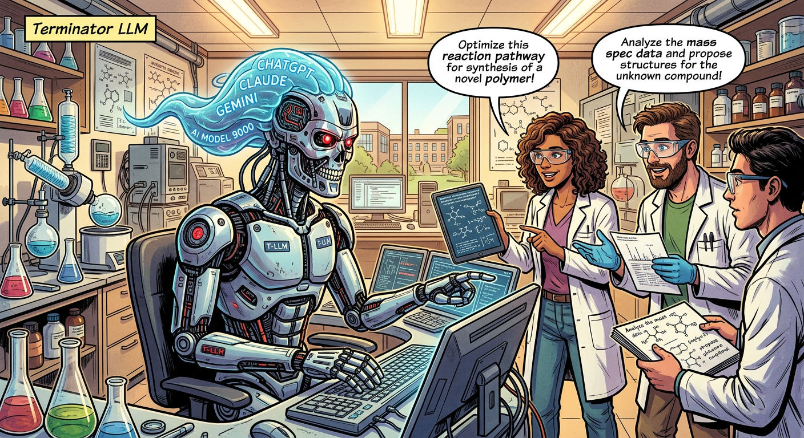
Bootcamp Objectives
Goal for the two weeks:
Basic literacy across data, representations, and algorithms
Basics of when to start/not start an AI/ML project.
Basics of how to get started coding wise.
Build a network of chemists interested in AI4Science.
AI4ChemicalSciences BootCamp 2026

Slide 29
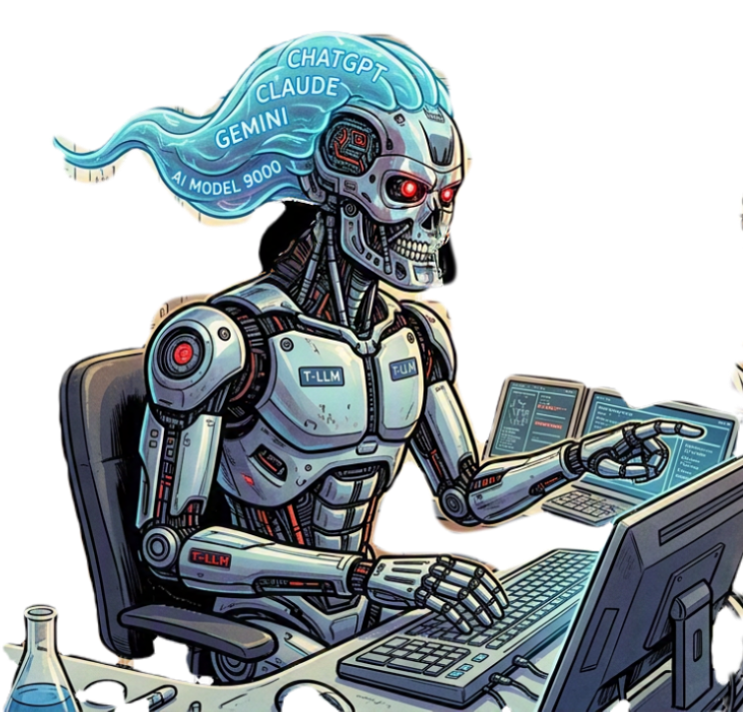
Coding agents are getting stronger, fast
↑ Capability
↑ Cost
↑ Need for direction
Agents now scaffold pipelines, debug, and write whole tutorials' worth of code in minutes.
That capability is not free — token and compute cost scale with how much you let an agent run unsupervised.
More power means you need to specify intent precisely and monitor what actually got done.
~80%
of you already reach for Claude, Codex, Gemini or Copilot.
How to direct them well? How to keep track of what they produce?
AI4ChemicalSciences BootCamp 2026

Slide 30
Going faster without losing control
Thursday, Week 2 — Agentic AI for Chemistry: ReAct, Coscientist, multi-agent workflows, self-driving labs.
Build a Chemistry ReAct agent with PubChem lookup, RDKit tools, and a BO surrogate, with guardrails.
Every hackathon: use agents deliberately — know what “good” output looks like before you delegate to one.
Ground rule for the two weeks: review the diff, don't just trust the green checkmark.
AI4ChemicalSciences BootCamp 2026

Slide 31
Morning Agenda
AI & ML today
Bootcamp Overview
Bootcamp Objectives & Roadmap
Logistics
AI4ChemicalSciences BootCamp 2026

Slide 32
Where to find everything
Schedule
Lectures
The live day-by-day plan — this page. Subject to small changes as the bootcamp goes.
Slides & notes for every lecture, linked directly from the schedule.
Tutorials
Resources
Every hands-on notebook — the same ones you'll open each session.
Curated courses, papers & tools by topic — from ML fundamentals to self-driving labs.
AI4ChemicalSciences BootCamp 2026

Slide 33
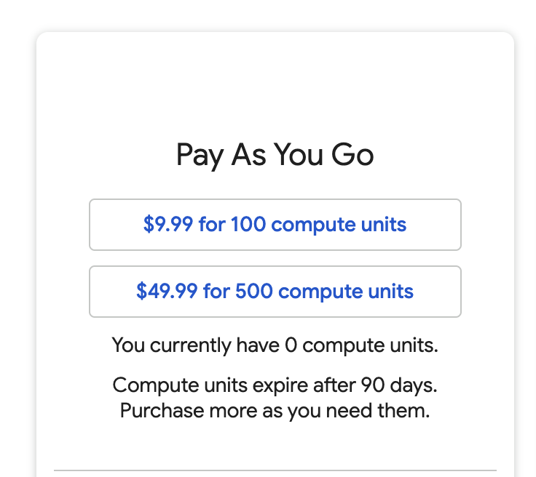
Claude and Colab Licenses
Claude Pro
If you don’t have access, send me an email at jul@caltech.edu now
Colab Pro
If you don’t have access go to this web page using the QR code, select 100 compute units and raise your hand, Tomomi will help for the paiment
AI4ChemicalSciences BootCamp 2026

Slide 34
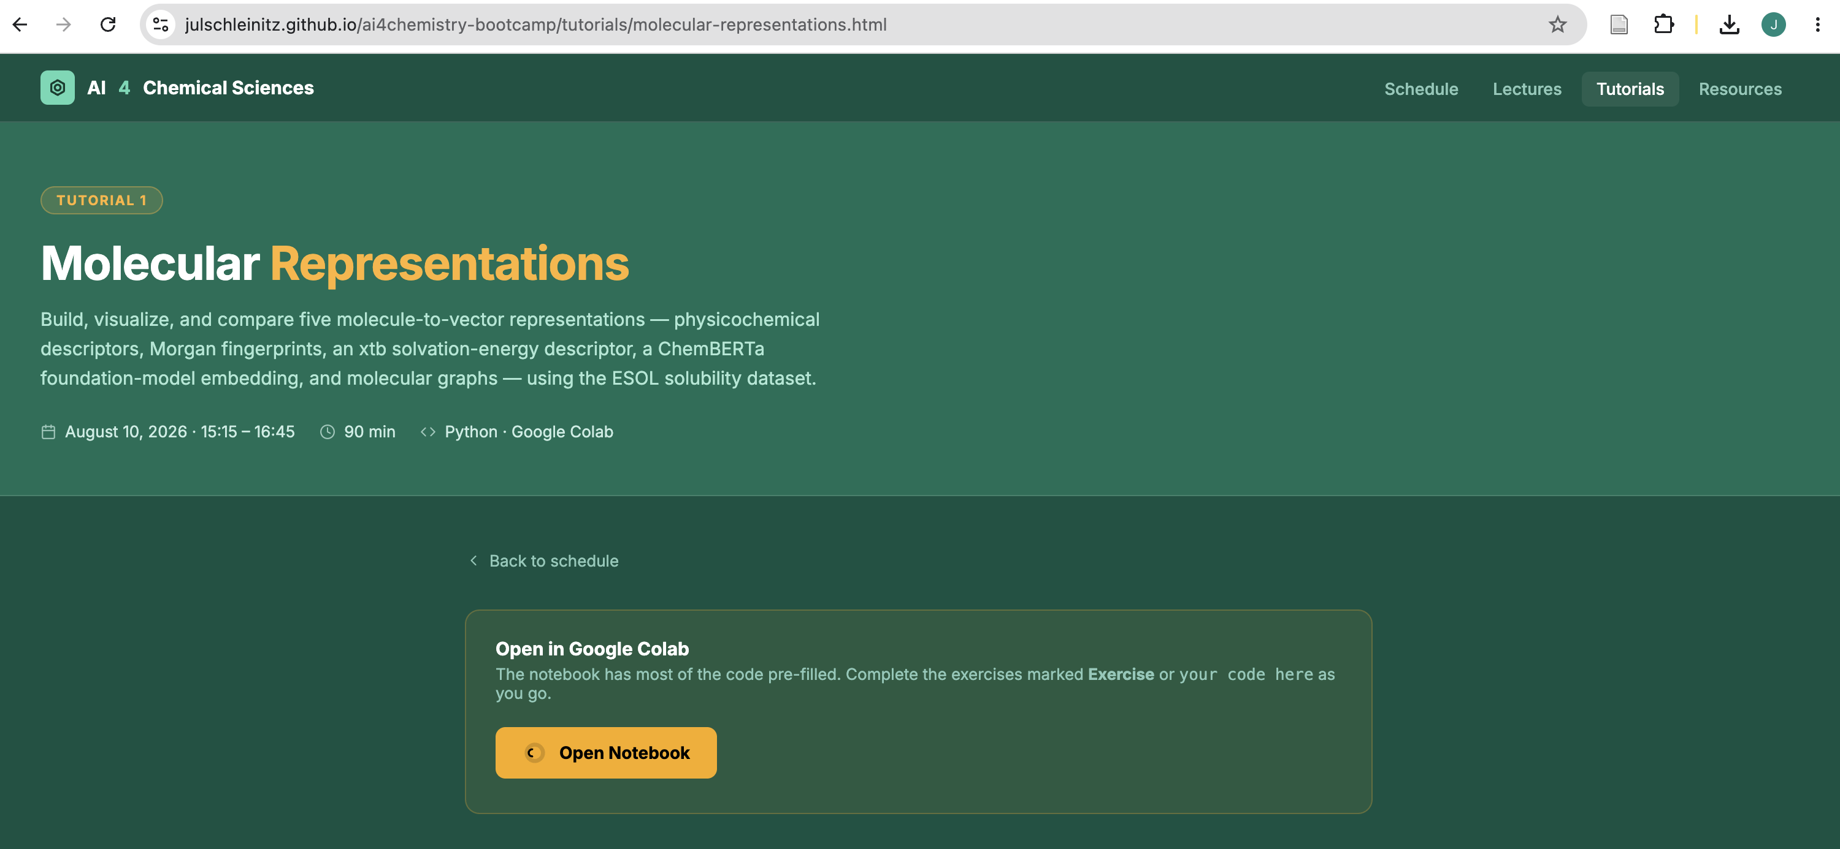
Checking Colab Interface
AI4ChemicalSciences BootCamp 2026

Slide 35
Let's meet each other
Next up, 10:45 — round-table introductions: your research background and what you're hoping to get out of these two weeks.
J. Schleinitz · jul@caltech.edu · AI4Chemical Sciences Bootcamp
AI4ChemicalSciences BootCamp 2026

