Slide 1
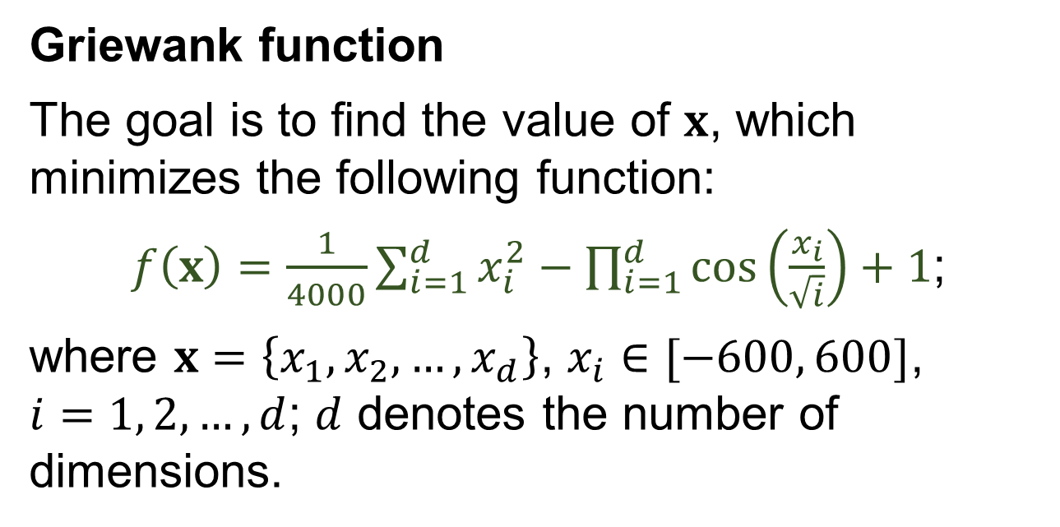
Examples of optimization problems (I)
Griewank function
The goal is to find the value of $x$, which minimizes the following function:
$f\left(x\right)=\frac{1}{4000}\sum_{i=1}^{d}{x_{i}^{2}}−\prod_{i=1}^{d}{\cos\left(\frac{x_{i}}{\sqrt{i}}\right)}+1$;
where $x=\left\{x_{1},x_{2}, …,x_{d}\right\}$, $x_{i}∈[−600, 600]$, $i=1, 2, …, d$; $d$ denotes the number of dimensions.

Slide 2
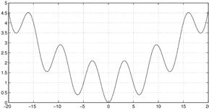
Examples of optimization problems (I)
Griewank function
Fig. 1. Illustration of Griewank function ($d=1$)

Slide 3
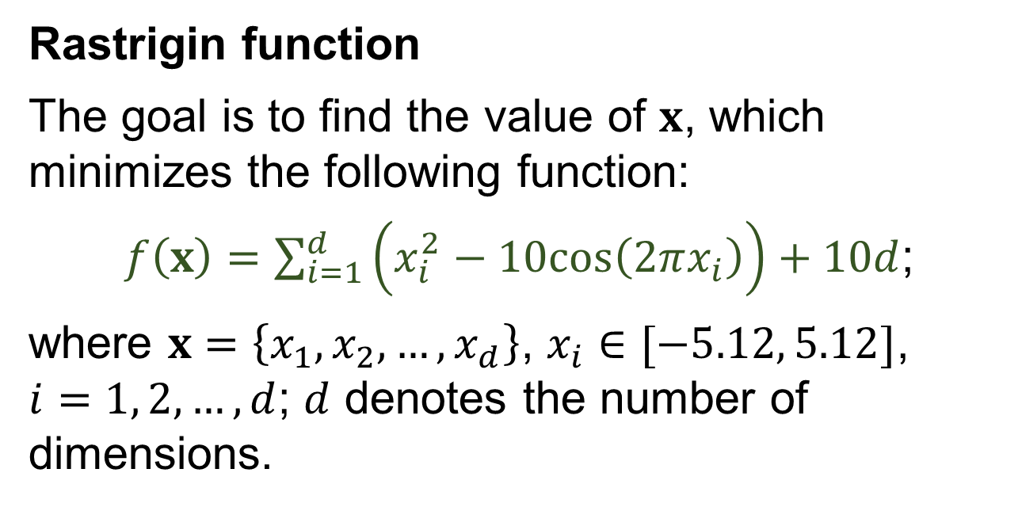
Examples of optimization problems (II)
Rastrigin function
The goal is to find the value of $x$, which minimizes the following function:
$f\left(x\right)=\sum_{i=1}^{d}{\left(x_{i}^{2}−10cos\left(2πx_{i}\right)\right)}+$ $10d$;
where $x=\left\{x_{1},x_{2}, …,x_{d}\right\}$, $x_{i}∈[−5.12, 5.12]$, $i=1, 2, …, d$; $d$ denotes the number of dimensions.

Slide 4
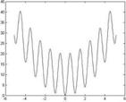
Examples of optimization problems (II)
Rastrigin function
Fig. 2. Illustration of Rastrigin function ($d=1$)

Slide 5
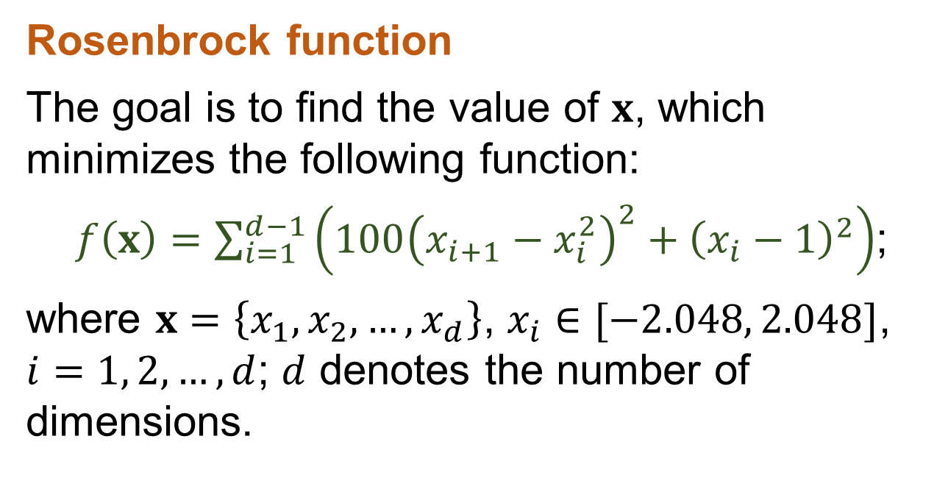
Examples of optimization problems (III)
Rosenbrock function
The goal is to find the value of $x$, which minimizes the following function:
$f\left(x\right)=\sum_{i=1}^{d−1}{\left(100{\left(x_{i+1}−x_{i}^{2}\right)}^{2}+{\left(x_{i}−1\right)}^{2}\right)}$;
where $x=\left\{x_{1},x_{2}, …,x_{d}\right\}$, $x_{i}∈[−2.048, 2.048]$, $i=1, 2, …, d$; $d$ denotes the number of dimensions.

Slide 6
Examples of optimization problems (III)
Rosenbrock function
Fig. 3. Illustration of Rosenbrock function ($d=1$)

Slide 7
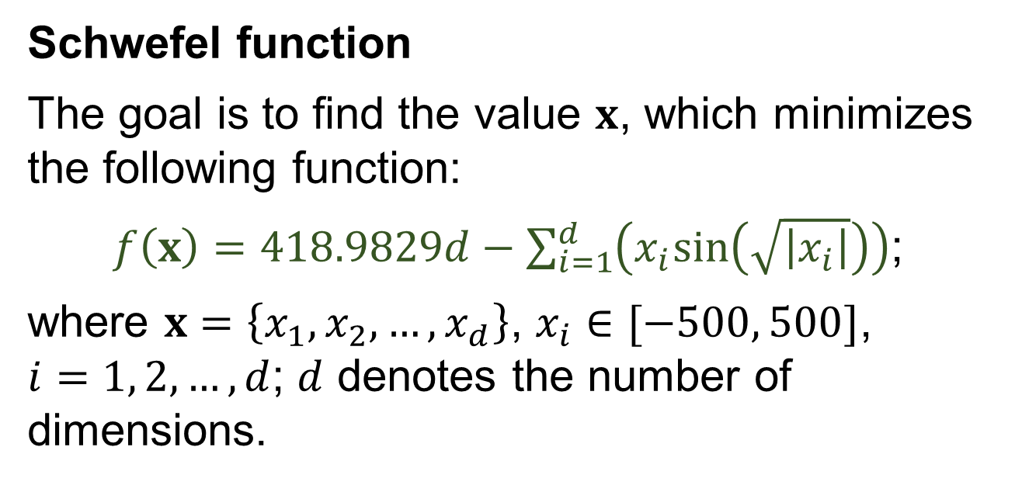
Examples of optimization problems (IV)
Schwefel function
The goal is to find the value $x$, which minimizes the following function:
$f\left(x\right)=418.9829d−\sum_{i=1}^{d}{\left(x_{i}sin\left(\sqrt{\left|x_{i}\right|}\right)\right)}$;
where $x=\left\{x_{1},x_{2}, …,x_{d}\right\}$, $x_{i}∈[−500, 500]$, $i=1, 2, …, d$; $d$ denotes the number of dimensions.

Slide 8
Examples of optimization problems (IV)
Schwefel function
Fig. 4. Illustration of a fragment of Schwefel function ($d=1$)

Slide 9
Examples of optimization problems (V)
References (I)
ADORIO, E. P.; DILIMAN, U. P. (2005). MVF - multivariate test functions library in C for unconstrained global optimization. Retrieved June 2013, from http://http://www.geocities.ws/eadorio/mvf.pdf.
DIXON, L.C.W.; SZEGO, G.P. (1978). The global optimization problem: an introduction. Towards global optimization, Vol.2, 1−15.
GLOBAL OPTIMIZATION TEST PROBLEMS. (2013). Retrieved June 2013, from http://www-optima.amp.i.kyoto-u.ac.jp/member/student/hedar/Hedar_files/TestGO.htm.

Slide 10
Examples of optimization problems (V)
References (II)
GRAMACY, R.B.; LEE, H.K. (2012). Cases for the nugget in modeling computer experiments. Statistics and Computing, Vol.22, 713−722.
FORRESTER, A.; SOBESTER, A.; KEANE, A. (2008). Engineering Design via Surrogate Modelling: A Practical Guide. Wiley, Chichester.
MICHALEWICZ, Z. (1996). Genetic Algorithms + Data Structures = Evolution Programs, Springer, New York.

