Slide 1
RESTAURANT
MENU ORDERING
SYSTEM
PROJECT SUPERVISOR: RANJEET PANIGRAHI

Slide 2
PRESENTED BY
SHIVAM KUMAR 1301210754
SOUMYA RANJAN JENA 1301210448
DEBARANJAN BEHERA 1301210588

Slide 3
Project Goal
Our main goal of this project is to create such a restaurant management software or system which will save time of both customers & restaurant management team. On the other hand it will help to run business with much more efficiently than past.
With this system customers can order food easily and order’s copy will go directly to kitchen room and cash counter immediately.

Slide 4
Required Materials
Platform | Windows, Android
Languages | Java, XML, JSP
Server | Apache Tomcat
Others | JDK 8, Database, Wi-Fi Zone

Slide 5
Why We Need This System??
To save time and to have a better
service.
Customers will easily get to know the new items implemented by the manager.
There is no need to reprint the menu after every update of item or price.
To revoke this types of problems we need this software.

Slide 6
Feasibility Study
It is very Logical to handle above mentioned problems.
This system will not a complex. It’s very simple and easy to maintain.
In present situation Upper & Middle Class Restaurant Management may have much demand of this system.

Slide 7
Project Analysis
According to our project goal we have to do following things …
User Login Option.
Table No, Food Items, Price, Food Selection & Order options.
Order flow to manager system and cook system .
Order Receiving Acknowledgement.
Bill Receiving System.

Slide 8
Future Enhancement
In the modern era almost everyone is having an Android smart phone, so every restaurant can apply this system to their respective restaurant’s.
It can simply improve the service of the restaurant and lead to more profit to the manager.
It will save time for the customers and give a better impression on their mind for the restaurant.
Hence, we must use this system for the future enhancement.

Slide 9
Advantages of This System
Easy to Use.
Easy to Learn the system.
Easy to Order Food.
Easy to Select Which foods have to prepare.
Easy to Calculate Bill.
This system can be used in Windows & Android OS Platform.

Slide 10
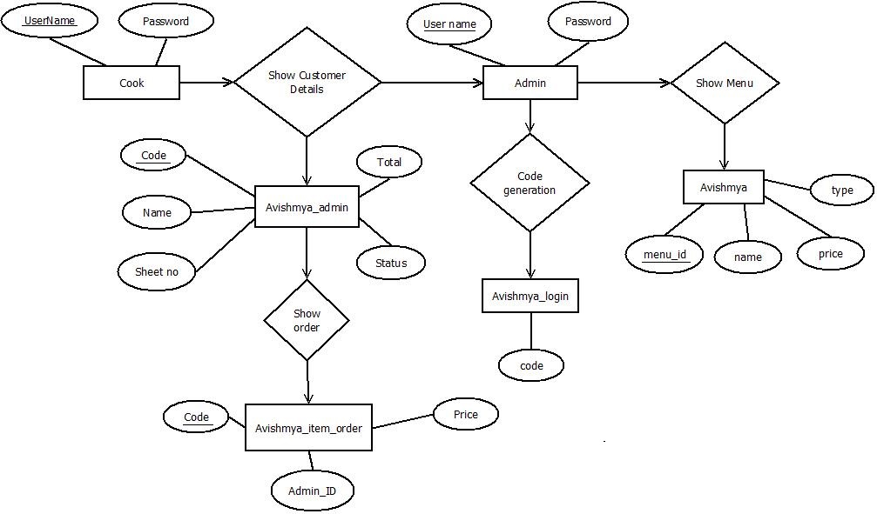

ER Diagram

Slide 11
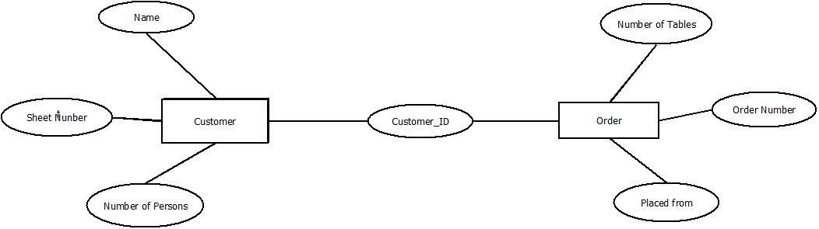
ER Diagram

Slide 12
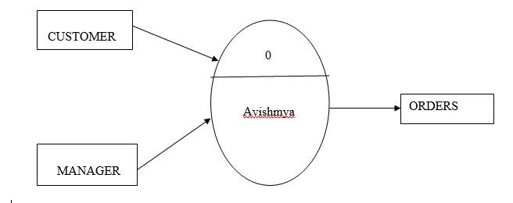
Data Flow Diagram
Level 0:-

Slide 13
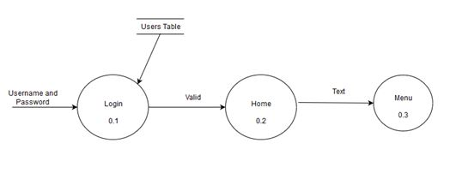
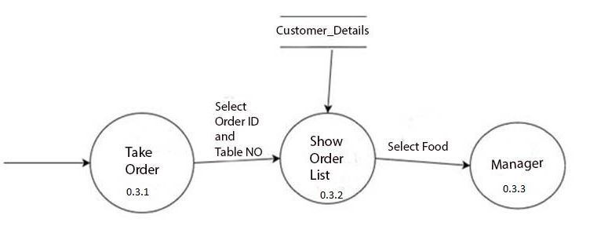
Level 1:-
Level 2:-

Slide 14
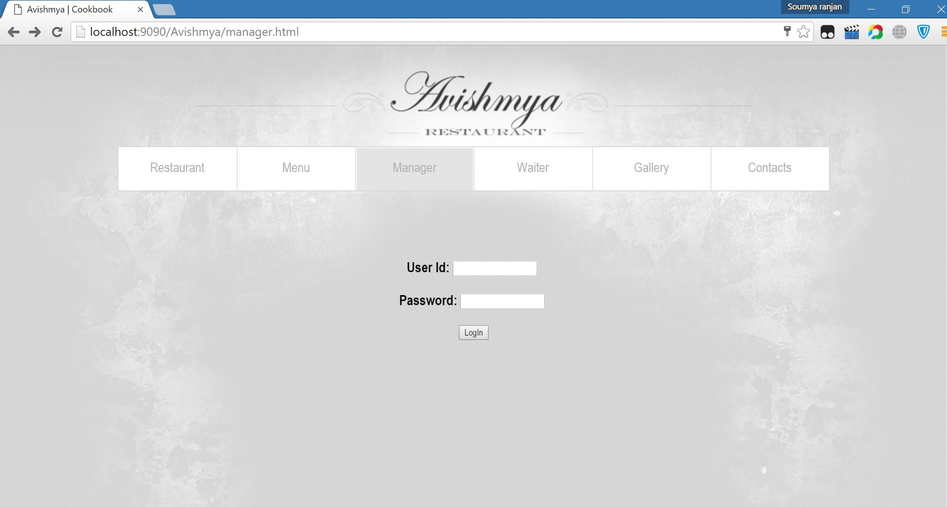
Webpage Screenshots

Slide 15
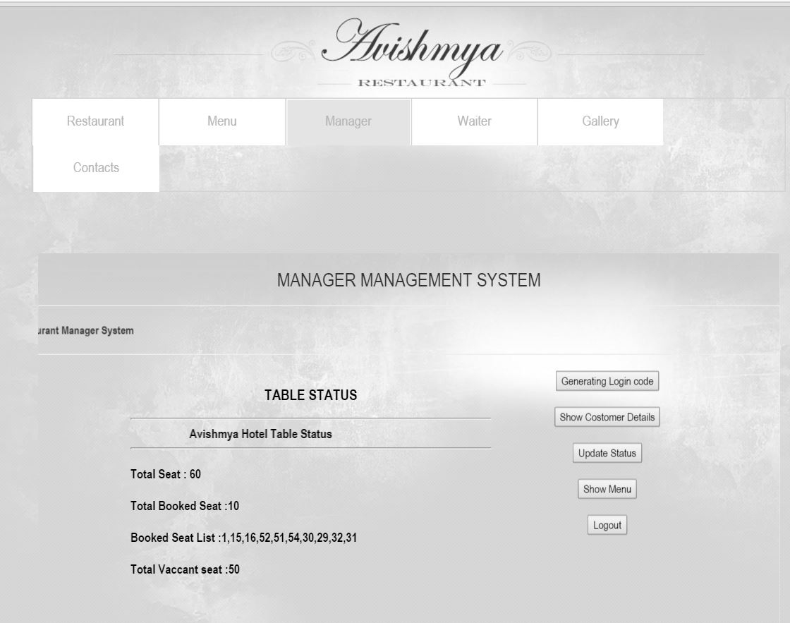

Slide 16
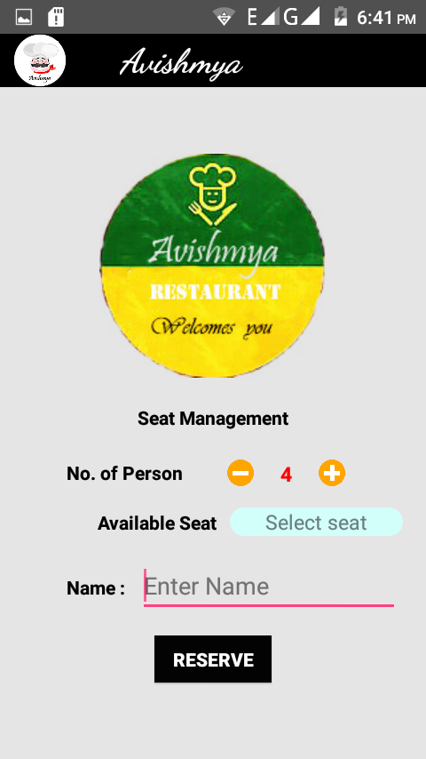
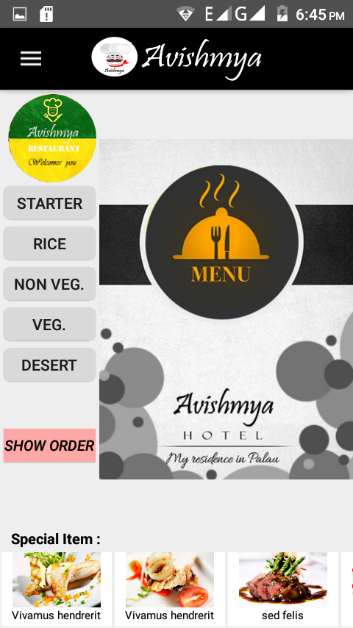
App Screenshots

Slide 17
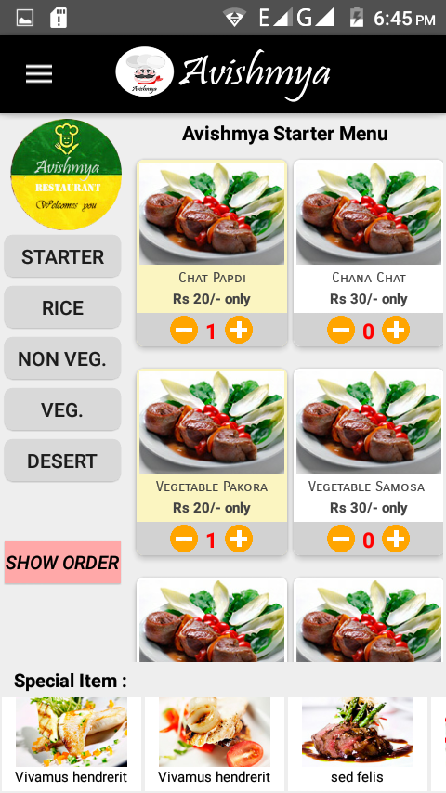
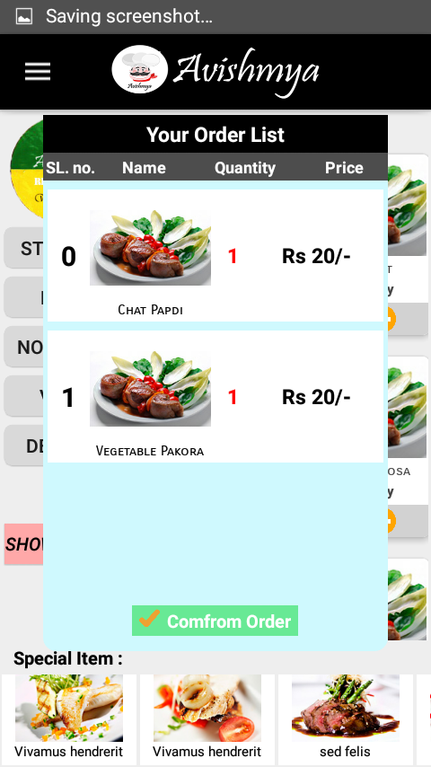
q
Confirm Order

Slide 18

Thank you

