Slide 1



Course: R language for Statistical Computing
Intended Audience: Absolute Beginners and Intermediate R Users
Prepared and presented by: Juluis Foyet

Slide 2


The Trainer
Juluis Foyet;
Google Data Analytics Professional Certificate;
DSWB Trainee;
MSc in Parasitology;
Facilitator of R Club of Univ. Dschang;
Co-founder RsDataA
Area of Interest: Malaria; NTDs, Parasitology, Molecular Biology, Statistical and Geo-Spatial Analysis, Mathematical Modeling, and Bioinformatics;
3+ years experience in using R;

Slide 3
Quick Tour of the Syllabus…

Slide 4
Module I
Overview
Lesson M1L01
Presentation of R, The working directory, and the script

Slide 5
History of R
Outline
M1L01
Applications of R
User interfaces
Advantages and limitations
The working directory?
The script?

Slide 6

History of R
Creators of R:
Ross Ihaka
Robert Gentleman

Slide 7
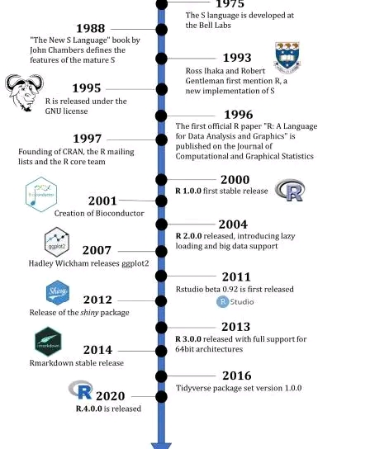
History of R
Important dates in the history of R:
November 2022
RStudio (the company) is renamed as Posit
Around June 2024
1st release of Positron
Nov 4th, 2024
RStudio 2024.09.1+394.pro7
Oct 31st, 2024
R 4.4.2 released

Slide 8
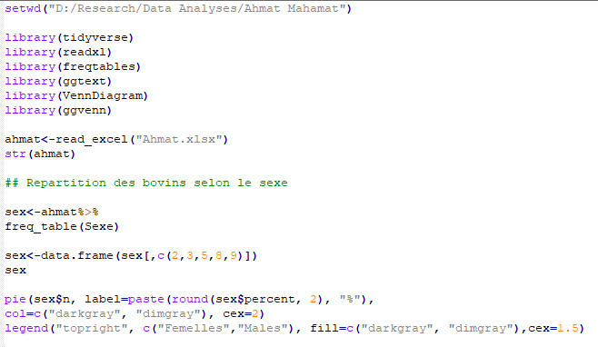
Applications of R
R is a language!
But a very easy one!

Slide 9
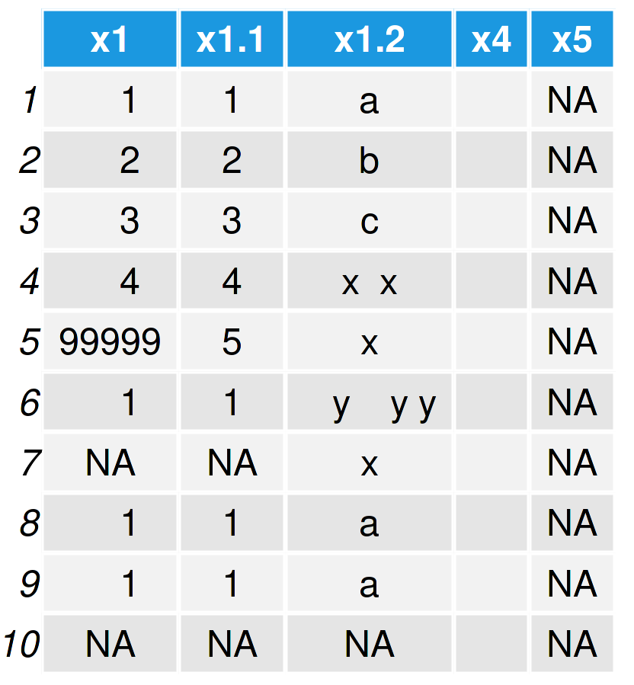
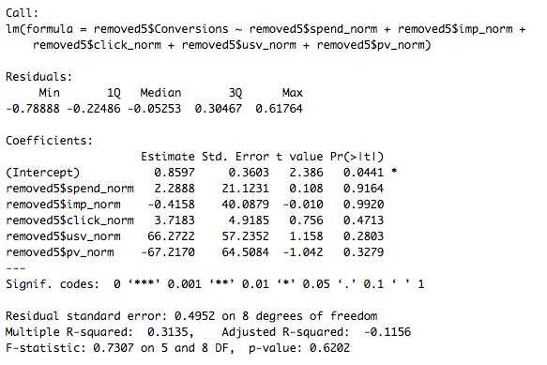
Applications of R
Statistical analyses
Data cleaning

Slide 10
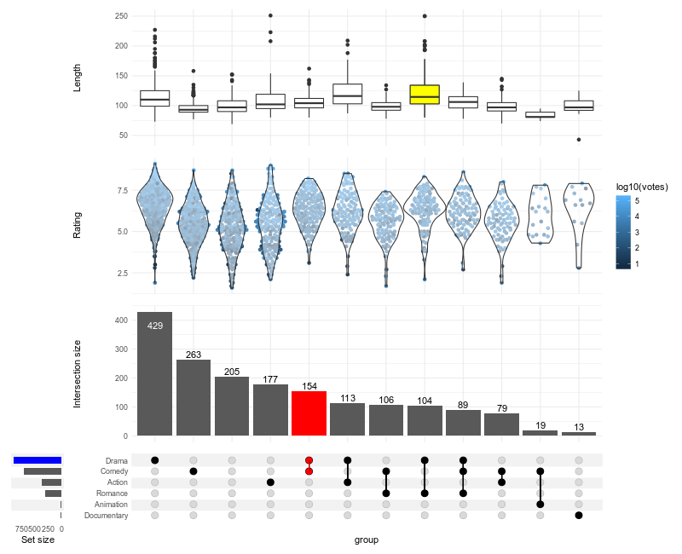
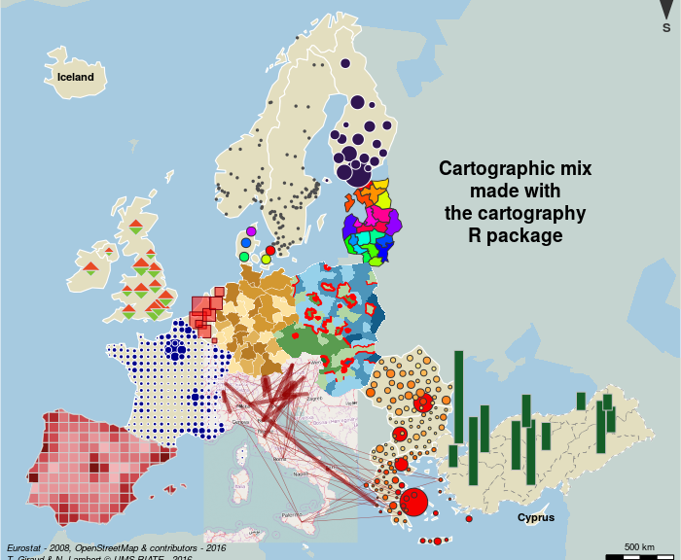
Applications of R
Data visualization
Geospatial analyses

Slide 11
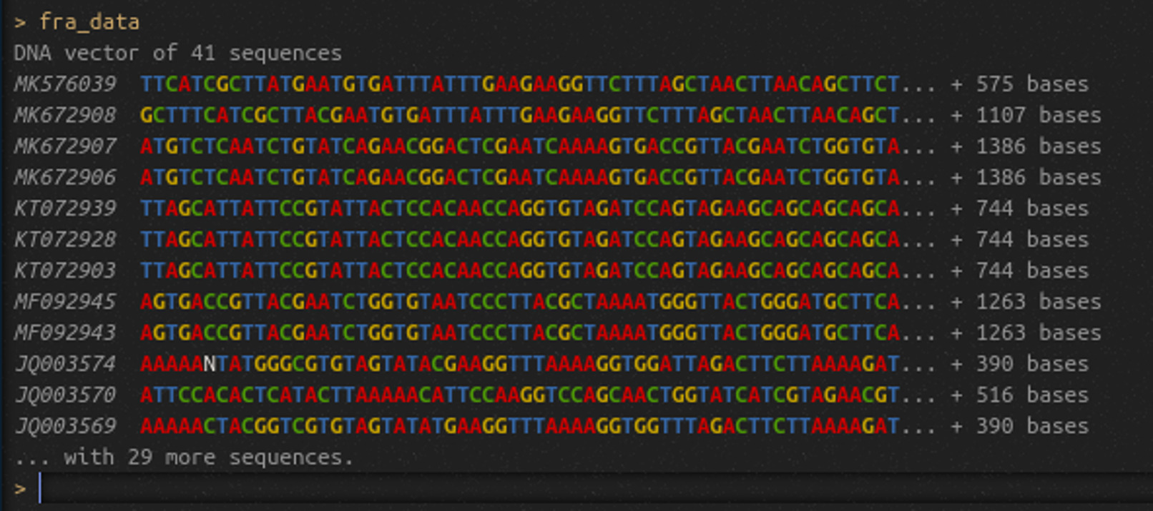
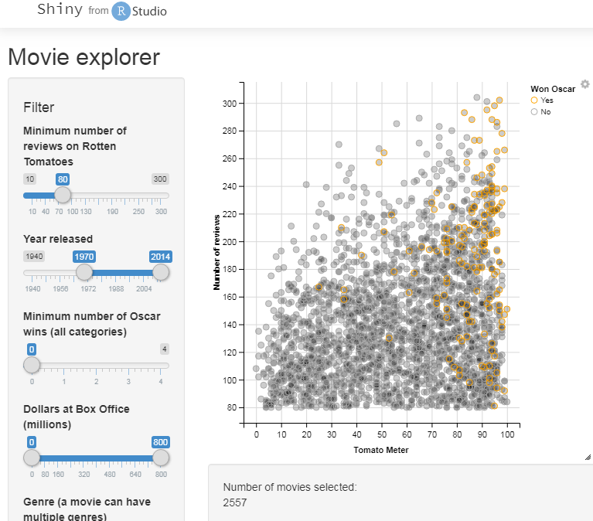
Applications of R
Bioinformatics
Bioinformatics
Online apps

Slide 12
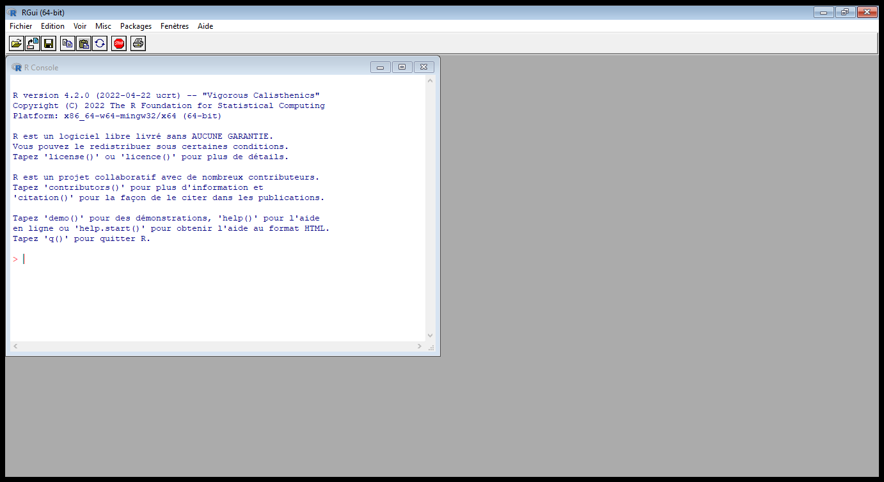
User interfaces
R GUI
Menu bar
Console

Slide 13
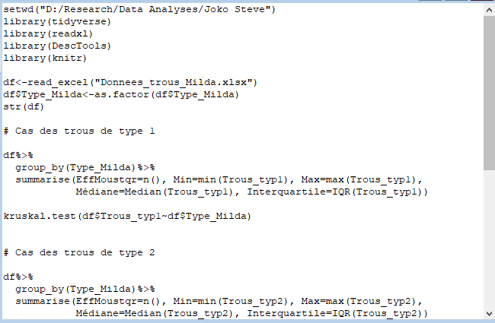
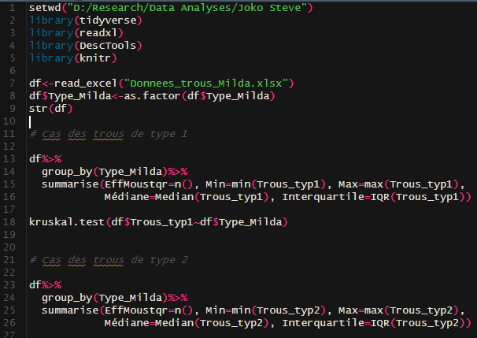

User interfaces
RStudio, an IDE (Integrated Development Environment)

Slide 14
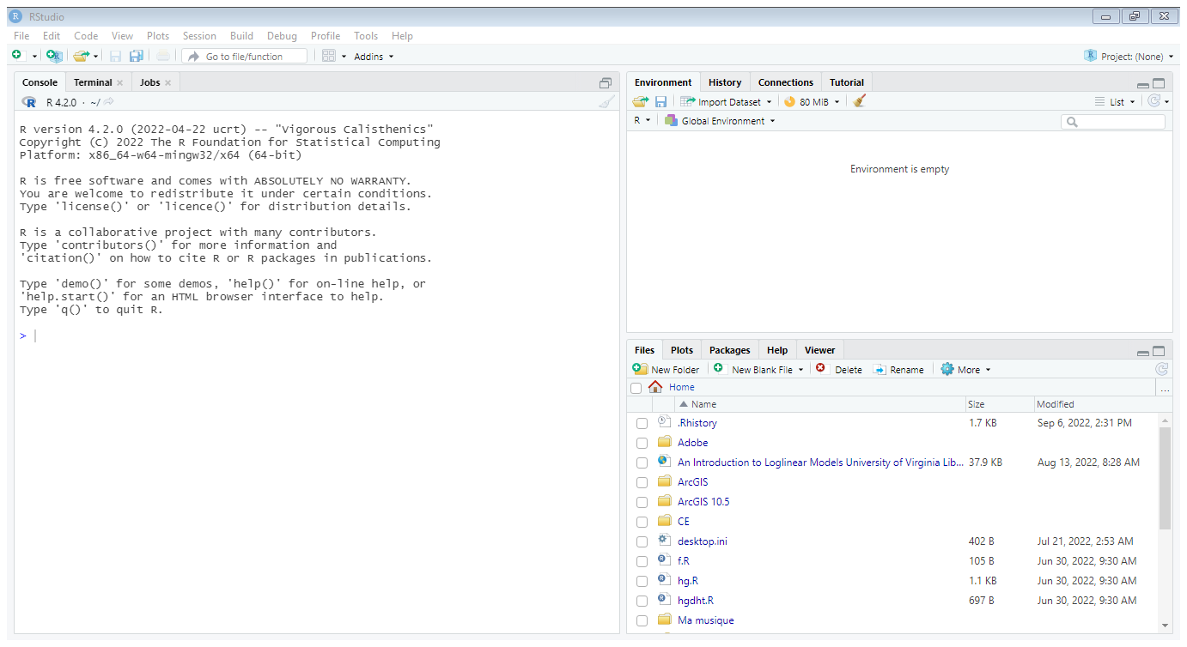
User interfaces
RStudio, an IDE (Integrated Development Environment)
Environment
Console
Files, plots,…

Slide 15
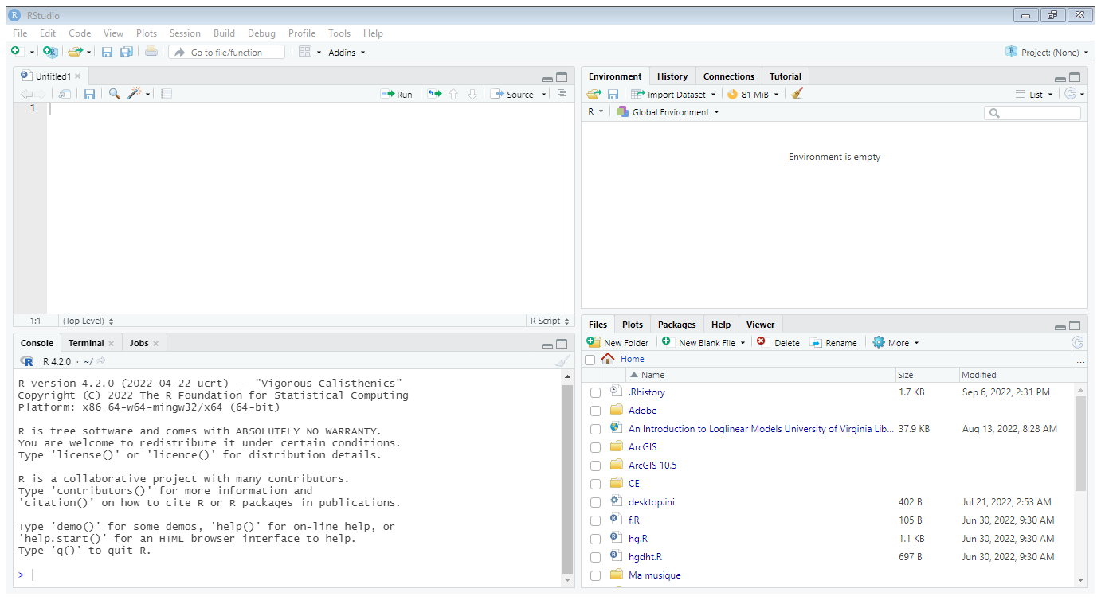
User interfaces
RStudio, an IDE (Integrated Development Environment)
Source
Environment
Console
Files, plots,…

Slide 16
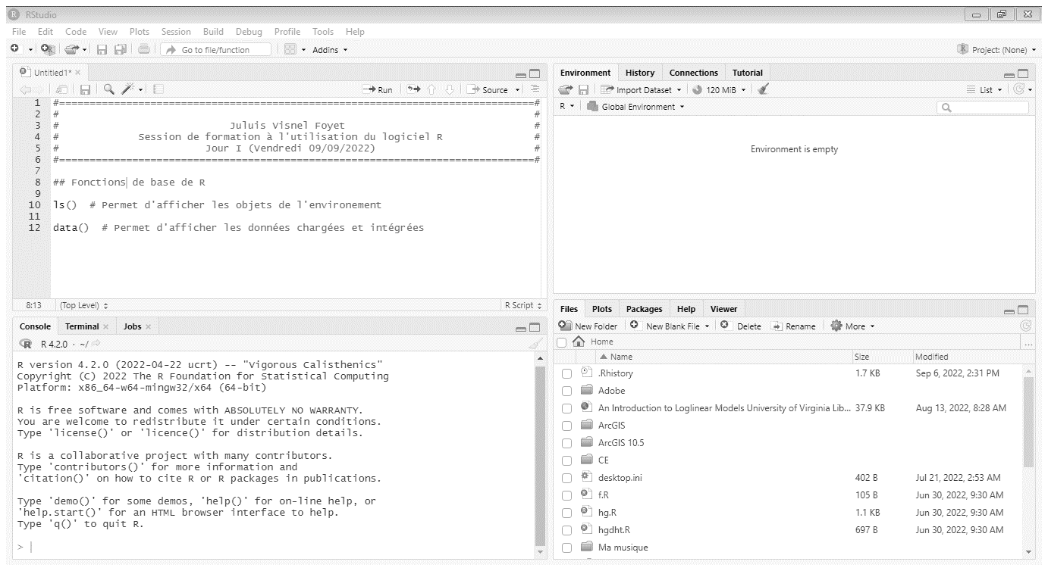
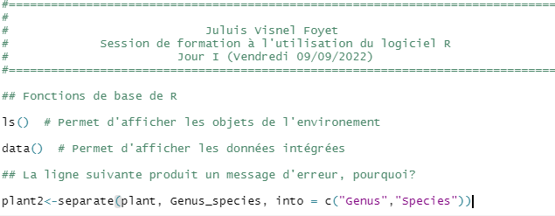
User interfaces
RStudio, an IDE (Integrated Development Environment)

Slide 17
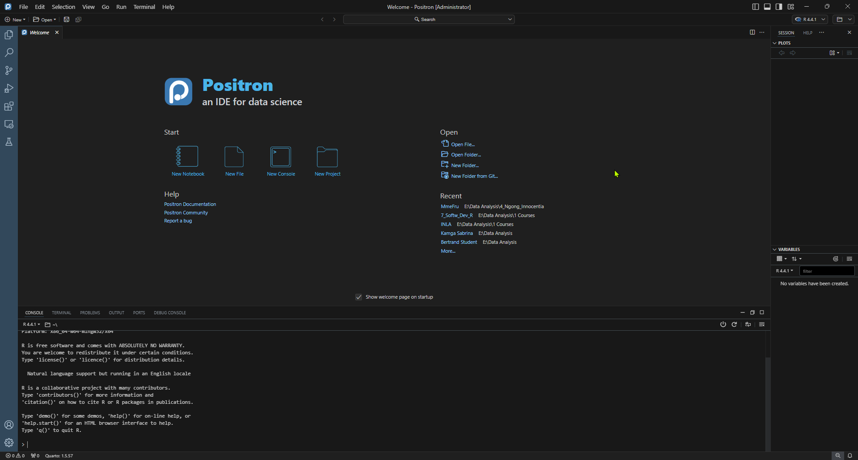
User interfaces
Positron, a Posit’s recent IDE

Slide 18
Advantages and limitations
Some advantages of R language (Matloff, 2011): 1/3
It is comparable, and often superior, in power to commercial products in most of the significant senses—variety of operations available, programmability, graphics, and so on.
It is available for the Windows, Mac, and Linux operating systems.

Slide 19
Advantages and limitations
Some advantages of R language (Matloff, 2011): 2/3
In addition to providing statistical operations, R is a general-purpose programming language, so you can use it to automate analyses and create new functions that extend the existing language features.
It incorporates features found in object-oriented and functional programming languages.

Slide 20
Advantages and limitations
Some advantages of R language (Matloff, 2011): 3/3
The system can save data sets between sessions, so you don’t need to reload them each time. It saves your command history too.
Because R is open-source software, it’s easy to get help from the user community. Also, a lot of new functions are contributed by users, many of whom are prominent statisticians.

Slide 21
Advantages and limitations
Some limitations of R language:
R is not very powerful with huge size data.
R does not deal well with too much data at once, or during the same session.

Slide 22
The working directory?
Directory?
In simple terms, a directory is simply a folder that can be made up of other files and folders.
e.g. Directories and Files

Slide 23
The working directory?
Directory?
Programs in a computer often have default folders/directories where they often store the files or folders that they generate while carrying out processes or operations within the program, or prompt the user to select a location for them to store generated files and folders.
In R and many other software, the default folder/directory is referred to Working Directory.

Slide 24
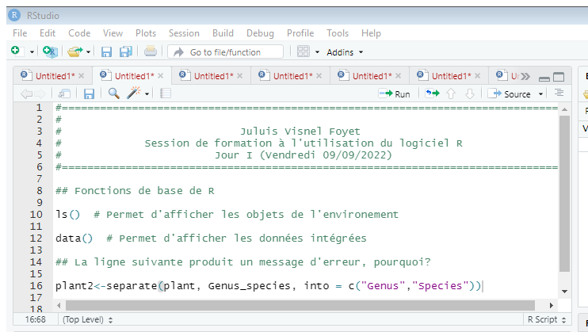
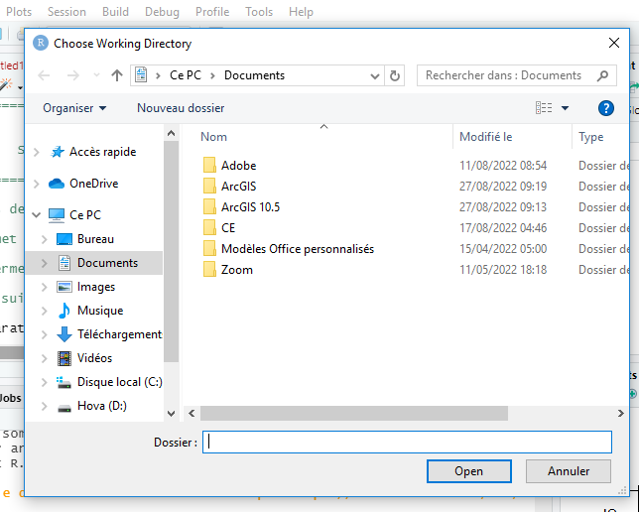
The working directory?
How it works in R
1
Session
2
Set Working Directory
3
Choose Directory

Slide 25
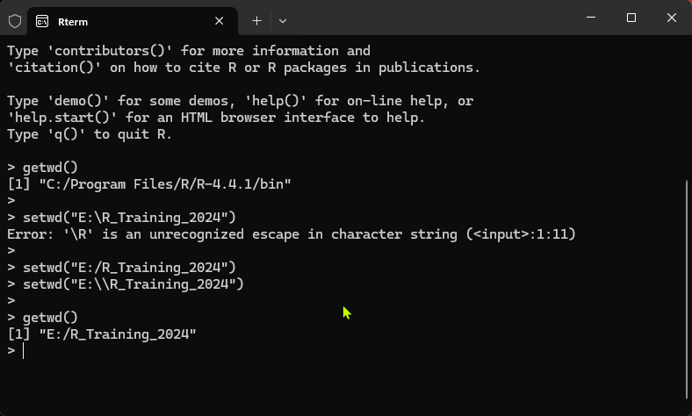
The working directory?
How it works in R
See also list.files() and list.dirs()

Slide 26
The Script?
In the jargon of R, a script is a file with extension .r or .R aimed to store command/codes.
Working in a script (instead of working directly in the console) presents the following advantages:
The user can save and access useful commands written for a particular analysis.
Enables collaboration, as scripts can be commented and shared for many reasons.
Make easy to implement modifications in analyses.

Slide 27
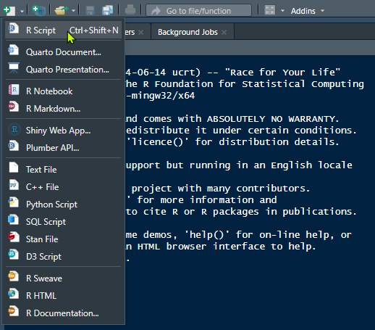
The Script?
How to create a script
Right under the menu bar, click on the on the icon at the extreme left. It will display types of file the can create.
Then click on the first option which is R Script.
All this could also be done simply through the shortcut Ctrl+Shift+N
At the end, don’t forget to save the script in the appropriate directory

Slide 28
Quick comment on functions (and arguments), commenting, prompt, index, and help…

Slide 29
Module I
Overview
Lesson M1L02
Operators and Basic Operations in R language

Slide 30
Introduction
Outline
M1L02
Arithmetic operators
Assignment operators
Comparison operators
Logical operators
Miscellaneous operators

Slide 31
Introduction
Operators are symbols used to carry out various operations on elements (operands).
R has more than two dozen operators, organized into five major groups:

Slide 32
Arithmetic operators
Operators | Name | Example
+ | Addition | x + y
- | Subtraction | x - y
* | Multiplication | x * y
/ | Division | x / y
^ | Exponent | x ^ y
%% | Modulus (Remainder from a division) | x %% y
%/% | Integer Division | x%/%y

Slide 33
Assignment operators
Operators | Name | Example
<- | Assign a value/content to an object/ a variable | my_var <- 3
<<- |  | my_var <<- 3
-> |  | 3 -> my_var
->> |  | 3 ->> my_var
= |  | My_var = 3

Slide 34
Comparison operators
Operators | Name | Example
== | Equal | x == y
!= | Not equal | x != y
> | Greater than | x > y
< | Less than | x < y
>= | Greater than or equal to | x >= y
<= | Less than or equal to | x <= y

Slide 35
Logical operators
Operators | Name | Example
& | Logical AND operator. It returns TRUE if both elements are TRUE | x==y & a>b
| | Logical OR operator. It returns TRUE if one of the statements is TRUE | x>=y | a==b
! | Logical NOT - returns FALSE if statement is TRUE | !x==y

Slide 36
Miscellaneous operators
Operator | Name | Example
: | Creates a series of numbers in a sequence | x <- 1:10
%in% | Find out if an element belongs to a vector | x %in% y

Slide 37
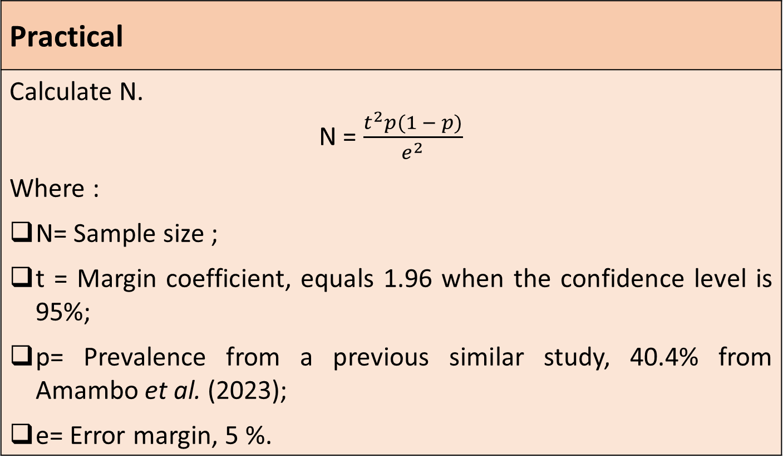
Practical
Calculate N. N = $\frac{t^{2}p(1 − p)}{e^{2}}$ Where : N= Sample size ; t = Margin coefficient, equals 1.96 when the confidence level is 95%; p= Prevalence from a previous similar study, 40.4% from Amambo et al. (2023); e= Error margin, 5 %.

Slide 38
Module I
Overview
Lesson M1L03
Project management in RStudio

Slide 39
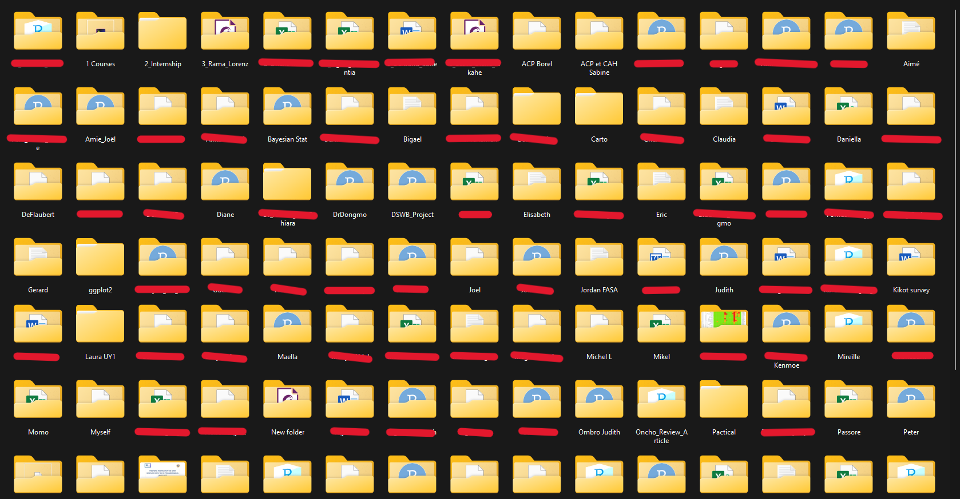

Slide 40
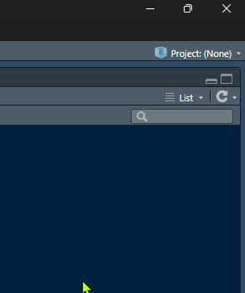
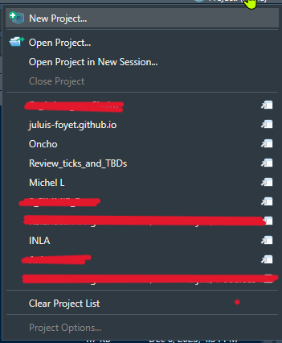
Data analyses’ projects managment into RStudio

Slide 41
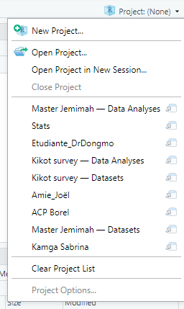
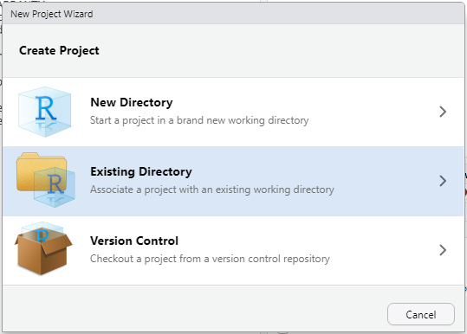
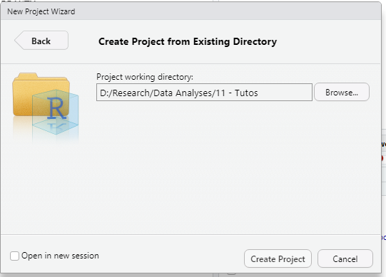
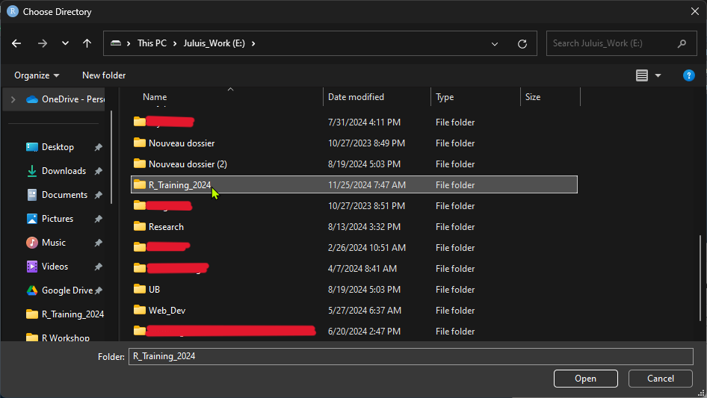
1
2
3
4
5

Slide 42
Module I
Overview
Lesson M1L04
Data types and structure

Slide 43
Vectors
Outline
M1L04
Matrices
Arrays
Data frames
Lists

Slide 44
Data types and structure
1. Vectors
>gly
[1] 1.01 0.83 1.05 1.15 0.99 1.02 1.07 1.00 1.19 0.96 1.05 1.12 0.94 0.96 0.81
[16] 0.81 0.83 1.18 1.20 1.15
1
>Abond
[1] 65 64 61 10 43 100 51 51 42 14 100 34 33 21 21 41 86 15 83
[20] 59
2
3
>Status
[1] 1 0 1 1 1 1 1 1 1 0 1 1 0 1 0 0 1 0 0 0
4
>Status
[1] TRUE TRUE FALSE FALSE FALSE TRUE FALSE FALSE TRUE FALSE FALSE TRUE
[13] FALSE FALSE TRUE TRUE TRUE TRUE FALSE FALSE
>ATB
[1] "Sensible" "Intermediare" "Sensible" "Sensible" "Intermediare"
[6] "Sensible" "Resistant" "Intermediare" "Resistant" "Resistant"
[11] "Intermediare" "Sensible" "Sensible" "Intermediare" "Intermediare"
[16] "Intermediare" "Sensible" "Intermediare" "Sensible" "Intermediare"
5
>Mention
[1] "Bien" "AssezBien" "TresBien" "Bien" "Passable" "Passable"
[7] "Passable" "Passable" "Bien" "AssezBien" "Bien" "AssezBien"
[13] "AssezBien" "Passable" "AssezBien" "Passable" "AssezBien" "TresBien"
[19] "TresBien" "TresBien"
6

Slide 45
Data types and structure
2. Matrices
>mat
[,1] [,2]
[1,] 34 29
[2,] 76 87
>mat
Statut
Sexe Infecte NonInfecte
F 34 29
M 76 87

Slide 46
Data types and structure
3. Data frame
>df
Date Gly Status
1 2022-09-21 0.86 1
2 2022-09-11 1.08 1
3 2022-09-12 1.03 0
4 2022-09-13 0.82 0
5 2022-09-14 1.19 0
6 2022-09-15 0.81 1
7 2022-09-16 0.93 0
8 2022-09-17 0.89 0
9 2022-09-18 1.05 1
10 2022-09-19 0.91 0
>str(df)
'data.frame': 10 obs. of 3 variables:
$ Date : Date, format: "2022-09-21" "2022-09-11" ...
$ Gly : num 0.86 1.08 1.03 0.82 1.19 0.81 0.93 0.89 1.05 0.91
$ Status: int 1 1 0 0 0 1 0 0 1 0

Slide 47
Types et structure des données et types de variables
4. Lists
A list is an object/a data that can contain any other type of data, including other lists.

