Slide 1
Dataset
Feature Engineering
User Features
Tweet Features
Enhanced User Features
Missing Data Handling
Numeric/Boolean Features
Tweets
Description
Feature Selection
Embedding
Embedding
Numeric Features
Boolean Features
Embedded Tweets
Embedded Description
Scaling
Scaled Numeric Features
Boolean Features
Embedded Tweets
Embedded Description
SMOTE

Slide 2
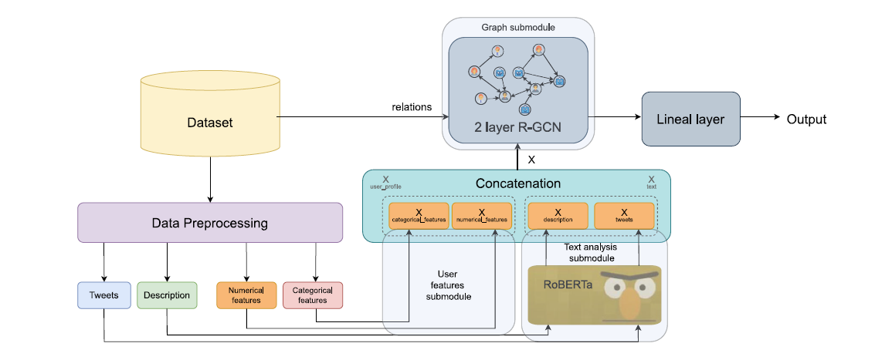
Scaled Numeric Features
Boolean Features
Embedded Tweets
Embedded Description
Linear Transformation
Linear Transformation
Linear Transformation
Leaky ReLU
Leaky ReLU
Leaky ReLU
Dropout
Dropout
Dropout
Output
Linear Transformation
Leaky ReLU
Dropout
Output

