Slide 1
Let’s Make a Pinterest Clone!
SpeakCode

Slide 2
Overview: How will we build this app?
Create an account with Nitrous
Steps:
Create a new Rails project
Create a home page
Send users to the home page
Create more pages
Style it with Bootstrap
Create Pins
Add the ability to upload images
Direct users to a view that shows all of our pins
Order the pins chronologically

Slide 3
Why use Nitrous.io?
What is it?
Free cloud-based integrated development environment (IDE) = access to a remote computer from your web browser
No need to install anything to get started using a variety of frameworks
Live preview and cross-browser testing
Available from any computer or tablet
Easy to collaborate
Notes:
Nitrous.io provides a hosted development environment. Basically, you get access to a remote computer from your web browser. The Nitrous computer runs Ubuntu Linux, which is a popular operating system for Rails development.

Slide 4
Create an account
Go to nitrous.io
Click on “Get Started for Free”
Enter desired username, email, password
Click on “I’m Not a Robot”
Don’t click “Create an organization after I sign up”
Click “Sign Up”

Slide 5
Create an account (continued)
Go into your email, confirm your email via the message from Nitrous, then come back to the Nitrous.io page
Select the free account
Select US East below that
Click “Create Workstation” button at the bottom

Slide 6
Create a project
Under Projects, click on the empty box with a “ + “ to create a new workstation
Under Project Name, write “pinterest_clone”
Select Ruby on Rails as the template
Click “Create Project”
Wait a few minutes for it to be created

Slide 7
Create a project (continued)
It should say “Your project pinterest_clone is ready!”
Click “Open IDE”
Ready to build!

Slide 8
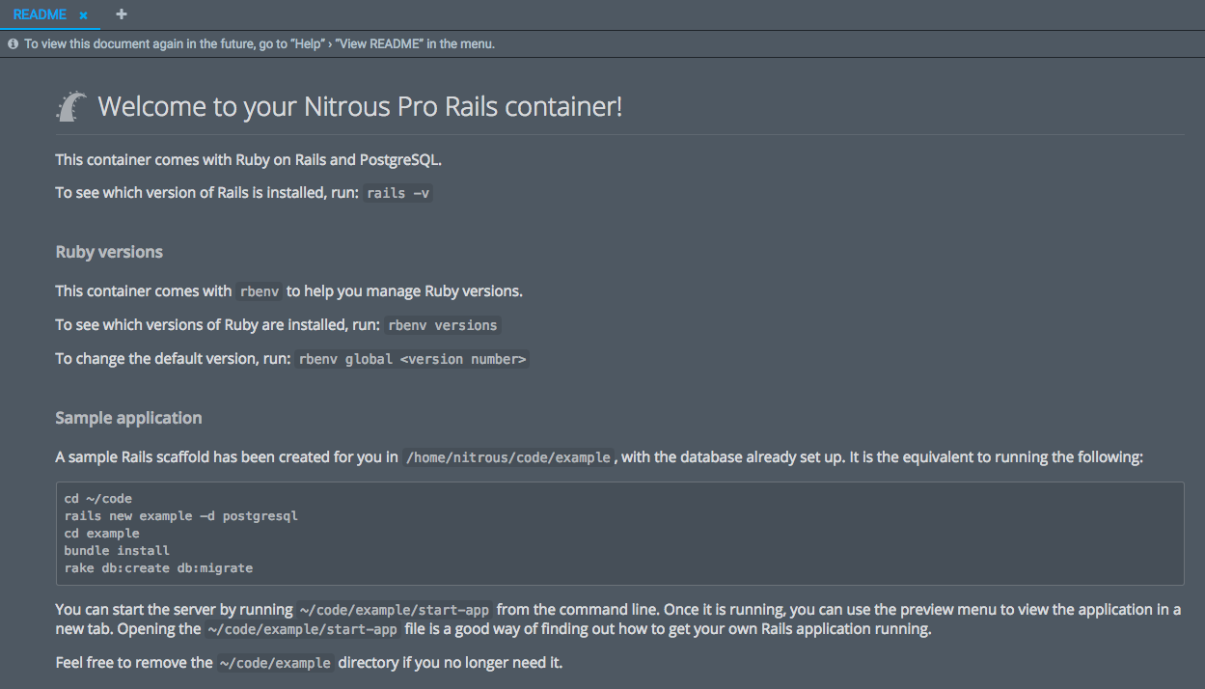
What’s in a README doc?
Notes:
Let’s take a look at what this README file says.
First it says “To see which version of Rails is installed, run: rails –v” so let’s do that in the black box at the bottom, which is called a console. We’re running Rails 4.2.5.1 which is important to know because if you run into trouble later on and need to ask questions about how to fix a bug, in your question it’s always helpful to include the version number of the tools you’re using.
Scrolling down on the README we can also see that Nitrous included a sample app, which we can delete by right-clicking on it.

Slide 9
Task 1: Create new project and start the server
In a Google doc, write the console commands to:
Switch into the code directory
Create a new rails project called pinterest_clone
Switch into that pinterest_clone directory you just created
Start the rails server

Slide 10
Task 1: Create new project and start the server (answer)
console
➜ cd ~/code
➜ rails new pinterest_clone –d postgresql
➜ cd pinterest_clone
Notes:
So now let’s build our pinterest app. To do that type these commands in the black box so that we can get situated inside the right folder
cd ~/code
and then create our app with the command,
rails new pinterest_clone –d postgresql
You can see that a ton of files were just created and a lot of things were just installed. Let’s switch from the code folder into the directory we just created with the command:
cd pinterest_clone

Slide 11
Task 1: Create new project and start the server (answer)
Start the Rails server from the console:
console
➜ rails s -b 0.0.0.0
Notes:
Now let’s run the Rails Server – or rails s – command that will run our app.

Slide 12
Preview the app
Click on Preview in the navigation bar at the top
Click on Port 3000(default)
Notes:
Now let’s see what our pinterest_clone looks like by going to the navigation bar at the top and clicking on PREVIEW and then Port 3000(default).
So there is our first Rails application. Very exciting!

Slide 13
Prepare to commit with Git
Open a new console tab by clicking on the “+” right above the black console at the bottom of your screen
Type inside that new tab:
console
➜ cd ~/code
➜ cd pinterest_clone
Notes:
Before we go any further, let’s use Git to save our progress.
First we’ll go back to Nitrous. The console tab we have open -- the black box at the bottom -- is for the server to run, and we can’t type anything in there unless we close down the server by typing control-C.
To open a new console tab, click on the plus-sign at the top of the console. Once inside that tab, navigate into the pinterest clone folder with these commands:
➜ cd ~/code
➜ cd pinterest_clone

Slide 14
Initialize Git
console
➜ git init
➜ git config --global user.email "youremail@example.com"
➜ git config --global user.name "Your Name"
➜ git status
➜ git add .
➜ git commit –am “Initial Commit”
Notes:
We only INITIALIZE and CONFIGURE Git once at the beginning of a new project.
Then type in these additional commands to get started.

Slide 15
Task 2: Generate a controller
In the Google doc, write the text for a single console command to generate a rails controller called “pages” that includes the action for a “home” page

Slide 16
Task 2: Generate a controller (answer)
Create a home page
console
➜ rails generate controller pages home
Notes:
To create pages in our app, first we’ll create a pages controller with this command

Slide 17
View the home page we just created
In your preview tab, tack this text onto to the URL:
/pages/home
Notes:
In your preview tab, tack this text onto to the URL:
/pages/home
and see the new blank homepage you just created.

Slide 18
Task 3: Update the text in the view for the home page
Write the file path (including the name of the file itself) for the view corresponding to the home page
Inside that file, write the code for:
“This is my app!” in heading 1 style
and
“We’re learning to build with Coding for Dummies” in paragraph style

Slide 19
Task 3: Update the text in the view for the home page (answer)
app/views/pages/home.html.erb
<h1>This is my app!</h1>
<p>We’re learning to build with SpeakCode</p>
Notes:
On the menu bar on the left side of the screen, open app→ views→pages→home.html.erb and type this code in that file:
<h1>This is my app!</h1>
<p>We’re learning to build with SpeakCode</p>
Save the file by typing:
Mac: Command + S
or
PC: Ctrl + S
Now we can refresh the browser preview tab and see our changes under pages/home

Slide 20
Task 4: Routing
Figure out how to make a “root” route in Rails
Write the single line of code that you’d add to the /routes.rb file to make a new root route that directs all users to the home page view when they first visit the app

Slide 21
Task 4: Routing (answer)
Direct users to home page:
Open config/routes.rb
Replace the line
get "pages/home"
with:
root "pages#home"
Notes:
You can direct people to a certain page by setting a route that points to that page.
1. Show the home page of your app
Open config/routes.rb
Replace the line
get "pages/home" with:
root "pages#home"
In the other browser tab, now if we delete the pages/home part of our URL we see that when we go to the home page, we’re getting redirected to pages and then home.html.erb.

Slide 22
Task 5: Add an action to a controller
Add a basic “about” action to the pages controller

Slide 23
Task 5: Add an action to a controller (answer)
app/controllers/pages_controller.rb
Type this in that file:
def about
end
Notes:
You’ll probably need more than just a "Home” page on your app. To do that, we’ll add a new view and set a route for it. First we’ll add a new action in the controller. To do this, open app/controllers/pages_controller.rb and type in this code:
def about
end

Slide 24
Task 6: Create the HTML in the view for pages/about
Find the view for the About page
In that page, write this code:
“About Us” in heading 1 style
“We’re building an app with Coding for Dummies” in heading 2 style

Slide 25
Task 6: Create the HTML in the view for pages/about (answer)
app/views/pages/about.html.erb
<h1>About Us</h1>
<p>We’re building an app with Coding for Dummies</p>

Slide 26
Task 7: Add a route
Write code to add a route in /config/routes.rb
to direct users to the about page

Slide 27
Task 7: Add a route (answer)
config/routes.rb
get "about" => "pages#about"

Slide 28
What’s embedded Ruby?
Add dynamic content to static HTML pages
Notes:
Embedded Ruby (erb) lets you add dynamic content to static HTML pages.

Slide 29
HTML links
<a href="#">here</a>
Notes:
Remember that in HTML, a link looks like this:
<a href="#">here</a>

Slide 30
Ruby tags
<%= [Ruby code] %>
Notes:
In a Rails app, we create links using embedded Ruby tags instead. Inside these tags we can write code in the Ruby language. The tags are like saying, heads up, we’re not going to be speaking HTML for a second—instead we’ll be speaking Ruby—so please listen for Ruby instead of HTML. This is what Ruby tags look like:
<%= %>

Slide 31
Add an embedded Ruby link to the home page
app/views/pages/home.html.erb
<%= link_to "here", "#" %>
Notes:
Let’s write a full Ruby link into the home.html.erb file. Navigate into
app/views/pages/home.html.erb and type in this code:
<%= link_to "here", "#" %>
In Ruby on Rails, a full link will look like that (that’s Ruby code inside the tags).

Slide 32
Task 8: Add navigation links
Google how to write embedded Ruby links to ERB pages (views) within a Rails app
Write 2 navigation links that direct users to a) the home page and b) the about page.

Slide 33
Task 8: Add navigation links (answer)
apps/views/layouts/application.html.erb
add this code above the line that says <%= yield %>:
<%= link_to "Home", root_path %>
<%= link_to "About", about_path %>
Notes:
In Rails, layouts let you create elements that show up on every page in your app--like a navigation bar that always appears that the top. So let’s add some navbar links. Open apps/views/layouts/application.html.erb and add this code above the line that says <%= yield %>:
<%= link_to "Home", root_path %> <%= link_to "About", about_path %>
Now when we refresh our other browser tab… we see these nav links.

Slide 34
Install the Bootstrap gem
What’s a gem?
A time-saving library of code that you can download and plug into your app
Notes:
Now we can add the Bootstrap gem for some styling. But first– what is a Ruby gem?
Ruby gems are time-saving libraries of code that you can download and plug into your application.
We save a list of our app’s Ruby gems in the Gemfile.
That’s where we’ll start to install Bootstrap in our app.

Slide 35
Add the Bootstrap gem to Gemfile
/Gemfile
add this code under the line that says “gem 'jbuilder', '~> 2.0'”
.. gem 'bootstrap-sass' ..
Notes:
To add the bootstrap gem, we’ll open /Gemfile and add this code under the line that says “gem 'jbuilder', '~> 2.0'”:
.. gem 'bootstrap-sass' ..

Slide 36
Bundle install to install the new gem
Console
➜ bundle install
Notes:
Every time we add a Ruby gem to our list of gems in the Gemfile, we need to tell Rails to grab those files from the internet, drop them into our app, and install them with this command in the console: bundle install

Slide 37
Using application.css
app/assets/stylesheets/application.css
Notes:
Before we take our next step with bootstrap, we need to understand a certain file: the application.css file
Let’s look at this file in app/assets/stylesheets/application.css
Application.css takes all the other files in your /stylesheets directory and combines them when you run your app.

Slide 38
Create a new SCSS file for custom Bootstrap
app/assets/stylesheets →New File
Add this to the new file contents:
@import 'bootstrap';
Notes:
One of the files that we will compile through that application.css file contains the customized bootstrap styling that we want to include in our app. To create this new file, right click on app/assets/stylesheets and scroll to “New File”
Inside that file, write @import ‘bootstrap’;

Slide 39
Create a new SCSS file for custom Bootstrap
Command + S or CTRL + S to save as:
bootstrap_custom.css.scss
Notes:
Then, use command+S or CTRL+S to save the file as: bootstrap_custom.css.scss
SCSS is a precompiler for CSS. It helps you write CSS quicker. (This will make more sense soon).

Slide 40
Restart the server
In console, switch to the first tab and shut off the Rails server:
CONTROL + C
Then use the up-arrow key to display your previous command, and press enter:
➜ rails s -b 0.0.0.0
Notes:
You need to restart your server whenever you add a new gem.
In console, switch over to the first tab and shut off the Rails server:
CONTROL + C
Then use the up-arrow key to display your previous command, and press enter:
➜ rails s -b 0.0.0.0
…Now when we refresh our home page we can see that some pretty Bootstrap styling has been applied.

Slide 41
Task 9: Add Bootstrap
Replace the green text with a container div in views/layouts/application.html.erb
<%= link_to "Home", root_path %>
<%= link_to "About", about_path %>
?????
<%= yield %>
?????
Notes:
You can write plain HTML within an html.erb file. Fill in

Slide 42
Task 9: Add Bootstrap (answer)
views/layouts/application.html.erb
<%= link_to "Home", root_path %>
<%= link_to "About", about_path %>
<div class="container">
<%= yield %>
</div>
Notes:
Add the green text to the application.html.erb page so that we can then view the effects of that container in the browser

Slide 43
Create a partial template for the header
app/views/layouts
create a new file called:
_header.html.erb
and save it
Notes:
If you have a big chunk of code that you’re going to use over and over in an app—in different parts of your app—then a partial template is a good way to streamline. The partial template is where you store that big chunk of code so that you’re not copy and pasting the same lines over and over.
Let’s create a new file called “_header.html.erb” and save it in app/views/layouts.

Slide 44
Task 10: Create a link to the partial
Google how to write a link to a partial template in Rails so that we can link to _header.html.erb within the application.html.erb file so that the partial template shows up on every page.

Slide 45
Task 10: Create a link to the partial (answer)
Create a link to that partial template place that link where the navbar links are currently:
app/views/layouts/application.html.erb:
replace
<%= link_to "Home", root_path %> <%= link_to "About", about_path %>
with
<%= render 'layouts/header' %>
Notes:
Instead of copying and pasting the same lines of code when you want all of those lines of code to be executed, you simply call the partial template using this line of code: In app/views/layouts/application.html.erb:
replace
<%= link_to "Home", root_path %>
<%= link_to "About", about_path %>
with
<%= render 'layouts/header' %>

Slide 46
Fill out app/views/layouts/_header.html.erb
<nav class="navbar navbar-default" role="navigation"> <div class="navbar-header"> <button type="button" class="navbar-toggle" data-toggle="collapse" data-target=".navbar- ex1-collapse"> <span class="sr-only">Toggle navigation</span> <span class="icon-bar"></span> <span class="icon-bar"></span> <span class="icon-bar"></span> </button> <a class="navbar-brand" href="#">My Pinterest Clone</a> </div> <div class="collapse navbar-collapse navbar-ex1-collapse"> <ul class="nav navbar-nav navbar-right"> <li><%= link_to "Home", root_path %></li> <li><%= link_to "About", about_path %></li> </ul> </div> </nav>
Notes:
Let’s take some time to fill out the nav bar partial with all of this code

Slide 47
Task 11: Add Bootstrap JavaScript to the application
Look at app/assets/javascripts/application.js and Google how to add a Javascript reference to that file so that Bootstrap JavaScript works inside all of the apps pages.

Slide 48
Task 11: Add Bootstrap JavaScript to the application (answer)
app/assets/javascripts/application.js
... //= require jquery //= require jquery_ujs //= require bootstrap //= require turbolinks //= require_tree .
Notes:
Now we’re going to require Bootstrap’s builtin JavaScript by adding a reference to it in our app’s application.js file.
Add the text in green to that file.

Slide 49
Task 12: Add a viewport meta tag to application.html.erb
Write code to add a viewport meta tag to views/layouts/application.html.erb
Google where to place that code within that file
Below the line that says <%= csrf_meta_tags %>, write:
<meta name="viewport" content="width=device-width, initial-scale=1.0">
Notes:
A viewport meta tag sets the width and initial scale of the viewport. Below the line that says <%= csrf_meta_tags %>, write the below code in
our application.html.erb file:
<meta name="viewport" content="width=device-width, initial-scale=1.0">

Slide 50
Task 12: Add a viewport meta tag to application.html.erb (answer)
Add the below viewport meta tag to views/layouts/application.html.erb
Below the line that says <%= csrf_meta_tags %>, write:
<meta name="viewport" content="width=device-width, initial-scale=1.0">
Notes:
A viewport meta tag sets the width and initial scale of the viewport. Below the line that says <%= csrf_meta_tags %>, write the below code in
our application.html.erb file:
<meta name="viewport" content="width=device-width, initial-scale=1.0">

Slide 51
Add a Jumbotron
views/pages/home.html.erb
<div class="jumbotron">
<h1>Welcome to my app!</h1>
<%= link_to "here", "#" %>
</div>
Notes:
Now let’s add a jumbotron by adding the green text to home.html.erb.
You can check what this looks like in the browser after you save your changes.

Slide 52
What’s a scaffold?
Pins = resources
For the pins resource, a scaffold will:
Create a pins model
Create a pins controller
Create pins views:
Create
Read
Update
Destroy
Notes:
Generating a scaffold in Rails lets us quickly add new pins to our app.
In this Rails app we have pins, which we call “resources” in this context. For pins, generating a scaffold will take care of all of these steps for us:
create a pins model (to define what data we have in our app, the relationships between that data, and how we will use it)
create a pins controller (to connect the View and the Model to the database where pin info is stored), and ferry information between all three
create views in which the user can for Creating, Reading (viewing), Updating (editing), and Destroying (deleting) pins. Another way of saying this is that it’s a CRUD—Create/Read/Update/Destroy—resource.

Slide 53
Task 13: Generate a pins scaffold
Write the line of code that you would enter into the console in order to generate a pins scaffold
Bonus: make sure, within that line of code, that every pin includes a description that is a string

Slide 54
Task 13: Generate a pins scaffold (answer)
Console
➜ rails generate scaffold pin description:string
Notes:
We do this with a simple command:
➜ rails generate scaffold pin description:string
In that command we’re tellng Rails to create all those files for a resource called a Pin, and each pin will have a description that’s a string.

Slide 55
Task 14: Migrate the database
What is the command to migrate the database in Rails, since we just added a pins model?

Slide 56
Task 14: Migrate the database (answer)
Console
➜ rake db:migrate
Notes:
Now, since we’ve added a form of data—Pins—to our app, we need to give Rails a heads up that we want to use the version of the database that has an empty table in which we’ll save data for our pins.
➜ rake db:migrate

Slide 57
Delete the default scaffold CSS
Delete this file:
app/assets/stylesheets/scaffolds.css.scss
Notes:
A style file is also created with scaffold. It messes with the rest of your CSS, so delete it
(to view this new file in Nitrous you might need to click “Refresh Tree”, which you can access by clicking on the three dots at the top of the tree, next to Pinterest_clone)
app/assets/stylesheets/scaffolds.css.scss

Slide 58
A look inside the pins controller
Actions that can be taken on each pin:
Index
Show
New
Edit
Create
Update
Destroy
“set_pin” and “pin_params” won’t be applied to any resource other than a pin
Notes:
Let’s look at the controller to better understand its actions. Open this file that we just created and delete the commented, gray text that starts a # symbol in:
app/controllers/pins_controller.rb
You can see in this file the actions that can be taken on each pin:
we can display an INDEX of all pins
we can SHOW a single pin
we can create a NEW pin that won’t be saved
we can EDIT an existing pin (this sends the user a form in their browser view, in which they can make edits)
we can CREATE a pin, which both creates and saves a new pin to the database
we can UPDATE a pin, which the action that happens when a user submits a form to EDIT the pin
we can DESTROY the pin, or delete it from the database
Then we have some private actions at the bottom. They’re called “private” because these methods—“set_pin” and “pin_params” won’t be applied to anything other than a pin.
So, again, these are actions that can be taken on each pin resource. If we were making a Twitter clone, we’d take these actions on resources called Tweets. If we were making a Facebook clone, we’d take these actions on resources we’d call Statuses.

Slide 59
Pins Views
Delete these files:
app/views/pins/index.json.jbuilder
app/views/pins/show.json.jbuilder
Notes:
Now, let's better understand the views we just created
First, we’ll delete these files:
We won't be using these JSON files, so we can get rid of them:
app/views/pins/index.json.jbuilder
app/views/pins/show.json.jbuilder

Slide 60
A partial template for a form
apps/views/pins/new.html.erb
(already says):
<%= render 'form' %>
… so where’s the form?

Slide 61
apps/views/pins/_form.html.erb
View it on browser at:
[your Nitrous app URL]/pins/new
Notes:
Let’s look at the form it’s rendering. That form lives in this file:
apps/views/pins/_form.html.erb
At the top of this form we can see that we have a block that starts with
<%= form_for(@pin) do |f| %>
Up top there is a block for messages that will get sent if there are any user errors that prevent a pin from being saved.
Below that there is a label—description, and then a text field—also a description.
Underneath that, there’s a submit button.

Slide 62
Commit to Git
console
➜ git status
➜ git add .
➜ git commit –am “Added styling, pins resource”
Notes:
Now would be a good time to commit the changes we’ve made to Git:
➜ git status
➜ git add .
➜ git commit –am “Added styling, pins resource”

Slide 63
But what about the images?
/Gemfile
➜ gem 'paperclip', '~> 4.3', '>= 4.3.6'
console:
➜ bundle install
Notes:
We have a form for pins, but there’s no field in that form for us to upload images. Paperclip is a gem that allows us to add that form field.
So we’ll Install the paperclip gem:
Type this into your Gemfile to add the paperclip gem to your list of gems, right under the bootstrap gem:
/Gemfile
➜ gem 'paperclip', '~> 4.3', '>= 4.3.6'
Then run in console:
➜ bundle install

Slide 64
Task 15: Tell the model that pins have images
Write code to make sure the pins model knows that it has an image attachment.
Hint: Your answer should include the lines:
has_attached_file
and
validates_attachment_content_type

Slide 65
Task 15: Tell the model that pins have images (answer)
/app/models/pin.rb
Add this text between “class Pin…” and “end”
has_attached_file :image, :styles => { :medium => "300x300>", :thumb => "100x100>" }
validates_attachment_content_type :image, :content_type => ["image/jpg", "image/jpeg", "image/png", "image/gif"]
Notes:
Now we need to tell explain, inside the pin model, that each pin has an attached image—and we need to explain what KIND of image we will allow users to upload. So let’s open up the pin model and add this code:
/app/models/pin.rb
class Pin < ActiveRecord::Base
has_attached_file :image, :styles => { :medium => "300x300>", :thumb => "100x100>" }
validates_attachment_content_type :image, :content_type => ["image/jpg", "image/jpeg", "image/png", "image/gif"]
end

Slide 66
Paperclip migration
Console
➜ rails generate paperclip pin image
➜ rake db:migrate
➜ rake db:migrate:status
Notes:
Now we need to tell database, look for an image for each pin that you’re storing, with this command in the console
➜ rails generate paperclip pin image
Then we run the migration:
➜ rake db:migrate
And we check to see the migrations that we’ve generated: console
➜ rake db:migrate:status
So with that last command you can see that the first migration covered the creation of pins, and the second one, which we just created, was to add attachment image to pins.

Slide 67
Restart server
console
➜ CTRL+C
Then arrow-up one step and press enter to restart the server
Notes:
We just added a gem, so we need to restart the server: in console press
➜ CTRL+C
Then arrow up one step and press enter to restart the server.

Slide 68
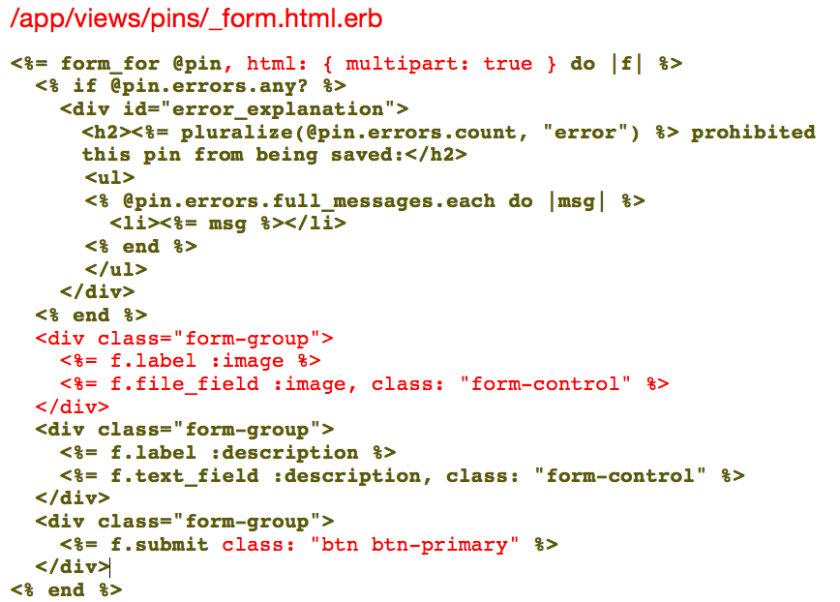
Add image field (the text in red) to pin form
Notes:
Our form still looks like it did before, which means our users can’t upload any images even though we now have the capability within out app to do that. So let’s change the user’s view of the form by adding a field to upload images—add the text in red that you see here. Don’t forget the comma aft @pin in the first line.

Slide 69
Update the Pins controller
/app/controllers/concerns/pins_controller.rb
def pin_params
params.require(:pin).permit(:description, :image)
end
Notes:
We also need to make a change in our controller to update our pin parameters. Parameters are basically pieces of data that a user supplies. In our pins controller here at the bottom, we are permitting one piece of data that’s tied to the pin—the description. So let’s add the pin’s image to that list by adding only the green text here.
def pin_params
params.require(:pin).permit(:description, :image)
end

Slide 70
Task 17: Update the pins show view
Write code for an image tag to place in /app/views/pins/show.html.erb
so that when we SHOW a pin, the pin’s image appears too

Slide 71
Task 17: Update the pins show view
/app/views/pins/show.html.erb
above the line that says <strong>Description:</strong> add this:
<%= image_tag @pin.image.url(:medium) %>
Notes:
Now we need to update the view of the pin so that includes the image that the user uploaded. So let’s add some Ruby code right above the line that says <strong>Description:</strong> … and since we want the image size to be medium, we’ll include that too.
/app/views/pins/show.html.erb
<%= image_tag @pin.image.url(:medium) %> . . .

Slide 72
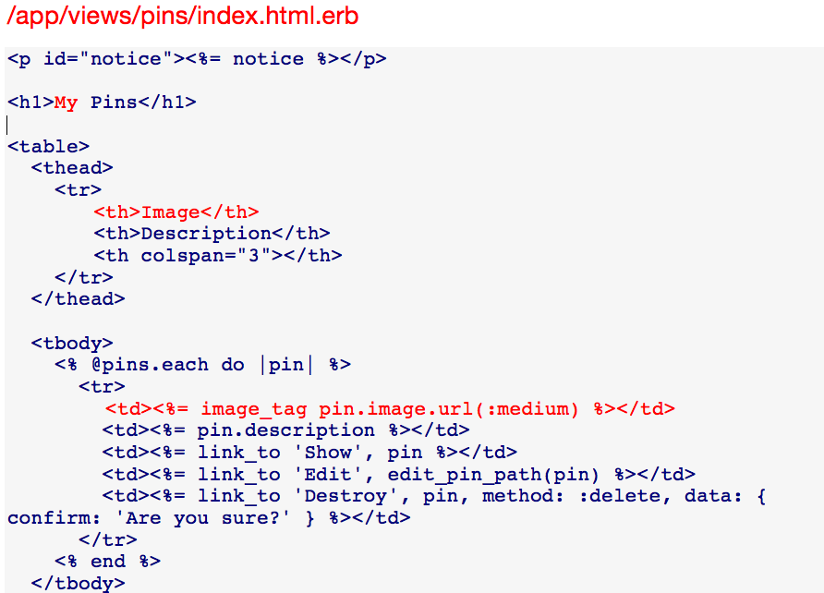
Update the pins index
Notes:
Now let’s add the text in red so that the image for each pin shows up in the index of all pins:

Slide 73
Add some pins
Upload 3 pins from your preview page so you can see what they’ll look like in the index and show views

Slide 74
Task 18: Change the root route
How would we edit the code in /config/routes.rb so that the root route takes us to the index action of the pins controller instead of the current direction (the home action in the pages controller)

Slide 75
Task 18: Change the root route
/config/routes.rb
replace
root 'pages#home'
with
root "pins#index"
Notes:
Let’s change a route in the routes.rb files so that all of our pins display on the homepage.
First we’ll change the routes so that the home pages is the Pins index
So replace the line, root ‘pages#home’
With
Root “pins#index”

Slide 76
Commit to Git
➜ git status
➜ git add .
➜ git commit –am “Add image upload with Paperclip and change root path”
Notes:
Now is a good time to commit to Git, so let’s follow these steps

Slide 77
Task 19: Make the most recent pin appear at the top
My most recent pin appears at the bottom of the page, and I want it to appear at the top.
How would we edit the index action in the pins controller so that @pins are displayed chronologically instead of the current order (reverse-chronologically).
Hint 1: Apply the “order” method to Rails
Hint 2: Google “created_at in Rails” -- how does it work as an argument to the order method?

Slide 78
Task 19: Make the most recent pin appear at the top (answer)
app/controllers/pins_controller.rb
replace
def index
@pins = Pin.all
end
with
def index
@pins = Pin.all.order("created_at DESC")
end
Notes:
Right now the Pin that I most recently uploaded is showing up at the bottom of the screen, but it would be nice if it showed up at the top instead. With some changes to the code in the pins controller, we can make pins show up reverse-chronologically. So replace the @pins = Pin.all with @pin = Pin.all.order(created_at_DESC”)

Slide 79
Commit to Git
Console
➜ git status
➜ git add .
➜ git commit –am “Made pins show up reverse-chronologically”
Notes:
And for our final step, let’s commit that change to Git. And that is all

Slide 80
Questions?

