Slide 1
MVC in Rails
Women Who Code DC

Slide 2
What does MVC stand for?
Model
View
Controller

Slide 3
View
What a user sees
ERB (embedded Ruby) is default
You can write any/all of the following in relation to your views:
HTML
CSS
JavaScript

Slide 4
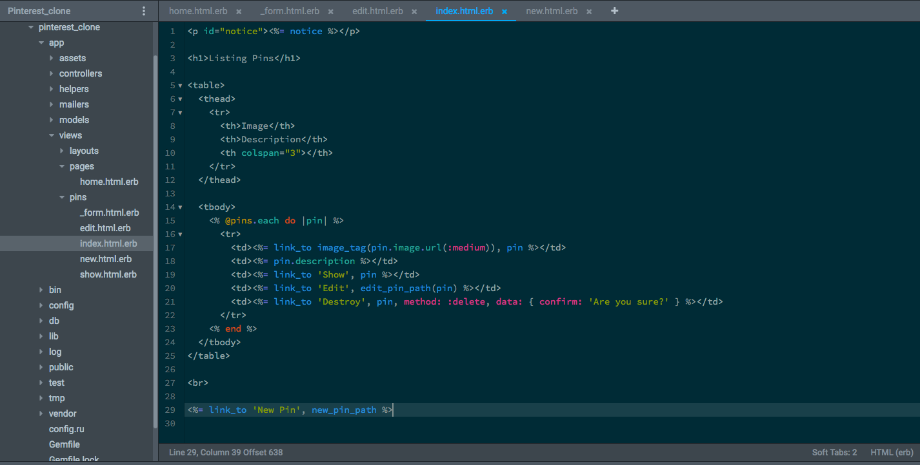
An example view

Slide 5
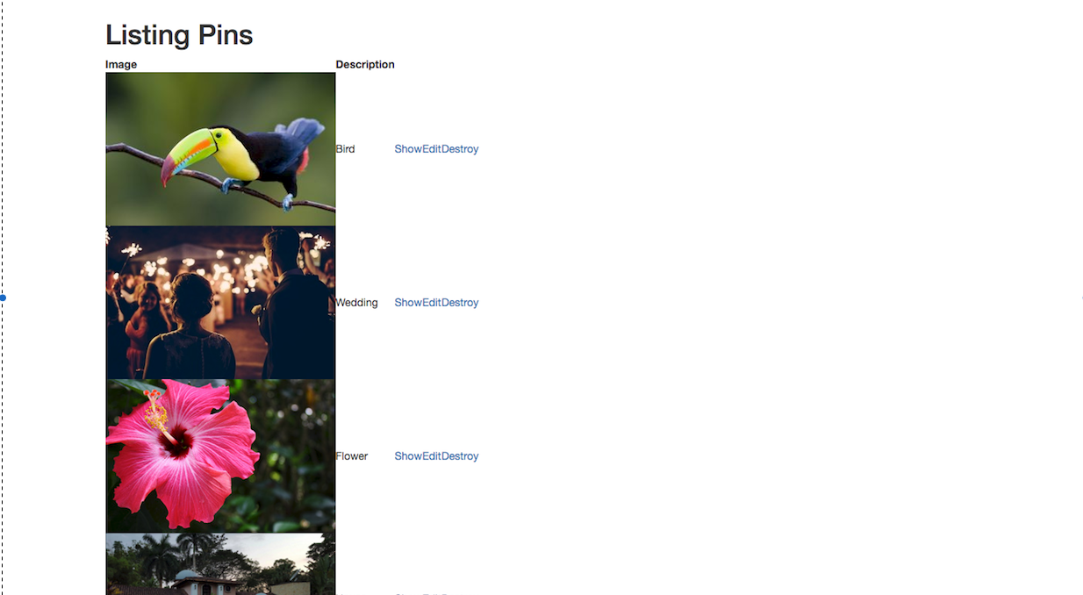
What that view looks like on browser

Slide 6
Model
Determines how data is stored and structured
Updates the view
Ruby (.rb) file
Contains the inherent nature or state of the object
Def full_name “#{first_name} #{last_name}
end

Slide 7
Basic model
class Pin < ActiveRecord::Base
has_attached_file :image, :styles => { :medium => "300x300>", :thumb => "100x100>" }
validates_attachment_content_type :image, :content_type => ["image/jpg", "image/jpeg", "image/png", "image/gif"]
end

Slide 8
Controller
This is where the action is at
Sends commands to the model to change or update any data
Can also send commands to the view
Acts like a gatekeeper or a traffic cop
Ruby (.rb) file

Slide 9
Sample pins controller
class PinsController < ApplicationController
before_action :set_pin, only: [:show, :edit, :update, :destroy]
def index
@pins = Pin.all.order("created_at DESC")
end
def show
end
def new
@pin = Pin.new
end
def destroy
@pin.destroy
respond_to do |format|
format.html { redirect_to pins_url, notice: 'Pin was successfully destroyed.' }
format.json { head :no_content }
end
end
end

Slide 10
Model or Controller?
Controller
Actions (I want to create a new event)
How the app responds to request for info
Is this a standard HTML request? Show that page view.
Is this another request? Render some model information
Model
Inherent states of behaviors (eg, what are my upcoming events?)
How the object responds to request for info (“My name is #{full_name}”)

Slide 11
MVC flow
User → View → Controller→ View→Controller→Model→Controller→View→User

