Slide 1
Intro to Ruby on Rails
Women Who Code DC

Slide 2
Today’s Outline
Coding components
What is Ruby?
What is Rails?
Command Terminal
Version Control
Install

Slide 3
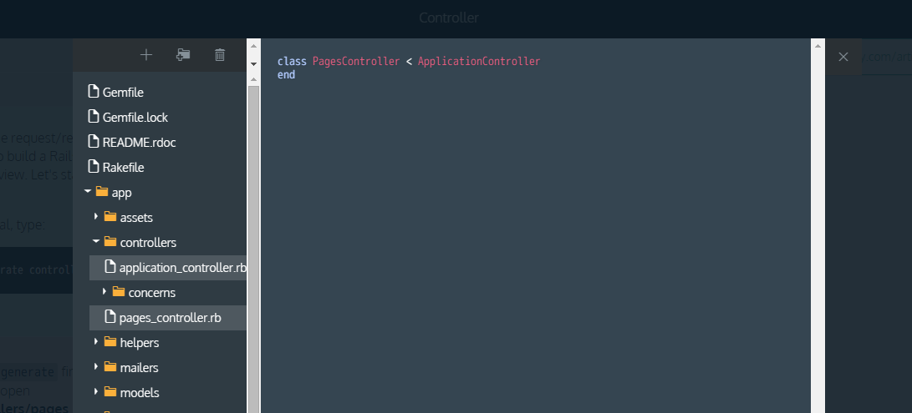
Text Editor and File Manager
Sublime Text
Notepad ++
X-Code
Notes:
If you’ve never coded before, you’ll notice when we move to installation later that the installation guide will mention installing a text editor. This is where you’ll write your code locally. What’s great about these text editors (and others), is that they use something called syntax highlighting, which will show different parts of the syntax like html tags and method definitions in different colors, so if it’s not showing the right color, there’s probably a typo or something you’ve accidentally left off.

Slide 4
Coding components
Command Terminal
Mac- Terminal
PC/Linux- Command Line
Notes:
If you’re on a Mac you’ll be using something called the terminal, and on a PC or a Linux machine it’s called the command line. There are advanced versions you can install, but each operating system comes with a good basic version. We’ll share some information and resources later on this.

Slide 5
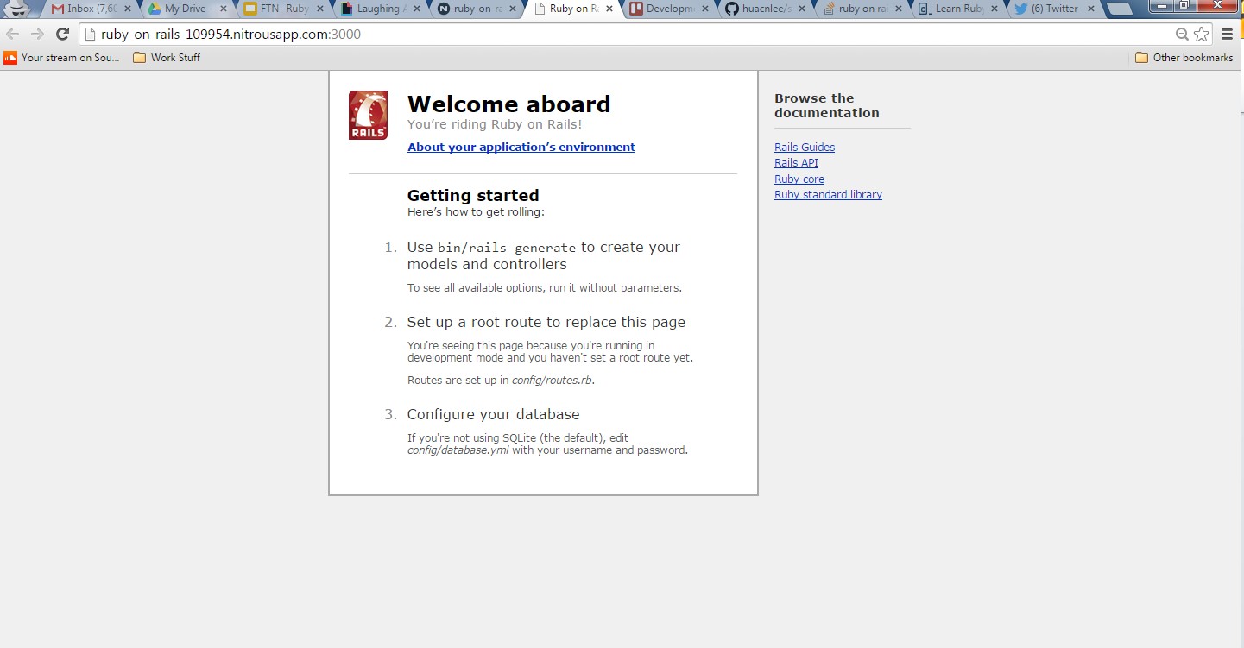
Coding Components
Browser
Chrome
Firefox
Safari
Internet Explorer

Slide 6
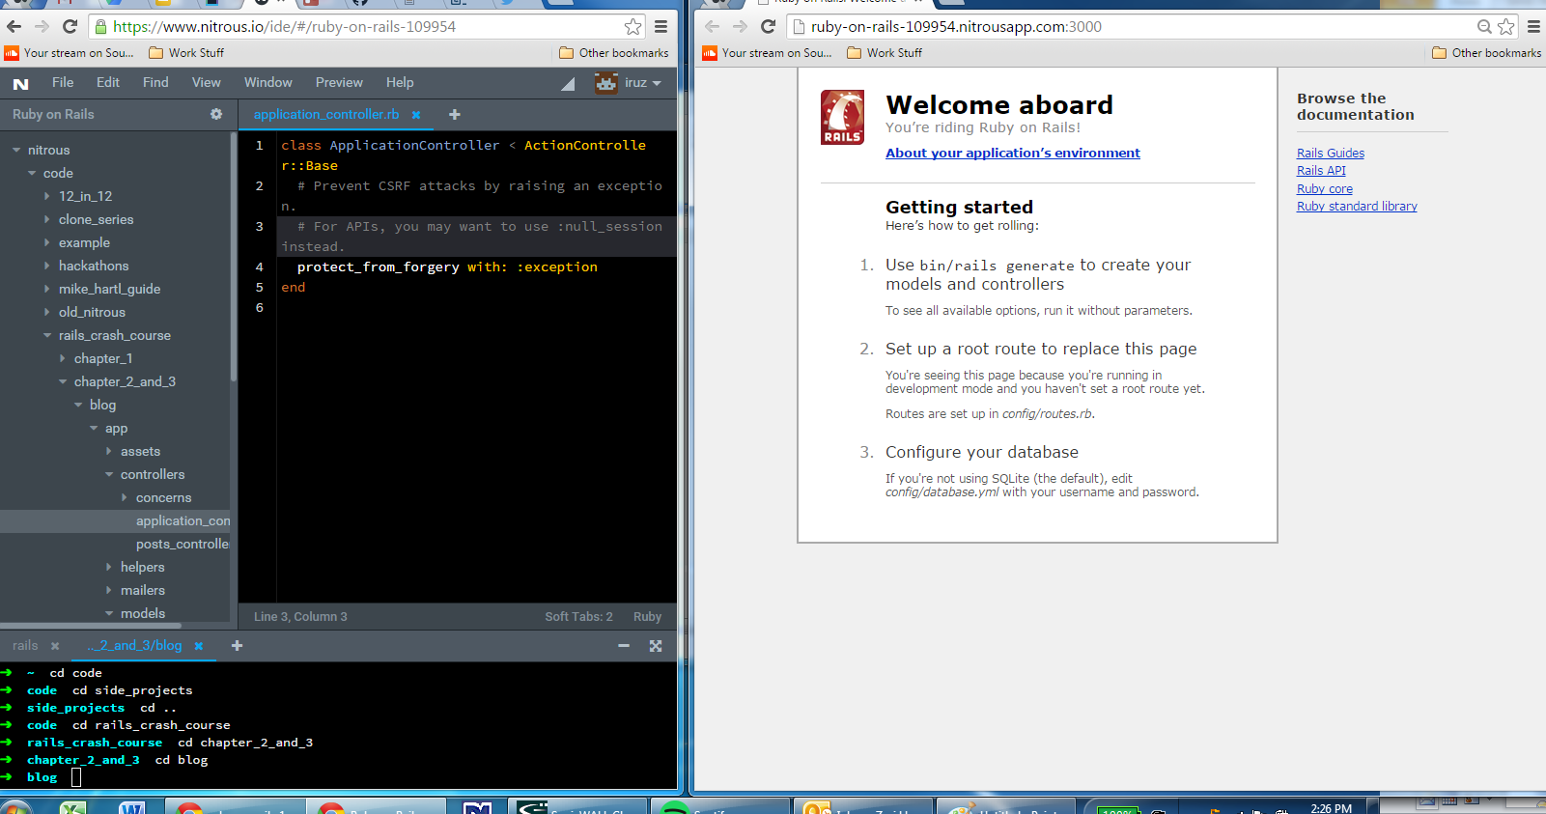
Notes:
It’s a lot of information already so don’t worry if you’re not sure how things work yet, but this is how the pieces fit together. In this case I’ve navigated to myblog in the command line in the bottom left corner, opened it up in her text editor on the left above that (it’s an online-based one so it may look different), and started the project in a browser so she could see how it looked.

Slide 7
What’s Ruby?
scripting language (not compiled first unlike languages like Java)
don’t have to declare variables (if I say 5 knows that it is an integer)
functions by sending messages between objects
created by Yukihiro "Matz" Matsumoto
Notes:
Before we continue, just out of curiosity how many of you have programming experience in another language?
Ruby is what’s called an interpreted scripting language for quick object oriented programming. It’s like making a cake from scratch.
First off, interpreted. For those of you who are coming from other languages like C or Java, Ruby is different because you don’t have to compile it first. The moment you type in a command, it reads it, parses it, and executes it. Assuming it’s a complete command anyhow.
Now quick and easy. Unlike other languages where you have to tell it that an integer is an integer, or a string (bit of text) is a string, Ruby understands that automatically.
Now object oriented. Ruby, like other object oriented languages, essentially functions by sending messages between objects. Even in a simple arithmetic problem like 1 + 2 you’re sending the addition message between 1 and 2 and because they’re both numbers (integers) they know what the plus sign means. Object oriented languages also make it easier to organize similar code to avoid repetition.
Remember when I mentioned that Ruby is all about happiness? Well Matz is its creator. Every time he was faced with a decision when making Ruby where he could make it run a little faster or he could make the programmer happier, he chose happier every time.

Slide 8
What’s Rails?
back end framework that interacts with and uses front end tech like HTML and CSS
convention over configuration
follow certain conventions in exchange for sparing you time spent on configuration
points of confusion
when there’s no convention
Notes:
Given that, you might be wondering what Rails is. Compared to Ruby’s raw, from scratch cake, I’d call Rails a boxed cake mix. It’s still got the same stuff inside (flour, sugar, fats, and so on), but it’s packaged up to give people a quicker and easier base.
When there’s no convention, people often turn to gems, prepackaged bits of code that you can add to your app. Other languages and frameworks might call them libraries or packages, or modules or something else entirely.

Slide 9
If Rails is the Creature...
David Heinemeier Hansson (DHH) is the Dr Frankenstein
Drives racecars
Created Rails for speed, self-reliance, and programmer happiness
Notes:
So if Rails is the creation, if it’s the creature, who is Dr. Frankenstein? Well, it’s this guy. DHH as he’s known. He looks less like a member of a European boyband now, but this is still the picture of him that most places use, including his own website. Obligatory information: he drives racecars. The reason why Rails is so popular with startups is that it was created to enable small teams or individuals to build with speed, and to enjoy it. A lot like Matz’s goal with Ruby.

Slide 10






Who Uses Rails?

Slide 11
Command Line/Terminal
Commands to know
cd - change directory
ls or dir - list all the files that are in the directory
cd ~ - change to the root directory
cd .. - go back one step in the directory
Notes:
Some of these may be slightly different across Mac and PC and Linux, but they should be fairly standard. We have some more resources listed later that will help you learn important commands.

Slide 12
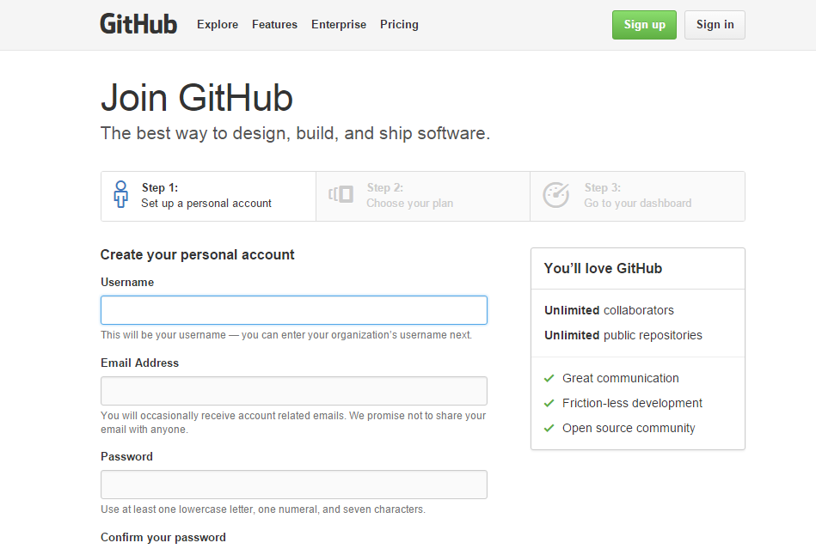
Local:
git
Online:
GitHub
BitBucket
www.github.com/join
Notes:
Have you ever worked on a document and wanted to save multiple versions or collaborate with others and see who changed what and why? Not that easy, right? Well version control makes this much easier for code. On your local machine you’ve installed something called git. This allows you to save version of your project and rollback to a previous version if that works better, to branch out and try a feature without contaminating the main project, and many other things. Two places that let you store and interact with this version control system online are GitHub and BitBucket. These online sites can also serve as a portfolio of sorts when you’re applying for tech jobs. We recommend GitHub, but you might see some tutorials using BitBucket.

Slide 13
Let’s Install!
http://installrails.com/
Notes:
On a Mac, Xcode may take a while to install. This is normal.
On a PC you may get an SSL error at some point. See this workaround for tips. We can help with this if it’s tough to understand.

