Slide 1
Brief Intro to Git
Just the Basics
Women Who Code DC

Slide 2
Goals
Learn the basics of Git
Learn the basics of GitHub and GitHub pages
Learn some Bash
Get started with Git and Github

Slide 3
What is Open Source?
What is Open Source?
Open = Free, available, public, transparent
Source = software source code
Opposite of commercial proprietary software
Important: public software projects on GitHub are open source

Slide 4
What’s Git?
A software program that helps you write software.
Distributed version control for source code
Distributed = more than one copy on more than one computer
Created in 2005 by Linus Torvalds (Linux kernel).

Slide 5
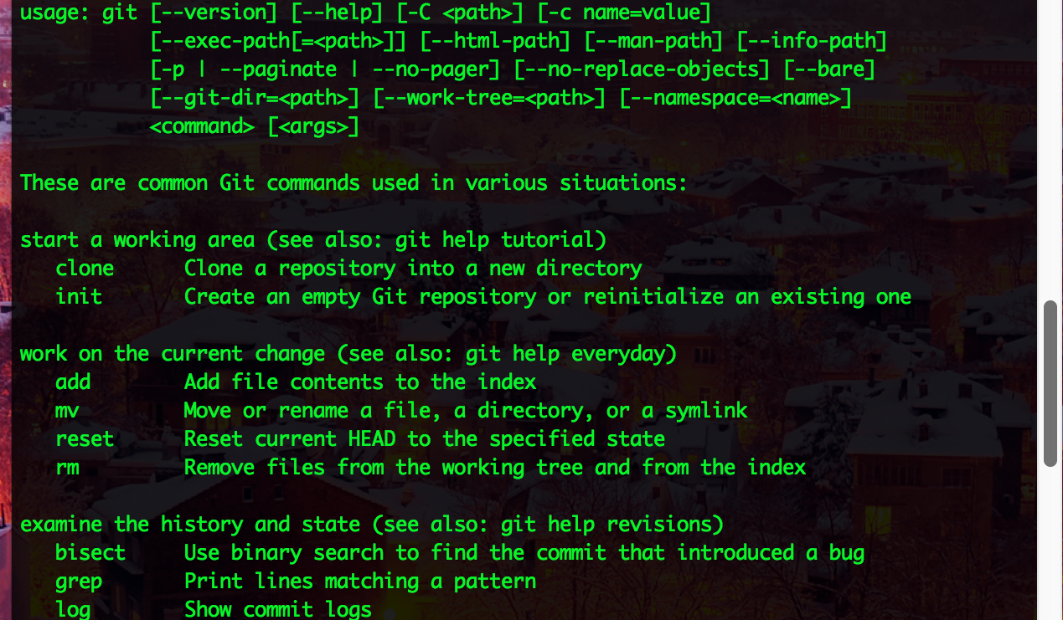
Git = a software program

Slide 6
What’s GitHub?
A website that hosts public and private Git repositories
Repository is a project or set of files
"Social coding”
Created 2008

Slide 7
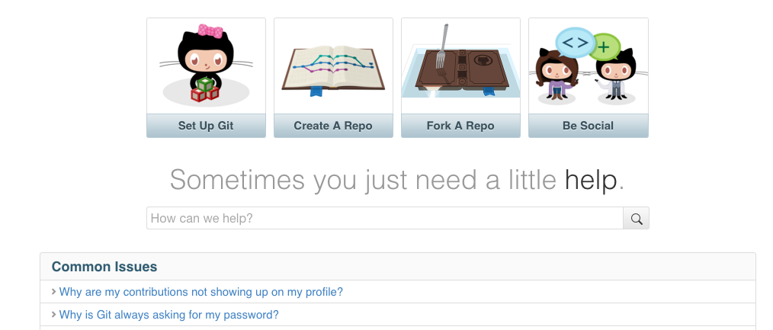
Github is a website

Slide 8
Git + social media = GitHub

Slide 9
What is GitHub Pages?
Public web site hosting via GitHub
Uses specially named repositories
User pages = http://username.github.io/
Organization pages = http://organization.github.io/
Project pages = http://username.github.io/my-cool-project

Slide 10
GitHub Pages Limitations
Only static files
HTML, CSS, JavaScript, CSV, JSON, GeoJSON
No PHP, Node.js, Ruby, Django, or server-side frameworks
This means it is hard to manage pieces of code that repeat on multiple pages - menus, headers, and footers

Slide 11
Why use it then?
Free!
Secure
Easy to use and configure
Under source control automatically
Use Jekyll to host your blog

Slide 12
Set up Git
Follow brief instructions according to your operating system (Mac, Windows, Linux) at:
https://help.github.com/articles/set-up-git/

Slide 13
Create a GitHub account
https://github.com/

Slide 14
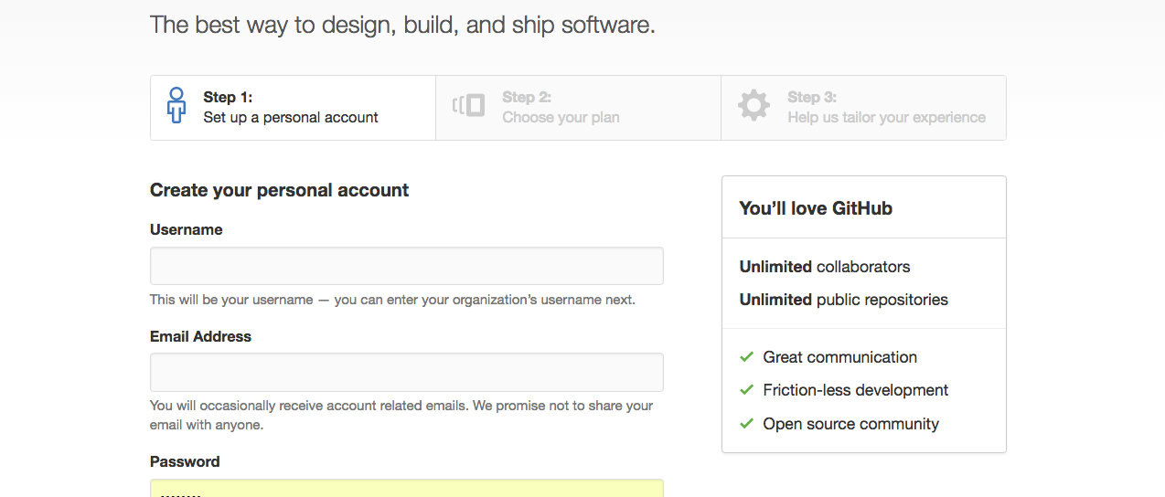
Enter username, email, password

Slide 15
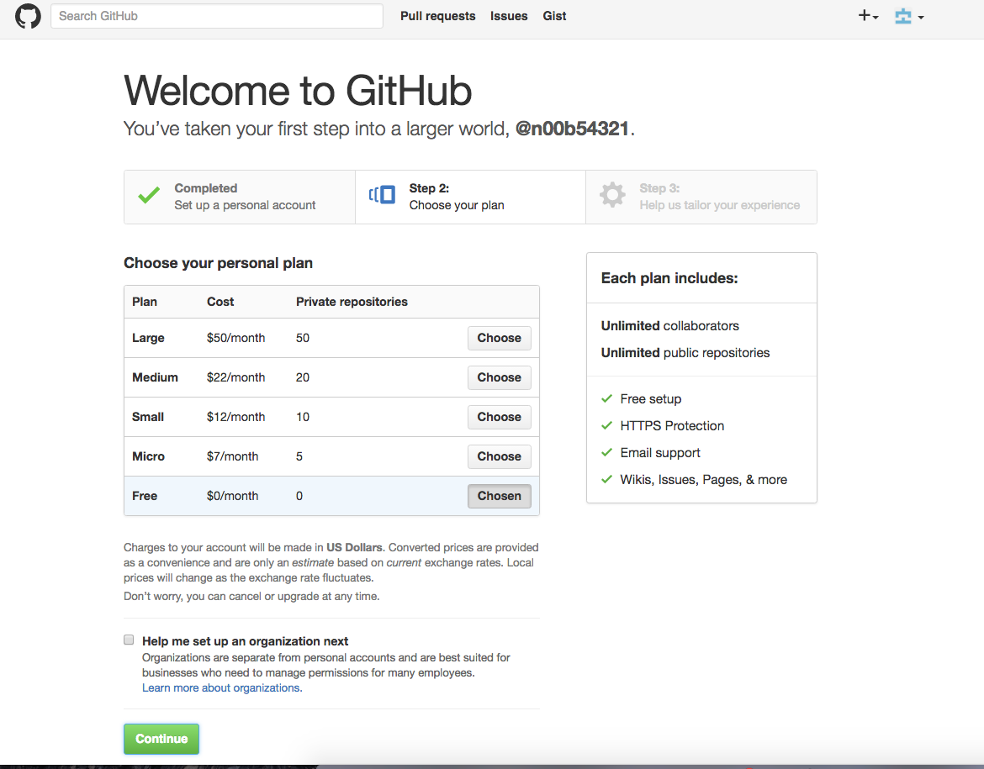
Keep the free account

Slide 16
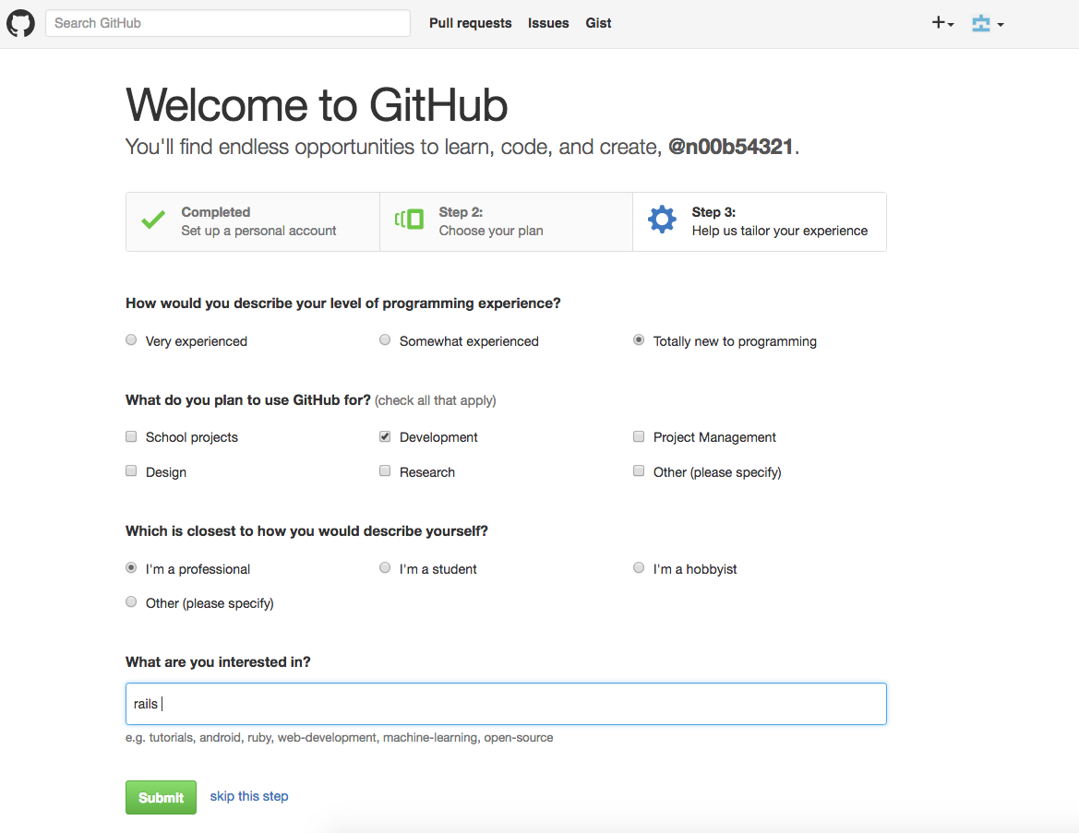
Finalize signup

Slide 17
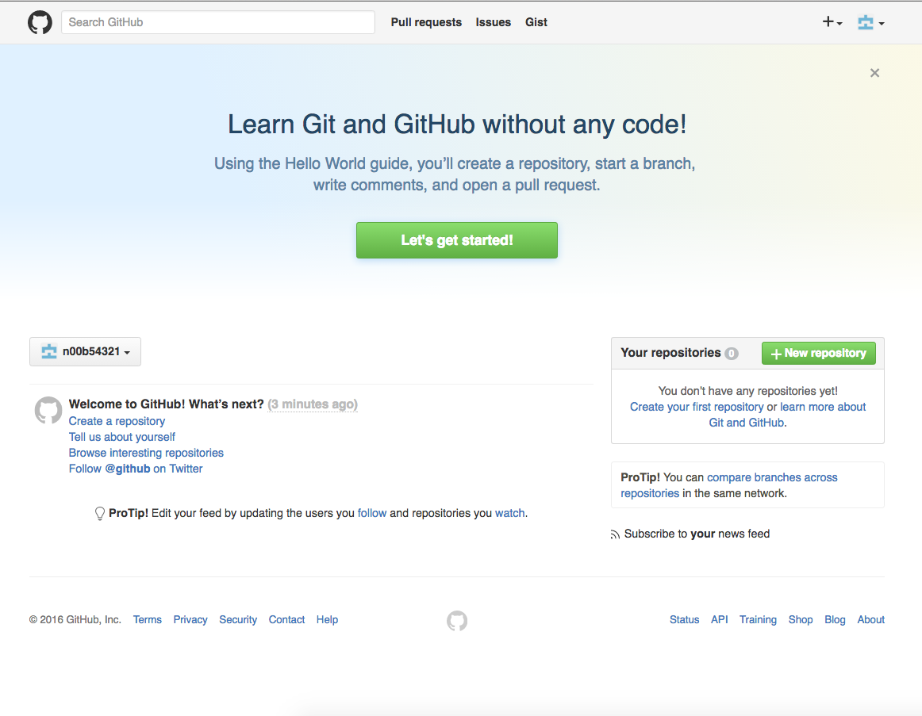
Click on New Repository (then verify email address)

Slide 18
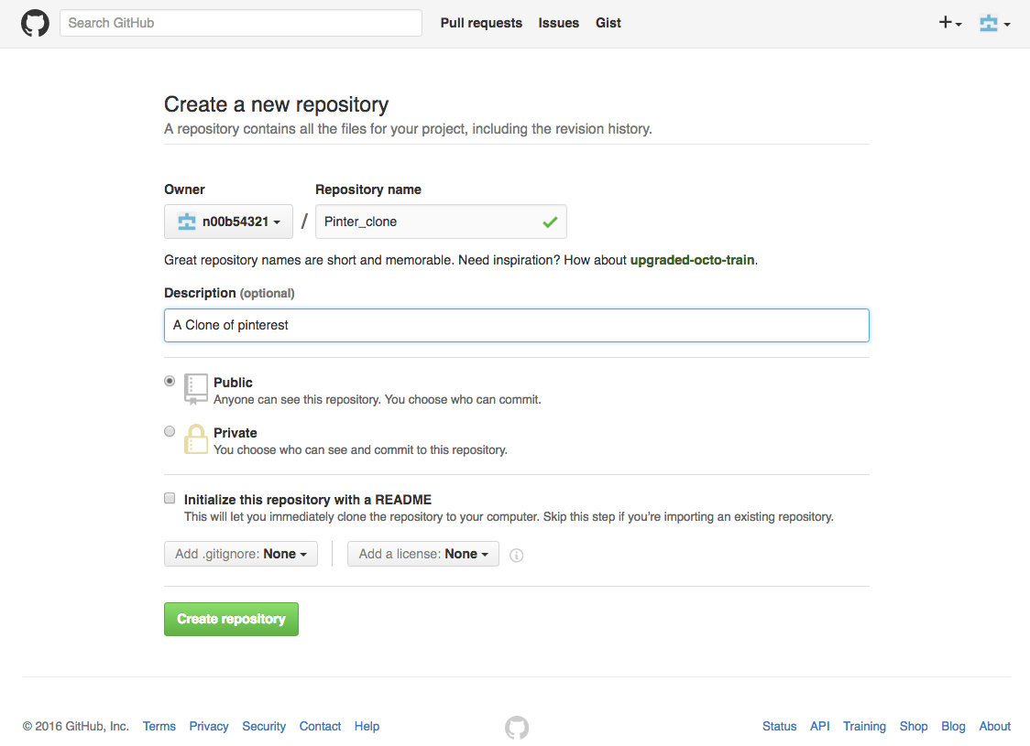
Add repo name and description, then click create repository

Slide 19
Type these commands inside Terminal once you’ve navigated to your app’s folder
git init
git add README.md
git commit -m "first commit"
git remote add origin https://github.com/n00b54321/MYAPPNAME.git [[CUSTOMIZE]]
git push -u origin master

Slide 20
Remember !
Git best practices:
Commit early and often
Don't panic (as long as you commit!)
Write thoughtful commit messages
Read more: sethrobertson.github.io/GitBestPractices

