Slide 1
Parkside Apartments
2026 Investor Performance Presentation
Synthetic Data | Automated Python Reporting

Slide 2
2026 Financial Performance
Effective Revenue: $1,434,500
Operating Expenses: $750,500
Net Operating Income: $684,000
Average Occupancy: 95.17%

Slide 3
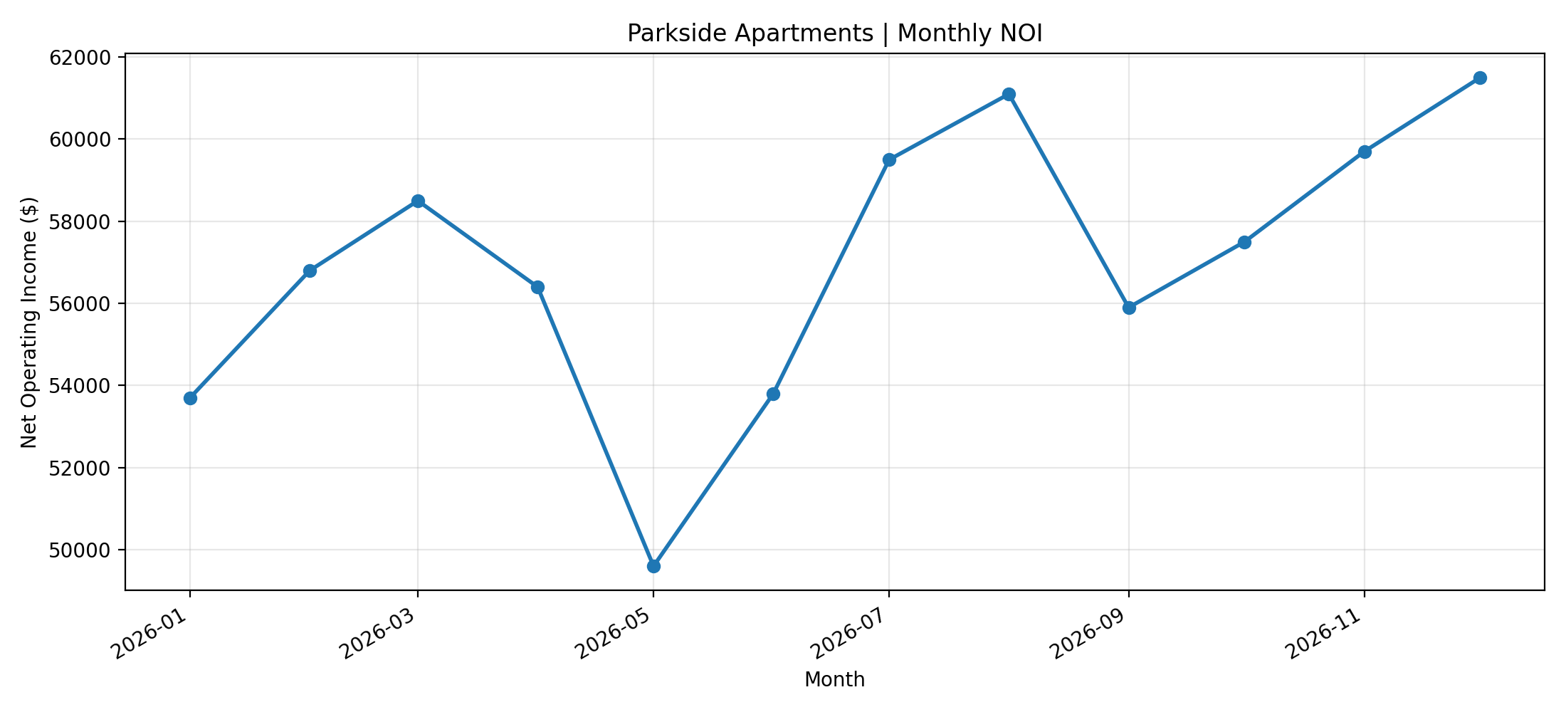
Monthly Net Operating Income

Slide 4
Management Overview
Occupancy remained near the operational target.
Revenue finished below budget.
Operating expenses exceeded budget.
Management should review variances and NOI trends.

Slide 5
Management Recommendations
Review revenue variance drivers.
Investigate lower-occupancy months.
Monitor operating expense categories.
Compare monthly NOI with future periods.

Slide 6
Automation & Methodology
Synthetic multifamily operations dataset
Python and pandas financial analysis
Automated matplotlib visualization
Rule-based management commentary
PowerPoint generated using python-pptx

