Slide 1

INDIVIDUAL ADVOCACY
IMPROVING CLIENT DATA MANAGEMENT & MEDICAID CLAIM EFFICIENCY
New Access Database Overview
Ju-Lynda Vaughn
Revenue Cycle / Business Analyst

Slide 2
EXECUTIVE SUMMARY
A centralized database that unifies client records, case manager activity, and Medicaid billing data reducing errors, improving access to information, and tracking over $100K in monthly revenue."
WHAT THE SYSTEM DELIVERS:
One source of truth for 400+ clients
Immediate visibility into authorizations & unit usage
Faster, more accurate Medicaid billing
TCM-friendly workflows and customized reporting
Improved compliance and service continuity
Individual Advocacy 1

Slide 3

PROBLEM
SOLUTION
Fragmented data caused recurring billing delays, incomplete client records, and preventable revenue loss.
A unified Client & Medicaid Billing Database that streamlines billing, improves data accuracy, and supports day-to-day TCM operations.
KEY CHALLENGES:
KEY CHALLENGES:
Average of $5K+ monthly at risk due to various claim issues
400+ client records scattered or incomplete
No centralized billing hub for claim status or authorization info
Unknown authorization lapses risking service interruptions
Manual processes created delays and inconsistent data accuracy
Centralized data access for clients, TCMs, and units
Faster claim tracking across all months
Automated authorization visibility to prevent lapses
Accurate monthly billing + cross-checks
Instant reports for management and case managers
Individual Advocacy 2

Slide 4
DATABASE ARCHITECTURE
Designed for stability, separation of duties, and future scalability.
Tables
Forms
Reports
Client Master Table
Monthly Billing Tables
Case Manager
Client Information
UHC Clients
Billing Entry
Client Lookup
TCM Tracking
Client/TCM Editing
TCM Client List & Units
Overall Unit Usage
Authorizations
Ad Hoc Views
Individual Advocacy 3

Slide 5
WORKFLOW OVERVIEW
MAIN MENU
VIEW DATA
Central navigation for all billing months, client views, and reports
TCM-specific views
UHC authorization tracking
Client search and year-at-a-glance summaries
ENTER DATA
REPORTING
Monthly billing entry
Cross-checks prevent unit discrepancies
Monthly billing output for management
TCM unit usage reports
Overall unit summaries
Individual Advocacy 4

Slide 6
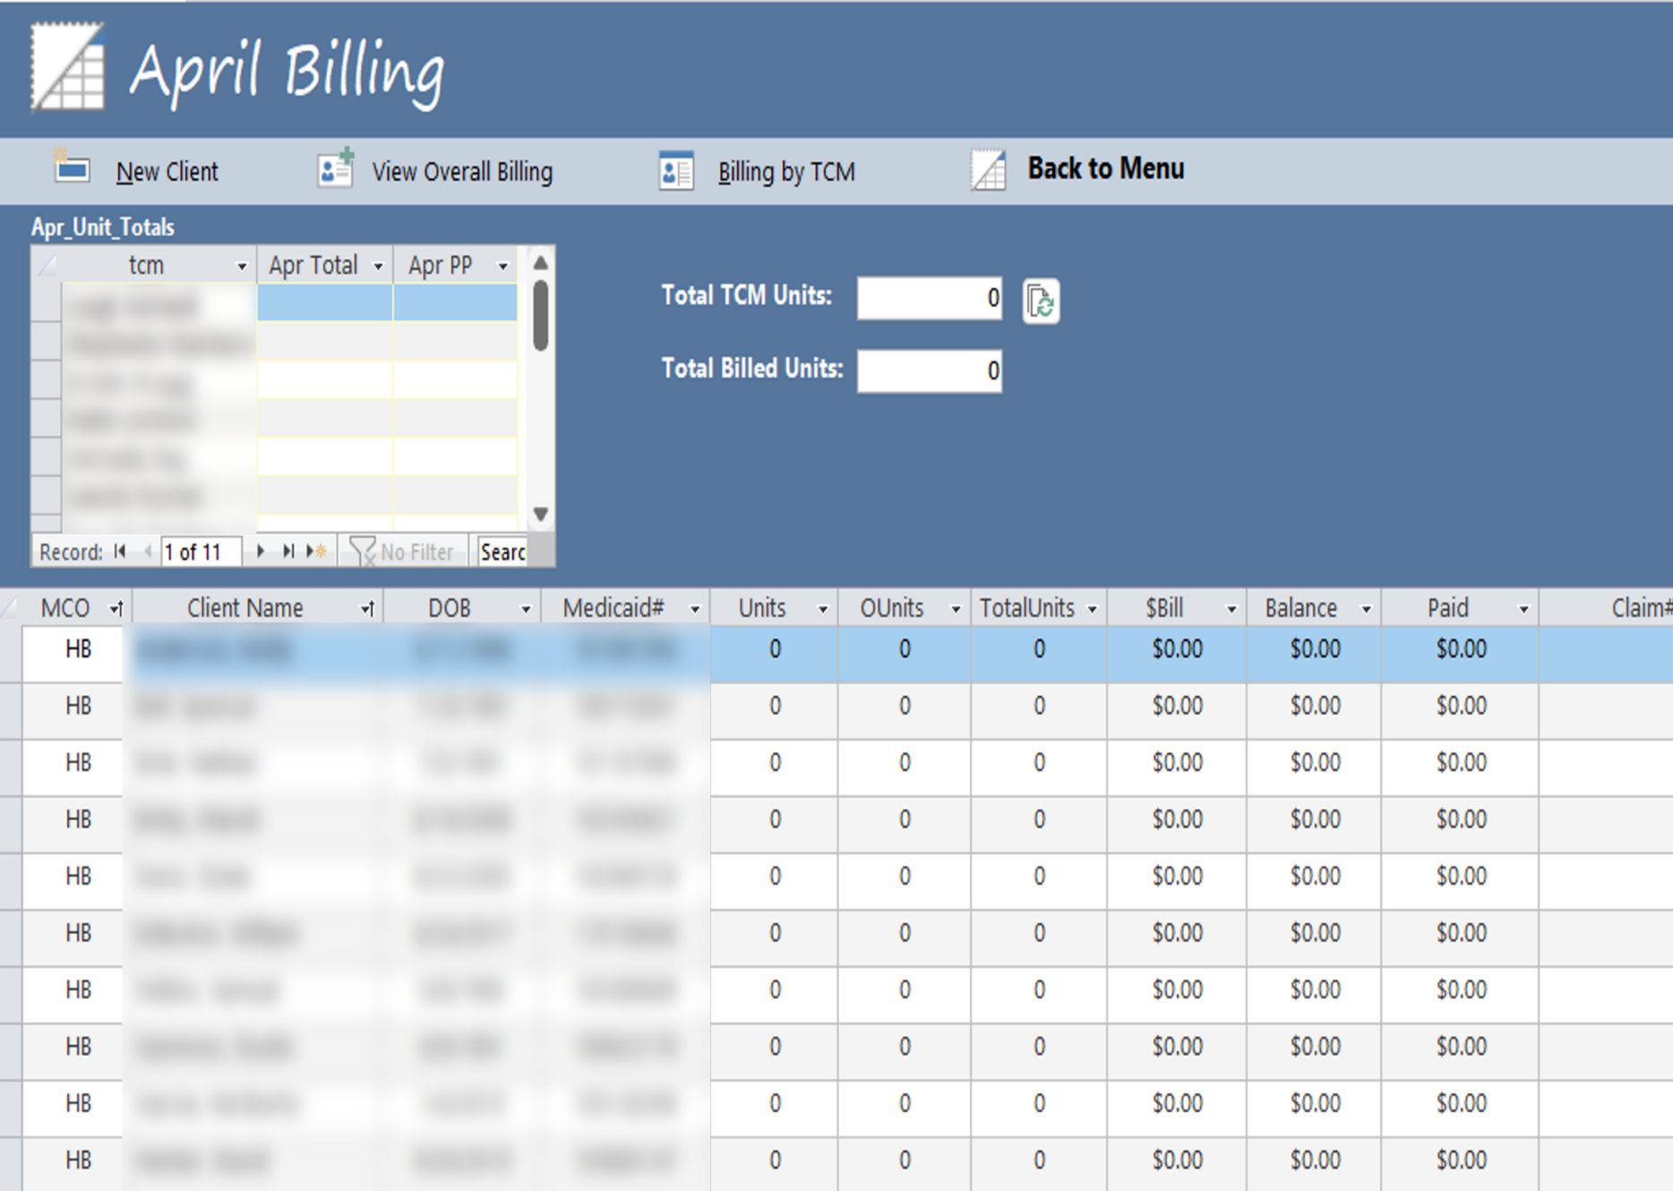
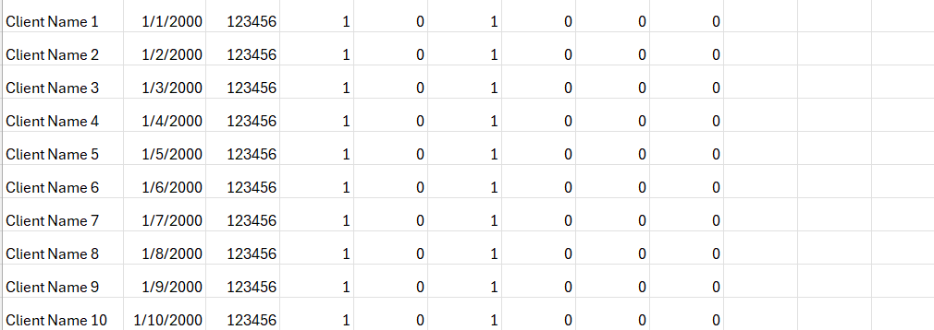
MONTHLY BILLING FORM
Ensures accurate billing by combining unit entry, claim information, and built-in validation.
*Sample form
KEY FEATURES:
Top form: TCM unit entry + automatic total calculation
Bottom form: Monthly billing details, claim numbers, and notes
Cross-check logic ensures unit totals match
Conditional formatting: Unpaid claims flagged in red
Case Manager Subform
TCM Total 1270
Billing Total 10
Cross-check section. Ensures that TCM unit totals match the manually entered totals
TCM 1 650 0
TCM 2 620 10
WHY IT MATTERS:
Reduces manual errors
Supports real-time claim status tracking
Improves month-end billing accuracy
Individual Advocacy 5

Slide 7
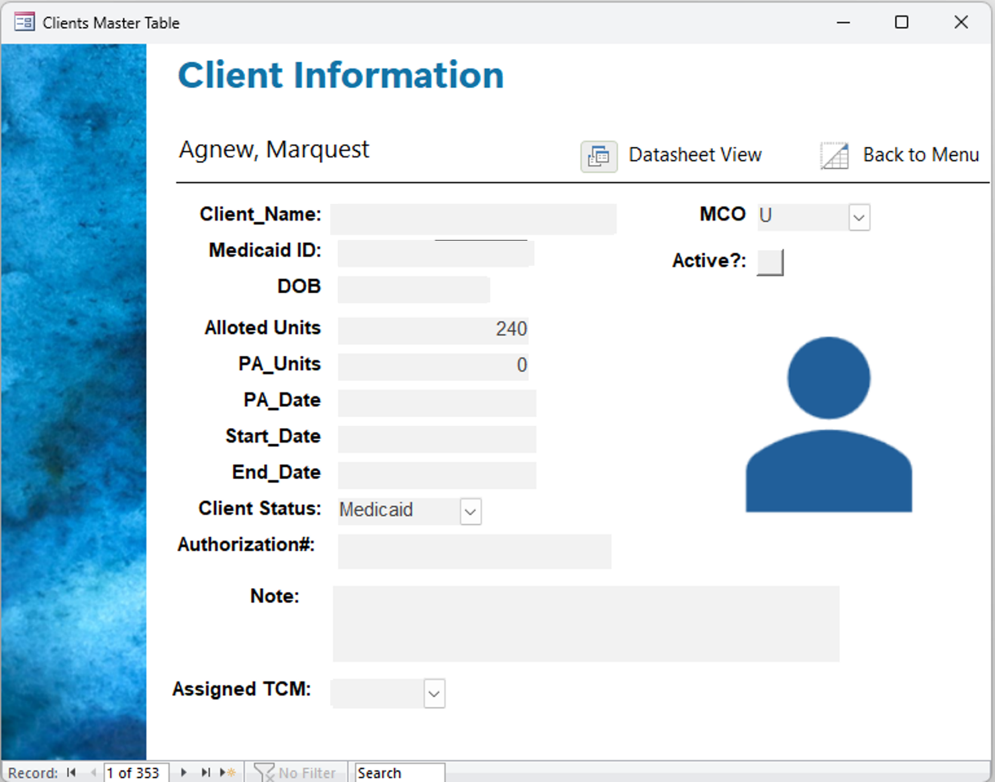
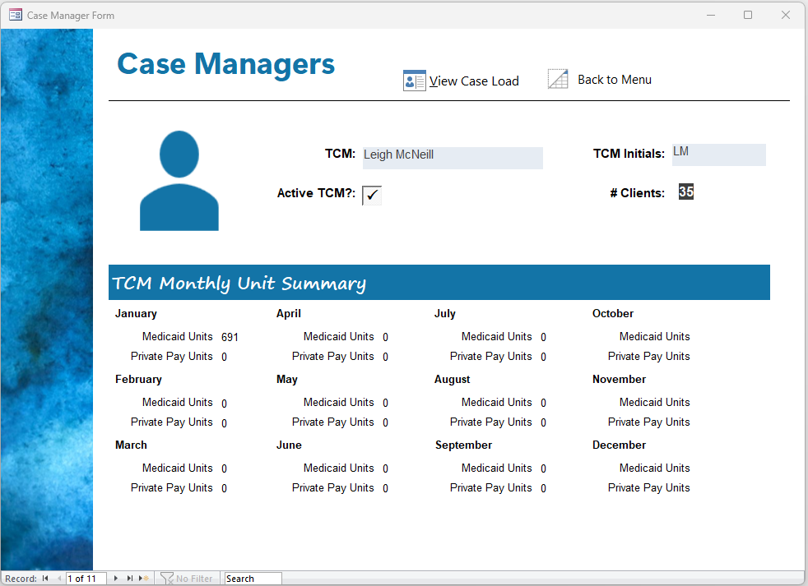
CLIENT & TCM VIEWS
Client Name
CLIENT VIEW:
TCM VIEW:
Core client details for billing
Option of incorporating a client photo
Note section for Care Coordinator/Guardian information
Option of incorporating a staff photo
Monthly ‘Unit Summary’ for Medicaid and Private Pay
‘TCM Login’: If security levels are needed for access
Individual Advocacy 6

Slide 8
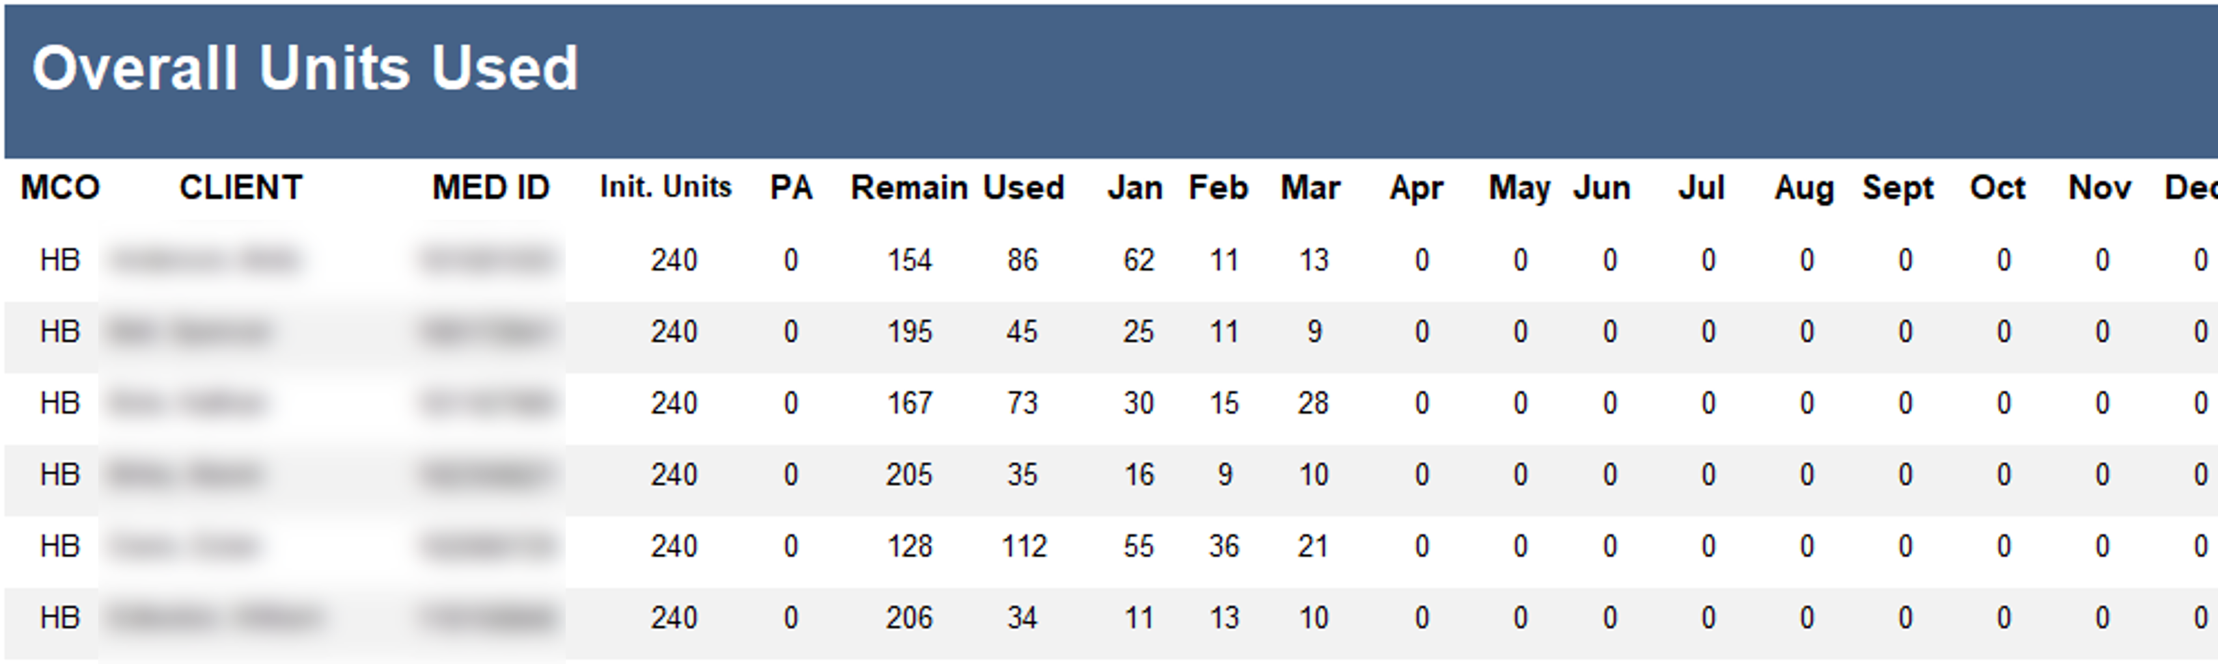
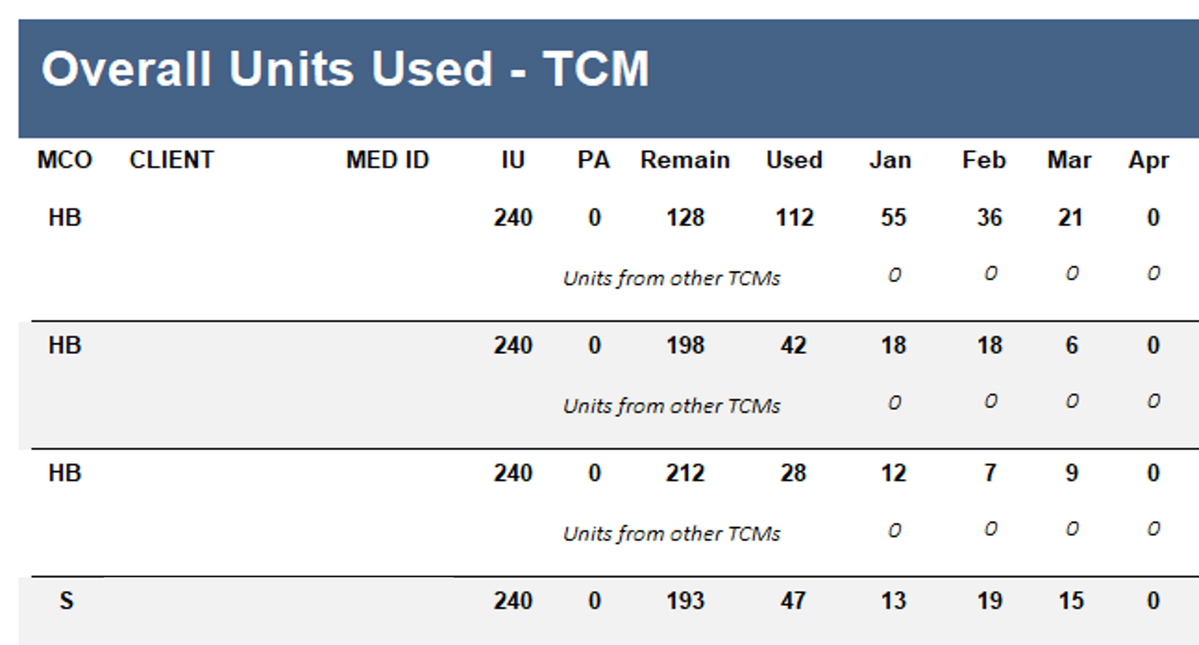
REPORTING
H Client 1 12364 240 0 100 140 50 40 50 H Client 2 45874 240 0 220 20 0 20 0 S Client 3 13256 240 0 200 40 0 0 40
H Client 1 12364 240 0 100 140 50 40 50 H Client 2 45874 240 0 220 20 0 20 0 S Client 3 13256 240 0 200 40 0 0 40
Sample Data
Sample Data
*PA – Prior Authorization Additional Units
*IU – Initial Units
*PA – Prior Authorization Additional Units
OVERALL UNITS REPORT:
TCM UNITS REPORT:
Management-level summary
Displays units granted (PA additional units) and monthly units used
Supports service continuity and audit requirements
Filtered by TCM using their initials
Shows unit usage across all clients
Includes secondary TCMs if applicable. This happens when filling in for case manager
Individual Advocacy 7

Slide 9
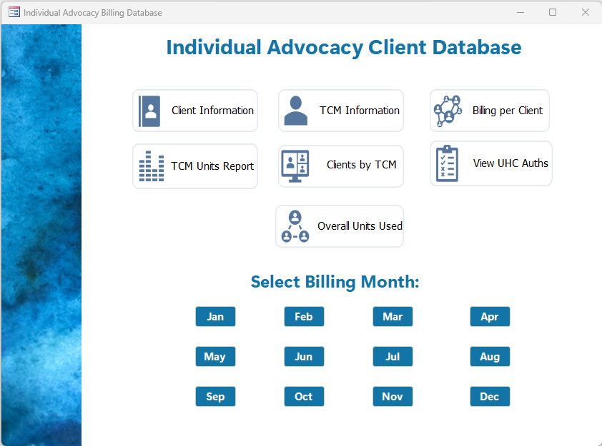
IMPACT AND VALUE
Medicaid Client Database
The new database improves accuracy, transparency, and revenue protection across the organization.
Company Client Database
MEASURABLE BENEFITS:
Protects $5K+ monthly revenue previously at risk due to denials
Eliminates manual tracking of units and claim status
Improves compliance with authorization requirements
Creates an audit-ready trail for all billing data
Scales for future forms, reports, or additional services
Select Billing Month
Jan
Feb
Mar
Apr
May
Jun
Jul
Aug
Sep
Oct
Nov
Dec
Individual Advocacy 8

Slide 10
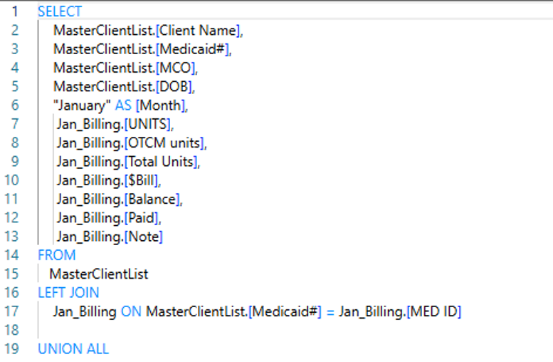
TECHNICAL SIDE OF THINGS
OTHER TECHNICAL TID-BITS:
The Database has been split into a ‘Front-End’ and a ‘Back-End;
Front-End – contains the forms and the reports
Back-End – contains the tables and queries and is not accessible to unauthorized individuals maintain the database’s integrity
Specialized reports can be created as needed
All data tables can be exported into either CSV or Excel files and used for visualizations
Update Queries are incorporated to ensure that any new clients appears in the appropriate billing month’s data entry table(s) and reports
HOW IS THE INFORMATION COMBINED?
Select information from the ‘Clients’ and each monthly billing table is combined into one using SQL (Structured Query Language) . Queries were created for each billing month
Information from the two tables are joined on the client’s Medicaid number
Individual Advocacy 9

Slide 11
INDIVIDUAL ADVOCACY
IMPROVING CLIENT DATA MANAGEMENT & MEDICAID CLAIM EFFICIENCY
New Access Database Overview
Thank You!
Ju-Lynda Vaughn
Revenue Cycle / Business Analyst

