Slide 1

Bahar Golmohammadi
Li Liang
Julie Zhou

Slide 2
About muji
Muji is a Japanese retail company founded in 1980, which sells a wide variety of products, including household goods, apparel, and food. The company is most known for its simple product design and minimalistic attributes. It is also praised for being a highly sustainable company that emphasizes recycling, avoids waste during the production process, and uses sustainable packaging. Muji’s most popular items range from stationary, to men and women’s clothing, to kitchen appliances.

Slide 3
Relational database design assumptions
Each customer creates an account with only one country, which is set as their “primary country.” If the customer wants to purchase a product in another country, the purchase still relates back to the customer’s primary country.
Each product only has one supplier.
Suppliers have offices listed in the USA.

Slide 4
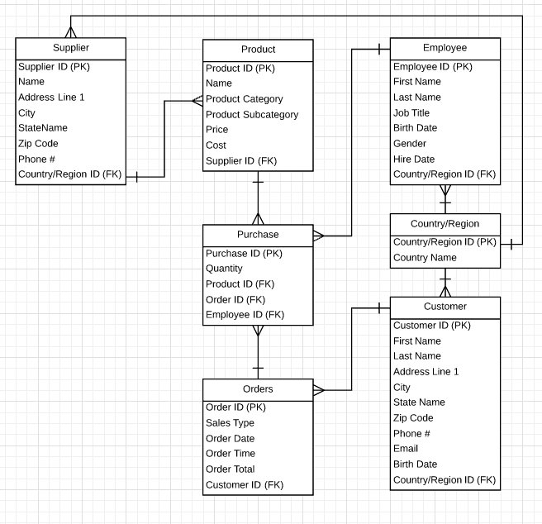
Relational database design

