Slide 1
Overview of Machine Learning
Geoff Hulten

Slide 2
Definitions of Machine Learning
Traditional Programming
Machine learning is a branch of artificial intelligence based on the idea that systems can learn from data, identify patterns and make decisions with minimal human intervention.
A computer program that can learn from experience E with respect to some class of tasks T and performance measure P, so that its performance at tasks in T, as measured by P, improves with experience E.
-Mitchell
Program
Computer
Output
Data
Machine Learning
Output
Computer
Program
Data

Slide 3
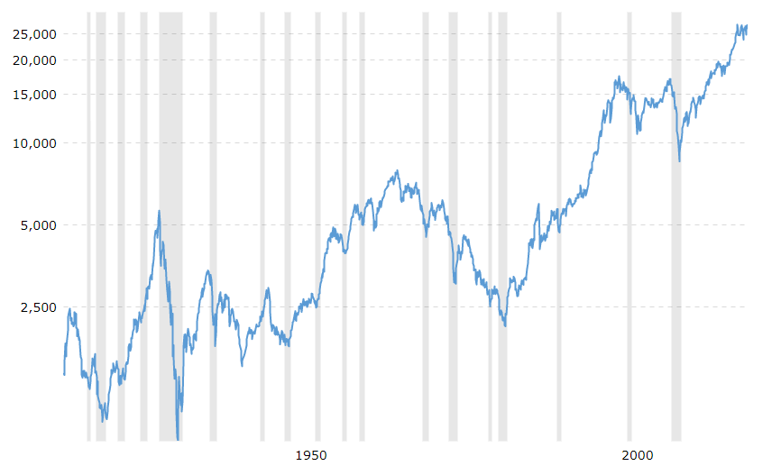
Why Machine Learning
Big problems
~100 million songs
~130 million books
~644 million websites
Open ended problems
8.6k tweets per second
2.4 billion active Facebook users
~66k new web pages per day
Time changing problems
Intrinsically hard problems
Human Level Perception
First speech recognition 1952
Complex Open-ended games
First chess program 1957
Deep Blue 1997 beat Kasparov
These things are hard to count. Numbers came from web searches and vague estimates. I’m sure they aren’t super precise.

Slide 4

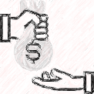





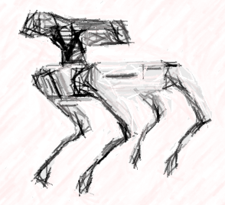

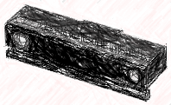
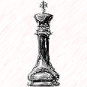
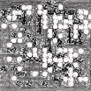
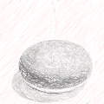
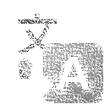


Successes of Machine Learning
Algorithmic Trading
Spam
Personalization
Malware
Loan
Underwriting
Targeting
Predicting
Churn
Identity
Theft
Portfolio
Management
Intrusion
Detection
Forecasting
Recommendations
Web Search
Finance
Marketing & E-commerce
Abuse / Security
Self-Driving Cars
Kinect
Go
Healthcare
Localization
Siri
Chess
Translation
Home
Social Networks
Perception
Control Systems
Conservation
Starcraft
Robotics
Digital Assistants
Games
Many Others

Slide 5
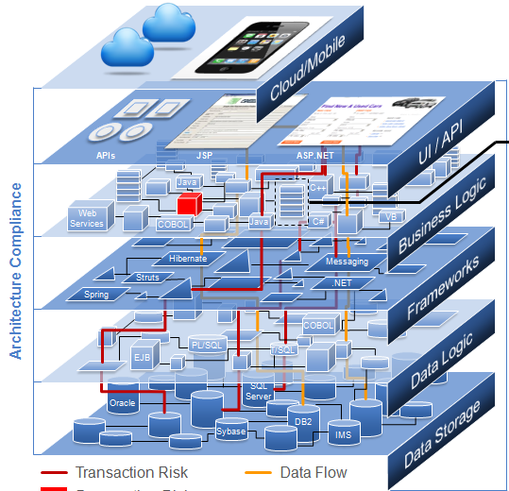
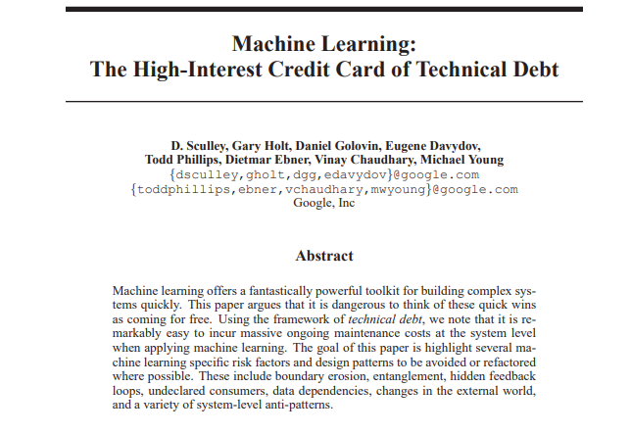
Why Not Machine Learning?
Machine
Learning
Machine Learning Not Set up for Success
Simple Problems
Deterministic Problems
Problems efficiently solved other ways
(Link to Paper)

Slide 6
Brief Review of Data
Unstructured Data
Collection of e-books
Crawl of 1,000,000 web pages
The raw contents of your hard drive
Images of every product in a product catalogue
Structured Data
Numerical
Categorical
Binary
Text
Relational
Etc…
Book Title | Number of Pages | Year Published | Genre | Best Seller | HasWord(Robot) | Author ID
Gone With The Wind | 1037 | 1936 | Historical Romance | 1 | 0 | 1001
For Whom the Bell Tolls | 480 | 1940 | War Drama | 1 | 0 | 1010
I, Robot | 253 | 1980 | Science Fiction | 1 | 1 | 1020
One Hundred Goodbyes | 100 | 2018 | Science Fiction | 0 | 0 | 1030

Slide 7
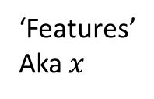
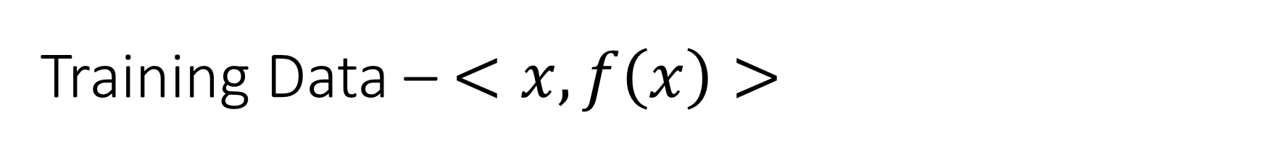
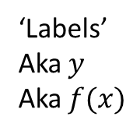
Training Data – $<x, f\left(x\right)>$
Book Title | Number of Pages | Year Published | Genre | Best Seller | HasWord(Robot) | Author ID
Gone With The Wind | 1037 | 1936 | Historical Romance | 1 | 0 | 1001
For Whom the Bell Tolls | 480 | 1940 | War Drama | 1 | 0 | 1010
I, Robot | 253 | 1980 | Science Fiction | 1 | 1 | 1020
One Hundred Goodbyes | 100 | 2018 | Science Fiction | 0 | 0 | 1030
‘Features’
Aka $x$
‘Labels’
Aka $y$
Aka $f(x)$
Book Title | Number of Pages | Year Published | Genre | HasWord(Robot) | Author ID
Gone With The Wind | 1037 | 1936 | Historical Romance | 0 | 1001
For Whom the Bell Tolls | 480 | 1940 | War Drama | 0 | 1010
I, Robot | 253 | 1980 | Science Fiction | 1 | 1020
One Hundred Goodbyes | 100 | 2018 | Science Fiction | 0 | 1030
Best Seller
1
1
1
0

Slide 8


Supervised Learning
Book Title | Number of Pages | Year Published | Genre | HasWord(Robot) | Author ID
Gone With The Wind | 1037 | 1936 | Historical Romance | 0 | 1001
For Whom the Bell Tolls | 480 | 1940 | War Drama | 0 | 1010
I, Robot | 253 | 1980 | Science Fiction | 1 | 1020
One Hundred Goodbyes | 100 | 2018 | Science Fiction | 0 | 1030
Best Seller
1
1
1
0
Features -- $x$
Labels -- $y$
ML ALGORITHM
Learned
Function
Discrete Y: Classification e.g. Genre
Continuous Y: Regression e.g. Number of Pages
Probability Estimation: e.g. P(Best Seller | X)
def F(BookTitle, NumberOfPages, YearPublished, Genre, HasWord(Robot), AuthorID):
# return 1 if the book is a best seller, and 0 if the book is not a best seller
return … # ← output of the machine learning algorithm goes here (sorta)

Slide 9
Types of Machine Learning Algorithms
Thousands of machine learning algorithms, hundreds new every year
Supervised (inductive) learning Training data includes desired outputs
Unsupervised learning Training data does not include desired outputs
Semi-supervised learning Training data includes a few desired outputs
Reinforcement learning Rewards from sequence of actions

Slide 10
Components of a Machine Learning Algorithm
Model Structure – Structure of the function the algorithm learns
Loss Function – What the learning algorithm optimizes for
Optimization – How the learning algorithm finds the best model

Slide 11
Components of an ML Algorithm Model Structure
Decision Tree
Book Title | Number of Pages | Year Published | Genre | HasWord(Robot) | Author ID
Gone With The Wind | 1037 | 1936 | Historical Romance | 0 | 1001
For Whom the Bell Tolls | 480 | 1940 | War Drama | 0 | 1010
I, Robot | 253 | 1980 | Science Fiction | 1 | 1020
One Hundred Goodbyes | 100 | 2018 | Science Fiction | 0 | 1030
Best Seller
1
1
1
0
F(X)
0
1
0
1
def F(BookTitle, NumberOfPages, YearPublished, Genre, HasWord(Robot), AuthorID):
if YearPublished > 1990:
if Genre == “Science Fiction”:
return 1
else:
return 0
elif AuthorID == 1010:
return 1
else:
return 0
Linear Models
Decision trees
Ensembles of models
Instance based methods
Neural networks
Support vector machines
Graphical models (Bayes/Markov nets)
Etc.
F(X)
1
0
0
0
Linear Model
def F(BookTitle, NumberOfPages, YearPublished, Genre, HasWord(Robot), AuthorID):
sum = 0.5 * NumberOfPages + 0.75 * YearPublished + 0.1 * AuthorID
return 1 if sum > 2000 else 0
Accurate? Generalize? We’ll get to these…

Slide 12
Components of an ML Algorithm Loss Function
Accuracy
Precision and recall
Cost / Utility
Squared error
Likelihood
Posterior probability
Margin
L1 & L2 Normalization
Entropy
K-L divergence
Etc.
Just get the right answer…
But there are many types of mistakes…
Smooth and continuous…
Some like probabilistic interpretations…
Controlling complexity is important…
Many proven/useful approaches…

Slide 13
Components of an ML Algorithm Optimization
Try N changes to the model, pick the best one, repeat
Greedy search
Gradient Descent
Linear Programming
Regularization
Many variations
Find gradient of loss WRT model parameters, take step, repeat
Set up as system of linear equations, find optimal
Tradeoff between model simplicity and loss reduction
Look ahead, momentum, stochastic methods / batching, learning rates, termination conditions, and more…

Slide 14
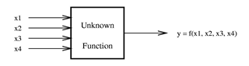


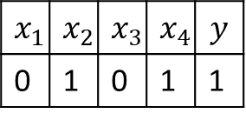


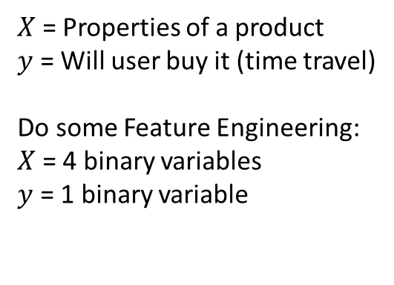

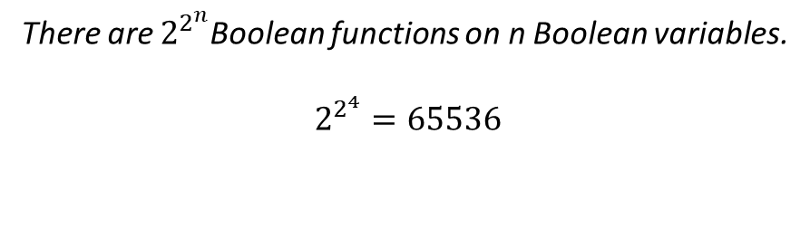

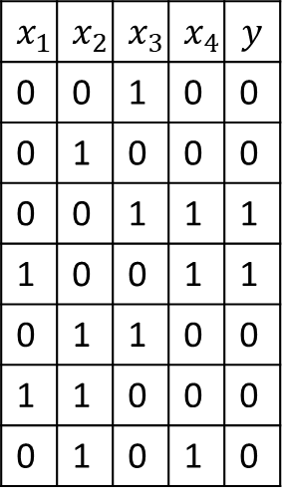

Simple Machine Learning Example
Gather a Training Set
So what is f()?
Process Generating Data
$$x_{1}$$ | $$x_{2}$$ | $$x_{3}$$ | $$x_{4}$$ | $$y$$
0 | 0 | 1 | 0 | 0
0 | 1 | 0 | 0 | 0
0 | 0 | 1 | 1 | 1
1 | 0 | 0 | 1 | 1
0 | 1 | 1 | 0 | 0
1 | 1 | 0 | 0 | 0
0 | 1 | 0 | 1 | 0
$X$ = Properties of a product
$y$ = Will user buy it (time travel)
Do some Feature Engineering:
$X$ = 4 binary variables
$y$ = 1 binary variable
$$f\left(x\right)=x_{1}$$
$$f\left(x\right)=x_{1}∧x_{2}$$
$$f\left(x\right)= ∼x_{1}$$
$$f\left(x\right)=x_{1}==x_{2}$$
$$x_{1}$$ | $$x_{2}$$ | $$x_{3}$$ | $$x_{4}$$ | $$y$$
0 | 1 | 0 | 1 | 1
$$f\left(x\right)=x_{1}∧\sim xor(x_{2},x_{3})$$
Training Example
There are $2^{2^{n}}$Boolean functions on n Boolean variables.
$$2^{2^{4}}=65536$$
$f\left(x\right)=x_{4}∧∼x_{2}$
$$f\left(x\right)={(x}_{1}∧x_{4}) ∨(x_{3}∧x_{4})$$
$$f\left(x\right)={(x}_{1}∧ ∼x_{2} ∧∼x_{3}∧x_{4}) ∨(∼x_{1}∧∼x_{2}∧x_{3}∧x_{4})$$
$$f\left(x\right)={0∗x}_{1}+ {−1∗x}_{2}+{0∗x}_{3}+{1∗x}_{4}> .5$$
And there are many other ways to represent functions…

Slide 15
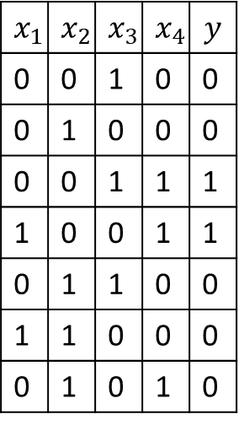
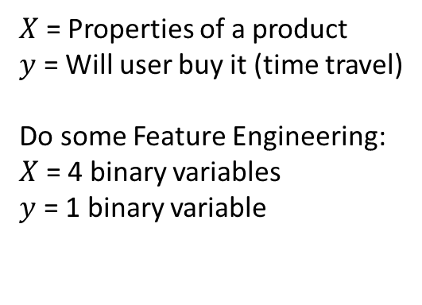
What Could Go Wrong…
Your training set is too small
Or is biased
User’s Tastes change
You don’t log the right data
Training Set
Process Generating Data
$$x_{1}$$ | $$x_{2}$$ | $$x_{3}$$ | $$x_{4}$$ | $$y$$
0 | 0 | 1 | 0 | 0
0 | 1 | 0 | 0 | 0
0 | 0 | 1 | 1 | 1
1 | 0 | 0 | 1 | 1
0 | 1 | 1 | 0 | 0
1 | 1 | 0 | 0 | 0
0 | 1 | 0 | 1 | 0
$X$ = Properties of a product
$y$ = Will user buy it (time travel)
Do some Feature Engineering:
$X$ = 4 binary variables
$y$ = 1 binary variable
You pick the wrong
Model type
Bias / Variance
Your feature engineering
loses important detail
Your Optimization takes too long
You learn something that doesn’t match the process
Generalization
And then you have to deploy it, hook it to users, and run it over time…

Slide 16
Making Working Systems
Traditional Software
AI and Machine Learning
Programming Languages
Algorithms
Data Structures
Networking
Etc.
Software Engineering
Statistics
Data Science
Machine Learning
Computer Vision
Natural Language Processing
Machine Learning Engineering
Notes:
And one more bit of context before we get into detail.
There are many skills that go into making working Intelligent Systems. As an analogy, in software you have base skills like:
Programming languages
Algorithms and data structures
Networking and other specialized skills
But then you have to take these skills and combine them to make a working system. And the ability to do this combination is a skill in its own right, sometimes called Software Engineering. To be good at software engineering you need to know about architecture, software lifecycles, management and program management -- all different ways to organize parts of the system and the people building the system to achieve success.
Software engineering skills are critical to moving beyond building small systems with a couple of people and to start have big impact.
When working with AI and machine learning you have to add a bunch of things to the base skills, including:
Statistics
Data science
Machine learning algorithms
And then maybe some specialized things like computer vision or natural language understanding
But then you also need to integrate these skills into your broader software engineering process, so that you can turn data into value at large scale.
This talk is about what you need to know to take these base data and machine learning skills and turn them into working systems. Not Software Engineering exactly, maybe call it Machine Learning engineering.

Slide 17
ML Careers | Core Activity | Core Skills
Researcher
Advance Human Knowledge
Scientific Method, Math, Basic Software Engineering
Early Days
Data Scientist
Stories from Data
Statistics, Data Manipulation, Some Modeling, Communication
Specialization
Machine learning algorithms, Domain specific feature engineering, Modeling, basic programming
Applied (ML) Scientist (Modeler)
Build Predictive Models
ML Engineer
Integrate Machine Learning into Systems
Software Engineering, ML Concepts, ML Design Patterns
ML Program Manager
Design solutions that leverage machine learning
Technical Program Management, ML Design Patterns

Slide 18
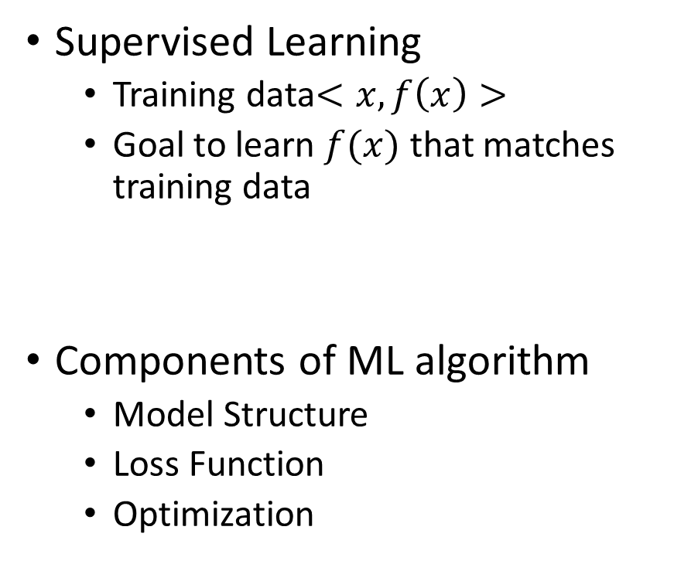
Summary
Reasons for ML
Big problems
Open-ended problems
Time-changing problems
Hard problems
Types of Learning
Supervised, unsupervised, semi-supervised, reinforcement learning
Supervised Learning
Training data$<x, f\left(x\right)>$
Goal to learn $f(x)$ that matches training data
Components of ML algorithm
Model Structure
Loss Function
Optimization
Exciting time for ML – many challenges & many ways to get involved

