Slide 1
Appliances Energy Prediction
Machine Learning Student: Murad Zhumabekov 537909

Slide 2
Problem & Dataset
• Goal: predict the energy used by appliances (Appliances, in Wh every 10 min) in a low-energy house.
• Data: 19,735 rows, 29 features, ~4.5 months in Belgium (UCI Repository).
• Features: room temperature & humidity, outdoor weather, and time features from the date.
• Target is strongly right-skewed: median 60 Wh, but peaks up to 1080 Wh.
• Energy use depends on occupancy and time of day → nonlinear, threshold effects.
• Plan: compare a linear baseline with nonlinear and ensemble models.

Slide 3
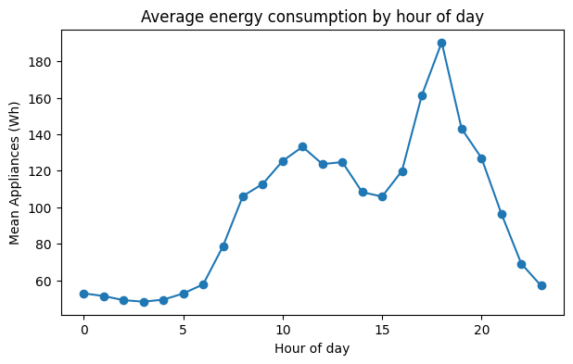
Exploratory Data Analysis
• No missing values in the dataset.
• All features have a weak linear correlation with the target (|r| < 0.2; strongest: lights ≈ 0.2).
– → no strong straight-line relationship with any feature.
• Clear daily pattern: low at night, large peak in the evening (people at home).
• This nonlinear time pattern is what trees can capture but a line cannot.

Slide 4
Preprocessing
• Missing values: none → no imputation needed.
• Removed rv1 and rv2: random columns, no physical meaning, correlation ≈ 0.
• Outliers (~11% high values): kept them.
– They are real high-consumption events, not errors; tree models are robust to them.
• Feature engineering: hour, day of week, weekend flag, month (from the date).
• Scaling: StandardScaler only for Linear & Polynomial (inside a Pipeline → no leakage).
– Trees and Random Forest split on thresholds → scaling not needed.

Slide 5
Models & Hyperparameter Tuning
• Baseline: Linear Regression (lower bound).
• Nonlinear: Polynomial Regression (degree 2) + Ridge, and Decision Tree.
• Ensemble: Random Forest (averages many trees → reduces variance).
• Tuning: GridSearchCV with 5-fold cross-validation
• Split: 80% train / 20% test, fixed random seed for reproducibility.

Slide 6
Results
Model | MAE | RMSE | R² test | R² train
Random Forest | 31.9 | 67.3 | 0.55 | 0.87
Decision Tree | 38.8 | 81.4 | 0.34 | 0.63
Polynomial (deg 2) | 48.6 | 82.7 | 0.32 | 0.37
Linear Regression | 52.6 | 91.1 | 0.17 | 0.17
• Random Forest is the best model: highest R² (0.55) and lowest errors.
• Linear Regression underfits: R² only 0.17 on both train and test.
• Random Forest: train 0.87 vs test 0.55 → some overfitting, but still the best test result.
• Residuals: the model under-predicts the rare high peaks (skewed target).

Slide 7
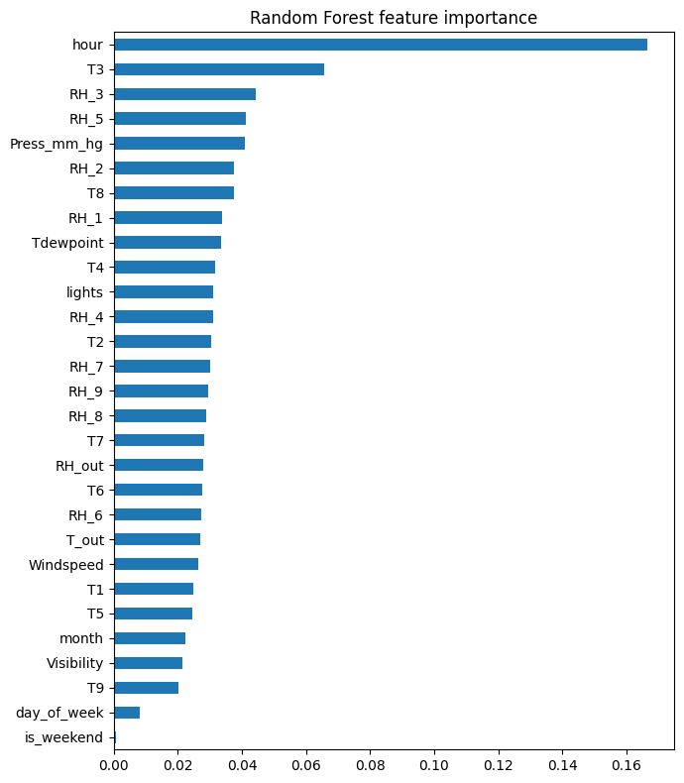
Why Nonlinear Beats Linear
• Random Forest almost tripled the linear R² (0.55 vs 0.17).
• No single feature is linearly strong → the signal is in interactions and thresholds.
– e.g. energy is high only when it is evening AND the house is occupied.
• A straight-line model cannot represent this; trees and the ensemble can.
• Most important by far: hour; then indoor temperature & humidity sensors → matches domain.

Slide 8
Conclusions & Limitations
• Best model: Random Forest — nonlinearity clearly matters for this problem.
• Trade-off: accuracy (Random Forest) vs interpretability (Linear Regression).

