Slide 1



AZ-900 Study Planner
Know what to study, and when you're ready.
Unofficial study tool
Vibe Coding Hackathon: AZ-900 Exam Prep Edition
01

Slide 2

The Problem
We kept mixing up Azure service names.
We never knew if we were really ready.
Learners know their exam date, but not how to plan the time before it.
02

Slide 3

Our Solution
Enter your exam date, daily study hours and how confident you feel in each exam area
Get a day-by-day plan: weaker areas first, revision days at the end
Tick off tasks and watch your progress and on-track status
Tap "Explain this simply" for a short explanation with an everyday African example, in English or Kiswahili
03

Slide 4

Product
Plan built from your exam date and confidence
Tick tasks and track progress by exam area
"Explain this simply" with African examples
English or Kiswahili
1 Setup
Exam date, hours and confidence
2 Your plan
Daily tasks and progress
04

Slide 5



Target Users
1
Students and graduates
Preparing for their first cloud certification
2
Career switchers
Moving into cloud with limited time to study
3
Self-taught developers
Learning Azure on their own, between work and life
05

Slide 6
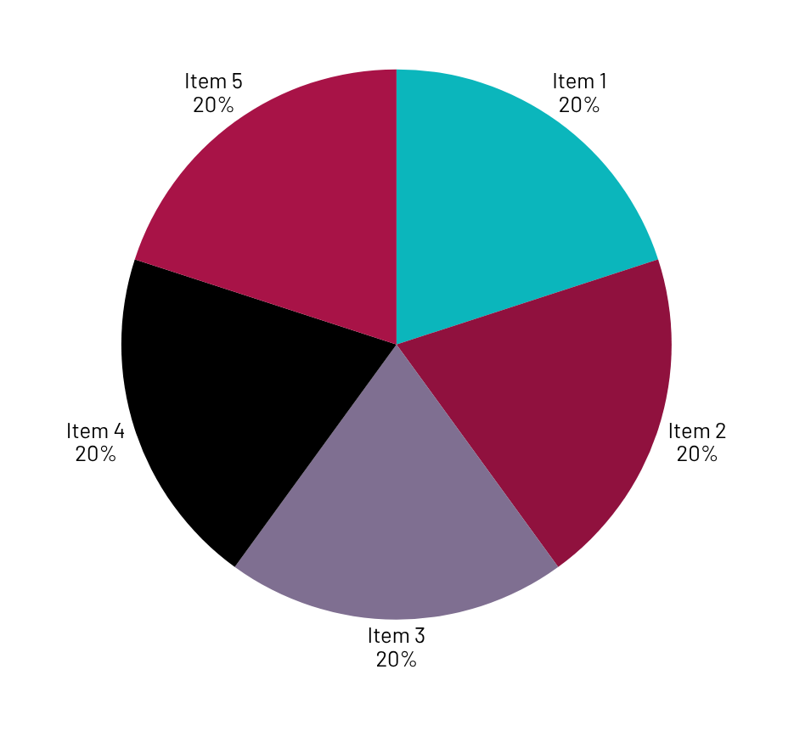
Market Size
AZ-900
Azure Fundamentals
AZ-900 is an entry-level Azure certification.
Our starting audience: learners in the 1 Million Devs community across Africa.
Next step: size the audience with real enrolment and exam data.

Slide 7
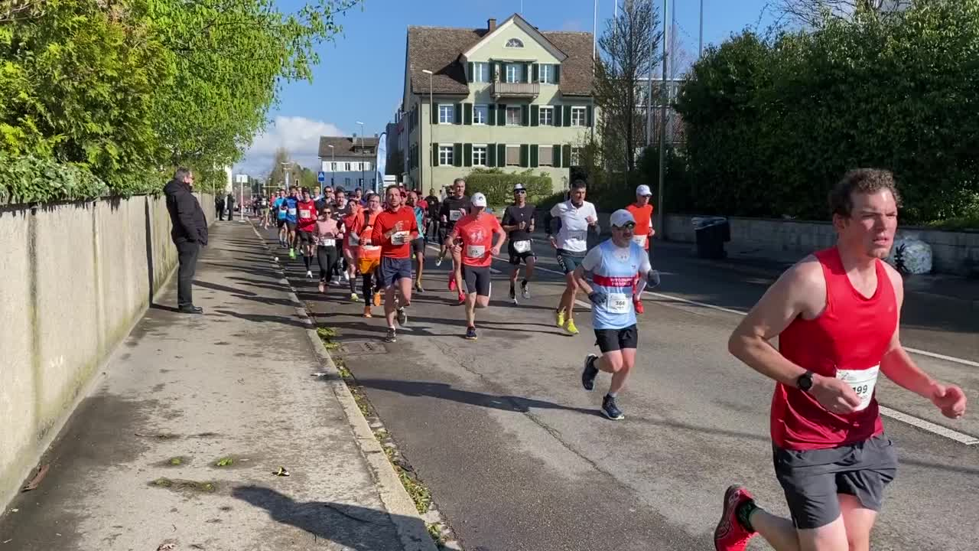
Competitors
How we are different: a plan built from your exam date and confidence, with African-life explanations.
Generic study planners: not built around AZ-900
Practice tests: strong on questions, light on plans
Video courses: strong on teaching, not on scheduling
Microsoft Learn: official content. We link to it
07

Slide 8

Competitive Advantage
Rule-based planner: dates are always right. AI never builds the schedule.
AI that explains simply: everyday African examples, in English or Kiswahili.
Offline fallback: pre-written explanations if the AI is unavailable.
Built to grow: topics are data, so new exams can follow.

Slide 9
Build Timeline
Tasks
Day 1
Day 2
Day 3
Day 4
Next
Agree plan and data contract
Database and plan logic
Screens and interface
Topics and explanations
AI explanations and fallback
Connect, test and fix
README, deck and demo video
Submit, then grow
09

Slide 10

Business Model
Free for learners today.
Ideas for later (not built yet): partnerships with training providers, sponsored study cohorts, and extra practice content.
10

Slide 11
Go To Market
Share the live link in the 1 Million Devs community
WhatsApp and Telegram study groups for AZ-900 learners
Campus tech clubs and community meetups
Learners invite their study partners to use it too

Slide 12
Social Impact
SDG 4, Quality Education: free, structured exam preparation.
SDG 8, Decent Work and Economic Growth: a step toward a recognised cloud credential.
SDG 10, Reduced Inequalities: mobile-first, lightweight, with a Kiswahili option.

Slide 13
Our Ask
Feedback from judges and AZ-900 learners
Mentorship to add more certifications and languages
Early testers from the community

Slide 14




Team Members
The people behind the planner
V
N
M
G
VICTOR
NATHALIE
MARK
GEORGE
Frontend and integration
Planner, database, pitch and docs
AI and prompt engineering
Content and AZ-900 topics

Slide 15



Thank you!
AZ-900 Study Planner
Live prototype and GitHub links are in our submission and README.
Unofficial study tool. Not affiliated with or endorsed by Microsoft.
15

