Slide 1



FINAL ML PROJECT
PREDICTIVE
MAINTENANCE
0.898
83.9%
PR-AUC
Recall
Machine Learning Methods and Models for Predicting
the Technical Condition of Industrial Equipment
47 / 56
14
Can sensor data identify operating conditions linked to machine failure?
Failures found
False alarms
Results shown in this deck: bundled offline AI4I-style replica • fixed seed 42
1

Slide 2

PROBLEM & SUCCESS CRITERIA
02
Predictive maintenance should detect the rare cases that matter — not just maximise accuracy.
01
REACTIVE
02
PREVENTIVE
03
PREDICTIVE
Repair after failure
Downtime has already happened
Service on a schedule
Can maintain healthy equipment
Use current condition
Prioritise equipment for inspection
SUCCESS CRITERIA
Detect a high share of real failures → Recall / F2
Evaluate rare positives correctly → PR-AUC
Keep alerts useful → Precision
Beat a simple baseline on a locked test set
Core question: which operating states can be detected reliably from the available sensor features?
2

Slide 3
CONTEXT: PREDICTIVE MAINTENANCE IN KAZAKHSTAN
03
The research direction already exists; this project focuses on a rigorous, reproducible baseline.
2024
2026
2026
Oil-well failure prediction
Operating-profile clustering
Bearing condition & RUL
~4,000 wells; LR / Random Forest / Naive Bayes
K-means to group oil-well operating behaviour
RF / XGBoost / LSTM + SHAP
SOCAR Proceedings
SOCAR Proceedings
EKTU JICS
OUR CONTRIBUTION leakage-safe pipeline • imbalance-aware evaluation • feature ablation • error analysis • SHAP • working API
Sources: Aktaukenov et al. (2024, 2026); Zharlykassova et al. (2026).
3

Slide 4
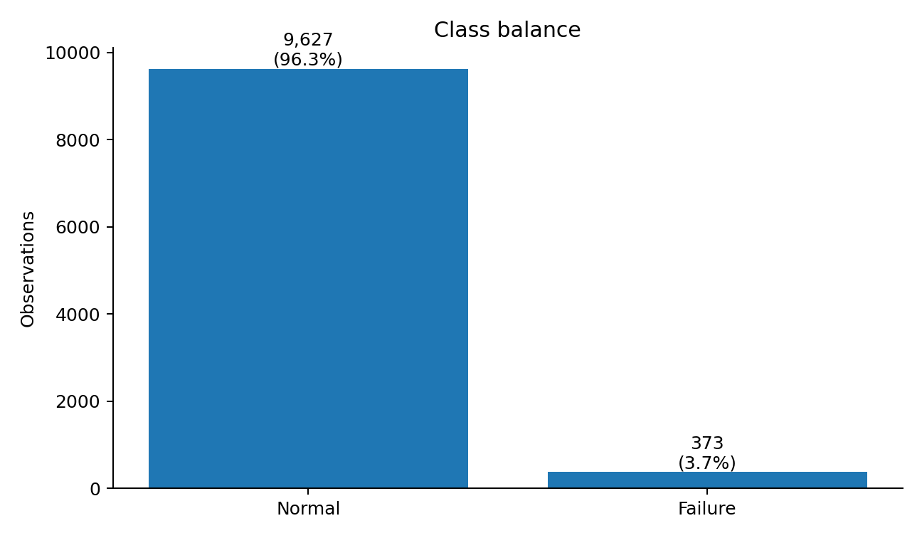
DATA: AI4I-STYLE PREDICTIVE MAINTENANCE
04
10,000 observations, six predictive inputs, rare failure class.
10,000
6
0
3.73%
Rows
Input features
Missing
Failure rate
INPUTS
Type (L/M/H)
Air temperature
Process temperature
Rotational speed
Torque
Tool wear
DATA NOTE This run uses a bundled offline replica built from the public UCI AI4I specification. It is not the byte-identical official UCI CSV; all reported metrics in this deck refer to this replica.
Official benchmark: UCI AI4I 2020 • 10,000 instances • 6 features • DOI: 10.24432/C5HS5C
4

Slide 5
DATA PREPARATION & LEAKAGE CONTROL
05
Only information available at inference time is allowed into the model.
STRATIFIED SPLIT
REMOVED FROM PREDICTIVE INPUTS
70%
15%
15%
UDI + Product ID → identifiers
TRAIN
VALIDATION
LOCKED TEST
TWF / HDF / PWF / OSF / RNF → target leakage
7,000
1,500
1,500
Failure-mode labels are used only after prediction for error analysis.
3 ENGINEERED FEATURES
Temperature gap
Mechanical power
Wear × torque
process temp − air temp
torque × RPM × 2π/60
tool wear × torque
No target information is used to construct the engineered features.
5

Slide 6
EXPERIMENT DESIGN
06
One pipeline, fair model comparison, validation-only threshold selection.
1
PREPROCESS
2
BASELINE
3
TREE MODELS
impute • scale • one-hot
Dummy + Logistic Regression
Random Forest + XGBoost
4
VALIDATE
5
TEST
6
EXPLAIN
choose threshold by F2
locked test metrics
SHAP + error analysis
WHY F2? A false negative means a real failure was missed. F2 weights recall more than precision, so the validation threshold is chosen to reduce missed failures.
Test set is not used for threshold selection.
6

Slide 7
EXPERIMENT: FEATURE ENGINEERING & THRESHOLD
07
We tested not only algorithms, but also whether the representation and decision rule improve the result.
FEATURE ABLATION — XGBoost
DECISION THRESHOLD
Input set
PR-AUC
Recall
F1
0.375
selected on validation by F2
Raw 6 features
0.798
0.804
0.714
Default 0.50
Recall 82.1% • F2 0.816
+ 3 engineered
0.895
0.821
0.829
Selected 0.375
Recall 83.9% • F2 0.825
PR-AUC +0.097
Engineered interactions make the failure rules easier for tree models to learn.
The threshold changes the operating point; it does not retrain the model.
Ablation uses the same split and evaluation protocol.
7

Slide 8
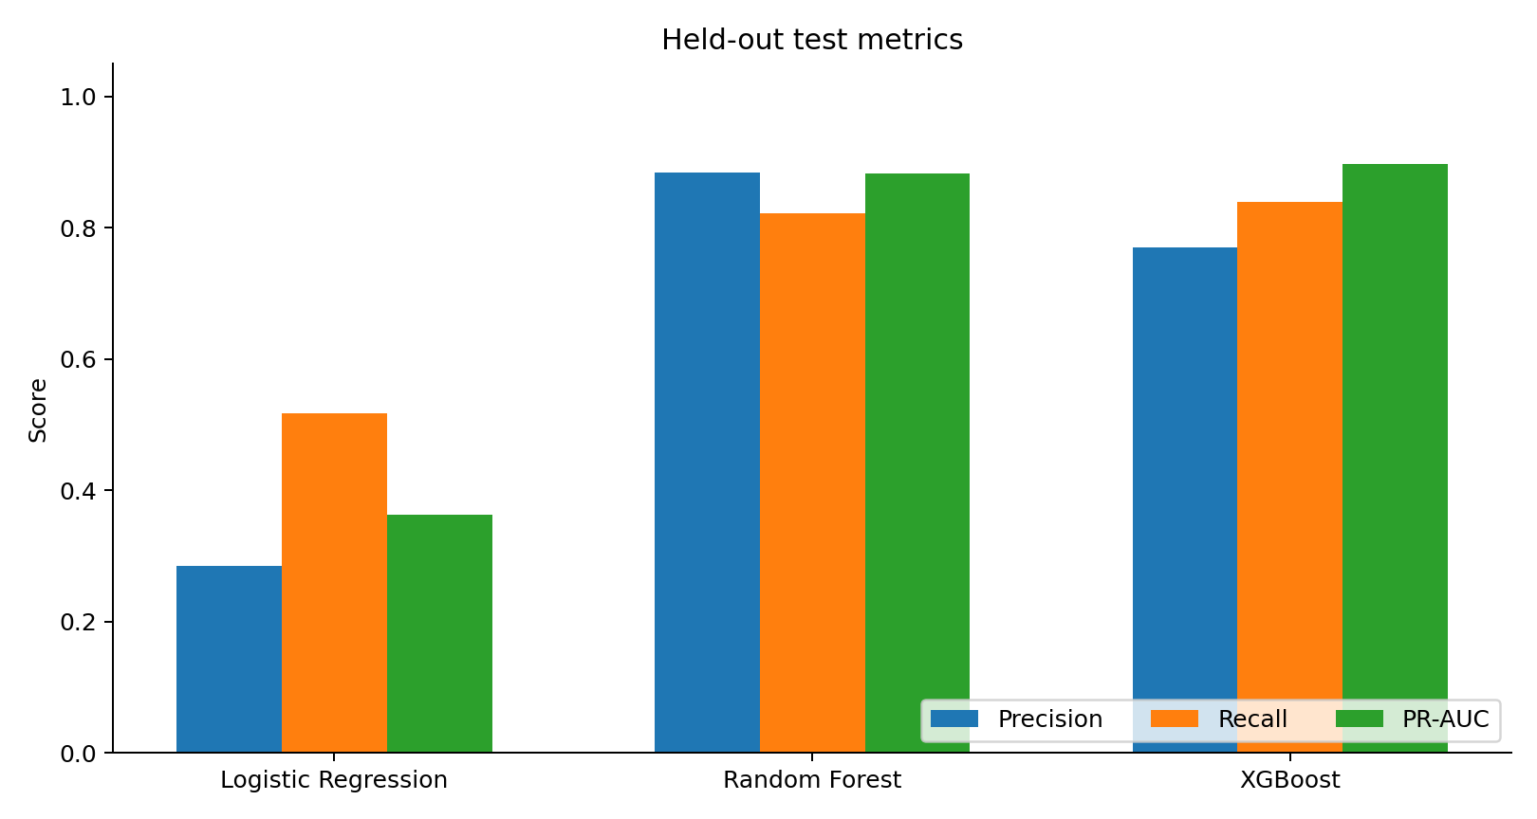
HELD-OUT TEST RESULTS
08
Tree ensembles strongly outperform the linear baseline on the rare failure class.
MODEL COMPARISON
Model
Prec.
Recall
F1
F2
PR-AUC
Dummy
0.000
0.000
0.000
0.000
0.037
Logistic Regression
0.284
0.518
0.367
0.445
0.362
Random Forest
0.885
0.821
0.852
0.833
0.883
XGBoost
0.770
0.839
0.803
0.825
0.898
Best PR-AUC
XGBoost 0.898
Dummy accuracy = 96.3% — but it detects 0 failures.
Locked test set: n=1,500 • failures=56 • metrics computed once after validation decisions were fixed.
8

Slide 9
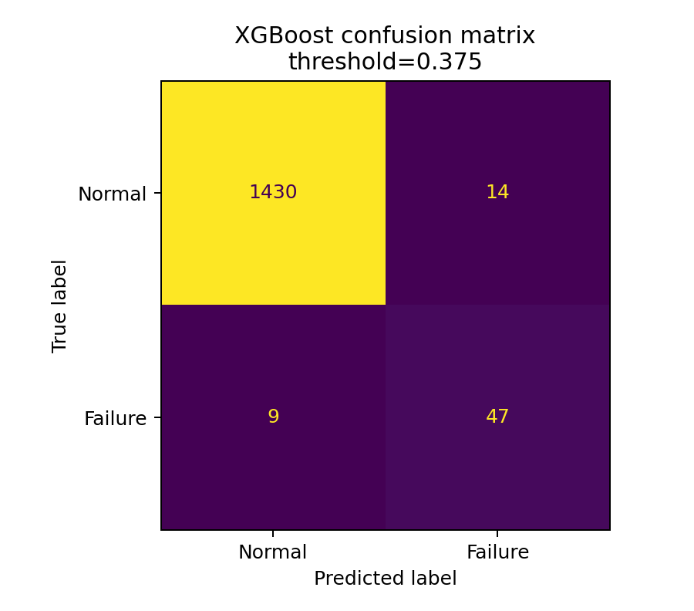
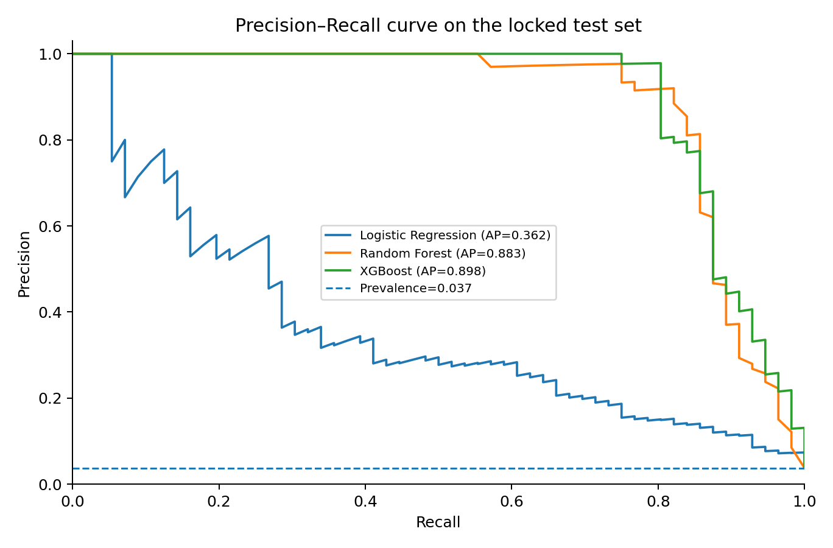
FINAL XGBOOST ON THE LOCKED TEST SET
09
The model finds 47 of 56 failures while producing 14 false alarms.
47 TP
9 FN
14 FP
XGBoost: precision 0.770 • recall 0.839 • F1 0.803 • F2 0.825 • ROC-AUC 0.987 • PR-AUC 0.898
9

Slide 10
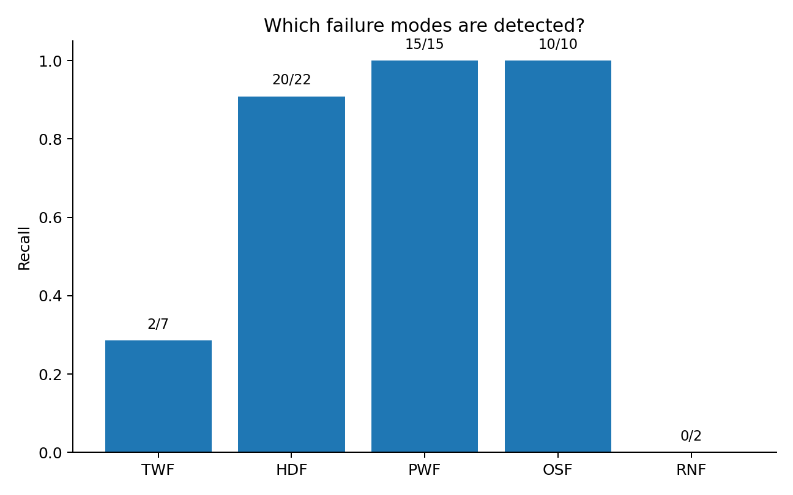
ERROR ANALYSIS: NOT EVERY FAILURE IS PREDICTABLE
10
Hidden failure-mode labels were inspected only after prediction to understand the nine false negatives.
WHAT THE ERRORS TELL US
PWF: 15 / 15 detected
OSF: 10 / 10 detected
HDF: 20 / 22 detected
TWF: only 2 / 7 detected
RNF: 0 / 2 detected
Some TWF/RNF events are random by construction. Missing information cannot be recovered by a stronger model.
This is a limitation of the observable feature set, not just a model-selection issue.
10

Slide 11
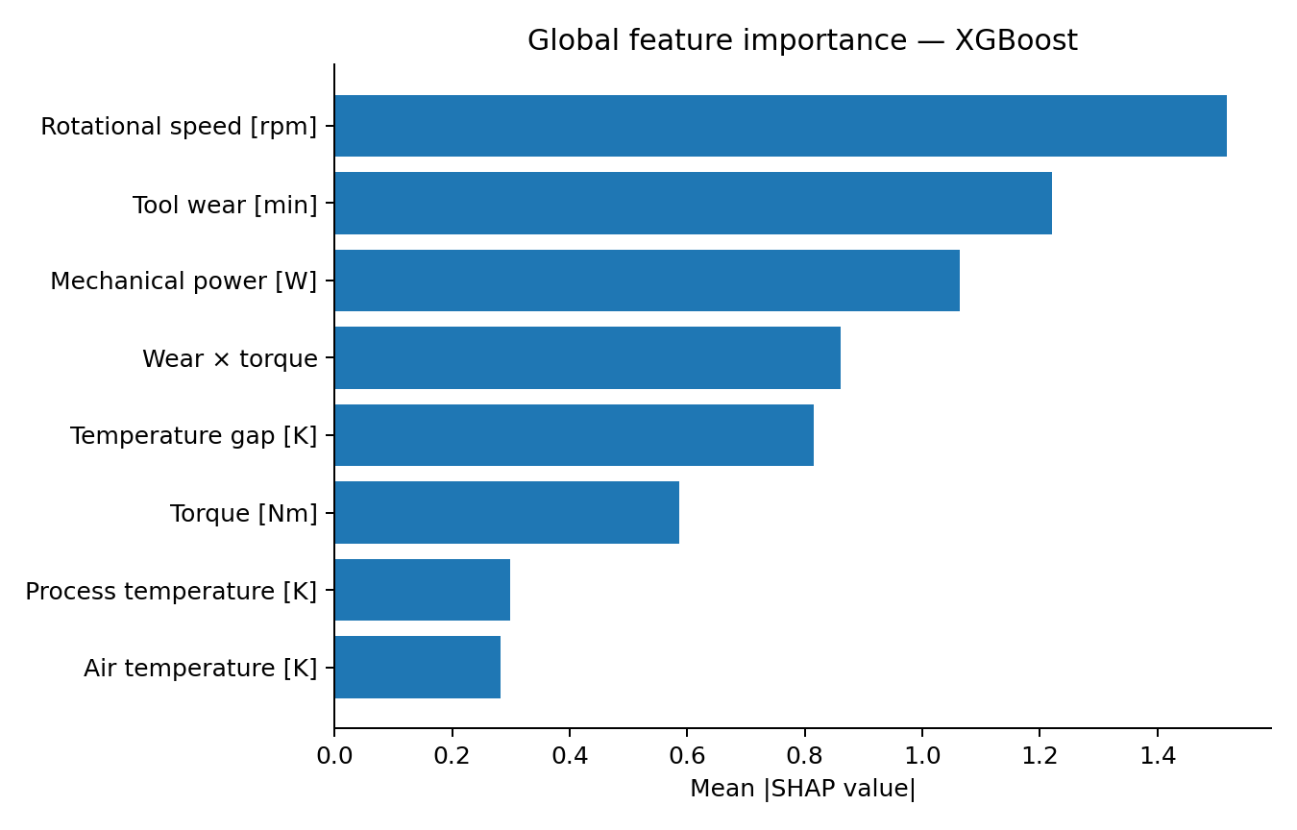
EXPLAINABILITY WITH SHAP
11
SHAP explains model behaviour; it does not prove physical causality.
TOP DRIVERS
1 Rotational speed
2 Tool wear
3 Mechanical power
4 Wear × torque
5 Temperature gap
Use case
Explain why a reading received a high model score and support an engineer’s review.
Interpretation: mean |SHAP| on the locked test set.
11

Slide 12
WORKING PROTOTYPE & ENGINEERING QUALITY
12
The same preprocessing and model artifact are used in training and inference.
DEMO FLOW
6 inputs
FastAPI
Pipeline
Output
→
→
→
sensor reading
/predict
preprocess + XGB
status + risk score
REPRODUCIBILITY
RESPONSIBLE AI
Fixed random seed
risk score ≠ calibrated probability
sklearn Pipeline
human-in-the-loop
requirements.txt
no automatic machine shutdown
Dockerfile + smoke test
real telemetry + drift monitoring required
Demo: uvicorn app:app --reload → Swagger /docs → POST /predict
12

Slide 13
CONCLUSION
WHAT WE ACHIEVED
NEXT STAGE
Leakage-safe, reproducible ML pipeline
Official / real industrial data
Random Forest / XGBoost strongly beat the linear baseline
Time-series telemetry
XGBoost: PR-AUC 0.898, recall 83.9% on locked test
Remaining Useful Life
Feature engineering produced a measurable gain
Cost-sensitive decisions
Error analysis exposed predictable and unpredictable failure modes
Working FastAPI prototype + SHAP explanations
MLOps + drift monitoring
KEY REFERENCES
UCI AI4I 2020 Predictive Maintenance Dataset, DOI 10.24432/C5HS5C • Matzka (2020), AI4I • Aktaukenov et al. (2024, 2026), SOCAR Proceedings • Zharlykassova et al. (2026), EKTU JICS
THANK YOU • QUESTIONS?
13

