Slide 1
Node-red lab-II

Slide 2
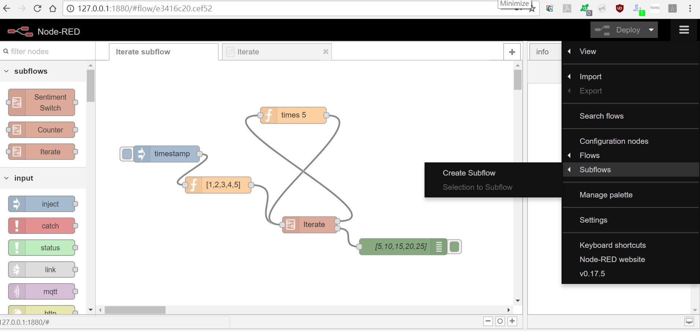

Slide 3
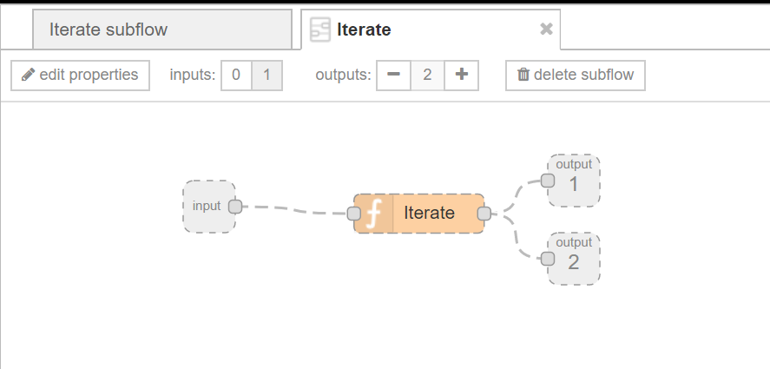

Slide 4
var currentMsg = null, outMessage = null;
var iState = msg.iState;
if (!iState) { // we received an initial message // if the message is not an array, make it one
if( Object.prototype.toString.call(msg.payload) !== '[object Array]' ) {
msg.payload = [msg.payload]; }
iState = {}; iState.index = 0; iState.inArray = msg.payload; iState.outArray = [];
msg.iState = iState }
else { // save results from the last iteration
iState.outArray.push(msg.payload) }
//If there are still objects left to iterate goto the next one in the original array
if (iState.index < iState.inArray.length) {
currentMsg = msg; msg.payload = iState.inArray[iState.index]; }
else { currentMsg = null; outMessage = msg; msg.payload = iState.outArray;
delete msg.iState;}
iState.index ++;
return [currentMsg, outMessage];

Slide 5
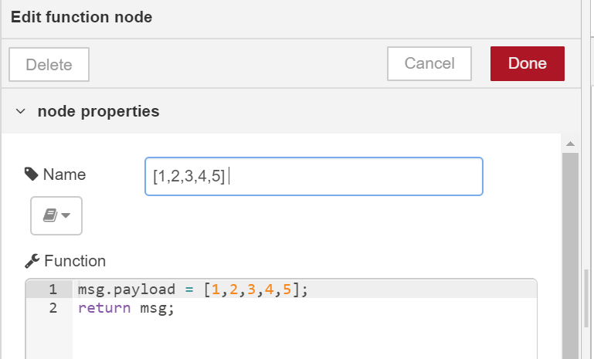
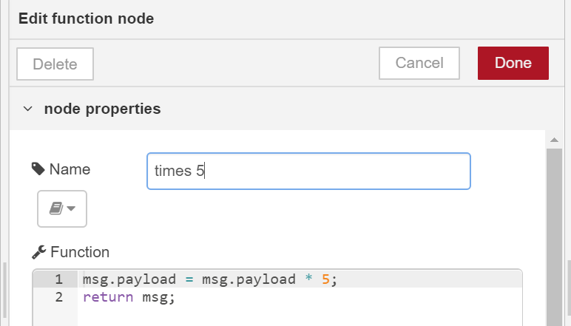

Slide 6
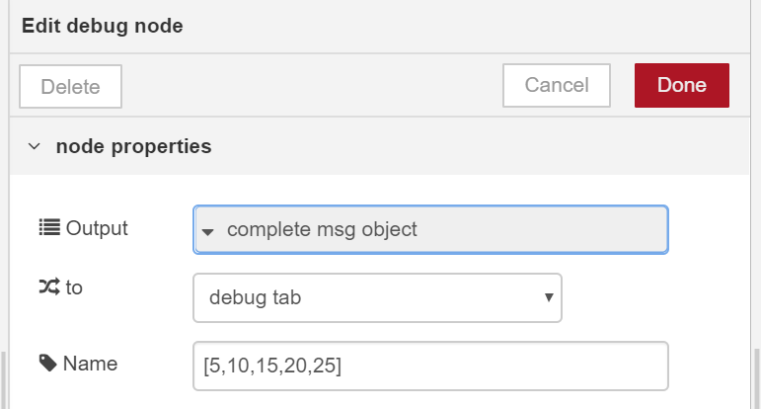
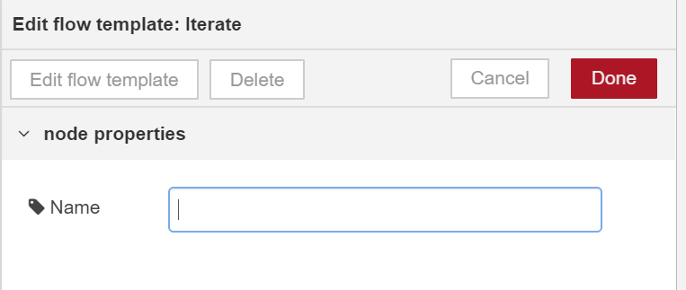

Slide 7
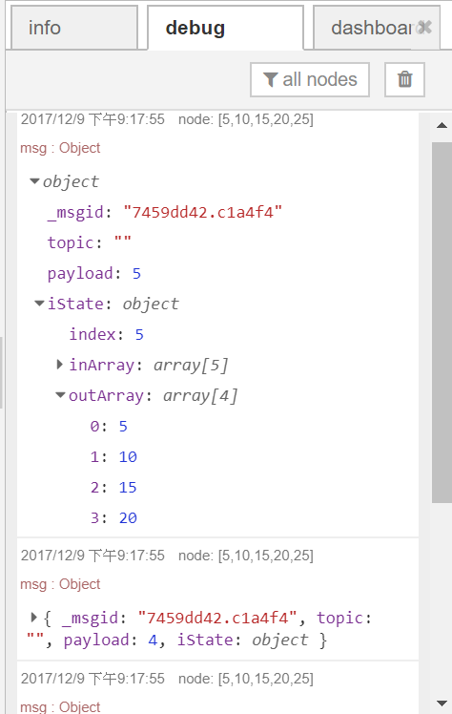

Slide 8
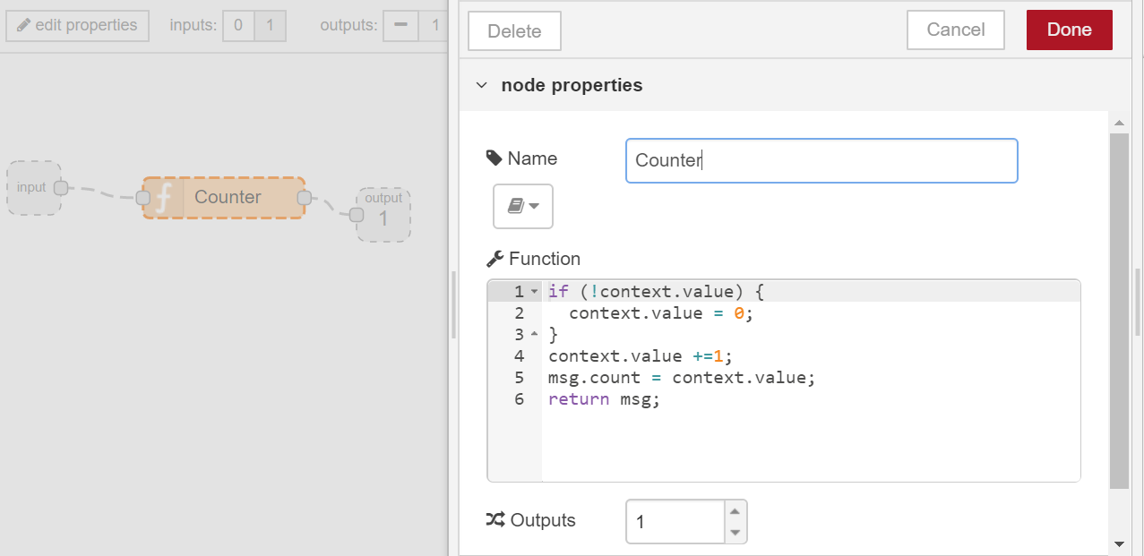
Sub flow: counter

Slide 9
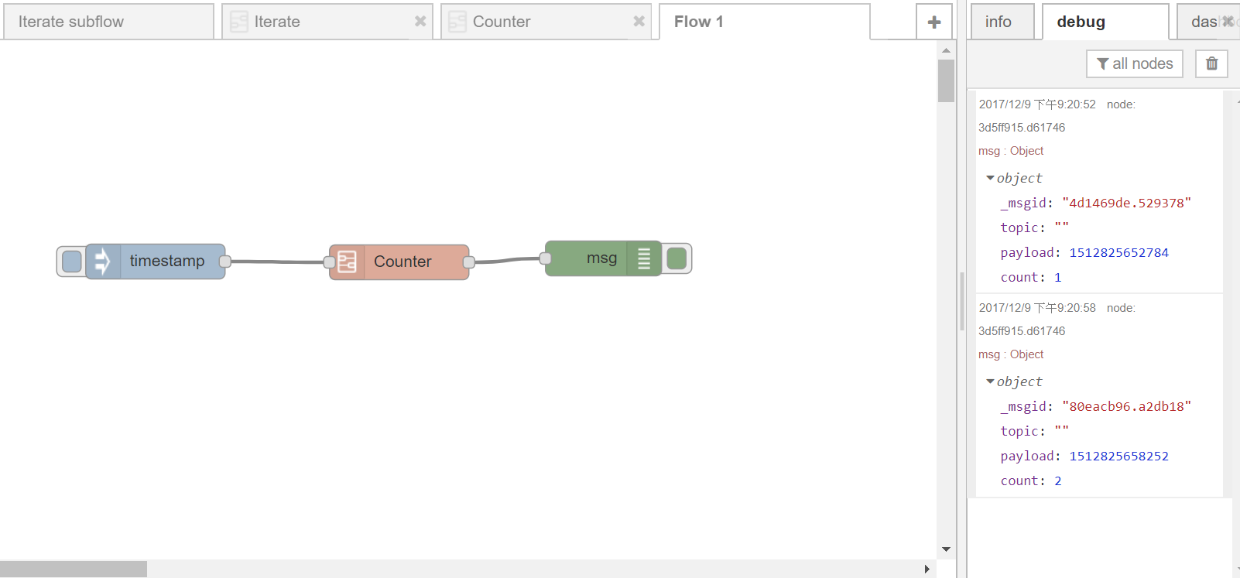

Slide 10
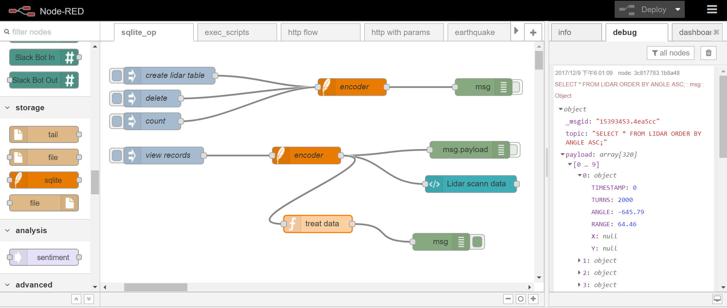
Node-red sqlite

Slide 11
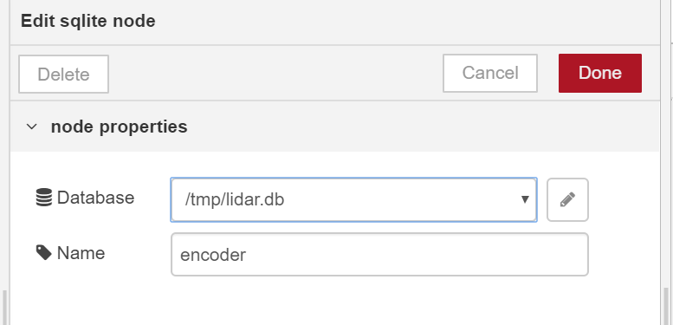

Sqlite database

Slide 12
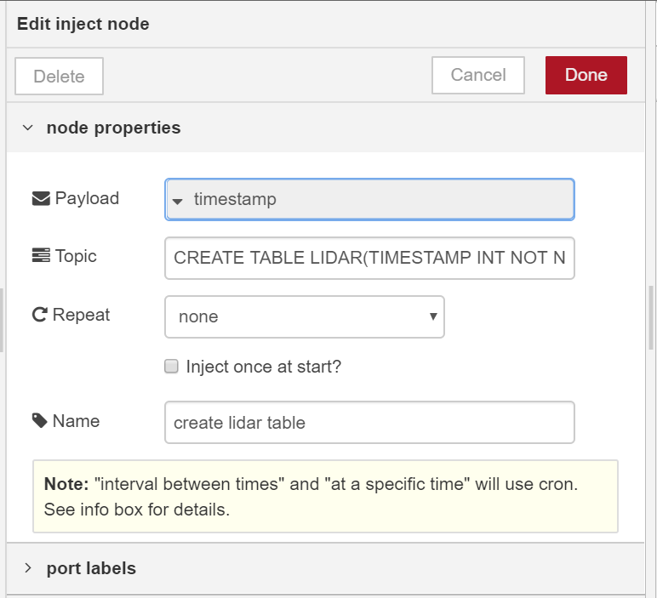
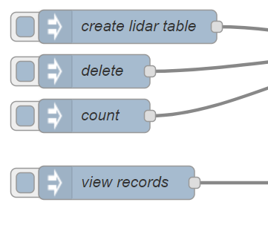
Create table
CREATE TABLE LIDAR(TIMESTAMP INT NOT NULL,
TURNS INT NOT NULL,
ANGLE INT NOT NULL,
RANGE INT NOT NULL);

Slide 13
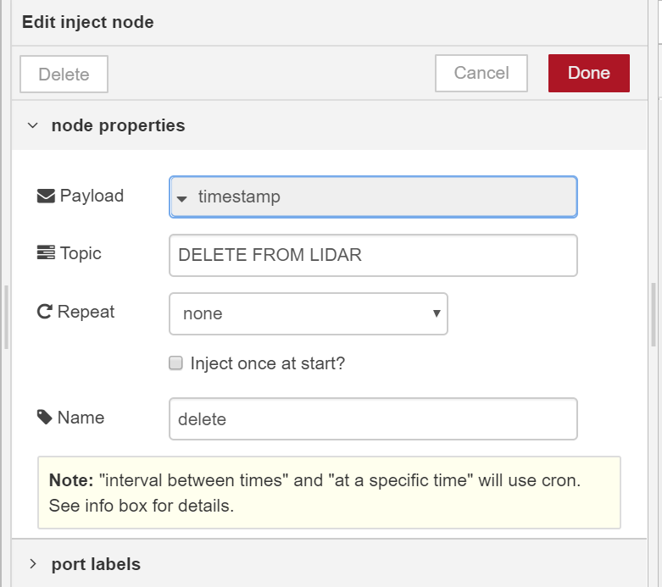
Delete data
DELETE FROM LIDAR

Slide 14
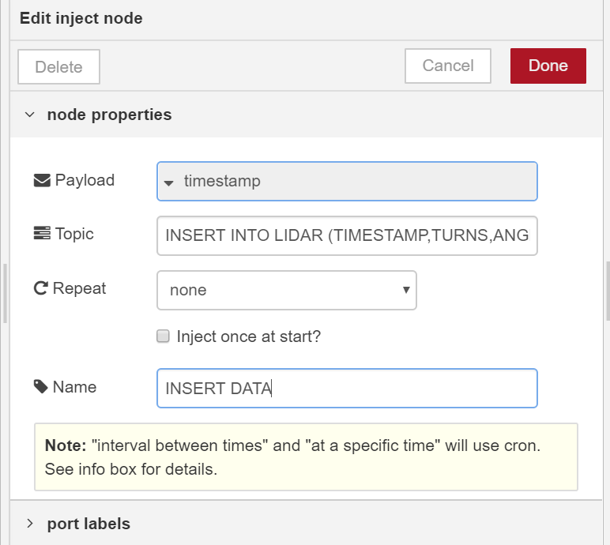
INSERT INTO LIDAR (TIMESTAMP, TURNS,ANGLE,RANGE)
VALUES (1,2100,110,400);

Slide 15
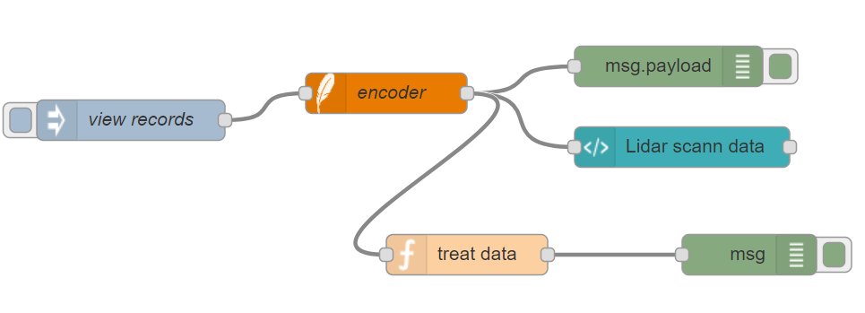
QUERY DATA

Slide 16
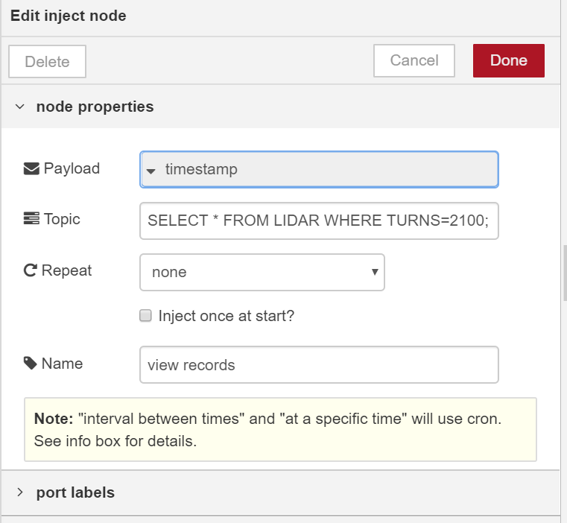

VIEW DATA
SELECT * FROM LIDAR WHERE TURNS=2100;

Slide 17
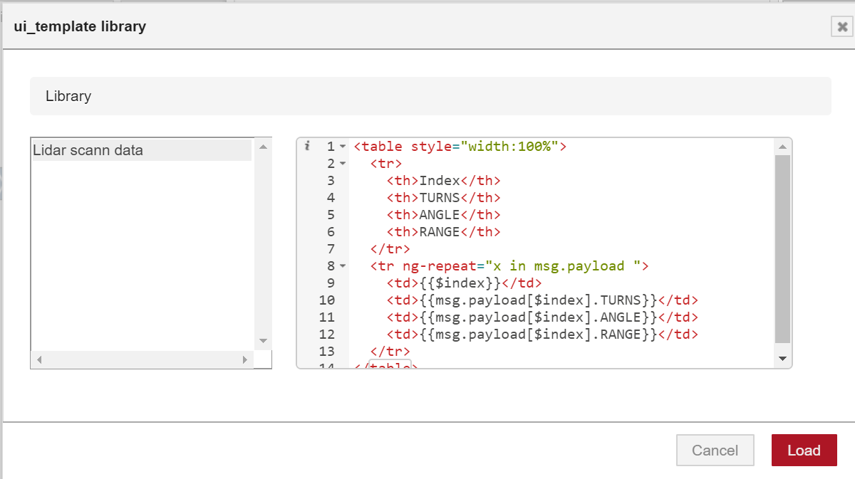
UI TEMPLATE

Slide 18
<table style="width:100%">
<tr>
<th>Index</th>
<th>TURNS</th>
<th>ANGLE</th>
<th>RANGE</th>
</tr>
<tr ng-repeat="x in msg.payload ">
<td>{{$index}}</td>
<td>{{msg.payload[$index].TURNS}}</td>
<td>{{msg.payload[$index].ANGLE}}</td>
<td>{{msg.payload[$index].RANGE}}</td>
</tr>
</table>

Slide 19
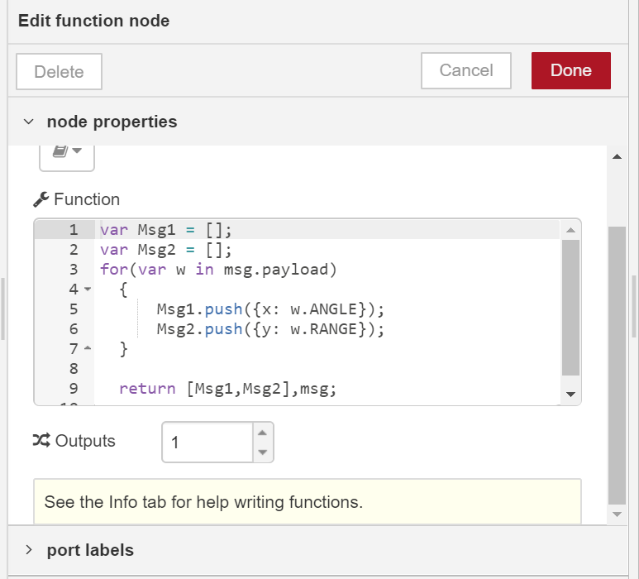
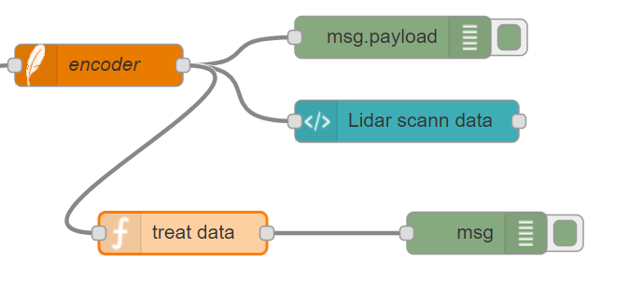
FUNCTION NODE
var Msg1 = [];
var Msg2 = [];
for(var w in msg.payload) {
Msg1.push({x: w.ANGLE});
Msg2.push({y: w.RANGE});
}
return [Msg1,Msg2],msg;

Slide 20
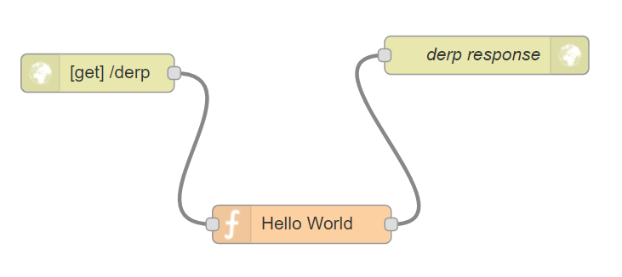
HTTP FLOW

Slide 21
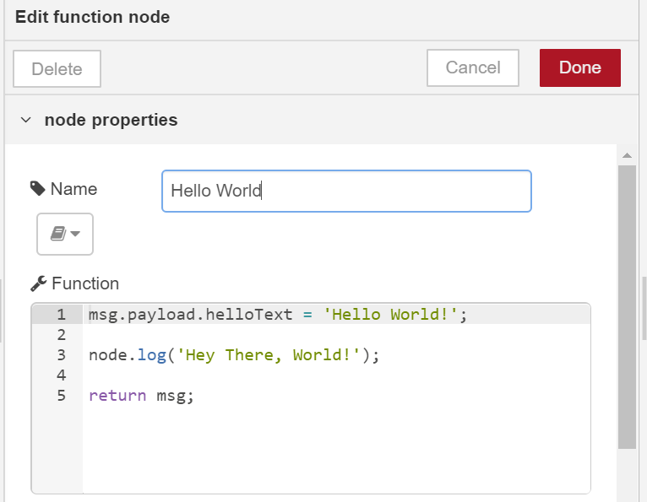
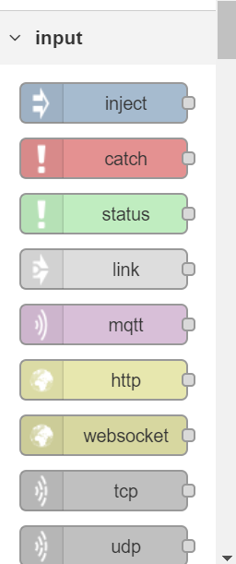
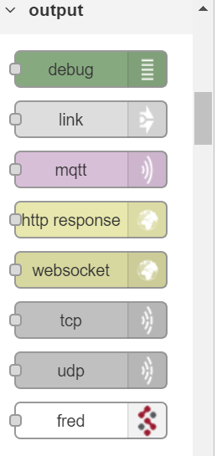
msg.payload.helloText = 'Hello World!’;
node.log('Hey There, World!’);
return msg;

Slide 22
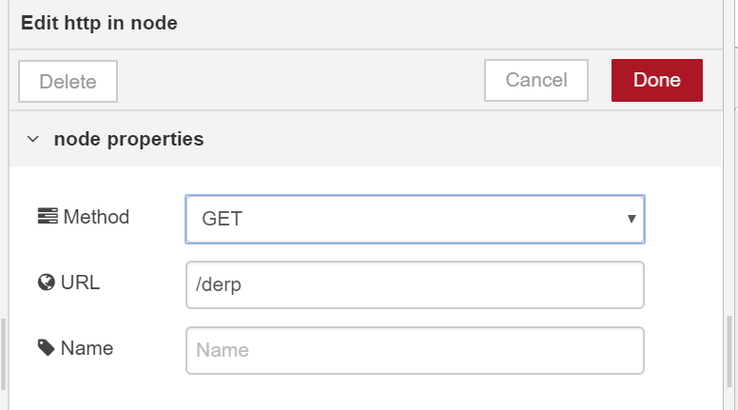
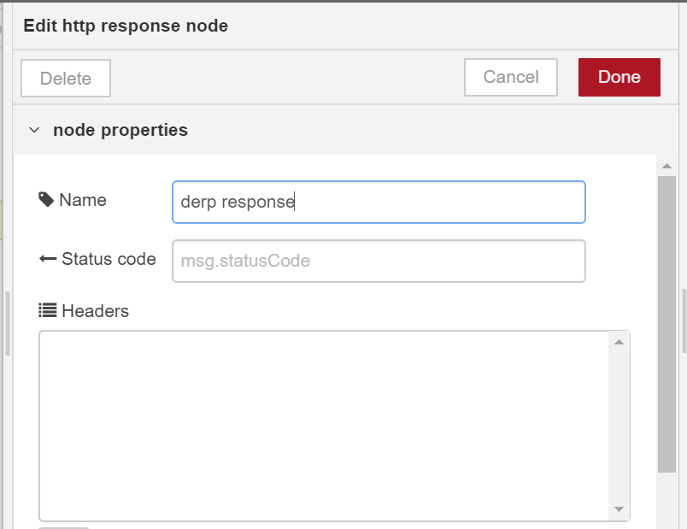

Slide 23
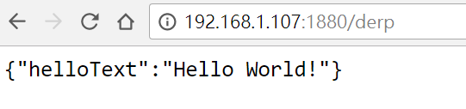

Slide 24
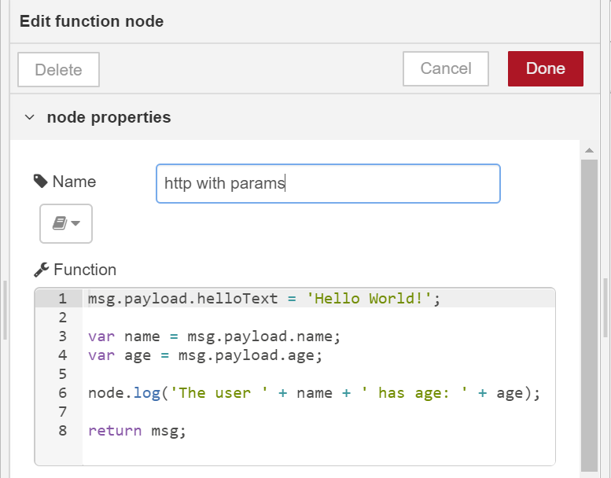
msg.payload.helloText = 'Hello World!’;
var name = msg.payload.name;
var age = msg.payload.age;
node.log('The user ' + name + ' has age: ' + age);
return msg;

Slide 25
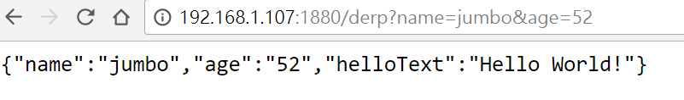

Slide 26
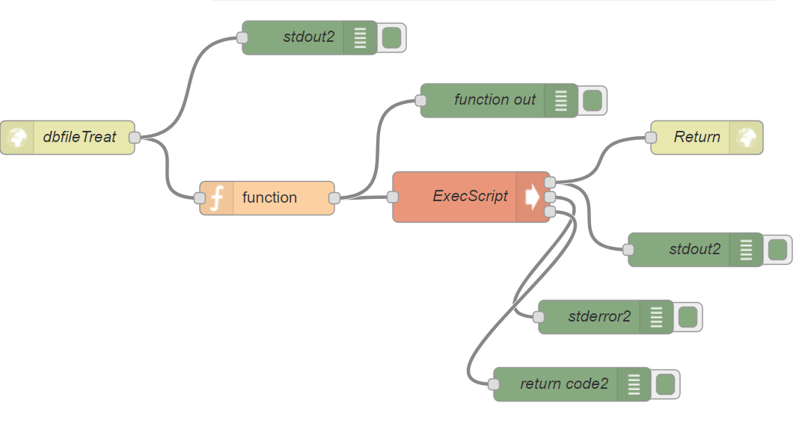
Exec script in node-red

Slide 27
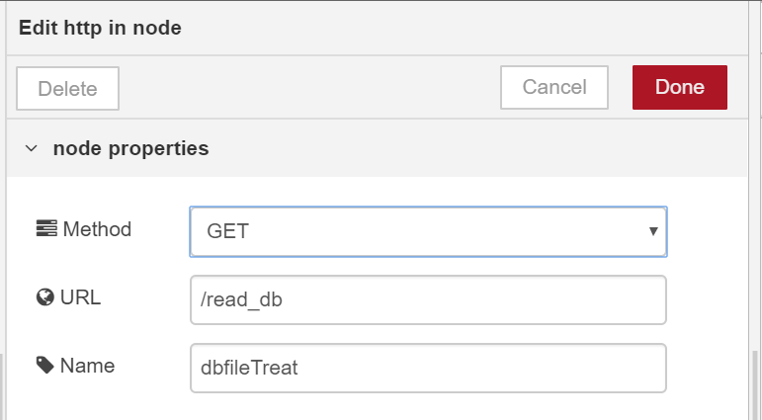
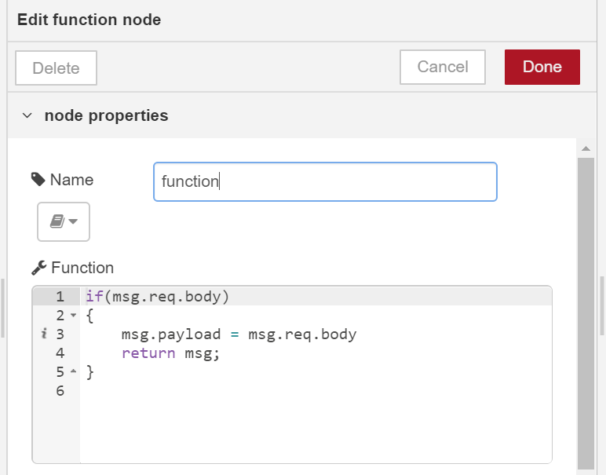
if(msg.req.body){
msg.payload = msg.req.body
return msg;
}

Slide 28
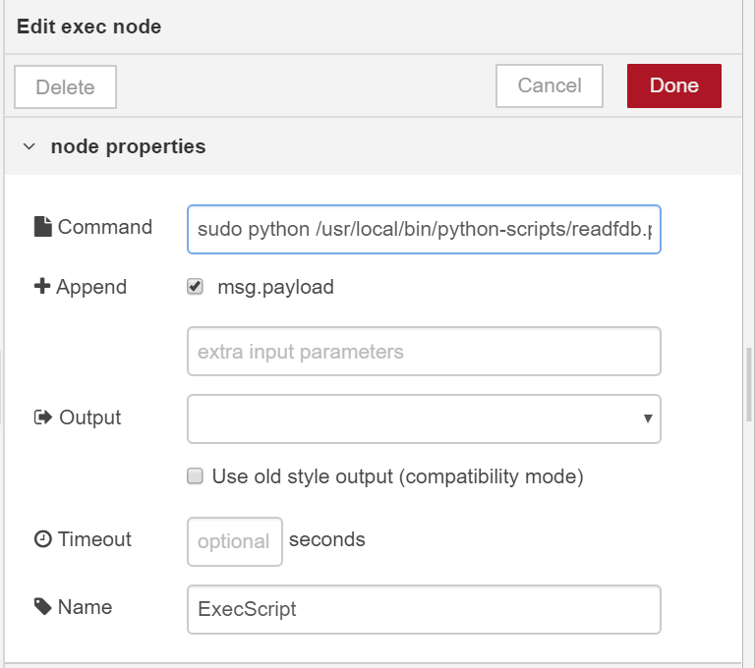

Slide 29
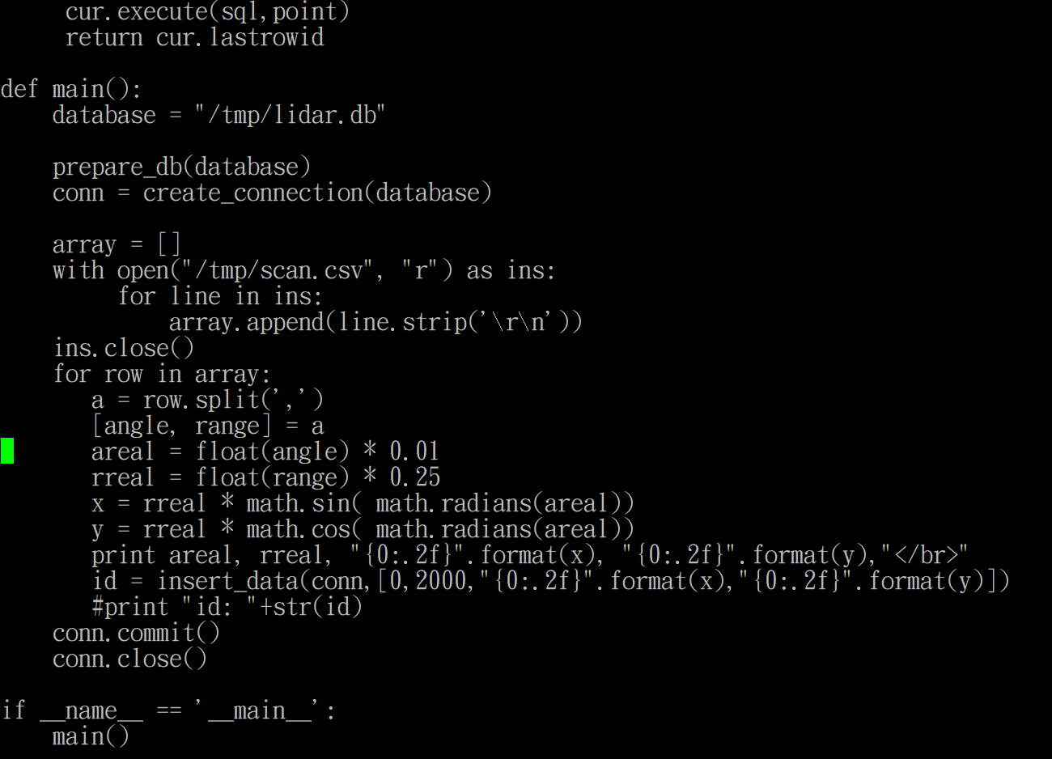

Slide 30
