Slide 1
雲端資料監控

Slide 2
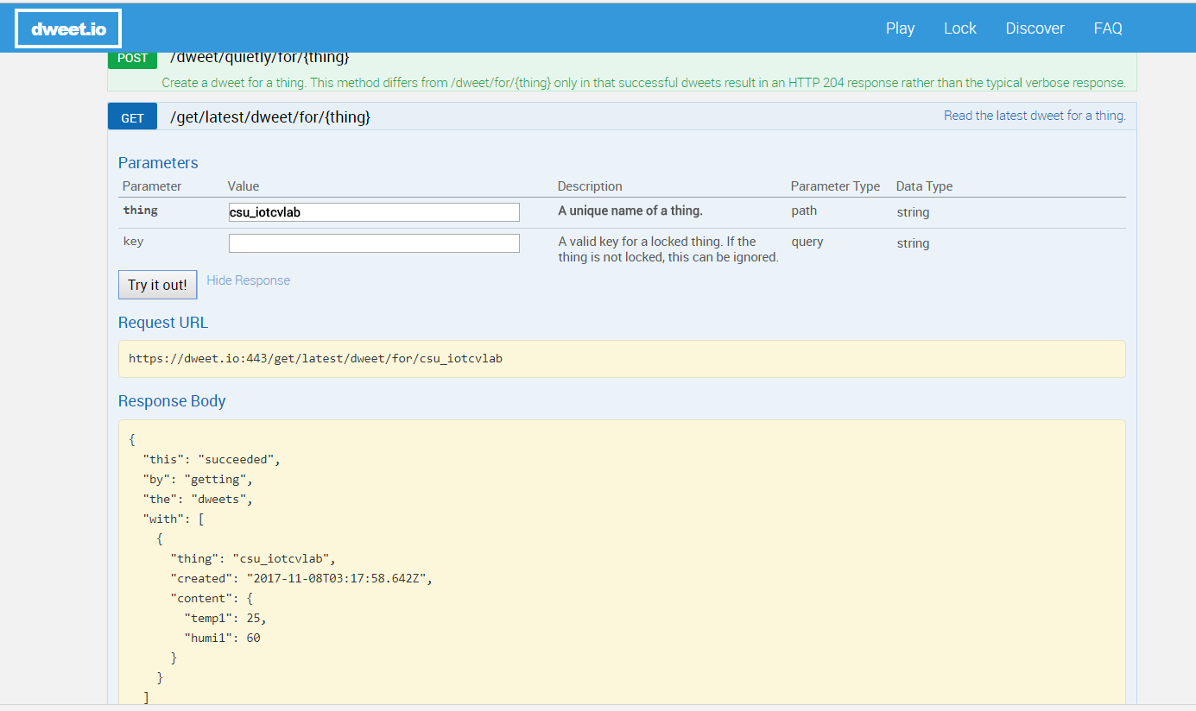
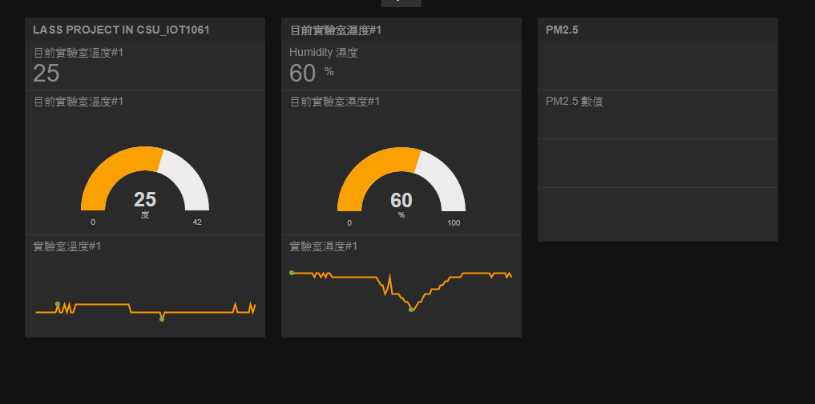
Freeboard.io & DWEET.io

Slide 3
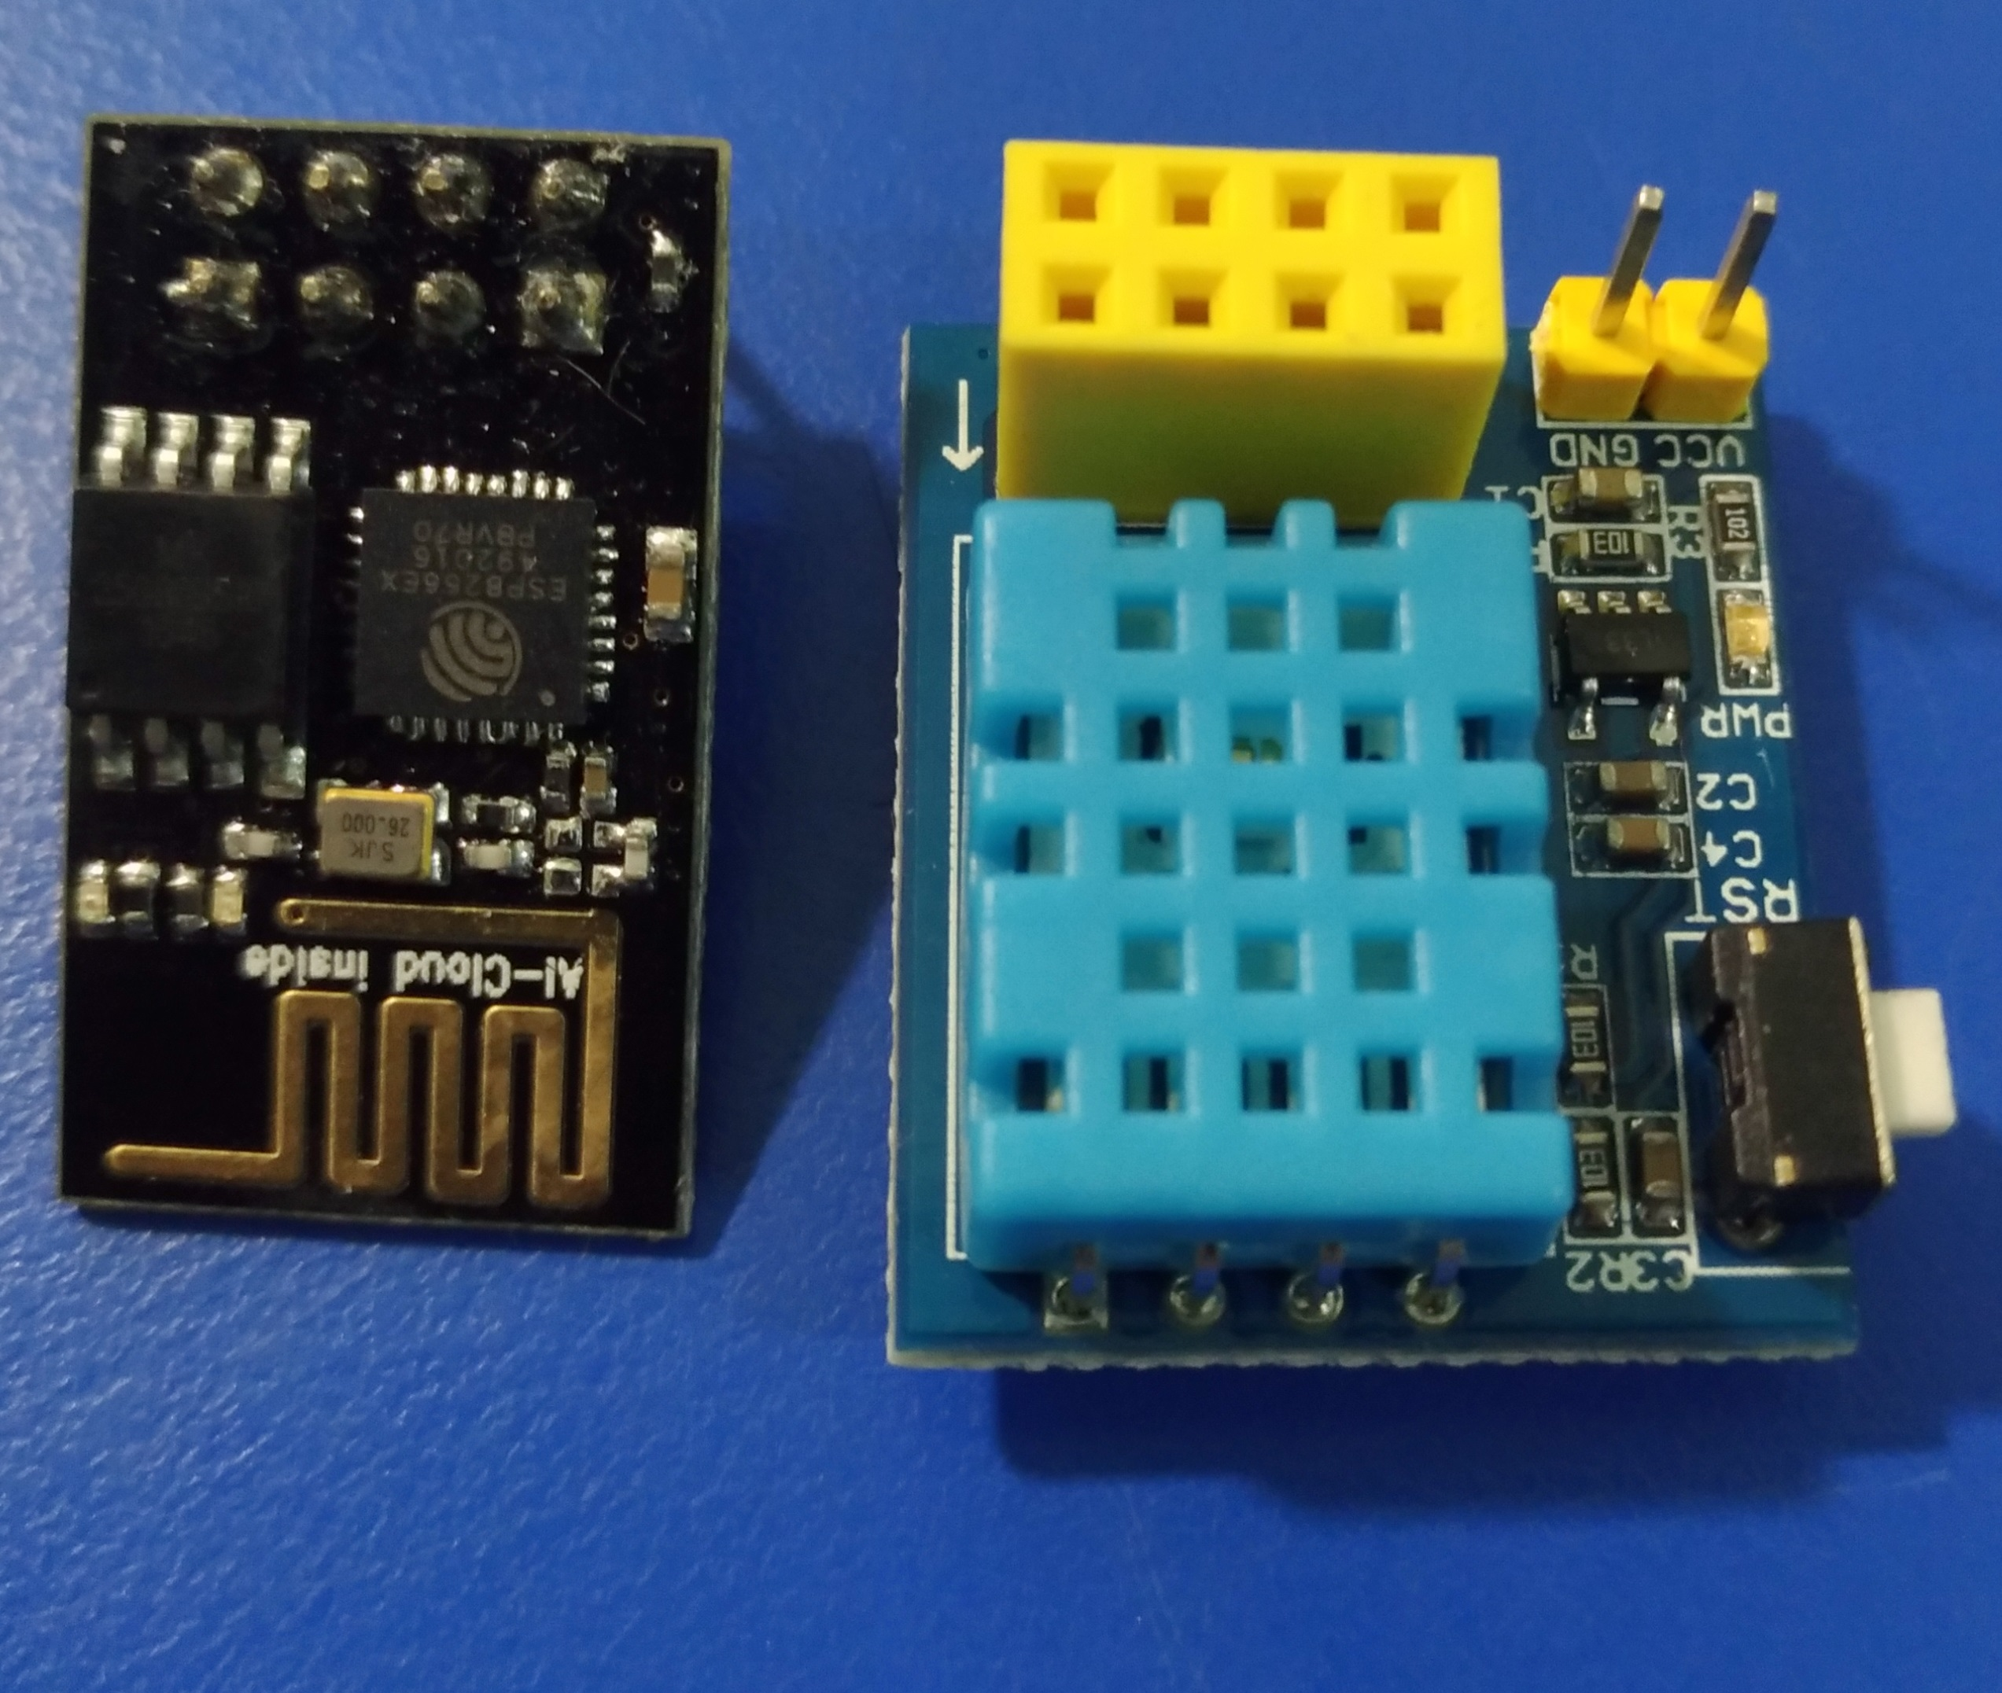



架構
https://dweet.io:443/get/latest/dweet/for/csu_iotcvlab{json}
http://freeboard.io/
Local
Storage
Output

Slide 4
建置程序—Local端
Local 端:
設置ESP8266+DHT11 使用 cloud_data_logger.ino
修改
const char* ssid = “CVLAB";
const char* password = “1234567890";
client.print(String(“GET /dweet/for/csu_iotcvlab?temp1=”) ⬅ 改csu_iotcvlab 成你的 thing name
燒錄、並測試 https://dweet.io:443/get/latest/dweet/for/csu_iotcvlab

Slide 5
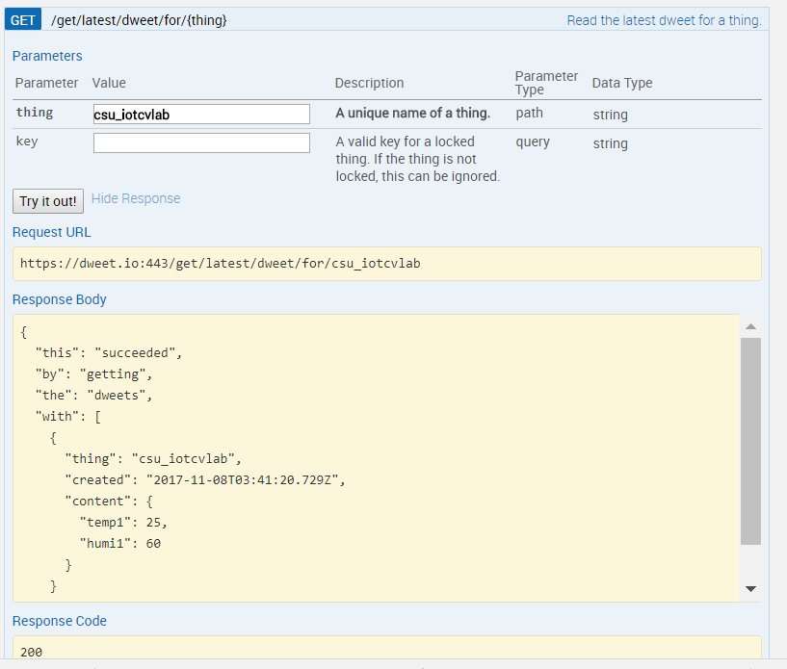
Dweet.io 測試結果

Slide 6
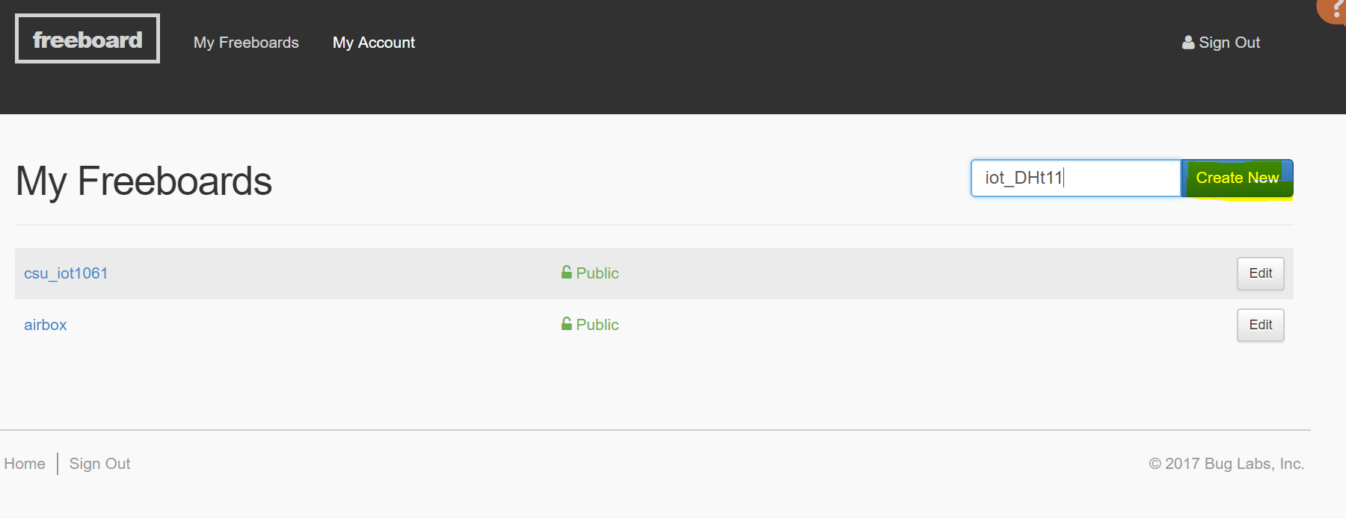
Freeboard.io 建立新channel

Slide 7
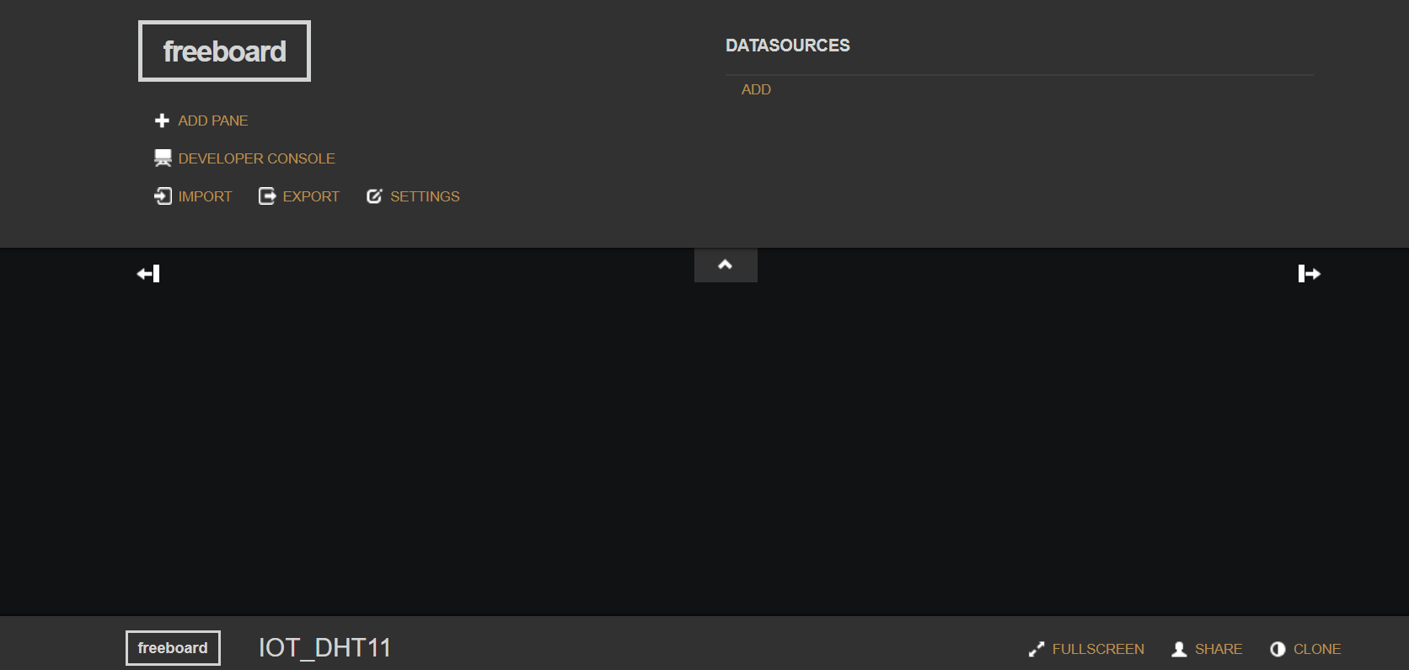
ADD data source

Slide 8
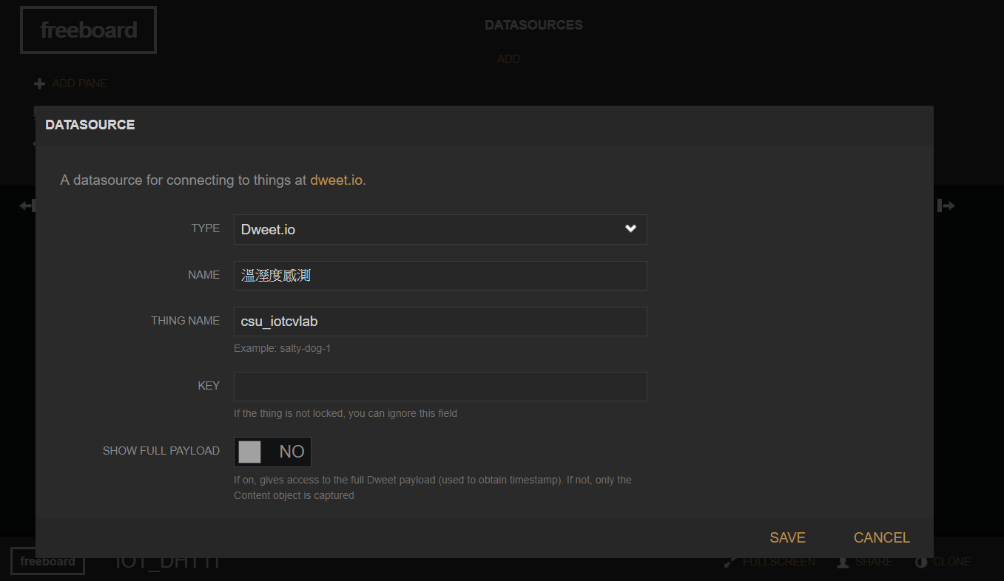
ADD data source (續)

Slide 9
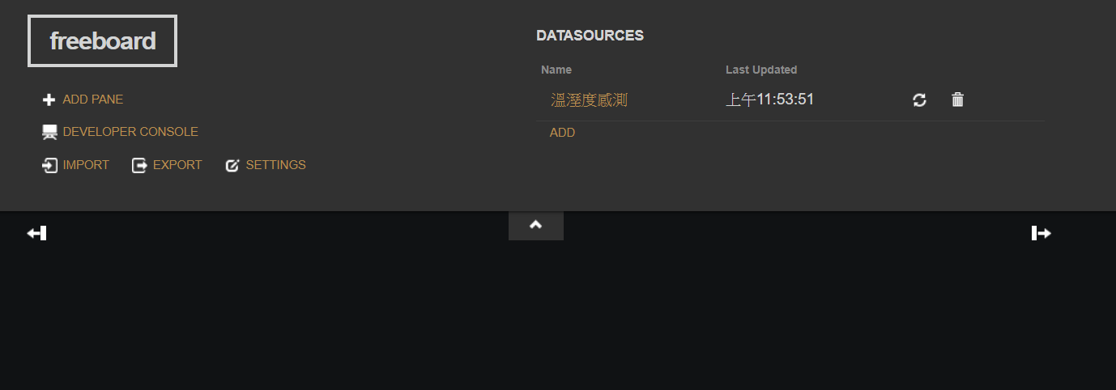
ADD PANE

Slide 10
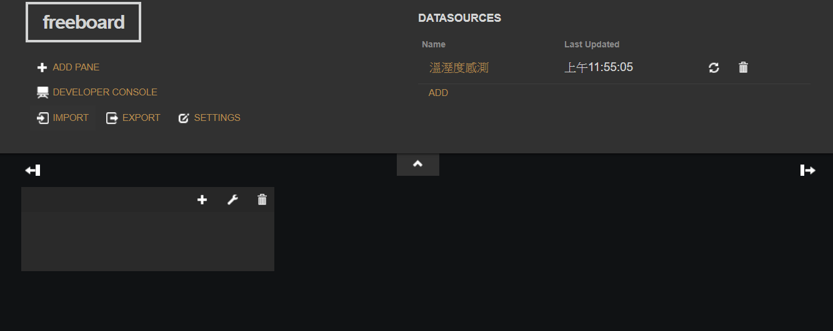
修改及增加panneL

Slide 11
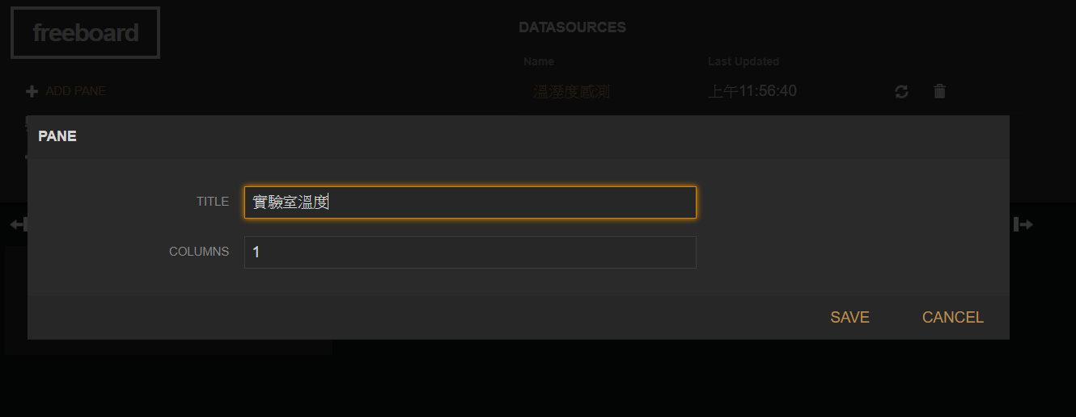
設定pane title

Slide 12
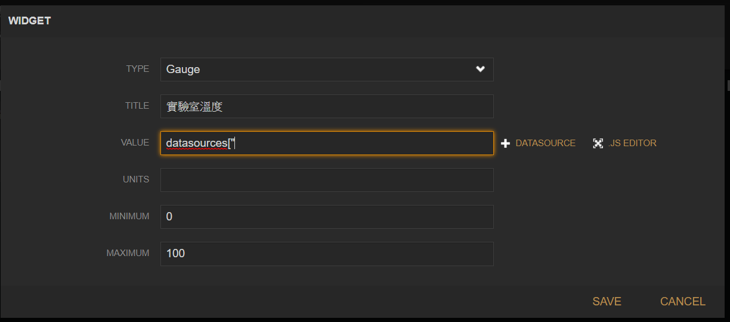
設定 type & data source

Slide 13
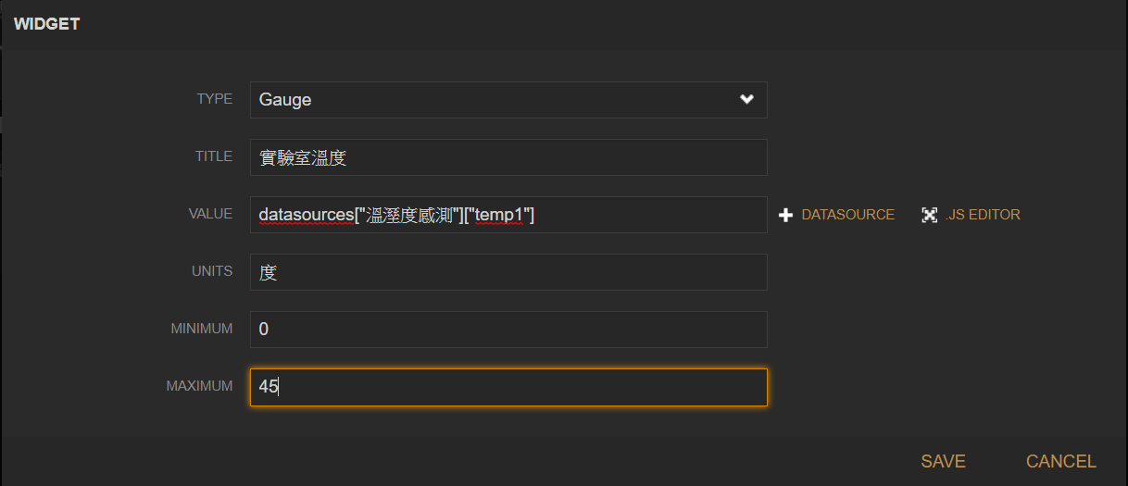

Slide 14
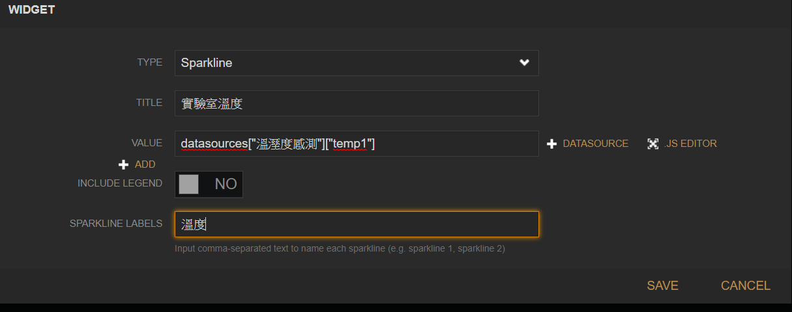

Slide 15
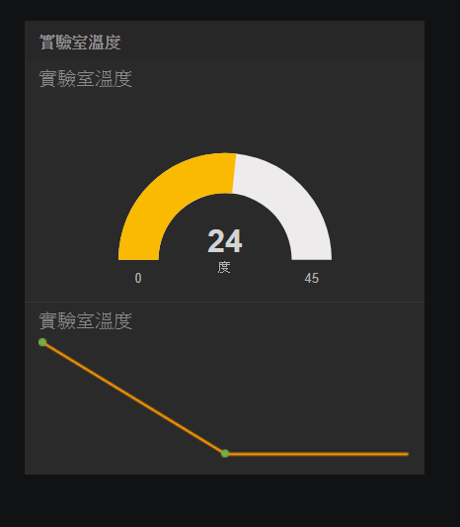

Slide 16
Export to json file
{
"version":1,
"allow_edit":true,
"plugins":["/plugins/all"],
"panes":[
{"title":"目前實驗室濕度#1",
"width":1,"row":{"3":1},"col":{"3":2},"col_width":1,
"widgets":
[
{"type":"text_widget",
"settings":
{"title":"Humidity 濕度",
"size":"regular",
"value":
"datasources[\"實驗室溫濕度#1\"][\"humi1\"]",
"animate":true,
"units":"%"}},
{"type":"gauge_widget",
"settings":
{"title":"目前實驗室濕度#1",
"value":"datasources[\"實驗室溫濕度#1\"][\"humi1\"]",
"units":"%",
"min_value":0,
"max_value":100}},
{"type":"sparkline_widget",
"settings":{"title":"實驗室濕度#1",
"value":["datasources[\"實驗室溫濕度#1\"][\"humi1\"]"],
"legend":"濕度"}}]},
…

Slide 17
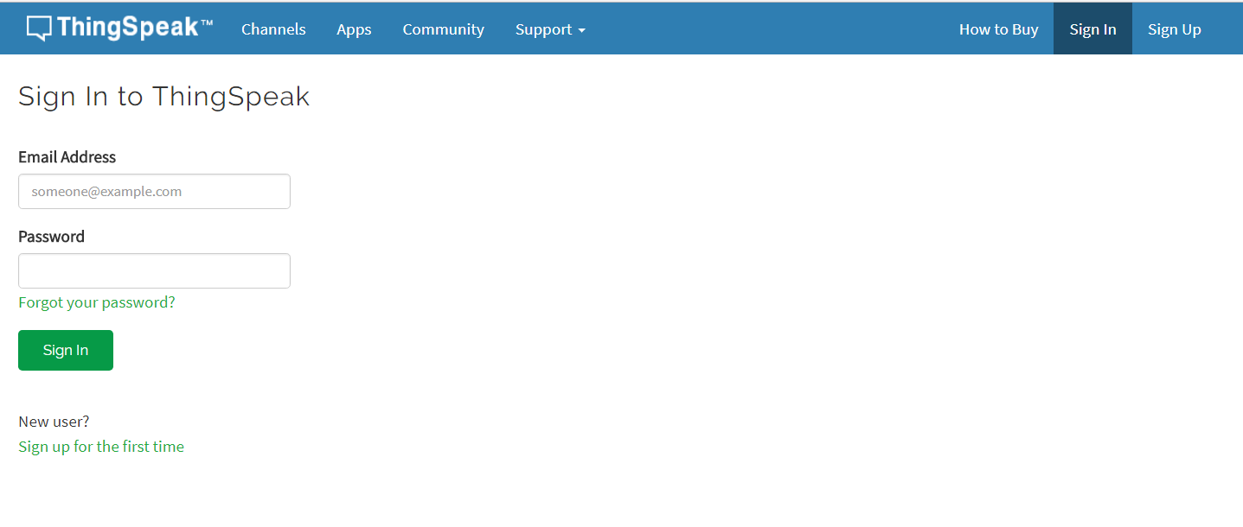
ThingSpeak

Slide 18
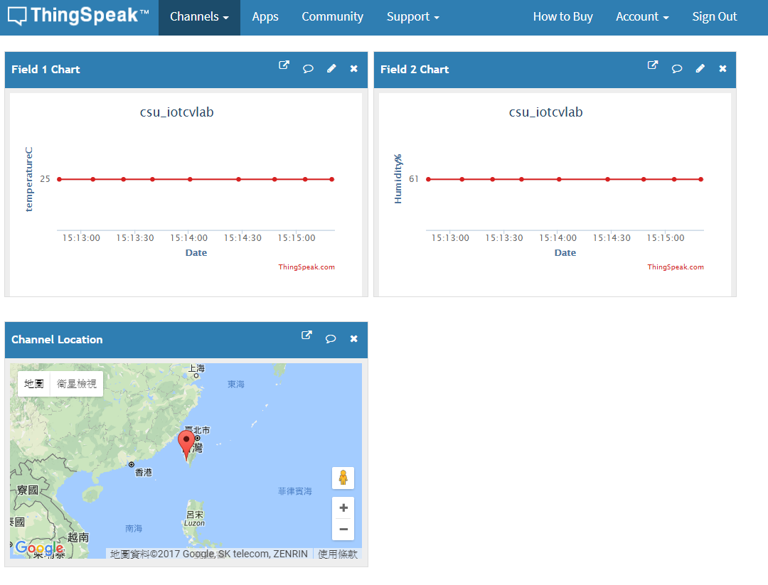
架構
https://thingspeak.com/channels/360692/private_show
Local
Storage
Output

Slide 19
建置程序—Local端
Local 端:
設置ESP8266+DHT11 使用 ThingSpeak_DHT11.ino
修改
const char* ssid = “CVLAB";
const char* password = “1234567890";
const char* privateKey = “U5PW627NKOE6J9SF”; ⬅ 改成你的
燒錄、並測試 https://thingspeak.com/channels/xxxxxx/private_show

Slide 20
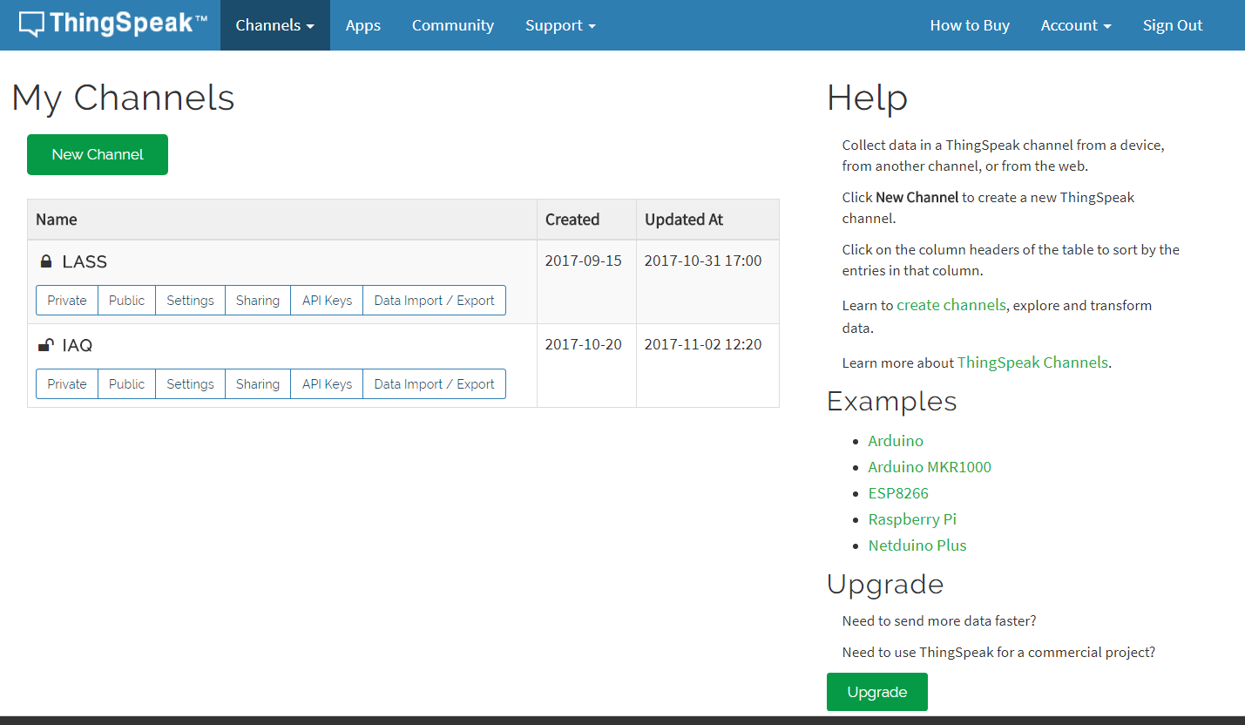

Slide 21
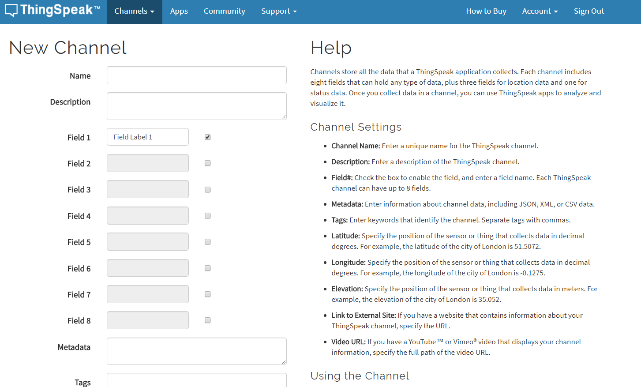

Slide 22
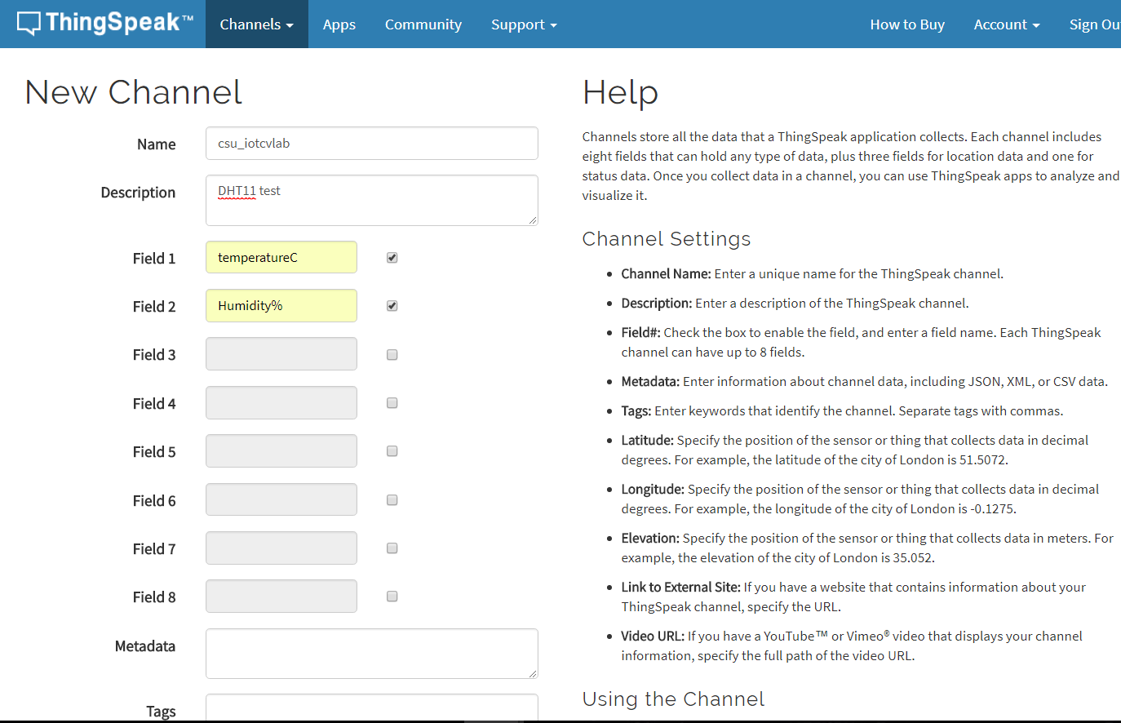

Slide 23
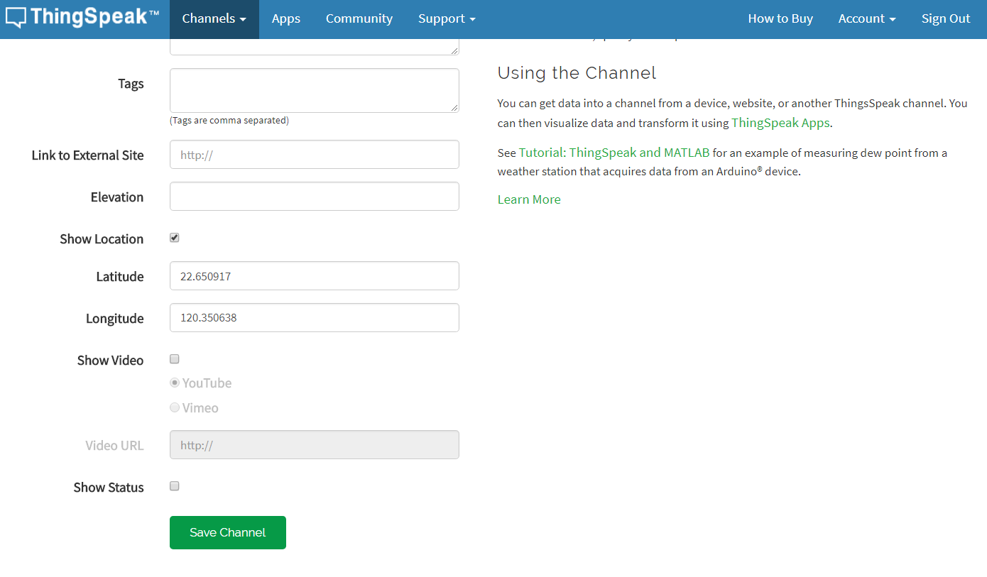

Slide 24
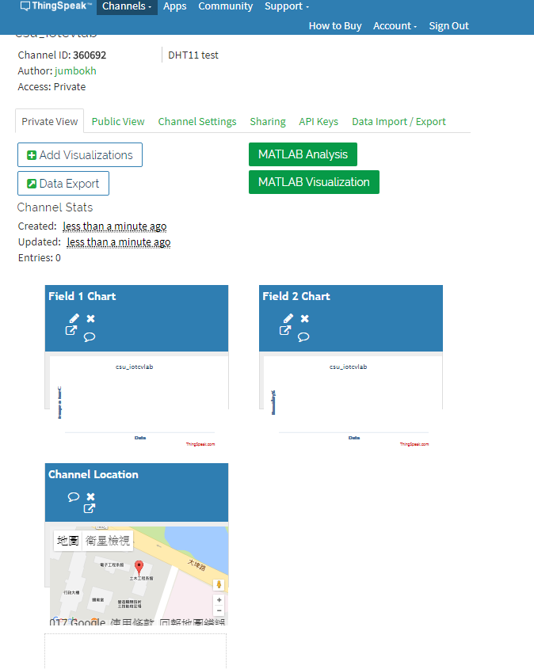

Slide 25
