Slide 1
樹莓派無螢幕安裝

Slide 2
安裝步驟
下載 Raspberry Pi 作業系統 (一般是 Raspbian)
燒錄 Raspberry Pi 作業系統映像檔至 Micro SD 卡
啟用 ssh 以便遠方登入
添加你使用的無線 WiFi 網路資訊 (SSID, Key)
退出 Micro SD 卡
Boot the Raspberry Pi from the micro SD card. ...
從WiFi 連線樹莓派登入.

Slide 3
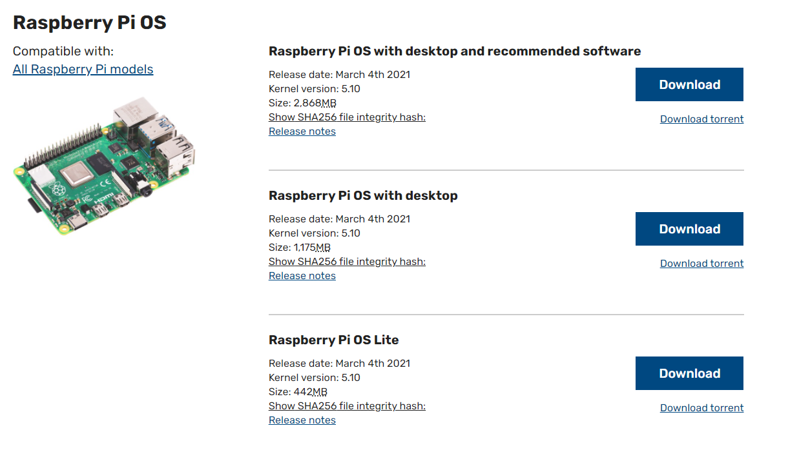
樹莓派官網

Slide 4
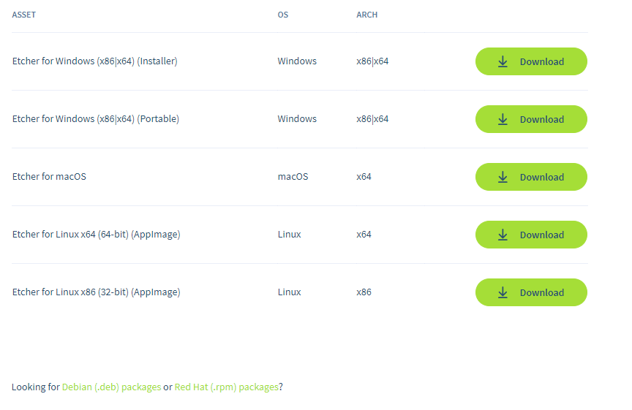
下載燒錄程式

Slide 5
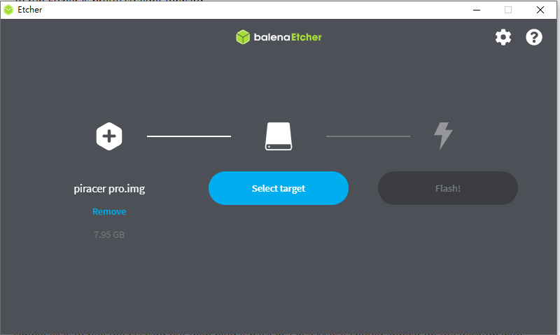
燒錄

Slide 6
啟用SSH遠端登入
執行cmd
切換到SD卡 (boot) 的根目錄
D:\ type NUL >> ssh
D:\ dir

Slide 7
添加WiFi訊息
在同一地方建立新檔: wpa_supplicant.conf
以文字編輯器寫入以下資訊:
country=TW
ctrl_interface=DIR=/var/run/wpa_supplicant GROUP=netdev
update_config=1
network={
ssid="NETWORK-NAME"
psk="NETWORK-PASSWORD"
}

Slide 8
Login remotely over WiFi
Download Bonjour Print Services for Windows v2.0.2 and run the installer.
Install Putty
If you already have Putty installed, skip to the next section.
Browse to: https://www.putty.org
Download the 64-bit MSI (Windows Installer)
Open it to run the installer (if asked for permission, click Yes)
Select: Add shortcut to PuTTY on the Desktop
Login over WiFi using Putty
This part assumes that ssh is enabled for your image and that the default user is pi with a password of raspberry.

Slide 9
Login
Launch Putty
Set the Host Name (or IP address) field to raspberrypi.local
By default the Port should be set to 22 and Connection type should be set to SSH
Click Open
If you see a Security Alert select Yes
A new terminal window should appear prompting you for a user name
The default user name is: pi
The default password is: raspberry

Slide 10
sudo raspi-config
參考: https://github.com/jumbokh/rpi_class/blob/master/Installation/first_time_setting.md

Slide 11
系統更新
sudo apt-get update -y
sudo apt-get upgrade -y

Slide 12
檢查無線網路節電狀態
Run this command:
$ iwconfig
Under wlan0 you will see this line:
Power Management:on
Another way to view the power management option is with this command line:
/sbin/iw wlan0 get power_save
Which on a new system will probably return this:
Power save: on

Slide 13
關掉無線網路節電
$ sudo /sbin/iw wlan0 set power_save off
並修改開機檔:
$ sudo nano /etc/rc.local
在最下方的 exit 0 之前, 添加:
/sbin/iw wlan0 set power_save off
儲存並離開檔案編輯

