Slide 1
智慧監視課程 (智慧型監控系統)
謝坤達
jumbokh@gmail.com
0953313123

Slide 2
大綱
1. 物件辨識介紹
2. 偵測演算法概論與實作
3. 智慧型監控系統簡介與實作
4. 各種數位影像演算法準確率之評估方法
5. 影像標示
6. 在雲端上實作深度學習物件辨識模型
7. 簡易 YOLO3 系統辨識
8. 臉部辨識實作
9. 結論

Slide 3
在雲端上實作深度學習物件辨識模型
何謂物件辨識
物件辨識演算法
訓練資料準備
實作

Slide 4
電腦視覺（Computer vision）
電腦視覺（Computer vision）
是一門研究如何使機器「看」的科學，更進一步的說，就是指用攝影機和電腦代替人眼對目標進行辨識、跟蹤和測量等機器視覺，並進一步做圖像處理，用電腦處理成為更適合人眼觀察或傳送給儀器檢測的圖像

Slide 5
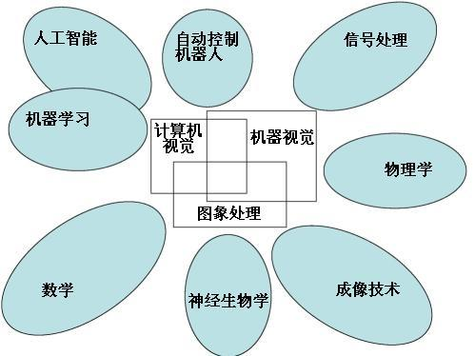
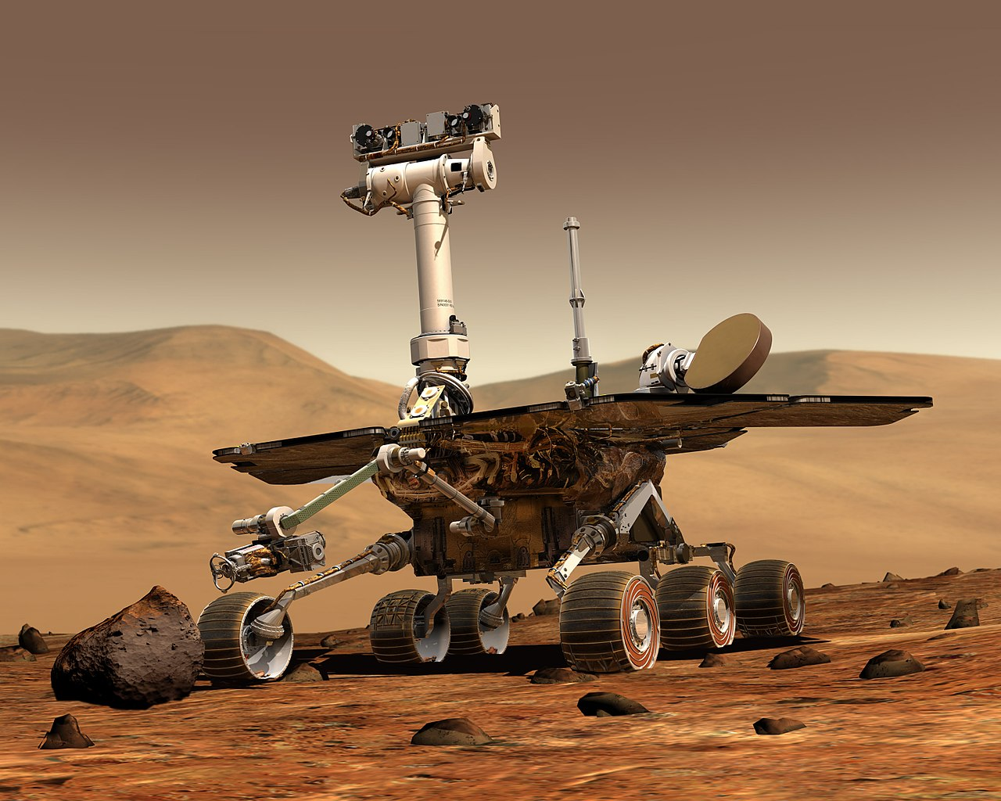
電腦視覺與其他領域的關係(維基百科)
由 NASA/JPL/Cornell University, Maas Digital LLC –
http://photojournal.jpl.nasa.gov/catalog/PIA04413 (image link),
公有領域, https://commons.wikimedia.org/w/index.php?curid=565283

Slide 6
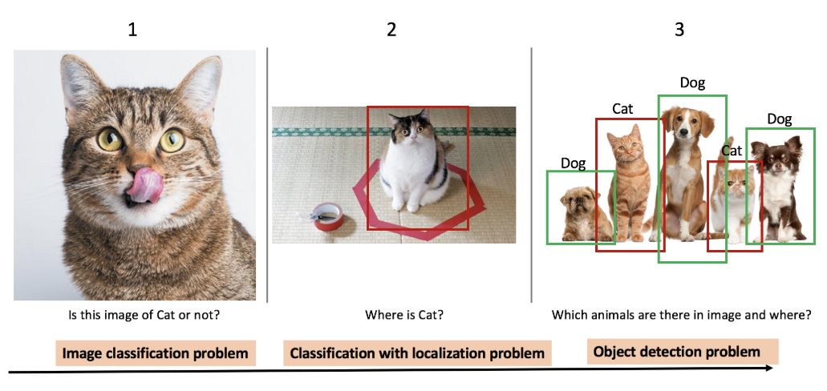
What is object detection?
Object detection compares the image classification and localizations
https://towardsdatascience.com/evolution-of-object-detection-and-localization-algorithms-e241021d8bad

Slide 7
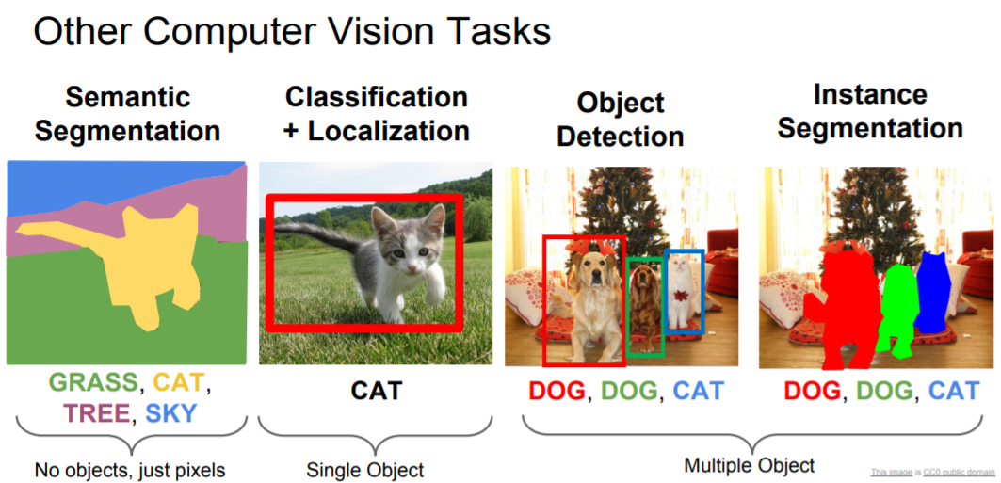
What is object dection?
http://cs231n.stanford.edu/slides/2018/cs231n_2018_lecture11.pdf

Slide 8
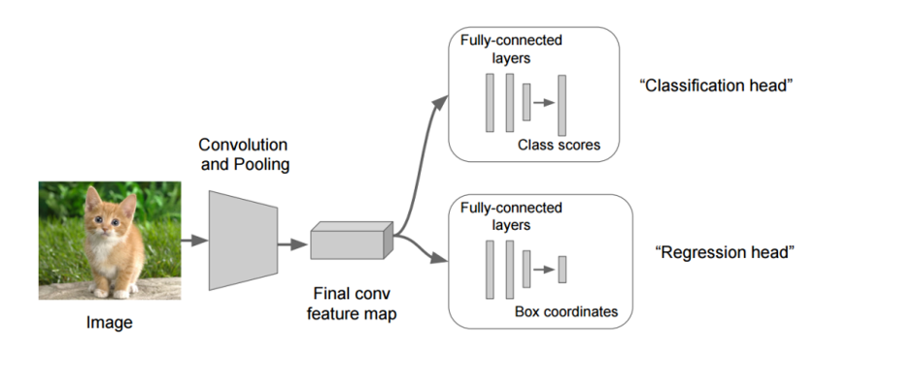
Object Detection algorithms

Slide 9
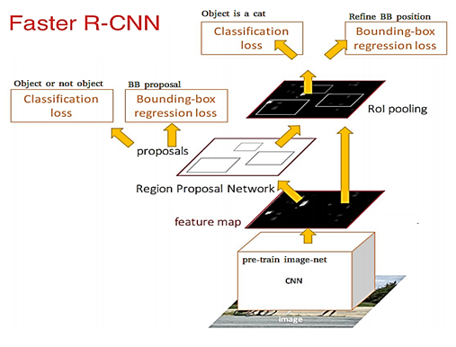
Object detection algorithms(cont.)
R-CNN(Region with CNN) (See: https://arxiv.org/abs/1311.2524)
Fast RCNN(See: https://arxiv.org/abs/1504.08083)
Faster RCNN(See: https://arxiv.org/abs/1506.01497)
R-FCN()
SSD
YOLOv1 to YOLOv3
ReinaNet
FPN

Slide 10
Object detection algorithms(cont.)
參考:
a. 關於影像辨識，所有你應該知道的深度學習模型
b. R-CNN, Fast R-CNN, Faster R-CNN, YOLO — Object Detection Algorithms
Deep Learning for Object Detection:
A Comprehensive Review
https://towardsdatascience.com/deep-learning-for-object-detection-a-comprehensive-review-73930816d8d9

Slide 11
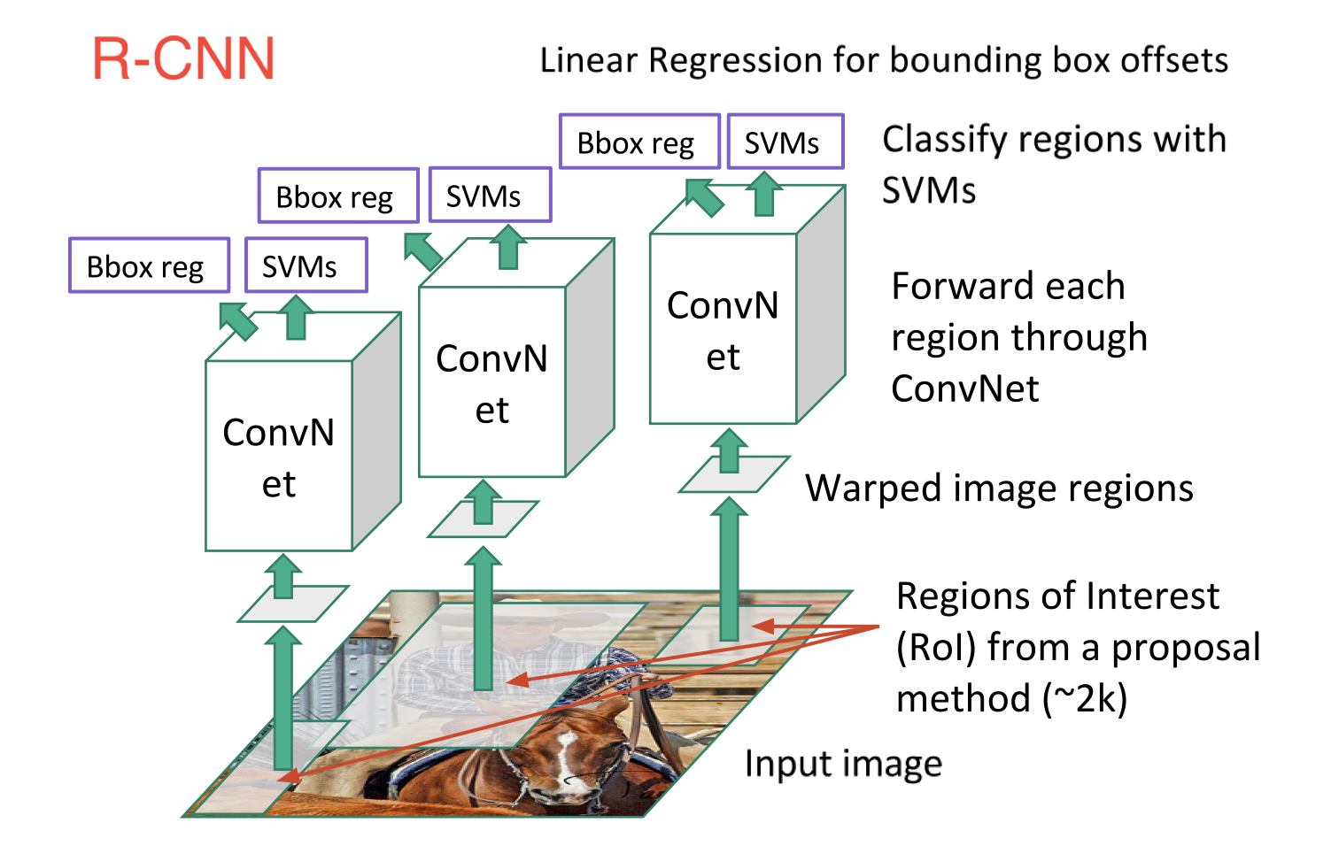
R-CNN (https://towardsdatascience.com/deep-learning-for-object-detection-a-comprehensive-review-73930816d8d9)

Slide 12
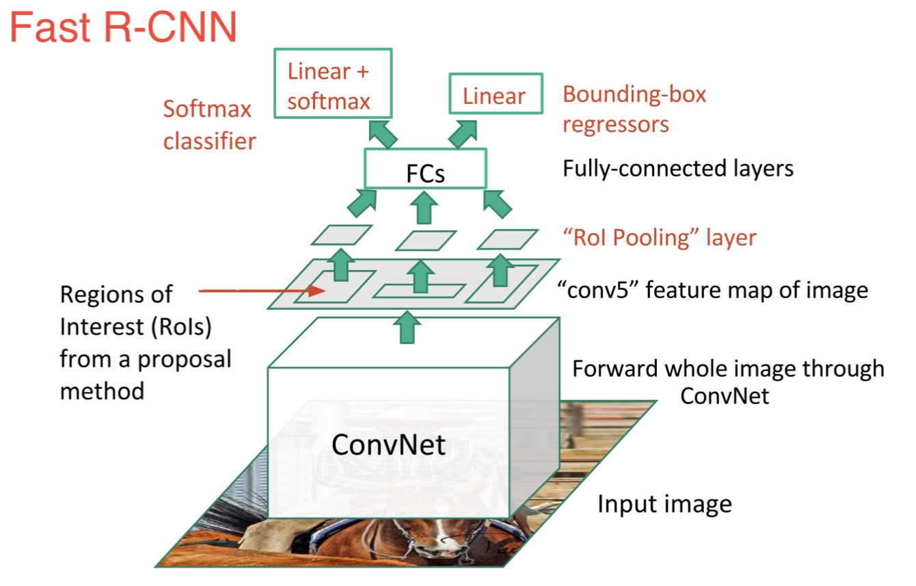
Fast R-CNN (https://towardsdatascience.com/deep-learning-for-object-detection-a-comprehensive-review-73930816d8d9)

Slide 13
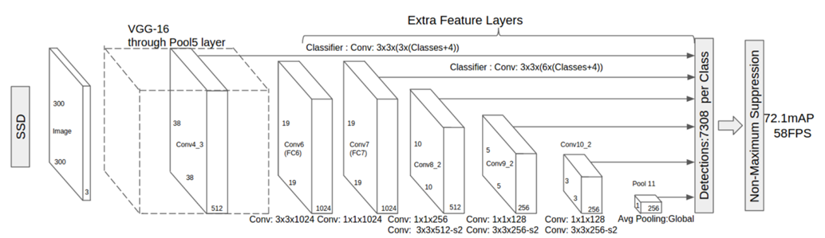
SSD (https://towardsdatascience.com/deep-learning-for-object-detection-a-comprehensive-review-73930816d8d9)

Slide 14
Object dection algorithms(cont.)
one stage and two stages
(深度學習-什麼是one stage，什麼是two stage 物件偵測
Optimizing the Trade-off between Single-Stage and Two-Stage Deep Object Detectors using Image Difficulty Prediction PDF)
Comparison
YOLOv3 is good as mAP and time
What’s new in YOLO v3?
https://towardsdatascience.com/deep-learning-for-object-detection-a-comprehensive-review-73930816d8d9 (https://pjreddie.com/media/files/papers/YOLOv3.pdf

Slide 15
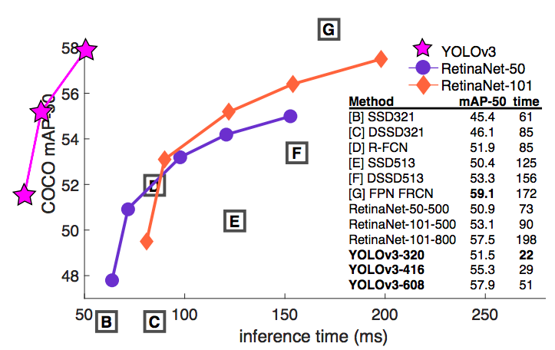
YOLO vs RetinaNet performance on COCO 50 Benchmark

Slide 16
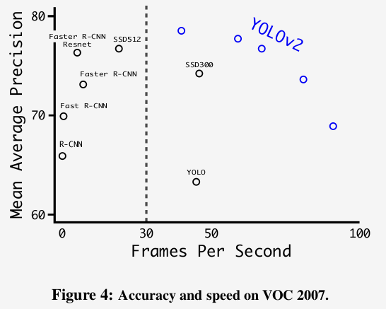
Accuracy and speed tradeoff on VOC 2007 (Source: YOLOv2 paper)
YOLO3: A Huge Improvement
https://mc.ai/yolo3-a-huge-improvement/

Slide 17
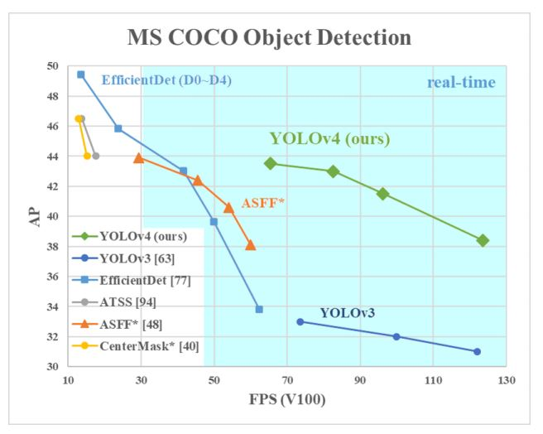
YOLO4 Bench

Slide 18
參考網頁
深度學習系列: 什麼是AP/mAP?
機器學習\統計方法: 模型評估-驗證指標(validation index)
用於目標檢測的深度學習：綜合回顧
YOLO3 paper
YOLO4 Blog
YOLO4 paper

Slide 19
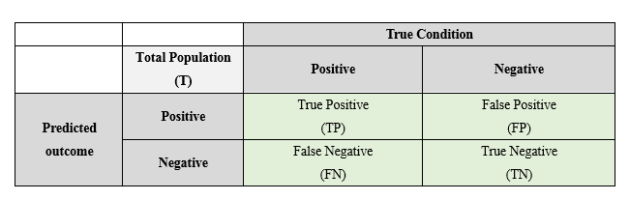
二元分類的混淆矩陣

Slide 20
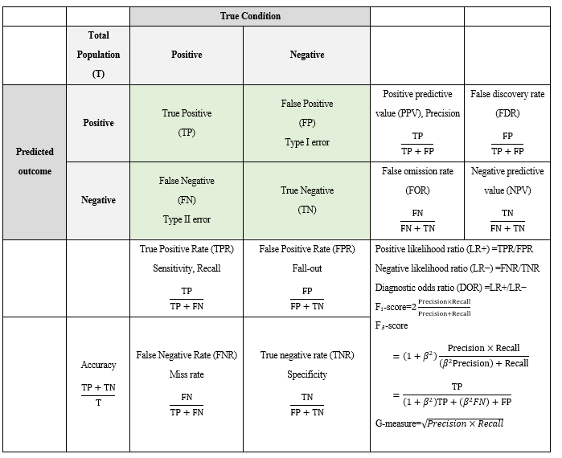
AP/mAP: Average Precision (https://chih-sheng-huang821.medium.com/%E6%B7%B1%E5%BA%A6%E5%AD%B8%E7%BF%92%E7%B3%BB%E5%88%97-%E4%BB%80%E9%BA%BC%E6%98%AFap-map-aaf089920848)
https://chih-sheng-huang821.medium.com/%E6%A9%9F%E5%99%A8%E5%AD%B8%E7%BF%92-%E7%B5%B1%E8%A8%88%E6%96%B9%E6%B3%95-%E6%A8
%A1%E5%9E%8B%E8%A9%95%E4%BC%B0-%E9%A9%97%E8%AD%89%E6%8C%87%E6%A8%99-b03825ff0814

Slide 21
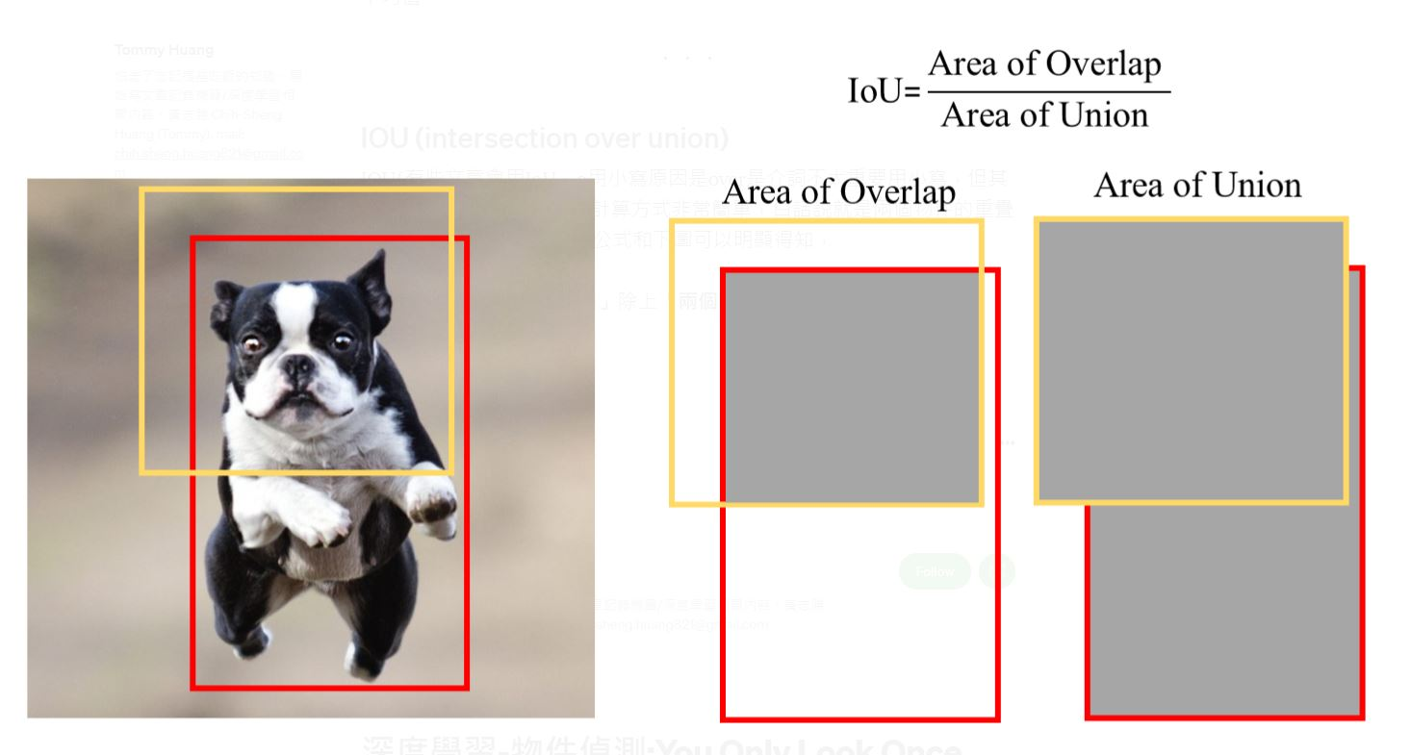
IoU
兩個物件的重疊(overlap)/交集比例

Slide 22
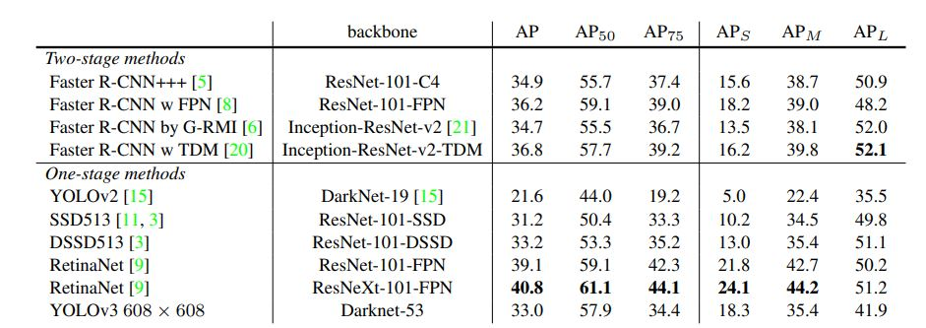
YOLO3 Table3

Slide 23
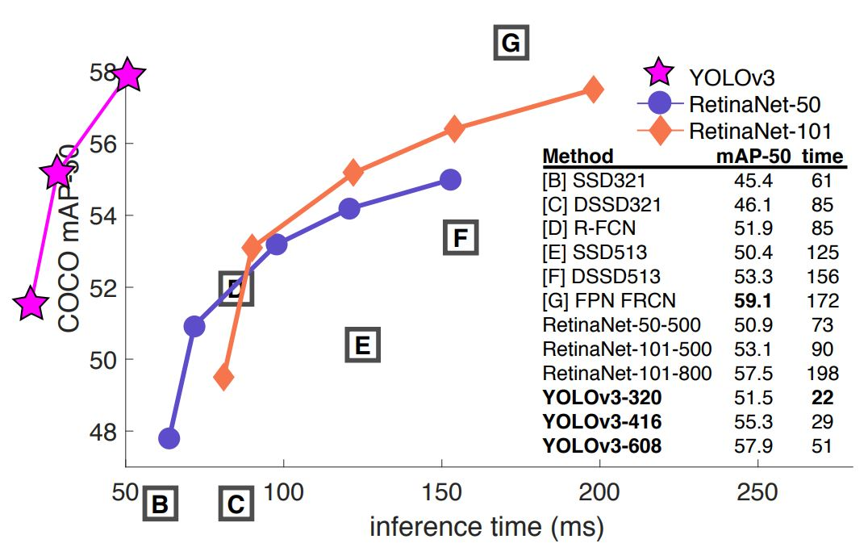
YOLO3 Fig.3

Slide 24
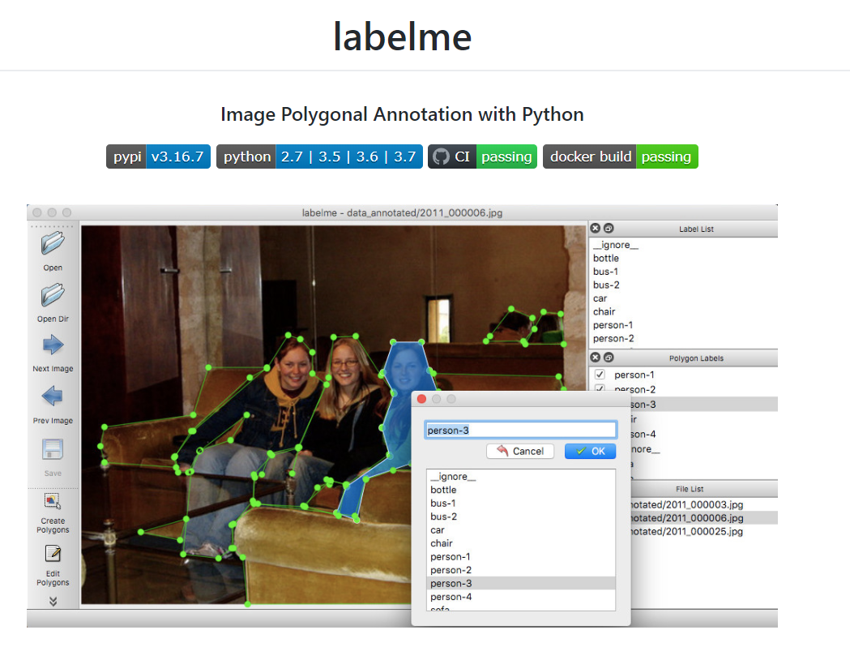
訓練資料準備
https://tzutalin.github.io/labelImg/
https://github.com/wkentaro/labelme

Slide 25
Model Evaluation It shows the mAP of our trained models.
from imageai.Detection.Custom import DetectionModelTrainer
trainer = DetectionModelTrainer()
trainer.setModelTypeAsYOLOv3()
trainer.setDataDirectory(data_directory="hololens")
trainer.evaluateModel(model_path="hololens/models", json_path="hololens/json/detection_config.json", iou_threshold=0.5, object_threshold=0.3, nms_threshold=0.5)

Slide 26
結論
The impact of the object detection
YOLO is a great framework so far
Implementation is quite easy now
Labeling job is quite laborious, we are working on some tricks

Slide 27
Reference
Reference:
ImageAI (v2.1.4)
https://github.com/OlafenwaMoses/ImageAI
Train Object Detection AI with 6 lines of code (Part_I) https://medium.com/deepquestai/train-object-detection-ai-with-6-lines-of-code-6d087063f6ff
Object Detection with 10 lines of code (Part_II)
https://towardsdatascience.com/object-detection-with-10-lines-of-code-d6cb4d86f606
Evolution of Object Detection and Localization Algorithms https://towardsdatascience.com/evolution-of-object-detection-and-localization-algorithms-e241021d8bad
Object Localization and Detection https://leonardoaraujosantos.gitbooks.io/artificial-inteligence/content/object_localization_and_detection.html https://medium.com/%E8%B3%87%E6%96%99%E9%9A%A8%E7%AD%86/machine-learning-103-d81ef2ad3597

