Slide 1
視覺辨識課程
謝坤達
jumbokh@gmail.com
0953313123

Slide 2
大綱
1. 視覺辨識介紹
2. 影像標示
3. 在雲端上實作深度學習物件辨識模型
4. 簡易 YOLO3 系統辨識
5. 臉部辨識實作

Slide 3
在雲端上實作深度學習物件辨識模型
何謂物件辨識
物件辨識演算法
訓練資料準備
實作

Slide 4
電腦視覺（Computer vision）
電腦視覺（Computer vision）是一門研究如何使機器「看」的科學，更進一步的說，就是指用攝影機和電腦代替人眼對目標進行辨識、跟蹤和測量等機器視覺，並進一步做圖像處理，用電腦處理成為更適合人眼觀察或傳送給儀器檢測的圖像

Slide 5
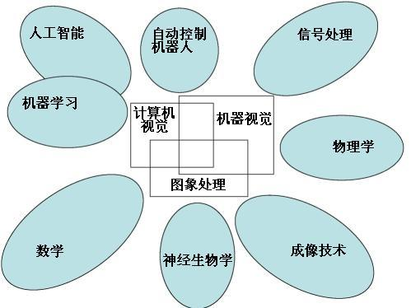
電腦視覺與其他領域的關係(維基百科)

Slide 6
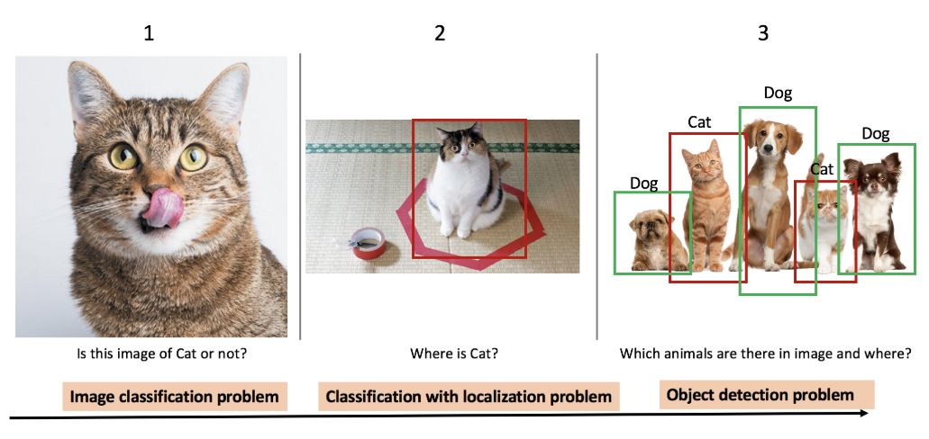
What is object detection?
Object dection compares the image classification and localizations
https://towardsdatascience.com/evolution-of-object-detection-and-localization-algorithms-e241021d8bad

Slide 7
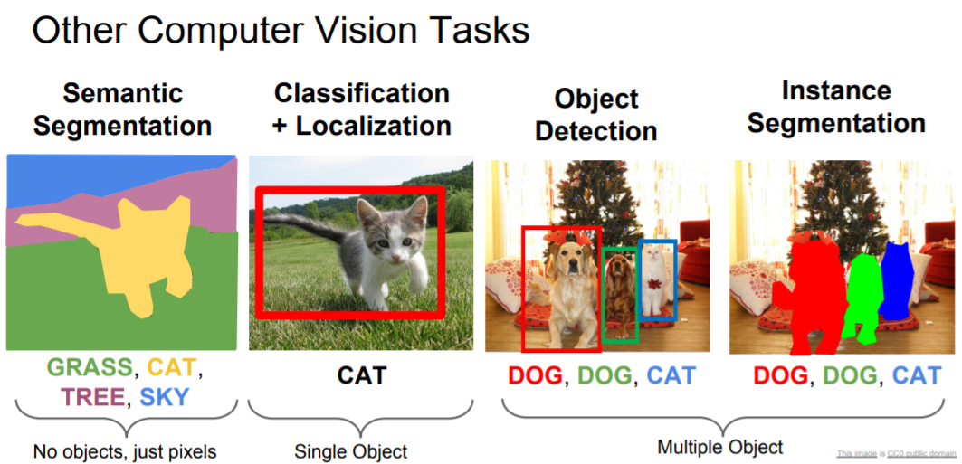
What is object dection?
http://cs231n.stanford.edu/slides/2018/cs231n_2018_lecture11.pdf

Slide 8
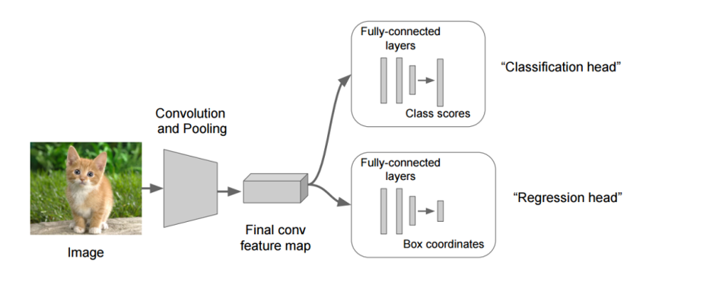
Object dection algorithms

Slide 9
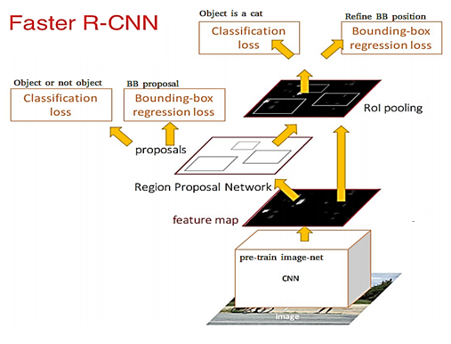
Object dection algorithms(cont.)
R-CNN(Region with CNN) (See: https://arxiv.org/abs/1311.2524)
Fast RCNN(See:https://arxiv.org/abs/1504.08083)
Faster RCNN(See: https://arxiv.org/abs/1506.01497)
R-FCN()
SSD
YOLOv1 to YOLOv3
ReinaNet
FPN

Slide 10

Object dection algorithms(cont.)
(參考: a. 關於影像辨識，所有你應該知道的深度學習模型’
b. R-CNN, Fast R-CNN, Faster R-CNN, YOLO — Object Detection Algorithms)
Deep Learning for Object Detection: A Comprehensive Review https://towardsdatascience.com/deep-learning-for-object-detection-a-comprehensive-review-73930816d8d9

Slide 11
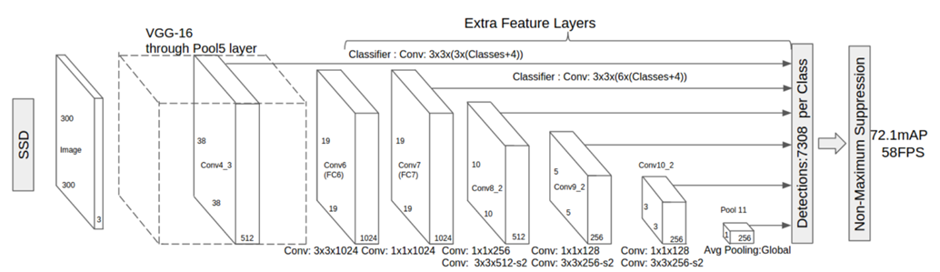
Object dection algorithms(cont.)

Slide 12
Object dection algorithms(cont.)
one stage and two stages
(深度學習-什麼是one stage，什麼是two stage 物件偵測
Optimizing the Trade-off between Single-Stage and Two-Stage Deep Object Detectors using Image Difficulty Prediction PDF)
Comparison
YOLOv3 is good as mAP and time
What’s new in YOLO v3?
https://towardsdatascience.com/deep-learning-for-object-detection-a-comprehensive-review-73930816d8d9 (https://pjreddie.com/media/files/papers/YOLOv3.pdf

Slide 13
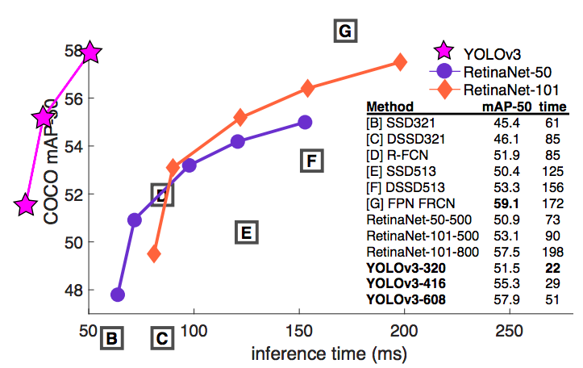
YOLO vs RetinaNet performance on COCO 50 Benchmark

Slide 14
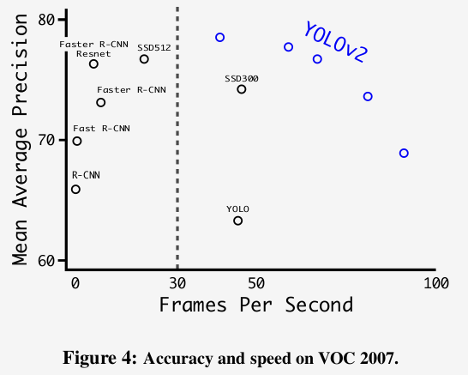
Accuracy and speed tradeoff on VOC 2007 (Source: YOLOv2 paper)
YOLO3: A Huge Improvement
https://mc.ai/yolo3-a-huge-improvement/

Slide 15
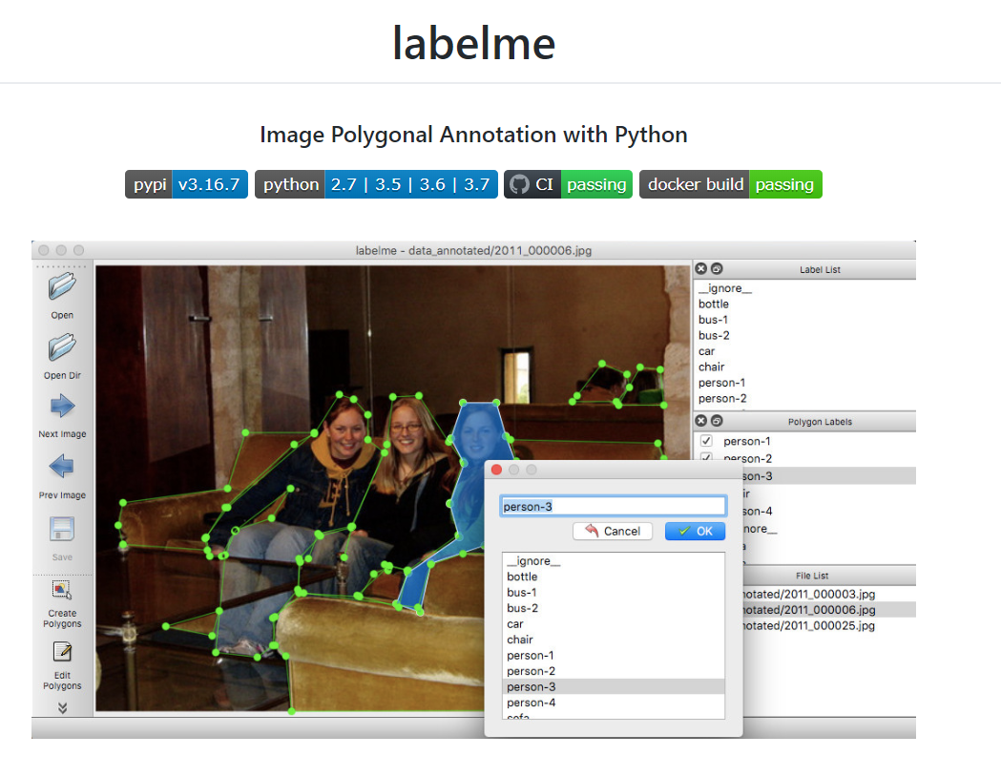
訓練資料準備
https://github.com/wkentaro/labelme
https://tzutalin.github.io/labelImg/

Slide 16
# python2
conda create --name=labelme python=2.7
source activate labelme
# conda install -c conda-forge pyside2
conda install pyqt
pip install labelme
# if you'd like to use the latest version. run below:
# pip install git+https://github.com/wkentaro/labelme.git
# python3
conda create --name=labelme python=3.6
source activate labelme
# conda install -c conda-forge pyside2
# conda install pyqt
# pip install pyqt5 # pyqt5 can be installed via pip on python3
pip install labelme
# or you can install everything by conda command
# conda install labelme -c conda-forge

Slide 17
其他安裝文章
https://www.itread01.com/content/1544810780.html

Slide 18
實作：訓練 XML標示

Slide 19
實作程式碼
Colab example: tensorflow-object-detection-training-colab.ipynb https://colab.research.google.com/github/Tony607/object_detection_demo/blob/master/tensorflow_object_detection_training_colab.ipynb?hl=en
Make a copy and test!

Slide 20
Implementations: Training
from imageai.Detection.Custom import DetectionModelTrainer
trainer = DetectionModelTrainer()
trainer.setModelTypeAsYOLOv3()
trainer.setDataDirectory(data_directory="hololens")
trainer.setTrainConfig(object_names_array=["hololens"], batch_size=8, num_experiments=5, train_from_pretrained_model="pretrained-yolov3.h5")
trainer.setTrainConfig(object_names_array=["hololens"], batch_size=8, num_experiments=5)
trainer.trainModel()

Slide 21
Model Evaluation It shows the mAP of our trained models.
from imageai.Detection.Custom import DetectionModelTrainer
trainer = DetectionModelTrainer()
trainer.setModelTypeAsYOLOv3()
trainer.setDataDirectory(data_directory="hololens")
trainer.evaluateModel(model_path="hololens/models", json_path="hololens/json/detection_config.json", iou_threshold=0.5, object_threshold=0.3, nms_threshold=0.5)

Slide 22
實作
If I have many items?
Object_names_array=[“Peanut”, “Hazelnut”]

Slide 23
Extras
Run SSD, Faster RCNN and FCN
https://medium.com/swlh/how-to-train-an-object-detection-model-easy-for-free-f388ff3663e
(Or https://www.dlology.com/blog/how-to-train-an-object-detection-model-easy-for-free/ )

Slide 24
結論
The impact of the object detection
YOLO3 is agreat framework so far
Implementation is quite easy now
Labeling job is quite laborious, we are working on some tricks

Slide 25
Reference
Reference:
ImageAI (v2.1.4)
https://github.com/OlafenwaMoses/ImageAI
Train Object Detection AI with 6 lines of code (Part_I) https://medium.com/deepquestai/train-object-detection-ai-with-6-lines-of-code-6d087063f6ff
Object Detection with 10 lines of code (Part_II)
https://towardsdatascience.com/object-detection-with-10-lines-of-code-d6cb4d86f606
Evolution of Object Detection and Localization Algorithms https://towardsdatascience.com/evolution-of-object-detection-and-localization-algorithms-e241021d8bad
Object Localization and Detection https://leonardoaraujosantos.gitbooks.io/artificial-inteligence/content/object_localization_and_detection.html https://medium.com/%E8%B3%87%E6%96%99%E9%9A%A8%E7%AD%86/machine-learning-103-d81ef2ad3597

