Slide 1
第4章 Simple Regression

Slide 2
4-1 簡單線性回歸
範例4-1 讀入本章資料
程式碼
^{#基本套件和模組}
^{import pandas as pd}
^{import numpy as np}
import matplotlib.pyplot as plt
^{import seaborn as sns}
^{%matplotlib inline}
%config InlineBackend.figure_format = 'retina'
plt.rcParams['font.sans-serif'] = ['DFKai-sb']
plt.rcParams['axes.unicode_minus'] = False
^{import warnings}
warnings.filterwarnings('ignore')
^{#資料模組}
from sklearn.datasets import load_boston
^{boston = load_boston()}

Slide 3

範例4-4 取出資料的特徵值
程式碼
print(boston['feature_name'])􀀌

Slide 4
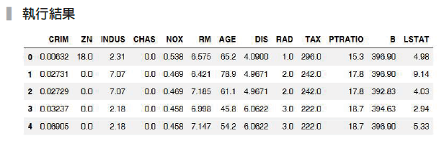
範例4-5 將資料整合到DataFrame裡
程式碼
df = pd.DataFrame(boston['data'],columns=boston['feature_name']
df.head()

Slide 5
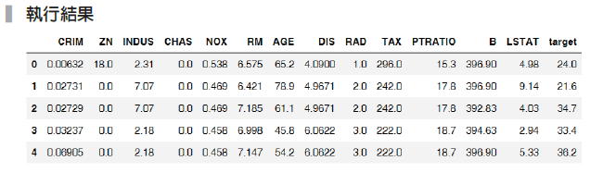
範例4-6 將預測目標的target也整合到DataFrame裡
程式碼
df['target']=boston['target']
df.head()

Slide 6
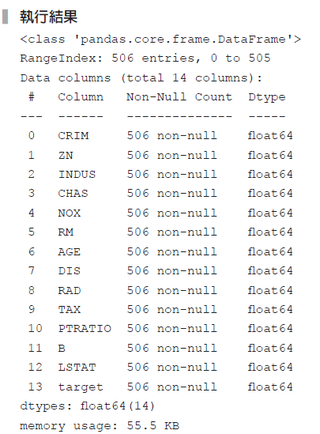
範例4-7 檢視資料是否有遺漏值
程式碼
df.info()􀀌

Slide 7
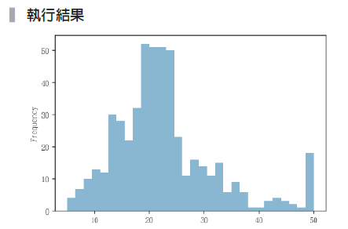
範例4-8 用直方圖探索目標變數target
程式碼
df['target'].plot(kind='hist', bins=30, alpha=0.5)

Slide 8
範例4-9 相關係數的探索
程式碼
(執行結果如下一頁)
corr = df.corr().round(2)
corr['target'].sort_values(ascending=False)

Slide 9
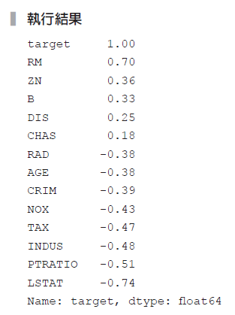

Slide 10
範例4-10 列出所有相關係數高於0.6的值，並用heatmap來呈現
程式碼
(執行結果如下一頁)
plt.figure(figsize=(8, 6))
corr[np.abs(corr) < 0.6] = 0
sns.heatmap(corr, annot=True, cmap='coolwarm');

Slide 11
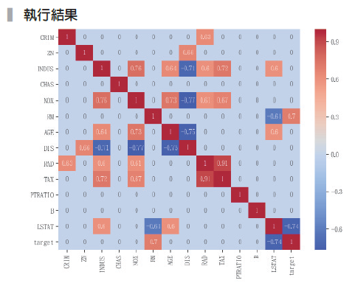

Slide 12
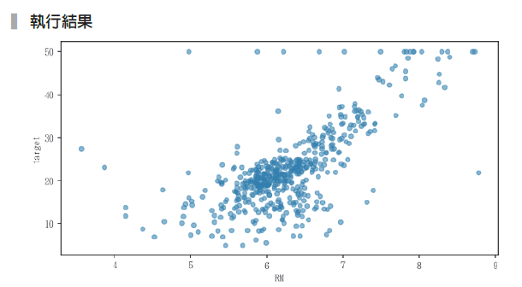
範例4-11 繪製RM和target的散布圖，並將透明度設為0.5
程式碼
df.plot(kind='scatter', x='RM', y='target', alpha=0.5, figsize=(8,4));

Slide 13
4-1-4 將資料整理出X和y
範例4-12 取出X和y
程式碼
X = df[['RM']]
y = df['target']

Slide 14
範例4-13 將資料切割成train和test兩個子集
程式碼
from sklearn.model_selection import train_test_split
X_train, X_test, y_train, y_test = train_test_split(X, y, test_size=0.33,random_state=42)

Slide 15
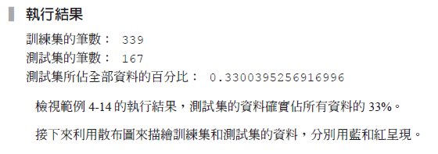
範例4-14 檢視資料切割的筆數
程式碼
print('訓練集的筆數：',len(X_train))
print('測試集的筆數：',len(X_test))
print('測試集所佔全部資料的百分比：',len(X_test)/len(X))

Slide 16
範例4-16 初始迴歸物件
程式碼
from sklearn.linear_model import LinearRegression
model = LinearRegression()

Slide 17

範例4-17 訓練迴歸模型
程式碼
model.fit(X_train, y_train)

Slide 18
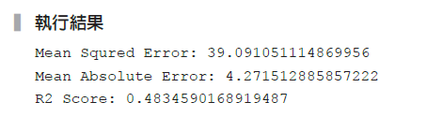
4-1-6 整體預測結果的好壞評估
範例4-25 迴歸模型預測結果好壞評估
程式碼
from sklearn.metrics import mean_squared_error,
mean_absolute_error, r2_score
print('Mean Squred Error:',mean_squared_error(y_test, y_pred))
print('Mean Absolute Error:', mean_absolute_error(y_test, y_pred))
print('R2 Score:', r2_score(y_test, y_pred))

Slide 19

4-1-7 運用模型來預測結果
範例4-26 如何用模型預測房價
程式碼
model.predict([[6]])

Slide 20

範例4-27 用估算出的係數算出預測值
程式碼
model.intercept_+ model.coef_*6

Slide 21
4-1-7 運用模型來預測結果
範例4-32 多次方轉換器
程式碼
#先將原本的二次方欄位刪除
X_train.drop('RM2', axis=1, inplace=True)
X_test.drop('RM2', axis=1, inplace=True)
#觀察前五筆資料與手動增加的二次方向是相同的,多出來的1不用去理它
from sklearn.preprocessing import PolynomialFeatures
polynomial = PolynomialFeatures(degree=2)
x_poly = polynomial.fit_transform(X_train)
x_poly[:5]

Slide 22
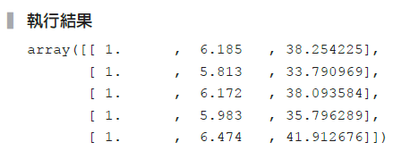

Slide 23
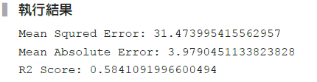
範例4-33 用管道器實現多次方的轉換器
程式碼
from sklearn.pipeline import make_pipeline
model_pl_2 = make_pipeline(PolynomialFeatures(degree=2),
LinearRegression())
model_pl_2.fit(X_train, y_train)
y_pred = model_pl_2.predict(X_test)
print('Mean Squred Error:',mean_squared_error(y_test, y_pred))
print('Mean Absolute Error:', mean_absolute_error(y_test, y_pred))
print('R2 Score:', r2_score(y_test, y_pred))

Slide 24
範例4-34 高次方項的預測結果說明
程式碼
errors_train = []
errors_test = []
for order in range(1, 10):
model_pl_o = make_pipeline(PolynomialFeatures(degree=order), LinearRegression())
model_pl_o.fit(X_train, y_train)
y_pred = model_pl_o.predict(X_train)
errors_train.append(mean_squared_error(y_train, y_pred))
y_pred = model_pl_o.predict(X_test) errors_test.append(mean_squared_error(y_test, y_pred))
plt.plot(range(1,10),errors_train, marker='.', ls = '--', label='訓練集')
plt.plot(range(1,10),errors_test, marker='o', label='測試集')
plt.legend();

Slide 25
