Slide 1
第5章 多元線性迴歸

Slide 2
範例5-1 載入本章資料
程式碼
import pandas as pd
import numpy as np
import matplotlib.pyplot as plt
import seaborn as sns
%matplotlib inline
plt.rcParams['font.sans-serif'] = ['DFKai-sb']
plt.rcParams['axes.unicode_minus'] = False
%config InlineBackend.figure_format = 'retina'
import warnings
warnings.filterwarnings('ignore')
from sklearn.datasets import load_boston
boston = load_boston()
df = pd.DataFrame(data = boston['data'], columns = boston['feature_names'])
df['target'] = boston['target']
df.head()

Slide 3
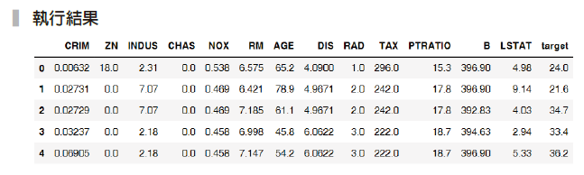

Slide 4
範例5-2 整理出資料中的X和y
程式碼
X = df.drop('target', axis=1)
y = df['target']

Slide 5
範例5-3 將資料分割成訓練集(_train)和測試集(_test)
程式碼
from sklearn.model_selection import train_test_split
X_train, X_test, y_train, y_test = train_test_split(X, y, test_size=0.33,random_state=42)

Slide 6
範例5-5 建構迴歸模型（－）──初始迴歸物件程式碼
from sklearn.linear_model import LinearRegression
model = LinearRegression()

Slide 7

範例5-6 建構迴歸模型（二）──訓練迴歸模型
程式碼
model.fit(X_train, y_train)

Slide 8
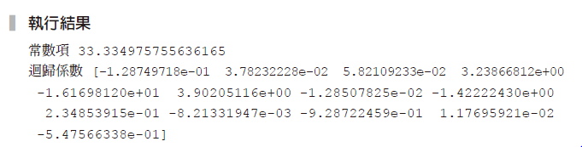
範例5-7 檢視訓練後的係數
程式碼
print('常數項',model.intercept_)
print('迴歸係數',model.coef_)

Slide 9
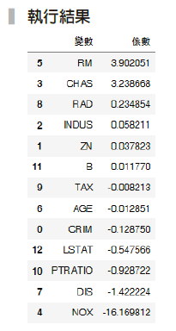
範例5-8 檢視訓練後的係數，並將係數由大到小排序
程式碼
pd.DataFrame(zip(X.columns, model.coef_), columns=['變數','係數']).\
sort_values(by='係數', ascending=False)

Slide 10
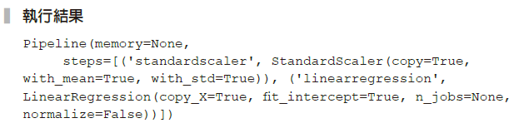
5-4 用標準化的數據再做一次機器學習
範例5-9 用「管道器」連接「標準化轉換器」和「迴歸預測器」
程式碼
from sklearn.preprocessing import StandardScaler
from sklearn.pipeline import make_pipeline
model_pl = make_pipeline(StandardScaler(), LinearRegression())
model_pl.fit(X_train, y_train)

Slide 11
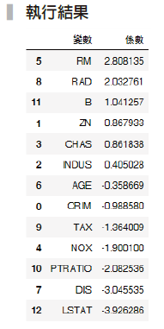
範例5-10 取得範例5-9 的迴歸係數結果
程式碼
reg = model_pl.named_steps['linearregression']
pd.DataFrame(zip(X.columns, reg.coef_), columns=['變數','係數']).\
sort_values(by='係數', ascending=False)

Slide 12
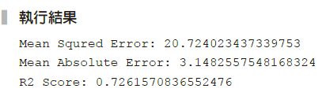
範例5-12 進行訓練集資料的預測
程式碼
y_pred = model_pl.predict(X_test)
from sklearn.metrics import mean_squared_error, mean_absolute_error, r2_score
print('Mean Squred Error:',mean_squared_error(y_test, y_pred))
print('Mean Absolute Error:', mean_absolute_error(y_test, y_pred))
print('R2 Score:', r2_score(y_test, y_pred))

Slide 13

範例5-13 取第一筆資料的實際y值
程式碼
y_train.iloc[0]

Slide 14

範例5-14 第一筆資料的預測結果
程式碼
model_pl.predict(X_train.iloc[[0]])

Slide 15
5-7 不同欄位的實驗
範例5-15 挑選前三個欄位進行預測
程式碼
from sklearn.compose import ColumnTransformer
data_pl = ColumnTransformer([
('column_sel',StandardScaler(),X.columns[:3])
])
model_pl = make_pipeline(data_pl, LinearRegression())
model_pl.fit(X_train, y_train)
y_pred = model_pl.predict(X_test)
print('Mean Squred Error:',mean_squared_error(y_test, y_pred))
print('Mean Absolute Error:', mean_absolute_error(y_test, y_pred))
print('R2 Score:', r2_score(y_test, y_pred))􀁇􀀋􀀕􀀌

Slide 16
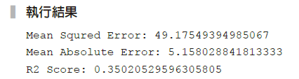

Slide 17
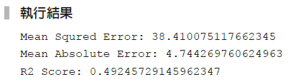
範例5-16 取LSTAT 欄位進行預測
程式碼
data_pl = ColumnTransformer([
('column_sel','passthrough',['LSTAT'])
])
model_pl = make_pipeline(data_pl, LinearRegression())
model_pl.fit(X_train, y_train)
y_pred = model_pl.predict(X_test)
print('Mean Squred Error:',mean_squared_error(y_test, y_pred))
print('Mean Absolute Error:', mean_absolute_error(y_test, y_pred))
print('R2 Score:', r2_score(y_test, y_pred))􀁒􀁘􀁑􀁇􀀋􀀕􀀌

Slide 18
範例5-17 繪製LSTAT欄位直方圖和進行log後的直方圖
程式碼
fig, axes = plt.subplots(1, 2, figsize=(8,3))
df['LSTAT'].hist(alpha=0.4, bins=30, ax=axes[0])
axes[0].set_title('原始')
#對'LSTAT'欄位進行log轉換
np.log1p(df['LSTAT']).hist(alpha=0.4, bins=30, ax=axes[1])
axes[1].set_title('進行log轉換');

Slide 19
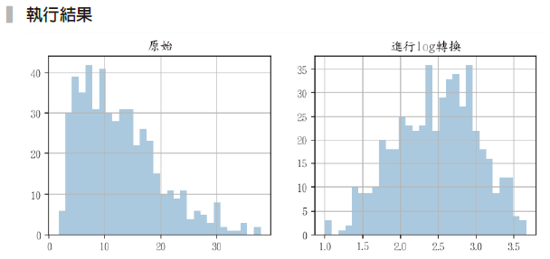

Slide 20
範例5-18 將log 函數加入管道器
程式碼
from sklearn.preprocessing import FunctionTransformer
data_pl = ColumnTransformer([
('column_sel','passthrough',['LSTAT'])
])
model_pl = make_pipeline(data_pl,
FunctionTransformer(np.log1p),
LinearRegression())
model_pl.fit(X_train, y_train)
y_pred = model_pl.predict(X_test)
print('Mean Squred Error:',mean_squared_error(y_test, y_pred))
print('Mean Absolute Error:', mean_absolute_error(y_test, y_pred))
print('R2 Score:', r2_score(y_test, y_pred))

Slide 21
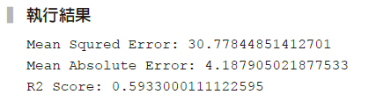

Slide 22
範例5-19 自製管道器流程
程式碼
#用字典存放初始化的轉換器和預測器。
pl = dict()
pl['ss'] = StandardScaler()
pl['regression'] = LinearRegression()
#訓練集會做標準化的學習和轉換，再進行預測器的學習。
pl['regression'].fit(pl['ss'].fit_transform(X_train), y_train)
#測試集會做標準化的轉換，和預測器的預測。
y_pred = pl['regression'].predict(pl['ss'].transform(X_test))
print('Mean Squred Error:',mean_squared_error(y_test, y_pred))
print('Mean Absolute Error:', mean_absolute_error(y_test, y_pred))
print('R2 Score:', r2_score(y_test, y_pred))

Slide 23
