Slide 1
第7章 K最近鄰

Slide 2
範例7-1 載入資料
  程式碼
import pandas as pd
import numpy as np
import matplotlib.pyplot as plt
import seaborn as sns
%matplotlib inline
plt.rcParams['font.sans-serif'] = ['DFKai-sb']
plt.rcParams['axes.unicode_minus'] = False
%config InlineBackend.figure_format = 'retina‘
import warnings
warnings.filterwarnings('ignore')
from sklearn.datasets import load_iris
iris = load_iris()
df = pd.DataFrame(iris['data'], columns=iris['feature_names'])
df['target'] = iris['target']
df = df[['sepal width (cm)', 'petal length (cm)','target']]
df = df.iloc[50:]
df.head()

Slide 3
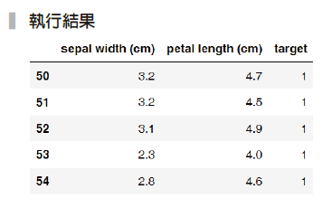

Slide 4
範例7-2 取出X和y
  程式碼
X = df.drop('target', axis=1)
y = df['target']
from sklearn.model_selection import train_test_split
X_train, X_test, y_train, y_test = train_test_split(X, y,
test_size=0.33, random_state=42)

Slide 5

範例7-3 取出X和y
  程式碼
from sklearn.neighbors import KNeighborsClassifier
# 初始物件
model = KNeighborsClassifier()
# 機器學習
model.fit(X_train, y_train)
#正確率的預測，model.score提供了簡便的正確率輸入方式
model.score(X_test, y_test)

Slide 6

範例7-4 用標準化的資料來分析
  程式碼
from sklearn.preprocessing import StandardScaler
from sklearn.pipeline import make_pipeline
model_pl = make_pipeline(StandardScaler(),
KNeighborsClassifier())
model_pl.fit(X_train, y_train)
model_pl.score(X_test, y_test)

Slide 7
範例7-5 預測結果分析
  程式碼
from sklearn.metrics import confusion_matrix, accuracy_score,
classification_report
y_pred = model_pl.predict(X_test)
print('正確率：', accuracy_score(y_test, y_pred).round(2))
print('混亂矩陣')
print(confusion_matrix(y_test, y_pred))
print('綜合報告')
print(classification_report(y_test, y_pred))

Slide 8
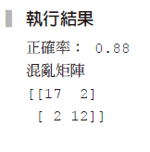
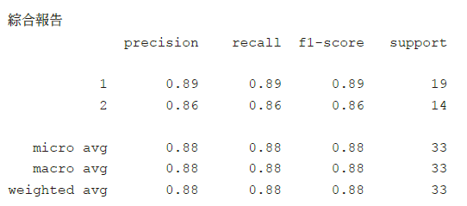

Slide 9
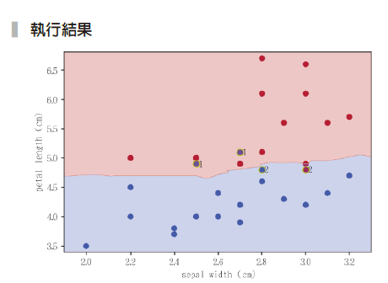
範例7-6 繪製未標準化結果的預測邊界

Slide 10
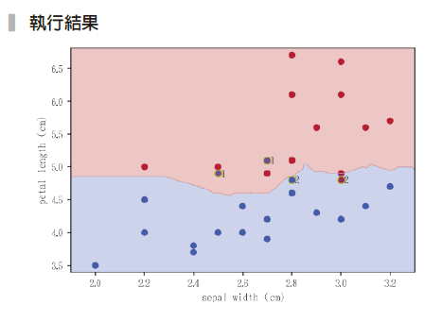
範例7-7 繪製標準化資料的預測邊界
  程式碼
plot_decision_boundary(X_test, y_test, model_pl, True)⁾

Slide 11
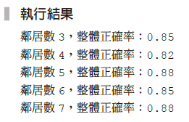
範例7-8 n_neighbors數目的選擇
  程式碼
accs = []
for n in range(3,8):
model_pl = make_pipeline(StandardScaler(),
KNeighborsClassifier(n_neighbors=n))
model_pl.fit(X_train, y_train)
print(f'鄰居數{n}，整體正確率：{model_pl.score(X_test, y_test).round(2)}')

Slide 12
範例7-9 用全部特徵值來分析
  程式碼
iris = load_iris()
df = pd.DataFrame(iris['data'], columns=iris['feature_names'])
df['target'] = iris['target']
df = df.iloc[50:]
#資料分割
X = df.drop('target', axis=1)
y = df['target']
X_train, X_test, y_train, y_test = train_test_split(X, y,
test_size=0.33,
random_state=42)

Slide 13
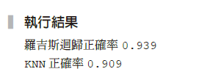
範例7-9 用全部特徵值來分析
  承接上一頁
#羅吉斯迴歸
from sklearn.linear_model import LogisticRegression
model_pl_lr = make_pipeline(StandardScaler(), LogisticRegression
(solver='liblinear'))
model_pl_lr.fit(X_train, y_train)
print(f'羅吉斯迴歸正確率{model_pl_lr.score(X_test, y_test).round(3)}')
# KNN
model_pl_knn = make_pipeline(StandardScaler(), KNeighborsClassifier())
model_pl_knn.fit(X_train, y_train)
print(f'KNN正確率{model_pl_knn.score(X_test, y_test).round(3)}')

Slide 14
7-4 主成分分析
範例7-10 創建PCA用的資料
  程式碼
np.random.seed(1)
x = np.linspace(-10, 10, 100)
y = 2 * x + 4*np.random.randn(100)
df_pca = pd.DataFrame(zip(x,y), columns=['x0','x1'])
plt.scatter(x, y);

Slide 15
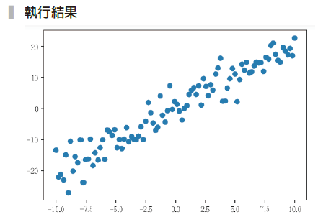

Slide 16
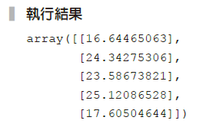
範例7-11 如何選擇軸，能最大化的代表這份二維資料
  程式碼
from sklearn.decomposition import PCA
pca = PCA(n_components=1)
X_pca = pca.fit_transform(df_pca)
X_pca[:5]

Slide 17
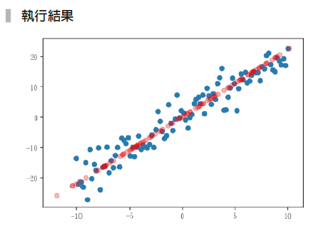
範例7-12 範例7-11 得到的軸，繪製在原來的散布圖裡
  程式碼
# 原來的資料
plt.scatter(x, y)
# 將X_pca 轉到原本的資料維度
X_new = pca.inverse_transform(X_pca)
plt.scatter(X_new[:,0], X_new[:,1], c='r', alpha=0.3);

Slide 18

範例7-14 將資料標準化，然後PCA(2)，再進行KNN預測
  程式碼
model_pl = make_pipeline(StandardScaler(),
PCA(n_components=2),
KNeighborsClassifier())
model_pl.fit(X_train, y_train)
y_pred = model_pl.predict(X_test)
print('整體正確率:',accuracy_score(y_test, y_pred).round(2))

Slide 19

7-5 SelectKBest
範例7-15 用SelectKBest選出最好的兩個特徵值，並指出是哪兩個欄位
  程式碼
from sklearn.feature_selection import SelectKBest, f_classif
selector = SelectKBest(f_classif, 2)
selector.fit(X_train, y_train)
selector.get_support()

Slide 20

範例7-16 呈上例，將取出的欄位名稱列出
  程式碼
X_test.columns[selector.get_support()]

Slide 21
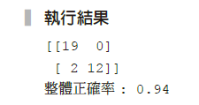
範例7-17 創建管道器，連結標準化、SelectKBest和K最近鄰預測
  程式碼
model_pl = make_pipeline(StandardScaler(),
SelectKBest(f_classif, 2),
KNeighborsClassifier())
model_pl.fit(X_train, y_train)
y_pred = model_pl.predict(X_test)
print(confusion_matrix(y_test, y_pred))
print('整體正確率:',accuracy_score(y_test, y_pred).round(2))

