Slide 1
第8章 支持向量機

Slide 2
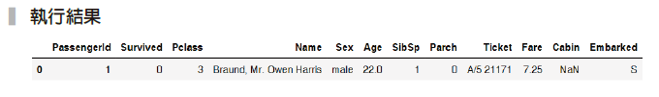
範例8-1 載入資料（資料請放在工作目錄）
  程式碼
import pandas as pd
import numpy as np
import matplotlib.pyplot as plt
import seaborn as sns
%matplotlib inline
plt.rcParams['font.sans-serif'] = ['DFKai-sb']
plt.rcParams['axes.unicode_minus'] = False
%config InlineBackend.figure_format = 'retina'
import warnings
warnings.filterwarnings('ignore')
df = pd.read_csv('titanic_train.csv')
df.head(1)

Slide 3
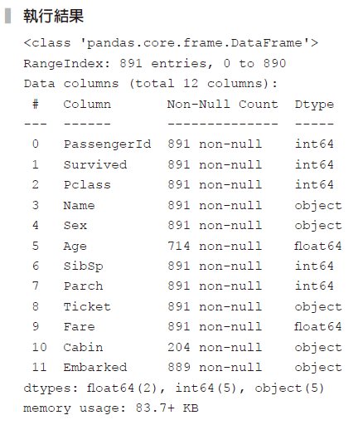
範例8-2 資料檢查和資料欄位說明
  程式碼
df.info()

Slide 4
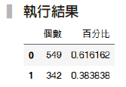
範例8-3 檢視目標值Survived的分布
  程式碼
pd.concat([df['Survived'].value_counts(),
df['Survived'].value_counts(normalize=True)],
axis=1, keys=['個數','百分比'])

Slide 5
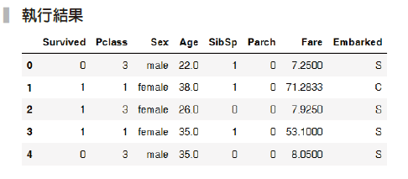
範例8-4 移除PassengerId、Name、Ticket、Cabin欄位
  程式碼
df = df.drop(['PassengerId', 'Name', 'Ticket', 'Cabin'], axis=1)
df.head()

Slide 6
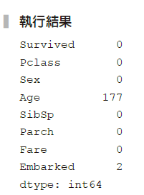
範例8-5 遺漏值檢查
  程式碼
df.isnull().sum()

Slide 7
範例8-6 用seaborn的pairplot來快速檢視變數關係
  程式碼
sns.pairplot(data=df, hue='Survived',
size=2, diag_kws={'bw':0.1});

Slide 8
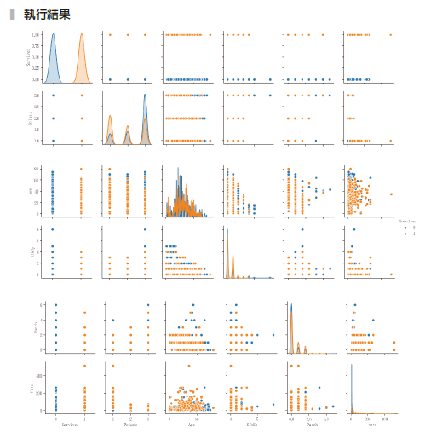

Slide 9
範例8-10 欄位處理
  程式碼
X_col_num = ['Age', 'SibSp', 'Parch', 'Fare']
X_col_cat = ['Pclass', 'Sex', 'Embarked']
X_cols = X_col_num + X_col_cat
y_col = 'Survived'

Slide 10
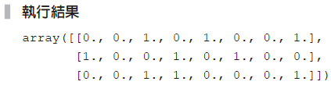
範例8-11 數值型資料的管道器
  程式碼
from sklearn.impute import SimpleImputer
from sklearn.preprocessing import StandardScaler
from sklearn.pipeline import make_pipeline
num_pl = make_pipeline(
SimpleImputer(strategy='median'),
StandardScaler()
)
# 檢查數值管道器的運作
print(f'數值型資料的欄位有：{X_col_num}')
num_pl.fit_transform(df[X_col_num])[:3]

Slide 11
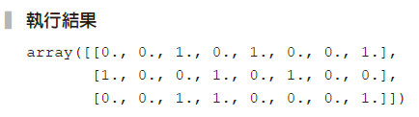
範例8-12 類別型資料的管道器
  程式碼
from sklearn.preprocessing import OneHotEncoder
cat_pl = make_pipeline(
SimpleImputer(strategy='most_frequent'),
OneHotEncoder(sparse=False)
)
# 檢查類別管道器的運作
cat_pl.fit_transform(df[X_col_cat])[:3]

Slide 12
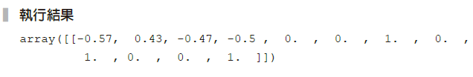
範例8-15 用「水平合併器」整合數值和類別資料管道器，並檢視資料
  程式碼
from sklearn.compose import ColumnTransformer
data_pl = ColumnTransformer([
('num_pl', num_pl, X_col_num),
('cat_pl', cat_pl, X_col_cat)
])
data_pl.fit_transform(df[X_cols])[:1].round(2)

Slide 13
範例8-16 將資料切成訓練集和測試集
  程式碼
from sklearn.model_selection import train_test_split
X = df[X_cols]
y = df[y_col]
X_train, X_test, y_train, y_test = train_test_split(X, y,
test_size=0.33,
random_state=42)

Slide 14
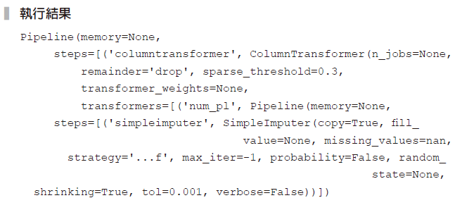
範例8-17 將支持向量機也加入管道器裡
  程式碼
from sklearn.svm import SVC
model_pl_svc = make_pipeline(data_pl, SVC())
model_pl_svc

Slide 15
範例8-18 用mode_pl_svc來做機器學習和預測
  程式碼
from sklearn.metrics import confusion_matrix, accuracy_score,
classification_report
model_pl_svc.fit(X_train, y_train)
y_pred = model_pl_svc.predict(X_test)
print('正確率：', accuracy_score(y_test, y_pred).round(2))
print('混亂矩陣')
print(confusion_matrix(y_test, y_pred))
print('綜合報告')
print(classification_report(y_test, y_pred))

Slide 16
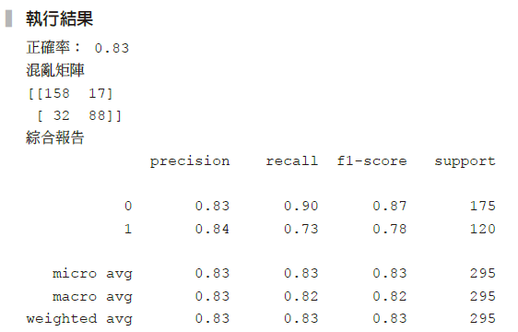

Slide 17
範例8-19 用羅吉斯迴歸來做預測
  程式碼
from sklearn.linear_model import LogisticRegression
model_pl_lr = make_pipeline(data_pl, LogisticRegression())
model_pl_lr.fit(X_train, y_train)
y_pred = model_pl_lr.predict(X_test)
print('正確率：', accuracy_score(y_test, y_pred).round(2))
print('混亂矩陣')
print(confusion_matrix(y_test, y_pred))
print('綜合報告')
print(classification_report(y_test, y_pred))

Slide 18
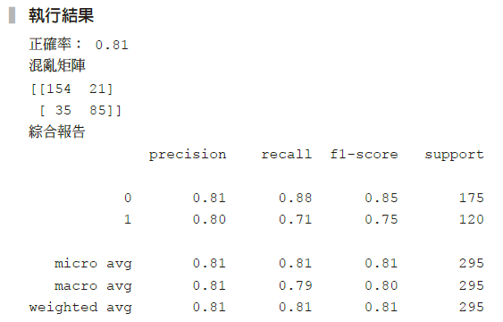

Slide 19
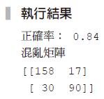
範例8-20 將'p_class'從類別型管道，移到數值型管道
  程式碼
data_pl = ColumnTransformer([
('num_pl', num_pl, ['Age', 'SibSp', 'Parch', 'Fare', 'Pclass']),
('cat_pl', cat_pl, ['Sex', 'Embarked'])
])
model_pl_svc = make_pipeline(data_pl, SVC())
model_pl_svc.fit(X_train, y_train)
y_pred = model_pl_svc.predict(X_test)
print('正確率：', accuracy_score(y_test, y_pred).round(2))
print('混亂矩陣')
print(confusion_matrix(y_test, y_pred))

Slide 20
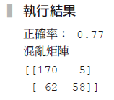
範例8-21 將SelectKBest加到資料管道器的後端，並選最重要的3個特徵值
  程式碼
from sklearn.feature_selection import SelectKBest, f_classif
data_pl = ColumnTransformer([
('num_pl', num_pl, X_col_num),
('cat_pl', cat_pl, X_col_cat)])
model_pl_svc = make_pipeline(data_pl,
SelectKBest(f_classif, 3),
SVC())
model_pl_svc.fit(X_train, y_train)
y_pred = model_pl_svc.predict(X_test)
print('正確率：', accuracy_score(y_test, y_pred).round(2))
print('混亂矩陣')
print(confusion_matrix(y_test, y_pred))

