Slide 1
第9章 決策樹

Slide 2
範例9-1 載入資料
  程式碼
import pandas as pd
import numpy as np
import matplotlib.pyplot as plt
import seaborn as sns
%matplotlib inline
plt.rcParams['font.sans-serif'] = ['DFKai-sb']
plt.rcParams['axes.unicode_minus'] = False
%config InlineBackend.figure_format = 'retina'
import warnings
warnings.filterwarnings('ignore')
# 資料載入
df = pd.read_csv('titanic_train.csv')
df = df.drop(['PassengerId', 'Name', 'Ticket', 'Cabin'], axis=1)

Slide 3
範例9-1 載入資料
  承接上一頁
# 欄位設定
X_col_num = ['Age', 'SibSp', 'Parch', 'Fare']
X_col_cat = ['Pclass', 'Sex', 'Embarked']
X_cols = X_col_num + X_col_cat
y_col = 'Survived'
# 資料切割成訓練集和測試集
from sklearn.model_selection import train_test_split
X = df[X_cols]
y = df[y_col]
X_train, X_test, y_train, y_test = train_test_split(X, y,
est_size=0.33, random_state=42)
df.head()

Slide 4
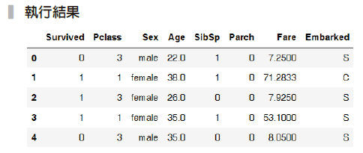

Slide 5
範例9-2 先實作資料管道器，並檢視是可用的
  程式碼
from sklearn.pipeline import make_pipeline
from sklearn.impute import SimpleImputer
from sklearn.preprocessing import OneHotEncoder
from sklearn.compose import ColumnTransformer
num_pl = make_pipeline(
SimpleImputer(strategy='median')
)
cat_pl = make_pipeline(
SimpleImputer(strategy='most_frequent'),
OneHotEncoder(sparse=False)
)

Slide 6
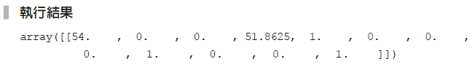
範例9-2 先實作資料管道器，並檢視是可用的
  承接上一頁
data_pl = ColumnTransformer([
('num_pl', num_pl, X_col_num),
('cat_pl', cat_pl, X_col_cat)
])
data_pl.fit_transform(X_train)[:1]

Slide 7
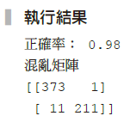
範例9-3 製作決策樹預測模型，用「訓練集」來觀察結果
  程式碼
from sklearn.tree import DecisionTreeClassifier
from sklearn.metrics import confusion_matrix, accuracy_score
model_pl_tree = make_pipeline(data_pl,
DecisionTreeClassifier(random_state=42))
model_pl_tree.fit(X_train, y_train)
y_pred = model_pl_tree.predict(X_train)
print('正確率：', accuracy_score(y_train, y_pred).round(2))
print('混亂矩陣')
print(confusion_matrix(y_train, y_pred))

Slide 8
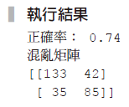
範例9-4 用決策樹模型來預測「測試集」的結果
  程式碼
y_pred = model_pl_tree.predict(X_test)
print('正確率：', accuracy_score(y_test, y_pred).round(2))
print('混亂矩陣')
print(confusion_matrix(y_test, y_pred))

Slide 9

範例9-5 決策樹的「深度」設定為4
  程式碼
model_pl_tree = make_pipeline(
data_pl,
DecisionTreeClassifier(max_depth=4, random_state=42)
)
model_pl_tree.fit(X_train, y_train)
print('「訓練集」的正確率：', model_pl_tree.score(X_train, y_train).round(2))
print('「測試集」的正確率：', model_pl_tree.score(X_test, y_test).round(2))

Slide 10
範例9-6 用不同的決策樹深度來觀察「訓練集」和「測試集」的結果變化
  程式碼
acc_train = []
acc_test = []
n_depth = range(2,25)
for n in n_depth:
model_pl_tree = make_pipeline(
data_pl,
DecisionTreeClassifier(max_depth=n, random_state=42)
)
model_pl_tree.fit(X_train, y_train)
acc_train.append(model_pl_tree.score(X_train, y_train))
acc_test.append(model_pl_tree.score(X_test, y_test))

Slide 11
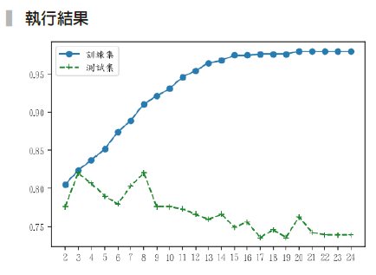
範例9-6 用不同的決策樹深度來觀察「訓練集」和「測試集」的結果變化
  承接上一頁
# 繪圖開始
plt.plot(n_depth, acc_train, marker='o', label='訓練集')
plt.plot(n_depth, acc_test, c='green',
marker='+', ls='--', label='測試集')
plt.xticks(n_depth, n_depth)
plt.legend();

Slide 12
範例9-7 透過min_samples_split來避免過度擬合發生
  程式碼
acc_train = []
acc_test = []
n_range = range(2,100,3)
for n in n_range:
model_pl_tree = make_pipeline(data_pl,
DecisionTreeClassifier(random_
state=42, min_samples_split=n))
model_pl_tree.fit(X_train, y_train)
acc_train.append(model_pl_tree.score(X_train, y_train).round(2))
acc_test.append(model_pl_tree.score(X_test, y_test).round(2))

Slide 13
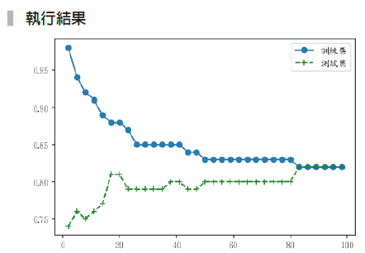
範例9-7 透過min_samples_split來避免過度擬合發生
  承接上一頁
plt.plot(n_range, acc_train, marker='o', label='訓練集')
plt.plot(n_range, acc_test, c='green', marker='+', ls='--', label='測試集')
plt.legend();

Slide 14

範例9-8 用決策樹了解哪些特徵值是重要的
  程式碼
model_pl_tree = make_pipeline(
data_pl,
DecisionTreeClassifier(max_depth=4, random_state=42)
)
model_pl_tree.fit(X_train, y_train)
tree = model_pl_tree.named_steps['decisiontreeclassifier']
feature_importance = tree.feature_importances_.round(3)
feature_importance

Slide 15
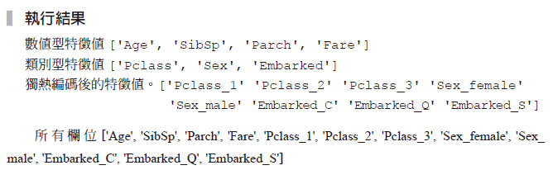
範例9-9 取出係數的對應欄位
  程式碼
print(f'數值型特徵值{X_col_num}')
print(f'類別型特徵值{X_col_cat}')
cat_pl = data_pl.named_transformers_['cat_pl']
oh_cols = cat_pl.named_steps['onehotencoder'].\
get_feature_names(X_col_cat)
print(f'獨熱編碼後的特徵值。{oh_cols}')
cols = X_col_num + oh_cols.tolist()
print(f'所有欄位{cols}')

Slide 16
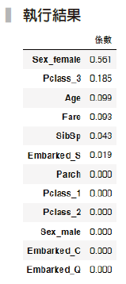
範例9-10 將係數和特徵值名稱結合起來，並依係數大小排序
  程式碼
pd.DataFrame(feature_importance, index=cols, columns=['係數']).\
sort_values(by='係數', ascending=False)

Slide 17
範例9-11 將結果用決策樹圖來呈現
  程式碼
from sklearn.tree import export_graphviz
import pydot
from IPython.display import Image
# features 變數存放所有欄位名稱
features = cols
# class_names 變數存放目標值表呈現的文字意義
class_names = ['死', '活']
# export_graphviz 的第一個參數是決策樹模型的預測結果
# max_depth=3 可設定決策樹呈現的深度，其餘參數讀者可自己測試
dot_data = export_graphviz(
model_pl_tree.named_steps['decisiontreeclassifier'],
out_file=None,

Slide 18
範例9-11 將結果用決策樹圖來呈現
  承接上一頁
feature_names=features,
class_names = class_names,
proportion = False,
max_depth=3,
filled=True,
rounded=True
)
graph = pydot.graph_from_dot_data(dot_data)
# 也將結果存到 tree.png檔案裡
graph[0].write_png('tree.png')
Image(graph[0].create_png())

Slide 19
