Slide 1
第10章 交叉驗證

Slide 2
範例10-1 用DESCR來了解資料的來龍去脈
  程式碼
import pandas as pd
import numpy as np
import matplotlib.pyplot as plt
import seaborn as sns
%matplotlib inline
plt.rcParams['font.sans-serif'] = ['DFKai-sb']
plt.rcParams['axes.unicode_minus'] = False
%config InlineBackend.figure_format = 'retina'
import warnings
warnings.filterwarnings('ignore')
from sklearn.datasets import load_breast_cancer
breast_cancer = load_breast_cancer()
print('\n'.join(breast_cancer['DESCR'].split('\n')[:15]))

Slide 3
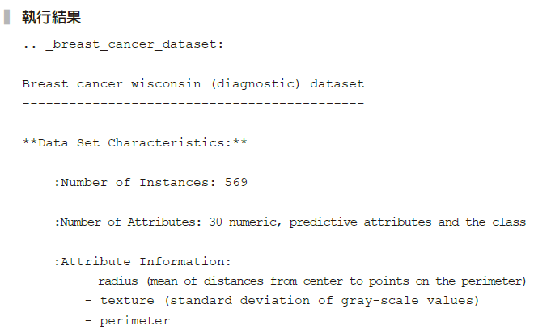

Slide 4
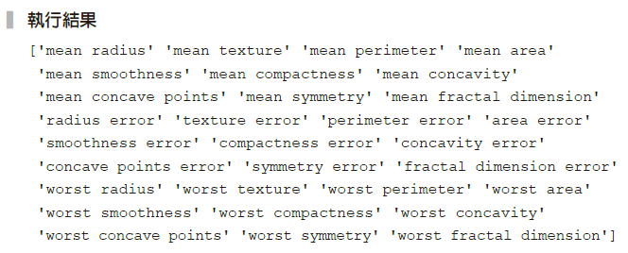
範例10-2 檢視資料的特徵值
  程式碼
print(breast_cancer['feature_names'])

Slide 5
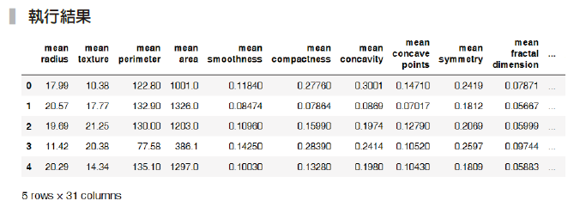
範例10-3 將資料和預測的目標值都整合到DataFrame裡
  程式碼
df = pd.DataFrame(data = breast_cancer['data'], columns = breast_
cancer['feature_names'])
df['target'] = breast_cancer['target']
df.head()

Slide 6
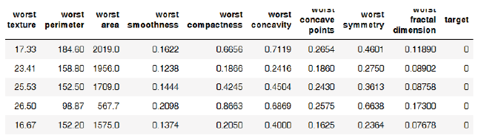

Slide 7
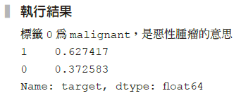
範例10-5 觀察目標值
  程式碼
print(f'標籤0為{breast_cancer["target_names"][0]}，是惡性腫瘤的意思')
print(df['target'].value_counts(normalize=True))

Slide 8
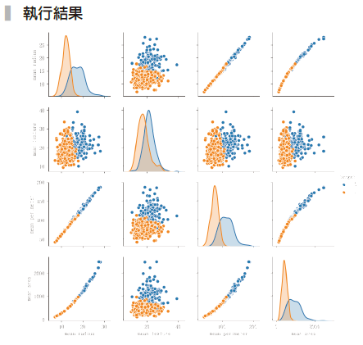
範例10-6 pairplot 的資料探索
  程式碼
sns.pairplot(df, vars=['mean radius','mean texture','mean perimeter',
'mean area'], hue='target', size=2);

Slide 9
範例10-10 欄位處理和將資料切割成訓練集和測試集
  程式碼
X_cols = df.columns.drop('target')
X = df[X_cols]
y = df['target']
from sklearn.model_selection import train_test_split
X_train, X_test, y_train, y_test = train_test_split(X, y,
test_size=0.33, random_state=42)

Slide 10
範例10-11 載入所有模組，並進行模型學習和預測
  程式碼
from sklearn.linear_model import LogisticRegression
from sklearn.svm import SVC
from sklearn.neighbors import KNeighborsClassifier
from sklearn.tree import DecisionTreeClassifier
from sklearn.pipeline import make_pipeline
from sklearn.preprocessing import StandardScaler
models = [LogisticRegression(), SVC(),
KNeighborsClassifier(),
DecisionTreeClassifier(max_depth=5)]

Slide 11
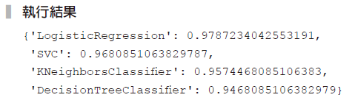
範例10-11 載入所有模組，並進行模型學習和預測
  承接上一頁
scores = {}
for model in models:
model_pl = make_pipeline(StandardScaler(), model)
model_pl.fit(X_train, y_train)
score = model_pl.score(X_test, y_test)
scores[model._ _class_ _._ _name_ _] = score
scores

Slide 12
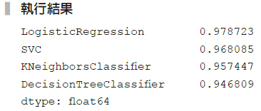
範例10-12 將範例10-11的執行結果整理到DataFrame，並加以排序
  程式碼
pd.Series(scores).sort_values(ascending=False)

Slide 13
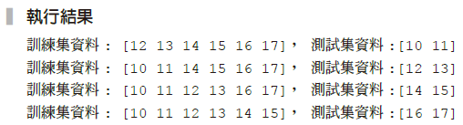
10-4 交叉驗證
範例10-13 資料切割
  程式碼
from sklearn.model_selection import KFold
data = np.arange(10,18)
kfold = KFold(n_splits=4)
for train_idx, test_idx in kfold.split(data):
print(f'訓練集資料: {data[train_idx]}， 測試集資料:{data[test_idx]}')

Slide 14

範例10-15 5折交叉驗證的簡單方式
  程式碼
from sklearn.model_selection import cross_val_score
model_pl_lr = make_pipeline(StandardScaler(), LogisticRegression())
scores = cross_val_score(model_pl_lr, X_train, y_train,
scoring='accuracy', cv=5)
print(f'5折交叉驗證的每次結果 {scores}')
print(f'5折交叉驗證的平均結果{np.mean(scores)}')

Slide 15
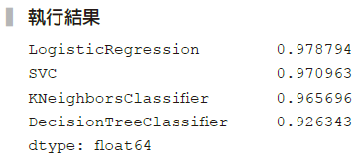
範例10-17 機器學習模型大亂鬥──正確版
  程式碼
models = [LogisticRegression(), SVC(), KNeighborsClassifier(), DecisionTreeClassifier(max_depth=10)]
scores = {}
for model in models:
model_pl = make_pipeline(StandardScaler(), model)
score = cross_val_score(model_pl, X_train, y_train,
scoring='accuracy', cv=10)
scores[model._ _class_ _._ _name_ _] = score.mean()
pd.Series(scores).sort_values(ascending=False)

Slide 16
範例10-18 檢視羅吉斯迴歸的各項數據報表
  程式碼
from sklearn.metrics import accuracy_score, confusion_matrix,
classification_report
model_pl_lr = make_pipeline(StandardScaler(), LogisticRegression())
model_pl_lr.fit(X_train, y_train)
y_pred = model_pl_lr.predict(X_test)
print('正確率：', accuracy_score(y_test, y_pred).round(3))
print('混亂矩陣')
print(confusion_matrix(y_test, y_pred))
print('綜合報告')
print(classification_report(y_test, y_pred))

Slide 17
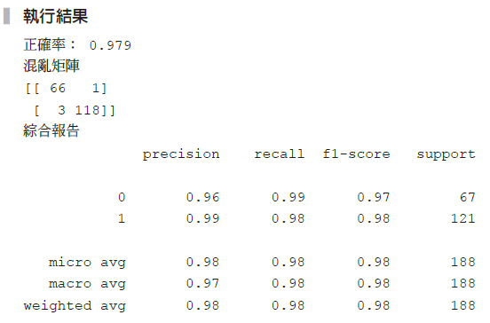

Slide 18
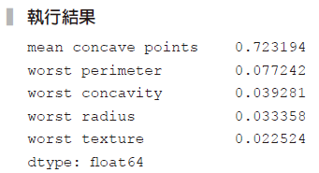
範例10-19 用決策樹檢視前五重要的變數和係數
  程式碼
model_tree = DecisionTreeClassifier(max_depth=10)
model_tree.fit(X_train, y_train)
pd.Series(model_tree.feature_importances_,
index=X.columns).sort_values(ascending=False).head()

Slide 19
範例10-20 將決策樹結果繪圖
  程式碼
from sklearn.tree import export_graphviz
import pydot
from IPython.display import Image
features = X.columns
class_names = ['惡性', '良性']
dot_data = export_graphviz(model_tree, out_file=None,
feature_names=features,
class_names = class_names,
proportion = False,
max_depth=3,
filled=True,
rounded=True)

Slide 20
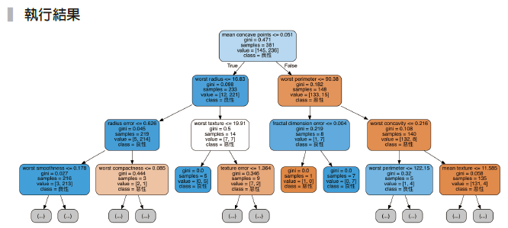
範例10-20 將決策樹結果繪圖
  承接上一頁
graph = pydot.graph_from_dot_data(dot_data)
graph[0].write_png('tumor.png')
Image(graph[0].create_png(), width=800)

