Slide 1
第11章 模型參數挑選和網格搜尋

Slide 2
範例11-1 定義邊界繪製函數
  程式碼
import pandas as pd
import numpy as np
import matplotlib.pyplot as plt
import seaborn as sns
%matplotlib inline
plt.rcParams['font.sans-serif'] = ['DFKai-sb']
plt.rcParams['axes.unicode_minus'] = False
%config InlineBackend.figure_format = 'retina'
import warnings
warnings.filterwarnings('ignore')

Slide 3
範例11-1 定義邊界繪製函數
  承接上一頁
def plot_decision_boundary(X_test, y_test, model, ax):
points = 500
x1_max, x2_max = X_test.max()
x1_min, x2_min = X_test.min()
X1, X2 = np.meshgrid(np.linspace(x1_min-0.1, x1_max+0.1, points),np.linspace(x2_min-0.1, x2_max+0.1, points))
x1_label, x2_label = X_test.columns
X_test.plot(kind='scatter', x=x1_label, y=x2_label, c=y_test,
cmap='coolwarm', colorbar=False, s=20, ax=ax)
grids = np.array(list(zip(X1.ravel(), X2.ravel())))
ax.contourf(X1, X2, model.predict(grids).reshape(X1.shape),
alpha=0.3, cmap='coolwarm')

Slide 4
範例11-2 載入鳶尾花的資料和完成資料預處理
  程式碼
from sklearn.datasets import load_iris
iris = load_iris()
df = pd.DataFrame(iris['data'], columns=iris['feature_names'])
df = df[['sepal width (cm)', 'petal length (cm)']]
df['target'] = iris['target']
df = df.iloc[50:]
X_cols = df.columns.drop('target')
y_col = 'target'
X = df[X_cols]
y = df[y_col]
from sklearn.model_selection import train_test_split
X_train, X_test, y_train, y_test = train_test_split(X, y,
test_size=0.33, random_state=42)

Slide 5
範例11-3 用預測邊界方式了解不同參數C對支持向量機的影響
  程式碼
from sklearn.preprocessing import StandardScaler
from sklearn.pipeline import make_pipeline
from sklearn.svm import SVC
fig, axes = plt.subplots(2,3, figsize=(8,5), sharex=True, sharey=True)
scores = []
Cs = [0.001, 0.01, 0.1, 1, 10, 100]
for ax, c in zip(axes.ravel(), Cs):
model_pl = make_pipeline(StandardScaler(), SVC(C=c))
model_pl.fit(X_train, y_train) plot_decision_boundary(X_train, y_train, model_pl, ax)
ax.set_title(f'參數C={c}')
plt.tight_layout()

Slide 6
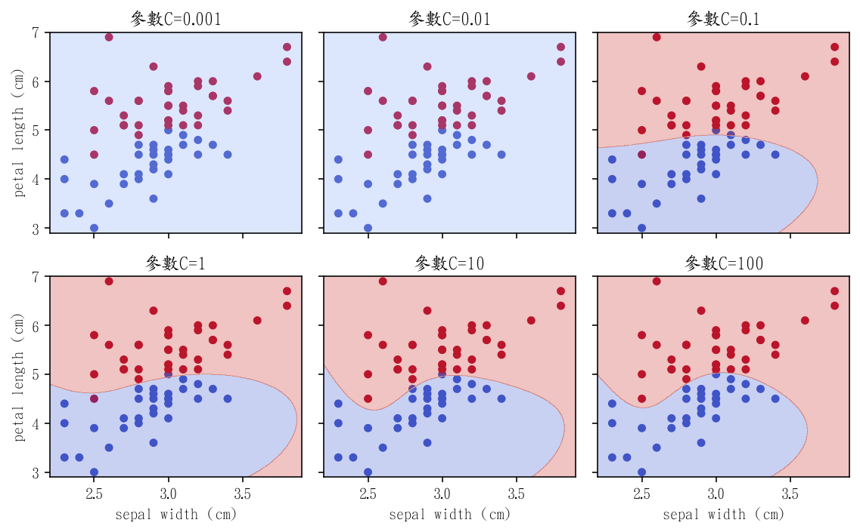

Slide 7
範例11-4 用邊界繪圖方式了解gamma參數對支持向量機的影響
  程式碼
fig, axes = plt.subplots(2,3, figsize=(8,5), sharex=True, sharey=True)
scores = []
gammas = [0.001, 0.01, 0.1, 1, 10, 100]
for ax, gamma in zip(axes.ravel(), gammas):
model_pl = make_pipeline(StandardScaler(), SVC(gamma=gamma))
model_pl.fit(X_train, y_train)
plot_decision_boundary(X_train, y_train, model_pl, ax)
ax.set_title(f'參數gamma={gamma}')
plt.tight_layout()

Slide 8
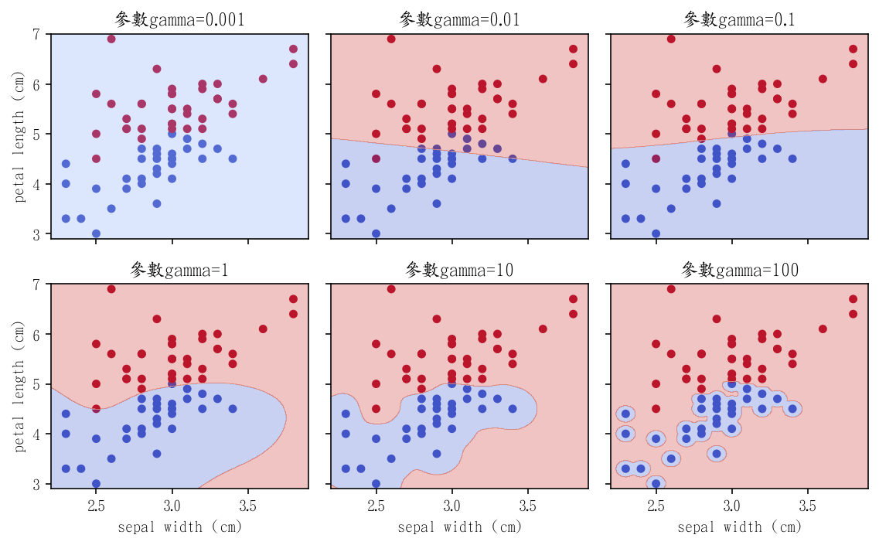

Slide 9
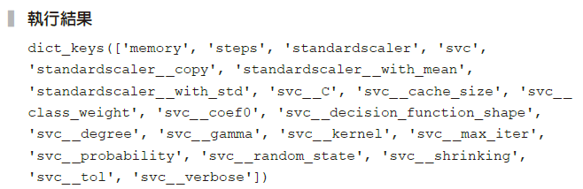
範例11-5 支持向量機能挑選的參數
  程式碼
model_pl = make_pipeline(StandardScaler(), SVC())
keys = model_pl.get_params().keys()
keys

Slide 10

範例11-6 支持向量機的參數組合偷懶版
  程式碼
param_grid = {
'svc_ _kernel': ['linear', 'rbf'],
'svc_ _C':[0.1, 0.5, 0.8, 1, 5],
'svc_ _gamma':np.arange(0.2, 1, 0.2)
}
print(param_grid)

Slide 11
範例11-8 進行網格搜尋
  程式碼
model_pl = make_pipeline(StandardScaler(), SVC())
gs = GridSearchCV(model_pl, param_grid=param_grid,
cv=10, return_train_score=True)
# 進行網路搜尋學習
gs.fit(X_train, y_train)

Slide 12
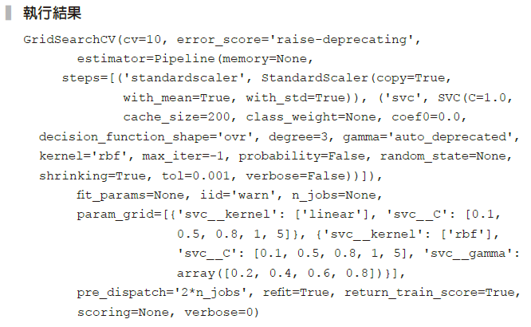

Slide 13

範例11-9 取得網格搜尋的最佳參數
  程式碼
gs.best_params_

Slide 14

範例11-10 取得網格搜尋裡最佳預測的結果
  程式碼
gs.best_score_

Slide 15

範例11-12 最佳參數運用在測試集的預測結果
  程式碼
model_pl_svc = make_pipeline(StandardScaler(), SVC(C=0.5, kernel='linear'))
model_pl_svc.fit(X_train, y_train)
model_pl_svc.score(X_test, y_test)

Slide 16
11-3 網格搜尋的過程分析
範例11-15 網格搜尋的過程分析
  程式碼
# 第一行是為了能看欄位裡所有的值
pd.set_option('display.max_colwidth', -1)
df_cv = pd.DataFrame(gs.cv_results_)[['params','mean_test_score']].\
sort_values(by = 'mean_test_score', ascending=False).head(12)
df_cv

Slide 17
