Slide 1
第13章 員工流失率預測

Slide 2
範例13-1 載入資料和欄位
  程式碼
import pandas as pd
import numpy as np
import matplotlib.pyplot as plt
import seaborn as sns
%matplotlib inline
%config InlineBackend.figure_format = 'retina'
import warnings
warnings.filterwarnings('ignore')
df = pd.read_csv('HR_comma_sep.csv')
df.head()

Slide 3
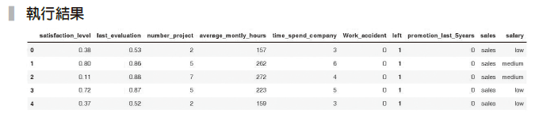

Slide 4
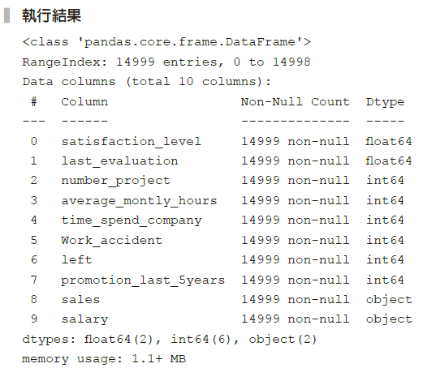
範例13-2 檢視資料的個數和基本形態
  程式碼
df.info()

Slide 5
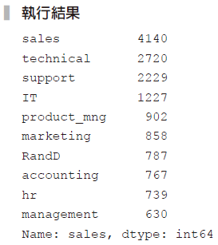
範例13-3 進一步檢視sales 欄位
  程式碼
df['sales'].value_counts()

Slide 6
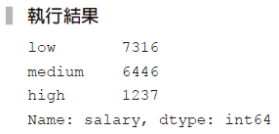
範例13-4 檢視salary 欄位
  程式碼
df['salary'].value_counts()

Slide 7
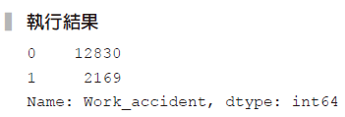
範例13-5 檢視Work_accident 欄位
  程式碼
df['Work_accident'].value_counts()

Slide 8
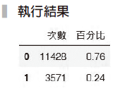
範例13-6 檢視目標欄位left
  程式碼
size = df['left'].value_counts()
pct = df['left'].value_counts(normalize=True).round(2)
pd.DataFrame(zip(size, pct), columns=['次數', '百分比'])

Slide 9
範例13-16 資料切割
  程式碼
X = df.drop('left', axis=1)
y = df['left']
from sklearn.model_selection import train_test_split
X_train, X_test, y_train, y_test = train_test_split(X, y,
test_size=0.3, random_state=42)

Slide 10
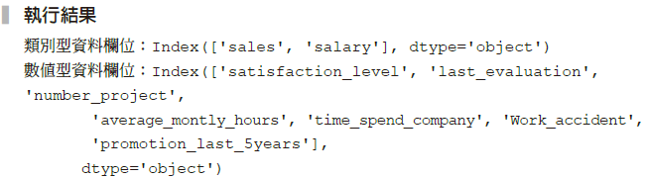
範例13-17 將X 欄位再細分成數值和類別
  程式碼
X_col_cat = X.select_dtypes(include = 'object').columns
X_col_num = X.select_dtypes(exclude = 'object').columns
print(f'類別型資料欄位：{X_col_cat}')
print(f'數值型資料欄位：{X_col_num}')

Slide 11
範例13-18 建構數值和類別兩個管道器，並整合到合併器
  程式碼
from sklearn.pipeline import make_pipeline
from sklearn.preprocessing import StandardScaler, OneHotEncoder
from sklearn.compose import ColumnTransformer
data_pl = ColumnTransformer([
('num', StandardScaler(), X_col_num),
('cat', OneHotEncoder(), X_col_cat)
])

Slide 12
範例13-19 求出「基礎」的預測結果
  程式碼
from sklearn.dummy import DummyClassifier
from sklearn.metrics import confusion_matrix, classification_report,accuracy_score
dmy = DummyClassifier(strategy='most_frequent')
dmy.fit(X_train, y_train)
dmy.score(X_train, y_train)
y_pred = dmy.predict(X_test)
print('正確率：', accuracy_score(y_test, y_pred).round(2))
print('混亂矩陣')
print(confusion_matrix(y_test, y_pred))
print('綜合報告')
print(classification_report(y_test, y_pred))

Slide 13
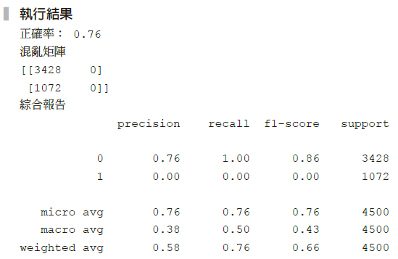

Slide 14
範例13-20 用GridSearchCV來挑選最佳結果(I)
  程式碼
# 載入所有模型
from sklearn.linear_model import LogisticRegression
from sklearn.svm import SVC
from sklearn.neighbors import KNeighborsClassifier
from sklearn.tree import DecisionTreeClassifier
from sklearn.ensemble import RandomForestClassifier,
BaggingClassifier, AdaBoostClassifier
from xgboost import XGBClassifier
# 載入 Pipeline ，PCA 和 GridSearchCV
from sklearn.pipeline import Pipeline
from sklearn.model_selection import GridSearchCV

Slide 15
範例13-20 用GridSearchCV來挑選最佳結果(I)
  承接上一頁
model_pl = Pipeline([
('preprocess', data_pl),
('model', LogisticRegression())
])
param_grid = {'model':[LogisticRegression(), SVC(),
KNeighborsClassifier(),
DecisionTreeClassifier(max_depth=10)]}
gs = GridSearchCV(model_pl, param_grid=param_grid,
cv=5, return_train_score=True)
gs.fit(X_train, y_train)
score = gs.best_estimator_.score(X_test, y_test)

Slide 16
範例13-20 用GridSearchCV來挑選最佳結果(I)
  承接上一頁
print('最佳預測參數', gs.best_params_)
print('訓練集交叉驗證的最佳結果', gs.best_score_.round(3))
print('測試集的結果', score.round(3))
y_pred = gs.best_estimator_.predict(X_test)
print('混亂矩陣\n',confusion_matrix(y_test, y_pred))

Slide 17
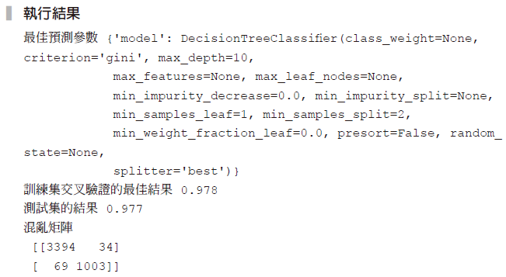

Slide 18
範例13-21 用GridSearchCV來挑選最佳結果(II)
  程式碼
model_pl = Pipeline([('preprocess', data_pl), ('model', LogisticRegression())])
np.random.seed(42)
param_grid = {'model':[RandomForestClassifier(), AdaBoostClassifier(),
BaggingClassifier(), XGBClassifier()]}
gs = GridSearchCV(model_pl, param_grid=param_grid,
cv=5, return_train_score=True)
gs.fit(X_train, y_train)
score = gs.best_estimator_.score(X_test, y_test)

Slide 19
範例13-21 用GridSearchCV來挑選最佳結果(II)
  承接上一頁
print('最佳預測參數', gs.best_params_)
print('訓練集交叉驗證的最佳結果', gs.best_score_.round(3))
print('測試集的結果', score.round(3))
y_pred = gs.best_estimator_.predict(X_test)
print('混亂矩陣\n',confusion_matrix(y_test, y_pred))

Slide 20
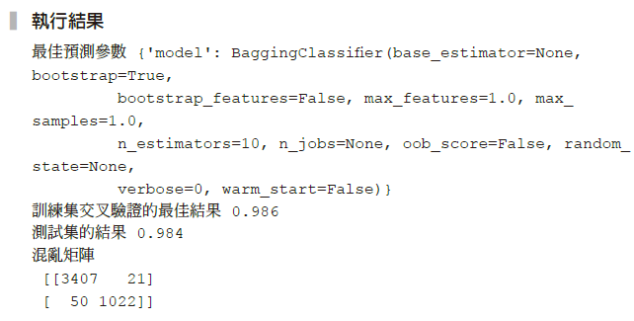

Slide 21
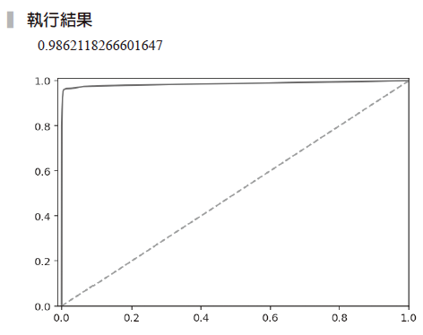
範例13-23 繪製ROC圖
  程式碼
from sklearn.metrics import roc_curve, roc_auc_score
y_pred_proba = model_pl_rf.predict_proba(X_test)[:,1]
fpr, tpr, thresholds = roc_curve(y_test,
y_pred_proba)
plt.plot(fpr, tpr)
plt.xlim(-0.01,1)
plt.ylim(0,1.01)
plt.plot([0,1],[0,1], ls='--')
roc_auc_score(y_test, model_pl_rf.predict_proba(X_test)[:,1])

