Slide 1
第14章 客戶流失率預測

Slide 2
範例14-1 資料載入
程式碼
import pandas as pd
import numpy as np
import matplotlib.pyplot as plt
import seaborn as sns
%matplotlib inline
%config InlineBackend.figure_format = 'retina'
import warnings
warnings.filterwarnings('ignore')
df = pd.read_csv('IBM_Churn.csv')
df.head()

Slide 3
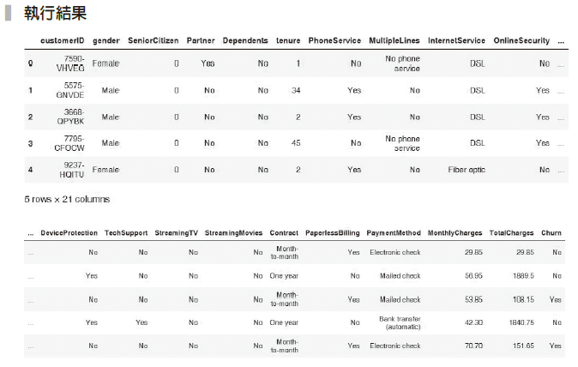

Slide 4
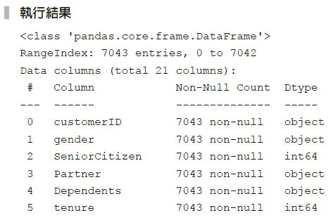
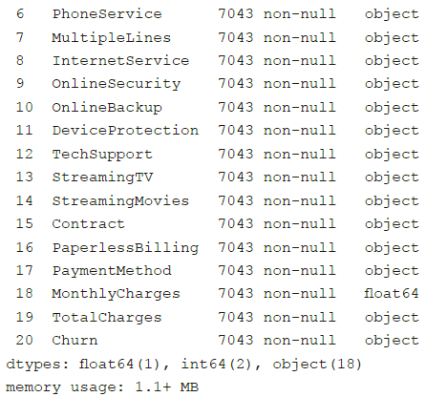
範例14-2 檢查遺漏值
程式碼
df.info()

Slide 5
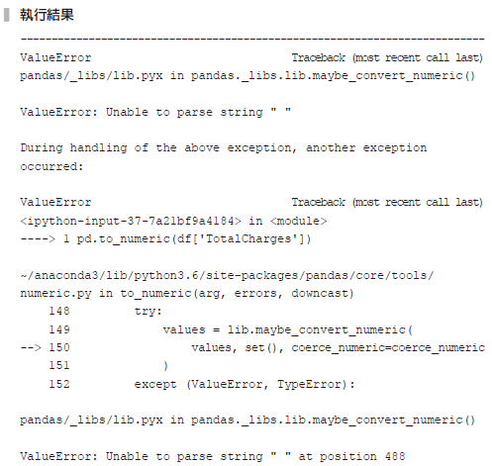
範例14-3 將TotalCharges 轉換成浮點數
程式碼
pd.to_numeric(df['TotalCharges'])

Slide 6
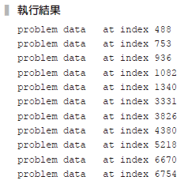
範例14-4 如何檢視有問題的資料
程式碼
for idx, d in enumerate(df['TotalCharges']):
try:
float(d)
except:
print(f'problem data {d} at index {idx}')

Slide 7
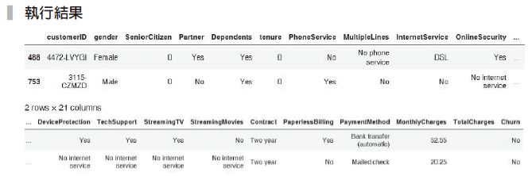
範例14-5 了解TotalCharges 的空白資料
程式碼
df.query('TotalCharges == " "').head(2)

Slide 8
範例14-6 將TotalCharges為空白的資料設為0，並轉換成浮點數
程式碼
df['TotalCharges'] = df['TotalCharges'].replace(' ',0)
df['TotalCharges'] = pd.to_numeric(df['TotalCharges'])

Slide 9
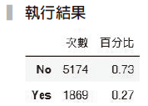
範例14-7 觀察目標欄位Churn 分布
程式碼
size = df['Churn'].value_counts()
pct = df['Churn'].value_counts(normalize=True).round(2)
pd.DataFrame(zip(size, pct), columns=['次數', '百分比'],
index=['No','Yes'])

Slide 10
範例14-8 將Churn欄位的No設為0，Yes設為1
程式碼
df['Churn'] = df['Churn'].replace({'No':0, 'Yes':1})
df.drop('customerID', axis=1, inplace=True)
df_orig = df.copy()

Slide 11
範例14-14 資料切割
程式碼
from sklearn.model_selection import train_test_split
X = df.drop('Churn', axis=1)
y = df['Churn']
X_train, X_test, y_train, y_test = train_test_split(X, y, test_size=0.3,
random_state=42)

Slide 12
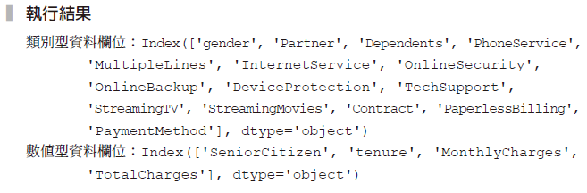
範例14-15 將X欄位再細分成數值和類別
（提示：這裡用select-dtypes 函數快速取到我們要的欄位。）
程式碼
X_col_cat = X.select_dtypes(include = 'object').columns
X_col_num = X.select_dtypes(exclude = 'object').columns
print(f'類別型資料欄位：{X_col_cat}')
print(f'數值型資料欄位：{X_col_num}')

Slide 13
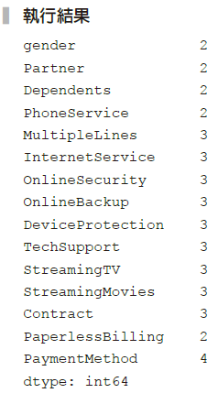
範例14-16 檢視類別變數裡的每個類別的出現次數
程式碼
df[X_col_cat].nunique()

Slide 14
範例14-18 求出基礎的預測正確率
程式碼
from sklearn.dummy import DummyClassifier
from sklearn.metrics import accuracy_score
from sklearn.metrics import confusion_matrix, classification_report
dmy = DummyClassifier(strategy='most_frequent')
dmy.fit(X_train, y_train)
dmy.score(X_train, y_train)
y_pred = dmy.predict(X_test)
print('正確率：', accuracy_score(y_test, y_pred).round(2))
print('混亂矩陣')
print(confusion_matrix(y_test, y_pred))
print('綜合報告')
print(classification_report(y_test, y_pred))

Slide 15
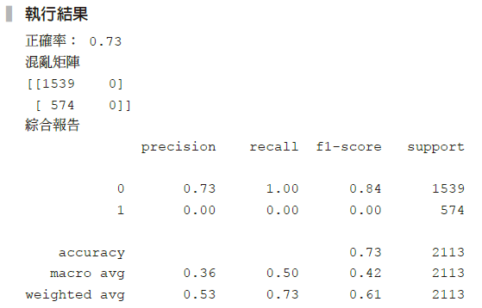

Slide 16
範例14-19 用GridSearchCV來挑選最佳結果──用簡單的機器學習模型
程式碼
# 載入所有模型
from sklearn.linear_model import LogisticRegression
from sklearn.svm import SVC
from sklearn.neighbors import KNeighborsClassifier
from sklearn.tree import DecisionTreeClassifier
from sklearn.ensemble import RandomForestClassifier,
AdaBoostClassifier, BaggingClassifier
from xgboost import XGBClassifier
# 載入 Pipeline ，PCA 和 GridSearchCV
from sklearn.pipeline import Pipeline
from sklearn.model_selection import GridSearchCV

Slide 17
範例14-19 用GridSearchCV來挑選最佳結果──用簡單的機器學習模型
承接上一頁
model_pl = Pipeline([('preprocess', data_pl), ('model', LogisticRegression())])
param_grid = {'model':[LogisticRegression(), SVC(),
KNeighborsClassifier(), DecisionTreeClassifier(max_depth=10)]}
gs = GridSearchCV(model_pl, param_grid=param_grid,
cv=5, return_train_score=True)
gs.fit(X_train, y_train)
score = gs.best_estimator_.score(X_test, y_test)

Slide 18
範例14-19 用GridSearchCV來挑選最佳結果──用簡單的機器學習模型
承接上一頁
print('最佳預測參數', gs.best_params_)
print('訓練集交叉驗證的最佳結果', gs.best_score_.round(3))
print('測試集的結果', score.round(3))
y_pred = gs.best_estimator_.predict(X_test)
print(confusion_matrix(y_test, y_pred))
print('綜合報告')
print(classification_report(y_test, y_pred))

Slide 19
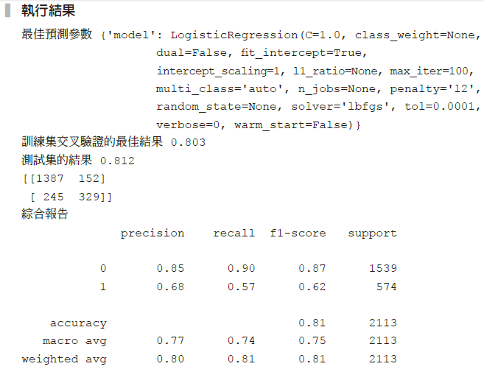

Slide 20
14-4 處理目標樣本不均衡的資料
範例14-20 修改權重
程式碼
model_pl = Pipeline([('preprocess', data_pl),
('model', LogisticRegression())])
param_grid = {'model':[LogisticRegression(class_weight='balanced'),
SVC(class_weight='balanced'),
DecisionTreeClassifier(class_weight='balanced',max_depth=10)]}
gs = GridSearchCV(model_pl, param_grid=param_grid,
cv=5, return_train_score=True)
gs.fit(X_train, y_train)
score = gs.best_estimator_.score(X_test, y_test)

Slide 21
範例14-20 修改權重
承接上一頁
print('最佳預測參數', gs.best_params_)
print('訓練集交叉驗證的最佳結果', gs.best_score_.round(3))
print('測試集的結果', score.round(3))
y_pred = gs.best_estimator_.predict(X_test)
print(confusion_matrix(y_test, y_pred))
print('綜合報告')
print(classification_report(y_test, y_pred))

Slide 22
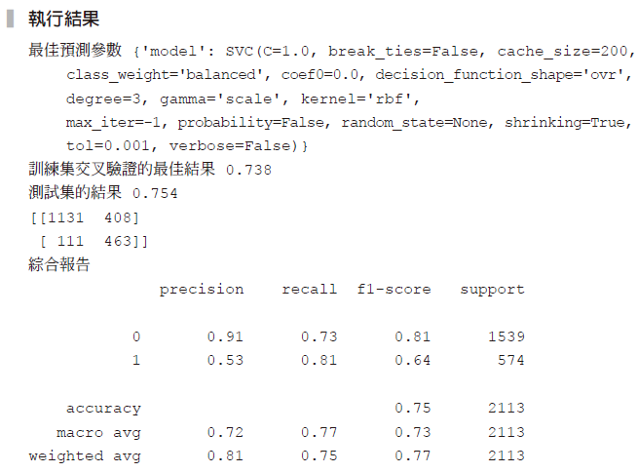

Slide 23
範例14-21 向下取樣的抽樣做法說明
程式碼
from imblearn.under_sampling import RandomUnderSampler
rus = RandomUnderSampler()
X_train_resample, y_train_resample = rus.fit_sample(X_train, y_train)
print('原資料的總個數',X_train.shape[0])
print('原本目標值1與0的個數')
print(pd.Series(y_train).value_counts())
print('向下取樣後的總個數',X_train_resample.shape[0])
print('向下取樣後的目標值1與0的個數')
print(pd.Series(y_train_resample).value_counts())

Slide 24
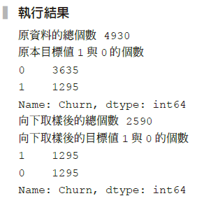

Slide 25
範例14-22 將向下取樣函數放入預測器裡
程式碼
# 將 Pipeline 重新命名為 Pipeline_im
from imblearn.pipeline import Pipeline as Pipeline_im
model_pl = Pipeline_im([
('preprocess', data_pl),
('resample', RandomUnderSampler()),
('model', LogisticRegression())
])
param_grid = {'model':[LogisticRegression(), SVC(),
KNeighborsClassifier(), DecisionTreeClassifier(max_depth=10)]}
gs = GridSearchCV(model_pl, param_grid=param_grid,
cv=5, return_train_score=True)
gs.fit(X_train, y_train)

Slide 26
範例14-22 將向下取樣函數放入預測器裡
承接上一頁
score = gs.best_estimator_.score(X_test, y_test)
print('最佳預測參數', gs.best_params_)
print('訓練集交叉驗證的最佳結果', gs.best_score_.round(3))
print('測試集的結果', score.round(3))
y_pred = gs.best_estimator_.predict(X_test)
print(confusion_matrix(y_test, y_pred))
print('綜合報告')
print(classification_report(y_test, y_pred))

Slide 27
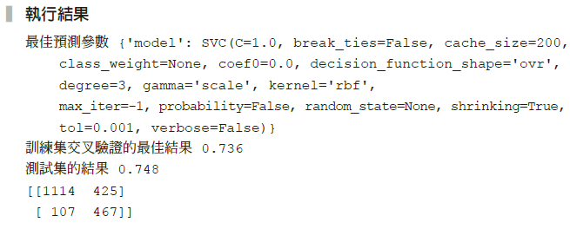
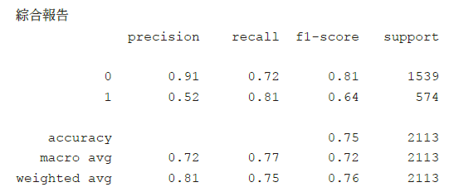

Slide 28
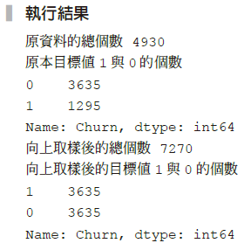
範例14-23 向上取樣的抽樣做法說明
程式碼
from imblearn.over_sampling import SMOTE
smt = SMOTE()
X_train_upsample, y_train_upsample = smt.fit_sample(data_pl.fit_
transform(X_train), y_train)
print('原資料的總個數',X_train.shape[0])
print('原本目標值1與0的個數')
print(pd.Series(y_train).value_counts())
print('向上取樣後的總個數',X_train_upsample.shape[0])
print('向上取樣後的目標值1與0的個數')
print(pd.Series(y_train_upsample).value_counts())

Slide 29
範例14-24 最常犯的向上取樣錯誤
程式碼
X_upsample, y_upsample = smt.fit_sample(data_pl.fit_transform(X), y)
X_train_up, X_test_up, y_train_up, y_test_up = train_test_split(X_upsample,
y_upsample, test_size=0.3)
np.random.seed(42)
lr = LogisticRegression()
lr.fit(X_train_up, y_train_up)
y_pred_up = lr.predict(X_test_up)
print('正確率')
print(accuracy_score(y_test_up, y_pred_up))
print('混亂矩陣')
print(confusion_matrix(y_test_up, y_pred_up))

Slide 30
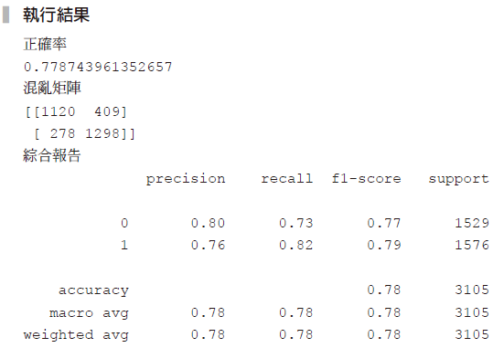
範例14-24 最常犯的向上取樣錯誤
承接上一頁
print('綜合報告')
print(classification_report(y_test_up, y_pred_up))

Slide 31
範例14-25 向上取樣的正確作法
程式碼
model_pl = Pipeline_im([
('preprocess', data_pl),
('resample', SMOTE()),
('model', LogisticRegression())
])
param_grid = {'model':[LogisticRegression(), SVC(),
KNeighborsClassifier(), DecisionTreeClassifier()]}
np.random.seed(42)
gs = GridSearchCV(model_pl, param_grid=param_grid,
cv=5, return_train_score=True)
gs.fit(X_train, y_train)
score = gs.best_estimator_.score(X_test, y_test)

Slide 32
範例14-25 向上取樣的正確作法
承接上一頁
print('最佳預測參數', gs.best_params_)
print('訓練集交叉驗證的最佳結果', gs.best_score_.round(3))
print('測試集的結果', score.round(3))
y_pred = gs.best_estimator_.predict(X_test)
print(confusion_matrix(y_test, y_pred))
print('綜合報告')
print(classification_report(y_test, y_pred))

Slide 33
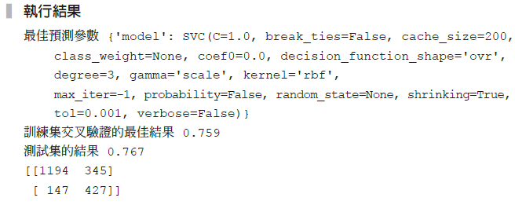
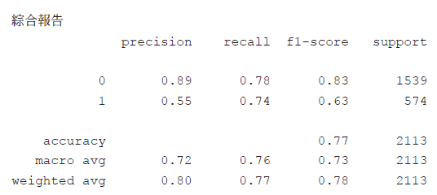

Slide 34
範例14-26 ROC圖
（提示：auc的計算結果是0.86，放在圖形的標題上。）
程式碼
from sklearn.metrics import roc_curve, auc, roc_auc_score
model_pl = make_pipeline(data_pl, LogisticRegression
(class_weight='balanced')) model_pl.fit(X_train, y_train)
y_pred_proba = model_pl.predict_proba(X_test)[:,1]
fpr, tpr, thres = roc_curve(y_test, y_pred_proba)
roc_auc = auc(fpr, tpr)
roc_auc
plt.plot(fpr, tpr, marker='.')
plt.title(roc_auc.round(2));

Slide 35
