Slide 1
第15章 信用偵測

Slide 2
範例15-1 載入資料並檢視
  程式碼
import pandas as pd
import numpy as np
import matplotlib.pyplot as plt
import seaborn as sns
%matplotlib inline
# plt.rcParams['font.sans-serif'] = ['DFKai-sb']
# plt.rcParams['axes.unicond_minus'] = False
%config InlineBackend.figure_format = 'retina'
import warnings
warnings.filterwarnings('ignore')
df = pd.read_csv('creditcard.csv')
df.head()

Slide 3
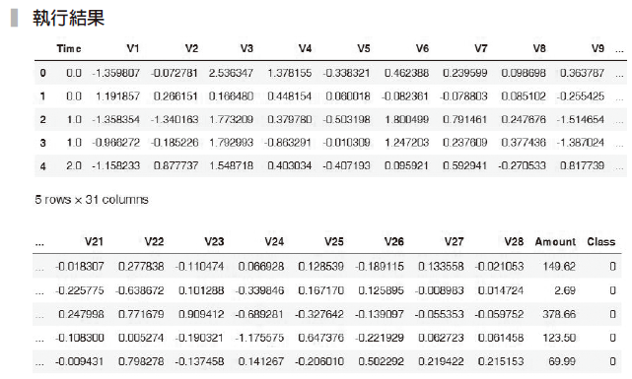

Slide 4
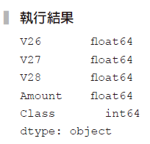
範例15-2 檢視資料型態
  程式碼
df.drop('Time', axis=1, inplace=True)
df.dtypes.tail()

Slide 5

範例15-3 檢查遺漏值
  程式碼
df.isnull().sum().sum()

Slide 6
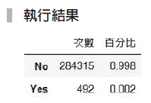
範例15-4 檢視目標變數的數目和百分比
  程式碼
size = df['Class'].value_counts()
pct = df['Class'].value_counts(normalize=True).round(3)
pd.DataFrame(zip(size, pct), columns=['次數', '百分比'],
index=['No','Yes'])

Slide 7
範例15-9 資料切割和預處理
  程式碼
from sklearn.model_selection import train_test_split
X = df.drop('Class', axis=1)
y = df['Class']
X_train, X_test, y_train, y_test = train_test_split
(X, y, test_size=0.3, random_state=42)

Slide 8
範例15-10 求出基礎的「偽」預測器的結果
  程式碼
from sklearn.metrics import confusion_matrix, classification_report,
accuracy_score
from sklearn.dummy import DummyClassifier
dmy = DummyClassifier(strategy='most_frequent')
dmy.fit(X_train, y_train)
dmy.score(X_train, y_train)
y_pred = dmy.predict(X_test)
print(accuracy_score(y_test, y_pred))
print(confusion_matrix(y_test, y_pred))
print(classification_report(y_test, y_pred))

Slide 9
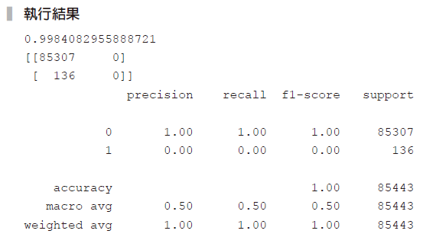

Slide 10
範例15-11 每個機器學習演算法的成果輸出
  程式碼
# 載入所有模型
from sklearn.linear_model import LogisticRegression
from sklearn.svm import SVC
from sklearn.neighbors import KNeighborsClassifier
from sklearn.tree import DecisionTreeClassifier
from sklearn.ensemble import RandomForestClassifier,
AdaBoostClassifier, BaggingClassifier
from xgboost import XGBClassifier
from sklearn.preprocessing import StandardScaler
from sklearn.pipeline import Pipeline, make_pipeline
from sklearn.metrics import recall_score

Slide 11
範例15-11 每個機器學習演算法的成果輸出
  承接上一頁
models = [LogisticRegression(), SVC(), KNeighborsClassifier(),
RandomForestClassifier()]
model_results = {}
for model in models:
model_pl = make_pipeline(StandardScaler(), model)
model_pl.fit(X_train, y_train)
y_pred = model_pl.predict(X_test)
score = accuracy_score(y_test, y_pred)
recall = recall_score(y_test, y_pred, pos_label=1)
model_results[model._ _class_ _._ _name_ _] = [score, recall]
print(f'模型名稱{model._ _class_ _._ _name_ _:-^50}')
print('混亂矩陣\n',confusion_matrix(y_test, y_pred))
print(f'正確率: {score:.3f}， 召回率: {recall:.3f}\n')

Slide 12
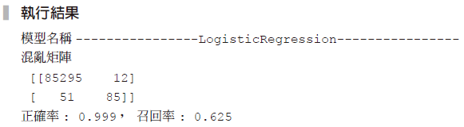
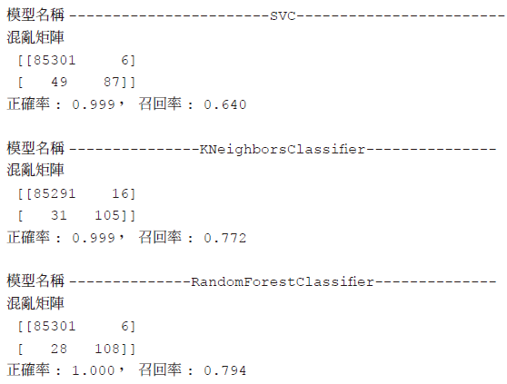

Slide 13
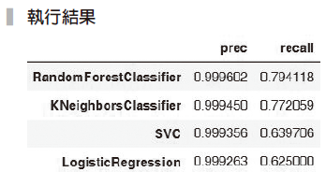
範例15-12 整理上例結果
  程式碼
df_orig = pd.DataFrame(model_results.values(), index=model_results.keys(),
columns=['prec','recall']).sort_values(by='recall', ascending=False)
df_orig

Slide 14
範例15-13 用權重方式解決目標類別不均衡的問題
  程式碼
models = [LogisticRegression(class_weight='balanced'), SVC(class_weight='balanced'), RandomForestClassifier(class_weight='balanced')]
model_results = {}
for model in models:
model_pl = make_pipeline(StandardScaler(), model)
model_pl.fit(X_train, y_train)
y_pred = model_pl.predict(X_test)
score = accuracy_score(y_test, y_pred)
recall = recall_score(y_test, y_pred, pos_label=1)
model_results[model._ _class_ _._ _name_ _] = [score, recall]

Slide 15
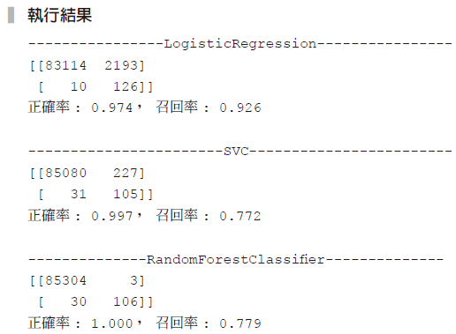
範例15-13 用權重方式解決目標類別不均衡的問題
  承接上一頁
print(f'{model._ _class_ _._ _name_ _:-^50}') print(confusion_matrix(y_test, y_pred))
print(f'正確率: {score:.3f}， 召回率: {recall:.3f}')
print()

Slide 16
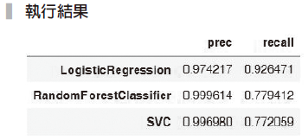
範例15-14 整理範例15-13 結果
  程式碼
df_weight = pd.DataFrame(model_results.values(), index=model_results.keys(),
columns=['prec','recall']).sort_values(by='recall', ascending=False)
df_weight

Slide 17
範例15-15 向下取樣結果
  程式碼
from imblearn.under_sampling import RandomUnderSampler
from imblearn.pipeline import make_pipeline
np.random.seed(42)
models = [LogisticRegression(), SVC(), KNeighborsClassifier(),
RandomForestClassifier()]
model_results = {}
for model in models:
model_pl = make_pipeline(StandardScaler(), RandomUnderSampler(), model)
model_pl.fit(X_train, y_train)
y_pred = model_pl.predict(X_test)
score = accuracy_score(y_test, y_pred)
recall = recall_score(y_test, y_pred, pos_label=1)

Slide 18
範例15-15 向下取樣結果
  承接上一頁
model_results[model._ _class_ _._ _name_ _] = [score, recall]
print(f'{model._ _class_ _._ _name_ _:-^50}')
print(confusion_matrix(y_test, y_pred))
print(f'正確率: {score:.3f}， 召回率: {recall:.3f}')
print()

Slide 19
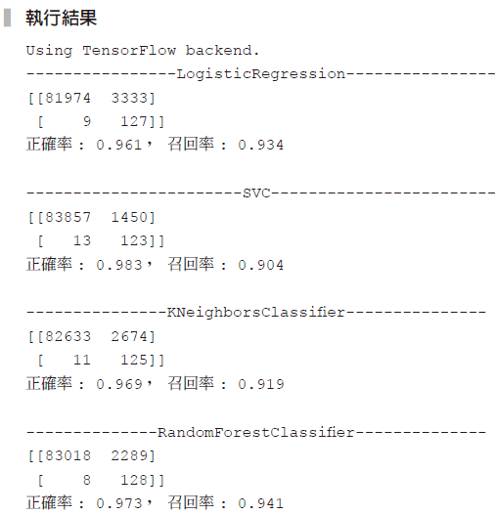

Slide 20
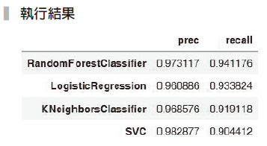
範例15-16 整理範例15-15結果
  程式碼
df_down = pd.DataFrame(model_results.values(), index=model_results.keys(),
columns=['prec','recall']).sort_values(by='recall', ascending=False)
df_down

Slide 21
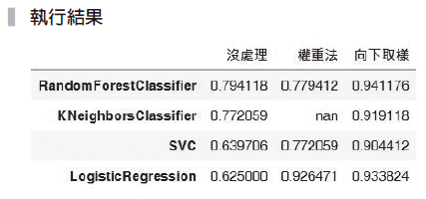
範例15-17 比較所有方法的召回率
  程式碼
df_recall = pd.concat([df_orig, df_weight, df_down], axis=1,
keys=['沒處理','權重法','向下取樣'])
df_recall.xs('recall', level=1, axis=1).style.highlight_max(axis=1)

Slide 22
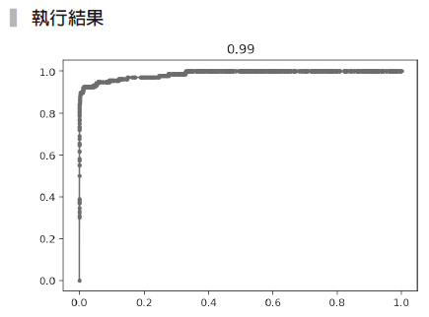
範例15-18 ROC曲線圖
  程式碼
from sklearn.metrics import roc_curve, auc, roc_auc_score
model_pl = make_pipeline(StandardScaler(),RandomUnderSampler(),
LogisticRegression())
model_pl.fit(X_train, y_train)
y_pred_proba = model_pl.predict_proba(X_test)[:,1]
fpr, tpr, thres = roc_curve(y_test, y_pred_proba)
roc_auc = auc(fpr, tpr)
roc_auc
plt.plot(fpr, tpr, marker='.')
plt.title(roc_auc.round(2));

