Slide 1
第16章 文字處理

Slide 2
範例16-1 載入資料
  程式碼
import pandas as pd
import numpy as np
import matplotlib.pyplot as plt
import seaborn as sns
%matplotlib inline
%config InlineBackend.figure_format = 'retina'
import warnings
warnings.filterwarnings('ignore')
from sklearn.datasets import fetch_20newsgroups
categories = ['alt.atheism', 'soc.religion.christian',
'comp.graphics', 'sci.med']
train = fetch_20newsgroups(subset='train', categories=categories,
shuffle=True, random_state=42)

Slide 3
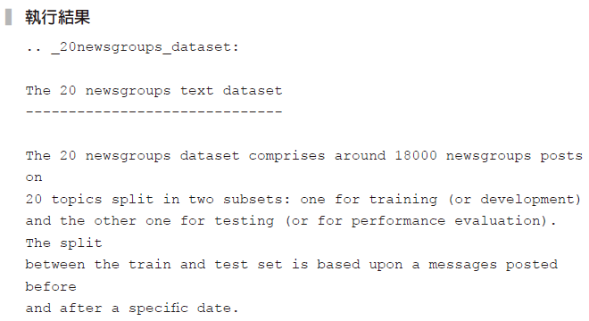
範例16-1 載入資料
  承接上一頁
test = fetch_20newsgroups(subset='test', categories=categories,
shuffle=True, random_state=42)
print('\n'.join(train['DESCR'].split('\n')[:10]))

Slide 4

範例16-2 了解目標類別的編碼
  程式碼
train['target_names']

Slide 5
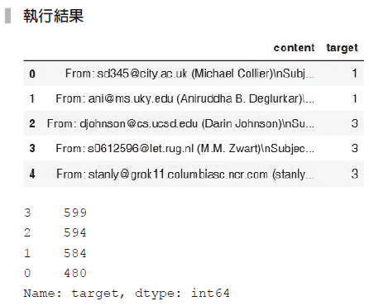
範例16-3 觀察目標值的資料分布
  程式碼
from IPython.display import display
df_train = pd.DataFrame(zip(train['data'], train['target']),
columns=['content','target'])
display(df_train.head())
display(df_train['target'].value_counts())

Slide 6
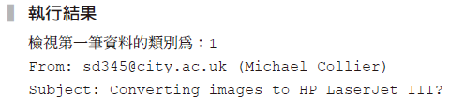
範例16-4 詳細檢視第一筆資料碼
  程式碼
print(f'檢視第一筆資料的類別為：{df_train.loc[0,"target"]}')
print(df_train.loc[0,'content'])

Slide 7
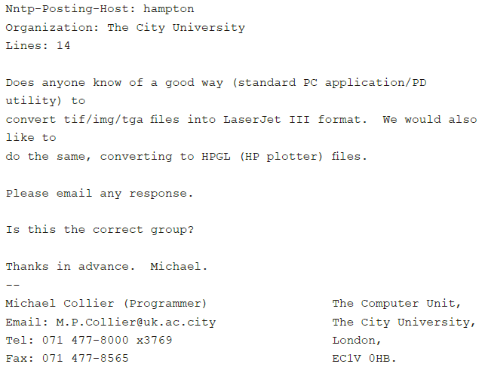

Slide 8
範例16-5 將資料放至X_train, X_test
  程式碼
X_train = train['data']
y_train = train['target']
X_test = test['data']
y_test = test['target']

Slide 9

範例16-6 詞袋基本介紹
  程式碼
from sklearn.feature_extraction.text import CountVectorizer
string = ['He do love her and He does not loves he']
cv = CountVectorizer()
bow = cv.fit_transform(string)
bow.toarray()

Slide 10
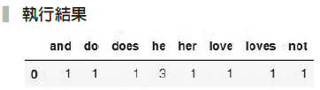
範例16-7 將文字放在上例結果
  程式碼
df_bow = pd.DataFrame(bow.toarray(), columns=cv.get_feature_names())
df_bow

Slide 11
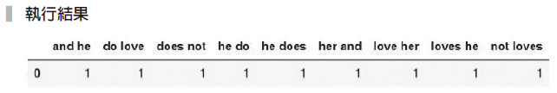
範例16-8 前後文字的連結編碼
  程式碼
string = ['He do love her and He does not loves he']
cv = CountVectorizer(ngram_range=(2,2))
bow = cv.fit_transform(string)
df_bow = pd.DataFrame(bow.toarray(), columns=cv.get_feature_names())
df_bow

Slide 12

範例16-9 移除停用詞的使用
  程式碼
string = ['He do love her and He does not loves he']
cv = CountVectorizer(stop_words='english')
bow = cv.fit_transform(string)
df_bow = pd.DataFrame(bow.toarray(), columns=cv.get_feature_names())
df_bow

Slide 13
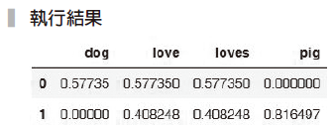
範例16-10 term frequency(tf)
  程式碼
from sklearn.feature_extraction.text import TfidfVectorizer
string = ['dog love loves',
'pig love loves pig']
cv = TfidfVectorizer(use_idf=False, stop_words='english')
bow = cv.fit_transform(string)
df_bow = pd.DataFrame(bow.toarray(), columns=cv.get_feature_names())
df_bow

Slide 14
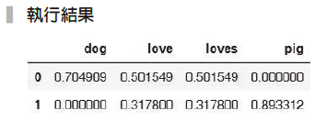
範例16-11 tf-idf
  程式碼
from sklearn.feature_extraction.text import TfidfVectorizer
string = ['dog love loves',
'pig love loves pig']
cv = TfidfVectorizer(stop_words='english')
bow = cv.fit_transform(string)
df_bow = pd.DataFrame(bow.toarray(), columns=cv.get_feature_names())
df_bow

Slide 15
範例16-12 載入所有模組和函數
  程式碼
from sklearn.linear_model import LogisticRegression
from sklearn.svm import SVC
from sklearn.neighbors import KNeighborsClassifier
from sklearn.naive_bayes import MultinomialNB
from sklearn.pipeline import make_pipeline, Pipeline
from sklearn.model_selection import GridSearchCV
from sklearn.metrics import confusion_matrix, accuracy_score,
classification_report

Slide 16
範例16-13 用GridSearchCV來挑選最佳結果
  程式碼
model_pl = Pipeline([
('preprocess', CountVectorizer(stop_words='english')),
('model', LogisticRegression())
])
param_grid = {
'model':[LogisticRegression(), SVC(),
KNeighborsClassifier(), MultinomialNB()]
}
gs = GridSearchCV(model_pl, param_grid=param_grid,
cv=5, return_train_score=True)
gs.fit(X_train, y_train)
score = gs.best_estimator_.score(X_test, y_test)

Slide 17
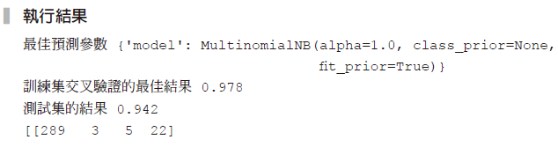
範例16-13 用GridSearchCV來挑選最佳結果
  承接上一頁
print('最佳預測參數', gs.best_params_)
print('訓練集交叉驗證的最佳結果', gs.best_score_.round(3))
print('測試集的結果', score.round(3))
y_pred = gs.best_estimator_.predict(X_test)
print(confusion_matrix(y_test, y_pred))
print('綜合報告')
print(classification_report(y_test, y_pred))

Slide 18
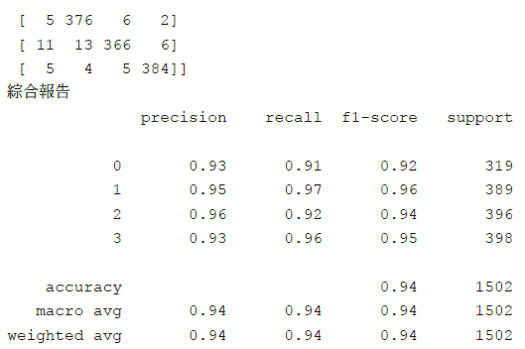

Slide 19
範例16-14 將三種產生詞袋的編碼方式也加入網格搜尋
  程式碼
model_pl = Pipeline([
('preprocess', CountVectorizer(stop_words='english')),
('model', LogisticRegression())
])
param_grid = {
'preprocess':[CountVectorizer(stop_words='english'),
TfidfVectorizer(stop_words='english'),
TfidfVectorizer(use_idf=False, stop_words='english')],
'model':[LogisticRegression(), SVC(),
KNeighborsClassifier(), MultinomialNB()]
}

Slide 20
範例16-14 將三種產生詞袋的編碼方式也加入網格搜尋
  承接上一頁
gs = GridSearchCV(model_pl, param_grid=param_grid,
cv=5, return_train_score=True)
gs.fit(X_train, y_train)
score = gs.best_estimator_.score(X_test, y_test)
print('最佳預測參數', gs.best_params_)
print('訓練集交叉驗證的最佳結果', gs.best_score_.round(3))
print('測試集的結果', score.round(3))
y_pred = gs.best_estimator_.predict(X_test)
print(confusion_matrix(y_test, y_pred))
print('綜合報告')
print(classification_report(y_test, y_pred))

Slide 21
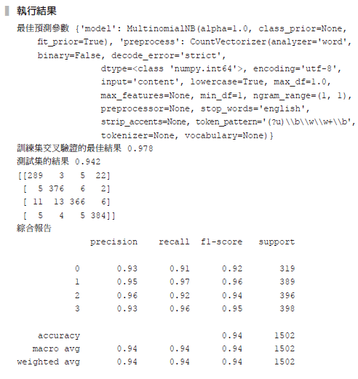

Slide 22

16-4 主題探索
範例16-15 潛在狄氏分配
  程式碼
cv = CountVectorizer(stop_words='english')
X = cv.fit_transform(train['data'])
np.random.seed(42)
from sklearn.decomposition import LatentDirichletAllocation
lda = LatentDirichletAllocation(n_components=4)
X_topics = lda.fit_transform(X)
lda.components_.shape

Slide 23
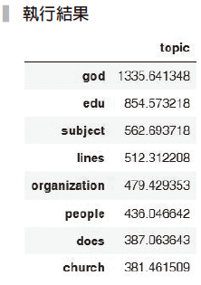
範例16-16 檢視第一個主題內容
  程式碼
pd.DataFrame(lda.components_[0], index=cv.get_feature_names(),
columns=['topic']).sort_values(by='topic', ascending=False)[:8]

Slide 24
範例16-17 將四大主題顯示出來
  程式碼
n_topics = 4
n_words = 10
words = {}
for topic in range(n_topics):
word = pd.DataFrame(lda.components_[topic],
index=cv.get_feature_names()).\
sort_values(by=0, ascending=False)[:n_words].index.tolist()
words[f'主題{topic+1}'] = word
pd.DataFrame(words)

Slide 25
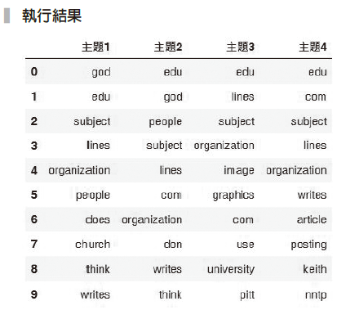

Slide 26
範例16-18 解決頻繁出現字詞的方法1 ──停用字詞表
  程式碼
# 用這三行增加新的停用字詞
from sklearn.feature_extraction import text
extra_words = ['edu','subject','lines','com']
stop_words = text.ENGLISH_STOP_WORDS.union(extra_words)
lda = LatentDirichletAllocation(n_components=4)
cv = CountVectorizer(stop_words=stop_words)
bow = cv.fit_transform(train['data'])
X_topics = lda.fit_transform(bow)
words = {}
for topic in range(n_topics):
word = pd.DataFrame(lda.components_[topic],
index=cv.get_feature_names()).\

Slide 27
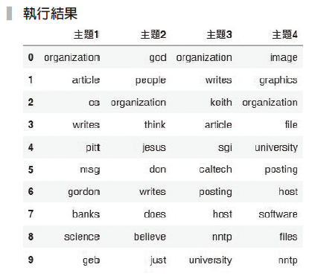
範例16-18 解決頻繁出現字詞的方法1 ──停用字詞表
  承接上一頁
sort_values(by=0,ascending=False)[:n_words].index.tolist()
words[f'主題{topic+1}'] = word
pd.DataFrame(words)

Slide 28
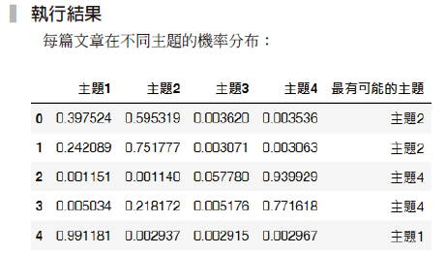
範例16-20 預測每一篇文章屬於哪一個主題
  程式碼
from IPython.display import display
print('每篇文章在不同主題的機率分布：')
df_class = pd.DataFrame(X_topics, columns=[f'主題{i}' for i in
range(1,5)])
df_class['最有可能的主題'] = df_class.idxmax(axis=1)
display(df_class.head().style.highlight_max(axis=1))
print('第一篇文章')
print(X_train[0])

