Slide 1
第17章 Amazon商品評論分析

Slide 2
範例17-1 載入資料，並將日期格式轉換成日期
  程式碼
import pandas as pd
import numpy as np
import matplotlib.pyplot as plt
import seaborn as sns
%matplotlib inline
%config InlineBackend.figure_format = 'retina'
import warnings
warnings.filterwarnings('ignore')
df= pd.read_csv('kindle_rating.csv', parse_dates=['date'])
df.head()

Slide 3
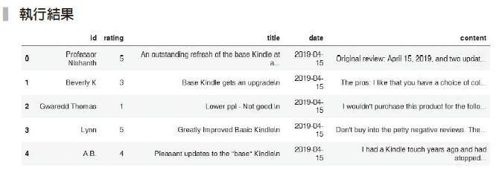

Slide 4
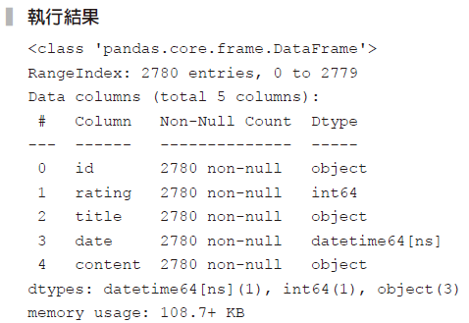
範例17-2 資料檢視
  程式碼
df.info()

Slide 5
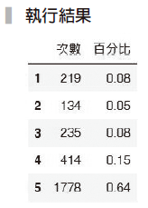
範例17-3 各評分的比例
  程式碼
size = df['rating'].value_counts().sort_index()
pct = df['rating'].value_counts(normalize=True).round(2).sort_index()
pd.DataFrame(zip(size, pct), columns=['次數', '百分比'], index=range(1,6))

Slide 6
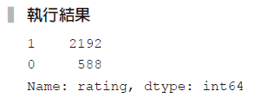
範例17-4 將資料切割成滿意和不滿意
  程式碼
df['rating'] = (df['rating'] > 3).map({True:1 , False:0})
df['rating'].value_counts()

Slide 7
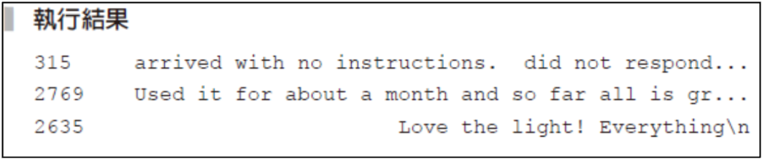

範例17-5 完成訓練集和測試集資料切割
  程式碼
X = df['content']
y = df['rating']
from sklearn.model_selection import train_test_split
X_train, X_test, y_train, y_test = train_test_split(X, y,
test_size=0.2, random_state=42)
X_train.head()

Slide 8
範例17-6 單純貝氏分類器預測結果
  程式碼
from sklearn.naive_bayes import MultinomialNB
from sklearn.pipeline import make_pipeline
from sklearn.feature_extraction.text import CountVectorizer
from sklearn.metrics import confusion_matrix, accuracy_score,
classification_report
model_pl = make_pipeline(CountVectorizer(stop_words='english'),
MultinomialNB())
model_pl.fit(X_train, y_train)
y_pred = model_pl.predict(X_test)
score = model_pl.score(X_test, y_test)
print('測試集的結果', score.round(3))
print(confusion_matrix(y_test, y_pred))

Slide 9
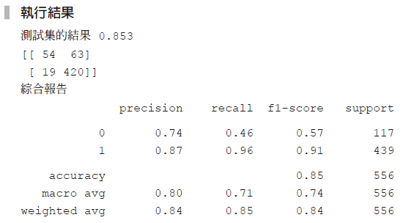
範例17-6 單純貝氏分類器預測結果
  承接上一頁
print('綜合報告')
print(classification_report(y_test, y_pred))

Slide 10
範例17-7 向下取樣的結果
  程式碼
from imblearn.under_sampling import RandomUnderSampler
from imblearn.pipeline import make_pipeline
model_pl = make_pipeline(CountVectorizer(stop_words='english'),
RandomUnderSampler(),
MultinomialNB())
model_pl.fit(X_train, y_train)
y_pred = model_pl.predict(X_test)
score = model_pl.score(X_test, y_test)
print('測試集的結果', score.round(3))
y_pred = model_pl.predict(X_test)
print(confusion_matrix(y_test, y_pred))
print('綜合報告')
print(classification_report(y_test, y_pred))

Slide 11
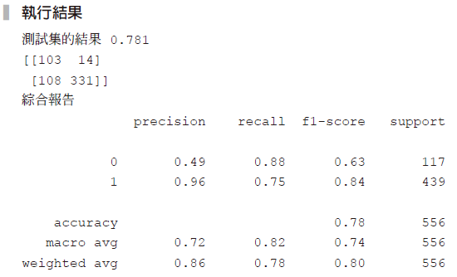

Slide 12
範例17-8 向上取樣的結果
  程式碼
from imblearn.over_sampling import SMOTE
model_pl = make_pipeline(CountVectorizer(stop_words='english'),
SMOTE(),
MultinomialNB())
model_pl.fit(X_train, y_train)
y_pred = model_pl.predict(X_test)
score = model_pl.score(X_test, y_test)
print('測試集的結果', score.round(3))
y_pred = model_pl.predict(X_test)
print(confusion_matrix(y_test, y_pred))
print('綜合報告')
print(classification_report(y_test, y_pred))

Slide 13
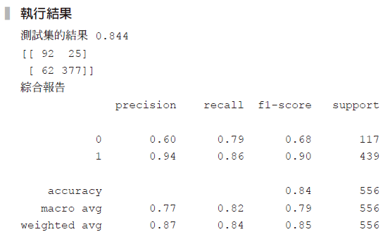

Slide 14
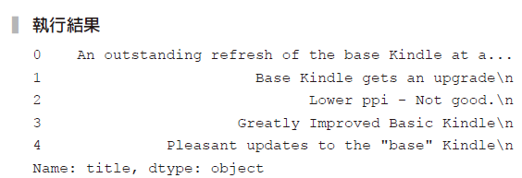
範例17-9 檢視title欄位
  程式碼
df['title'].head()

Slide 15
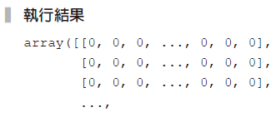

範例17-10 製作title和content的水平合併器
  程式碼
X = df[['title', 'content']]
from sklearn.compose import ColumnTransformer
data_pl = ColumnTransformer([
('title', CountVectorizer(stop_words='english'), 'title'),
('content', CountVectorizer(stop_words='english'), 'content')
])
data_pl.fit_transform(X).toarray()

Slide 16
範例17-11 進行預測──沒有處理目標類別不均衡問題
  程式碼
X_train, X_test, y_train, y_test = train_test_split(X, y, test_
size=0.2, random_state=42)
model_pl = make_pipeline(data_pl, MultinomialNB())
model_pl.fit(X_train, y_train)
y_pred = model_pl.predict(X_test)
score = model_pl.score(X_test, y_test)
print('測試集的結果', score.round(3))
y_pred = model_pl.predict(X_test)
print(confusion_matrix(y_test, y_pred))
print('綜合報告')
print(classification_report(y_test, y_pred))

Slide 17
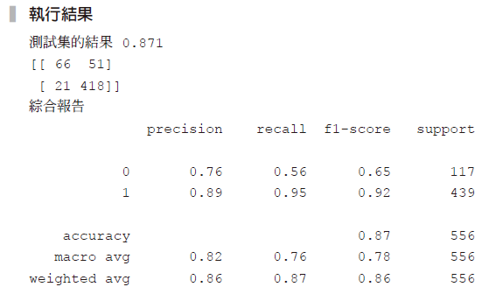

Slide 18
範例17-12 向下取樣的結果
  程式碼
np.random.seed(42)
model_pl = make_pipeline(data_pl, RandomUnderSampler(), MultinomialNB())
model_pl.fit(X_train, y_train)
y_pred = model_pl.predict(X_test)
score = model_pl.score(X_test, y_test)
print('測試集的結果', score.round(3))
y_pred = model_pl.predict(X_test)
print(confusion_matrix(y_test, y_pred))
print('綜合報告')
print(classification_report(y_test, y_pred))

Slide 19
