Slide 1
第18章 中文文字處理

Slide 2
範例18-1 載入資料
  程式碼
import pandas as pd
import numpy as np
import matplotlib.pyplot as plt
import seaborn as sns
%matplotlib inline
plt.rcParams['font.sans-serif'] = ['DFKai-sb']
plt.rcParams['axes.unicode_minus'] = False
%config InlineBackend.figure_format = 'retina'
import warnings
warnings.filterwarnings('ignore')
df = pd.read_excel('tripadvisor.xlsx', parse_dates=['date'])
df.head()

Slide 3
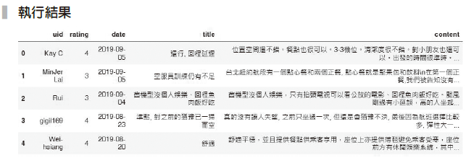

Slide 4
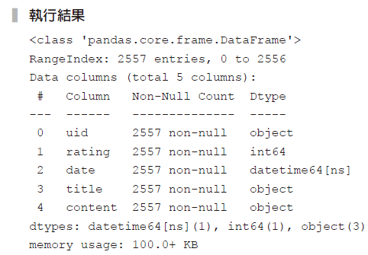
範例18-2 資料檢視
  程式碼
df.info()

Slide 5
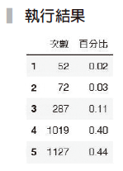
範例18-3 各評分的比例
  程式碼
size = df['rating'].value_counts().sort_index()
pct = df['rating'].value_counts(normalize=True).round(2).sort_index()
pd.DataFrame(zip(size, pct), columns=['次數', '百分比'],
index=range(1,6))

Slide 6

範例18-5 繁體斷字
  程式碼
import jieba
# 載入繁體字典
jieba.set_dictionary('dict.txt.big')
print(list(jieba.cut('下雨天留客天留我不留')))
# 將串列組合回字串，用空白做區隔
s = ' '.join(jieba.cut('下雨天留客天留我不留'))
print(s)

Slide 7
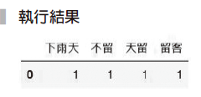
範例18-6 將範例18-5 做詞袋處理
  程式碼
from sklearn.feature_extraction.text import CountVectorizer
cv = CountVectorizer()
bow = cv.fit_transform([s])
pd.DataFrame(bow.toarray(), columns=cv.get_feature_names())

Slide 8
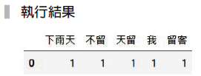
範例18-7 允許詞袋裡存在單一字元的字
  程式碼
cv = CountVectorizer(token_pattern='(?u)\\b\\w+\\b')
bow = cv.fit_transform([s])
pd.DataFrame(bow.toarray(), columns=cv.get_feature_names())

Slide 9

範例18-8 觀察tripadvisor第一筆資料內容
  程式碼
df.loc[0, 'content']

Slide 10
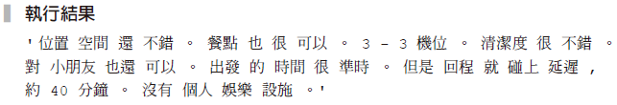
範例18-9 先進行中文斷字
  程式碼
s = ' '.join(jieba.cut(df.iloc[0]['content']))
s

Slide 11
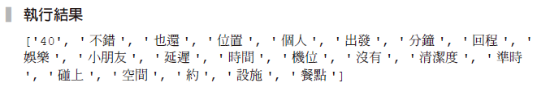
範例18-10 詞袋處理，並加入停用字
  程式碼
# 從檔案讀取停用字，並做成串列
with open('stop.text','r', encoding='utf-8') as f:
stops = f.read()
stops = stops.split('\n')
cv = CountVectorizer(token_pattern='(?u)\\b\\w+\\b',
stop_words=stops)
bow = cv.fit_transform([s])
print(cv.get_feature_names())

Slide 12
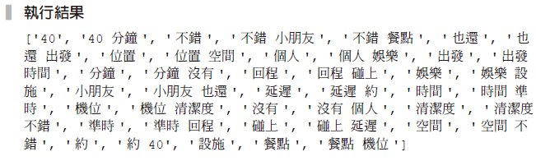
範例18-11詞袋處理，並允許ngrame為1到2
  程式碼
cv = CountVectorizer(token_pattern='(?u)\\b\\w+\\b',
stop_words=stops,
ngram_range=(1,2))
bow = cv.fit_transform([s])
print(cv.get_feature_names())

Slide 13
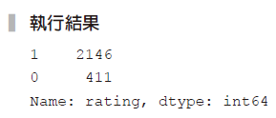
範例18-12 將資料切割成滿意和不滿意
  程式碼
df['rating'] = (df['rating'] > 3).map({True:1 , False:0})
df['rating'].value_counts()

Slide 14
範例18-13 完成訓練集和測試集資料切割
  程式碼
X = df['content']
y = df['rating']
from sklearn.model_selection import train_test_split
X_train, X_test, y_train, y_test = train_test_split(X, y,
test_size=0.2, random_state=42)

Slide 15
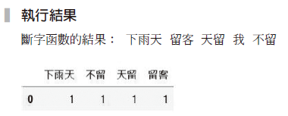
範例18-14 撰寫斷字程式
  程式碼
def preprocessor(s):
return ' '.join(jieba.cut(s))
print('斷字函數的結果：', preprocessor('下雨天留客天留我不留'))
cv = CountVectorizer(preprocessor=preprocessor,
token_pattern='(?u)\\b\\w+\\b',
stop_words=stops)
bow = cv.fit_transform(['下雨天留客天留我不留'])
pd.DataFrame(bow.toarray(), columns=cv.get_feature_names())

Slide 16
範例18-15 單純貝氏分類器預測結果
  程式碼
from sklearn.naive_bayes import MultinomialNB
from sklearn.pipeline import make_pipeline
from sklearn.feature_extraction.text import CountVectorizer
from sklearn.metrics import confusion_matrix, accuracy_score,
classification_report
cv = CountVectorizer(preprocessor=preprocessor,
token_pattern='(?u)\\b\\w+\\b',
stop_words=stops)
model_pl = make_pipeline(cv, MultinomialNB())
model_pl.fit(X_train, y_train)
y_pred = model_pl.predict(X_test)
score = model_pl.score(X_test, y_test)

Slide 17
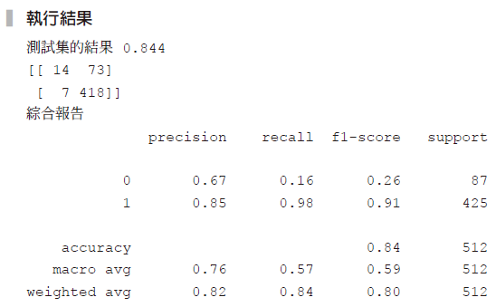
範例18-15 單純貝氏分類器預測結果
  承接上一頁
print('測試集的結果', score.round(3))
print(confusion_matrix(y_test, y_pred))
print('綜合報告')
print(classification_report(y_test, y_pred))

Slide 18
範例18-16 向下取樣的結果
  程式碼
from imblearn.under_sampling import RandomUnderSampler
from imblearn.pipeline import make_pipeline
np.random.seed(42)
model_pl = make_pipeline(cv, RandomUnderSampler(), MultinomialNB())
model_pl.fit(X_train, y_train)
y_pred = model_pl.predict(X_test)
score = model_pl.score(X_test, y_test)
print('測試集的結果', score.round(3))
print(confusion_matrix(y_test, y_pred))
print('綜合報告')
print(classification_report(y_test, y_pred))

Slide 19
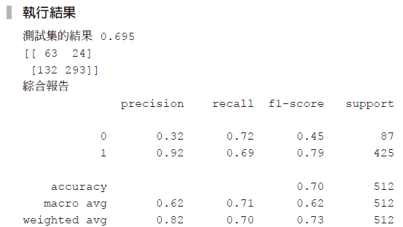

Slide 20
範例18-17 向上取樣的結果
  程式碼
from imblearn.over_sampling import SMOTE
np.random.seed(42)
model_pl = make_pipeline(cv, SMOTE(), MultinomialNB())
model_pl.fit(X_train, y_train)
y_pred = model_pl.predict(X_test)
score = model_pl.score(X_test, y_test)
print('測試集的結果', score.round(3))
y_pred = model_pl.predict(X_test)
print(confusion_matrix(y_test, y_pred))
print('綜合報告')
print(classification_report(y_test, y_pred))

Slide 21


Slide 22
範例18-22 印出第一篇主題
  程式碼
n_topics = 12
n_words = 10
from sklearn.decomposition import LatentDirichletAllocation
lda = LatentDirichletAllocation(n_components=n_topics, random_state=42)
cv = CountVectorizer(preprocessor=preprocessor,
token_pattern='(?u)\\b\\w+\\b', stop_words=stops,
max_df=0.5)
X_array = cv.fit_transform(df['content'])
X_topics = lda.fit_transform(X_array)
idx = cv.get_feature_names()
pd.DataFrame(lda.components_[0], index=idx, columns=['topic']).\
sort_values(by='topic', ascending=False)[:n_words]

Slide 23
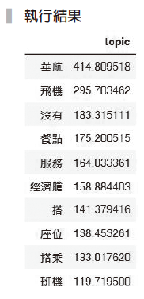

Slide 24
範例18-23 印出12 個主題的內容
  程式碼
words = {}
for topic in range(n_topics):
word = pd.DataFrame(lda.components_[topic], index=idx).\
sort_values(by=0, ascending=False)[:n_words].index.tolist()
words[f'主題{topic+1}'] = word
pd.DataFrame(words)

Slide 25
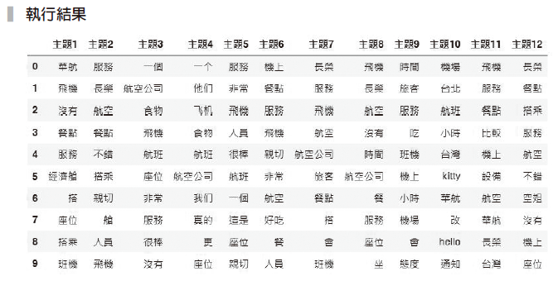

Slide 26
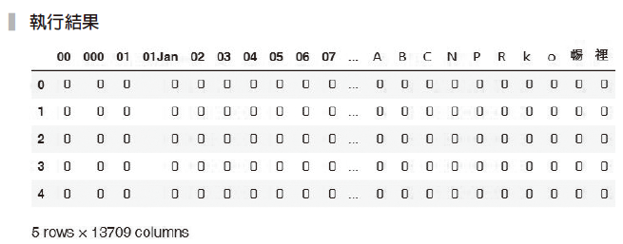
18-5 文字雲
範例18-24 先進行斷字並產生詞袋
  程式碼
cv = CountVectorizer(preprocessor=preprocessor,
token_pattern='(?u)\\b\\w+\\b',
stop_words=stops, max_df=0.5)
bow = cv.fit_transform(df['content'])
df_bow = pd.DataFrame(bow.toarray(),columns=cv.get_feature_names())
df_bow.head()

Slide 27
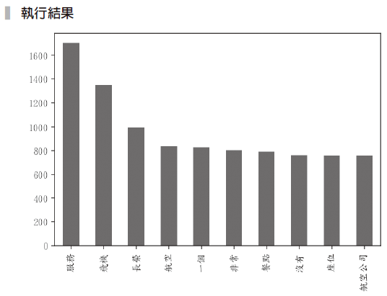
範例18-25 用長條圖繪出最常出現的十大關鍵字
  程式碼
df_bow.sum().sort_values(ascending=False)[:10].plot(kind='bar');

Slide 28
範例18-26 繪製文字雲
  程式碼
from wordcloud import WordCloud
from matplotlib import pyplot as plt
from PIL import Image
alice_mask = np.array(Image.open("cloud_mask7.png"))
wc = WordCloud(background_color="white", max_words=2000,
mask=alice_mask, font_path="simsun.ttf")
wc.generate_from_frequencies(df_bow.sum())
wc.to_file("cloud.png")
plt.figure(figsize=(15,15))
plt.imshow(wc, interpolation='bilinear')
plt.axis("off")

Slide 29


