Slide 1
第20章 Keras 深度學習

Slide 2
範例20-1 載入資料
  程式碼
import pandas as pd
import numpy as np
import matplotlib.pyplot as plt
import seaborn as sns
%matplotlib inline
%config InlineBackend.figure_format = 'retina'
import warnings
warnings.filterwarnings('ignore')
from sklearn.datasets import load_digits
digit = load_digits()
print('\n'.join(digit['DESCR'].split('\n')[:19]))

Slide 3
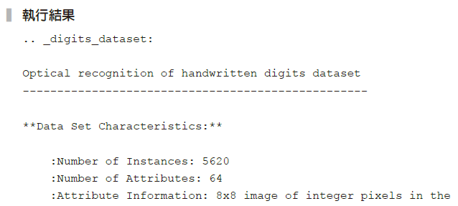
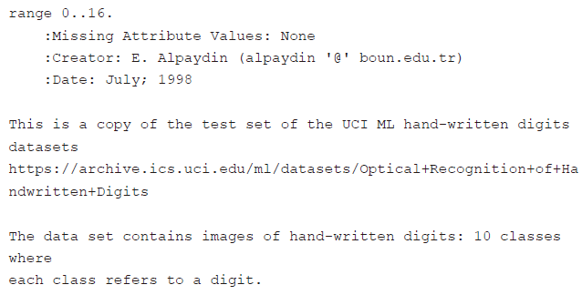

Slide 4
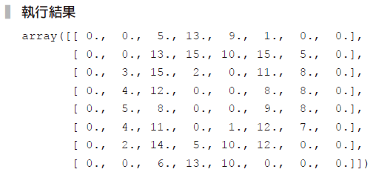
範例20-2 資料檢視
  程式碼
digit['data'][0].reshape(8, 8)

Slide 5
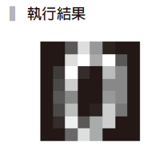
範例20-3 將範例20-2的數字變成圖像
  程式碼
plt.figure(figsize=(1,1))
plt.imshow(digit['data'][0].reshape(8, 8), cmap='gray')
plt.axis('off');

Slide 6
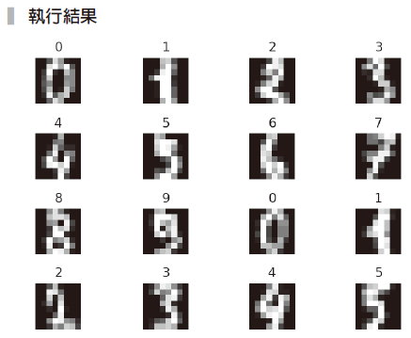
範例20-4 將前16筆資料繪出，並在標題上註記其真實數值
  程式碼
fig, axes = plt.subplots(4,4, figsize=(6,4))
for i, ax in enumerate(axes.flatten()):
img = digit['data'][i].reshape(8, 8)
ax.imshow(img, cmap='gray')
ax.set_title(digit['target'][i])
ax.axis('off')
plt.tight_layout()

Slide 7

範例20-5 檢視目標值的個數
  程式碼
print('資料總筆數為：', np.size(digit['target']))
print('資料目標值的個數：', np.bincount(digit['target']))

Slide 8
範例20-6 資料切割
  程式碼
X = digit['data']
y = digit['target']
from sklearn.model_selection import train_test_split
X_train, X_test, y_train, y_test = train_test_split(X, y,
test_size=0.3, random_state=42)

Slide 9
範例20-7 模型預測
  程式碼
from sklearn.neighbors import KNeighborsClassifier
from sklearn.linear_model import LogisticRegression
from sklearn.preprocessing import MinMaxScaler
from sklearn.pipeline import make_pipeline
model_pl_kn = make_pipeline(MinMaxScaler(), KNeighborsClassifier())
model_pl_kn.fit(X_train, y_train)
y_pred = model_pl_kn.predict(X_test)
from sklearn.metrics import confusion_matrix, accuracy_score
print('正確率：',accuracy_score(y_test, y_pred).round(3))
print(confusion_matrix(y_test, y_pred))

Slide 10
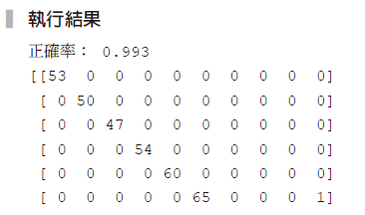
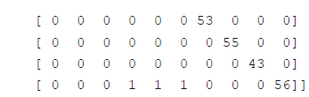

Slide 11
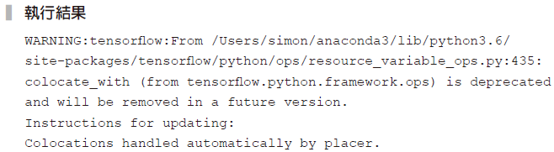
範例20-8 keras深度學習架構
  程式碼
from tensorflow.keras import models
from tensorflow.keras.layers import Dense
model = models.Sequential()
model.add(Dense(512, activation='relu', input_shape=(64,)))
model.add(Dense(10, activation='softmax'))
model.compile(optimizer='adam', loss='categorical_crossentropy',
metrics=['accuracy'])

Slide 12
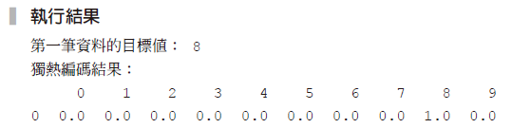
範例20-9 將y值改成獨熱編碼
  程式碼
from sklearn.preprocessing import OneHotEncoder
oh = OneHotEncoder()
y_train_oh = oh.fit_transform(y_train.reshape(-1,1))
y_test_oh = oh.transform(y_test.reshape(-1,1))
print('第一筆資料的目標值：', y_train[0])
print('獨熱編碼結果：')
print(pd.DataFrame(y_train_oh.toarray()[[0]]))

Slide 13
範例20-10 模型的學習和預測
  程式碼
np.random.seed(42)
model.fit(X_train, y_train_oh.toarray(),
epochs=50, verbose=0, validation_split=0.2)
y_pred_oh = model.predict(X_test)
y_pred = y_pred_oh.argmax(axis = 1)
print('正確率：',accuracy_score(y_test, y_pred).round(3))
print(confusion_matrix(y_test, y_pred))

Slide 14
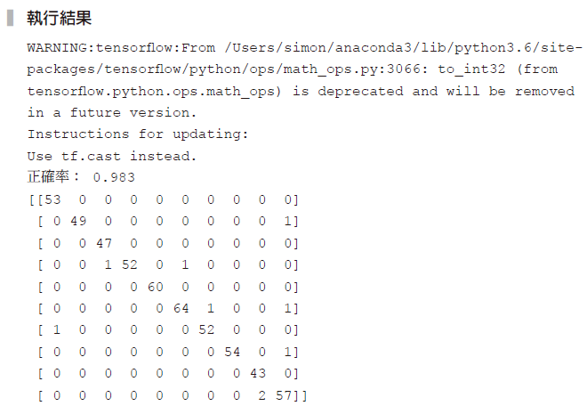

Slide 15
範例20-11 keras包裝器測
  程式碼
from tensorflow.keras.wrappers.scikit_learn import KerasClassifier
def build_model():
model = models.Sequential()
model.add(Dense(512, activation='relu', input_shape=(64,)))
model.add(Dense(10, activation='softmax'))
model.compile(optimizer='adam', loss='categorical_crossentropy',
metrics=['accuracy'])
return model
np.random.seed(42)
model_deep = KerasClassifier(build_fn=build_model, epochs=50, verbose=0)

Slide 16
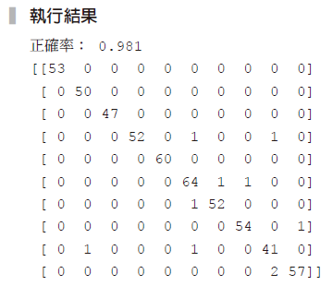
範例20-11 keras 包裝器測
  承接上一頁
model_pl = make_pipeline(MinMaxScaler(), model_deep)
model_pl.fit(X_train, y_train)
y_pred = model_pl.predict(X_test)
print('正確率：',accuracy_score(y_test, y_pred).round(3))
print(confusion_matrix(y_test, y_pred))

Slide 17
範例20-12 以網格搜尋尋找keras裡的epochs和validation_split參數
  程式碼
param_grid = {
'kerasclassifier_ _epochs':[50, 100, 150],
'kerasclassifier_ _validation_split':[0.1, 0.2]}
from sklearn.model_selection import GridSearchCV
gs = GridSearchCV(model_pl, param_grid=param_grid,
cv=5, scoring='accuracy')
gs.fit(X_train, y_train)
print('最佳參數：',gs.best_params_)
y_pred = gs.best_estimator_.predict(X_test)
print('正確率：',accuracy_score(y_test, y_pred).round(3))
print(confusion_matrix(y_test, y_pred))

Slide 18
