Slide 1
Node-red lab

Slide 2
install
1.. 從 node.js 官網下載 node 並安裝 https://nodejs.org/en/ --> windows(x64) 8.9.1LTS
2. 開始_> 執行 -> cmd
3. > npm install -g node-red
5. npm install node-red-dashboard -g
6. npm install node-red-contrib-thingspeak42 -g
7. npm install node-red-contrib-slack -g
8. npm install node-red-contrib-firebase -g
9. git clone https://github.com/Freeboard/freeboard.git
npm install freeboard -g
git clone https://github.com/urbiworx/node-red-contrib-freeboard.git
cd node-red-contrib-freeboard
npm install
cd ..
npm install node-red-contrib-freeboard
10. node-red
11. http://127.0.0.1:1880

Slide 3
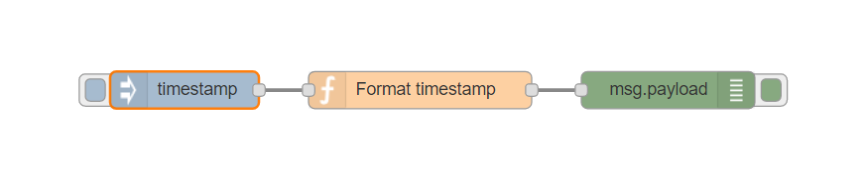
Lab 1

Slide 4
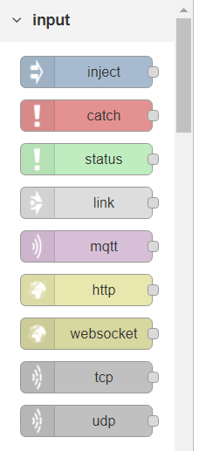
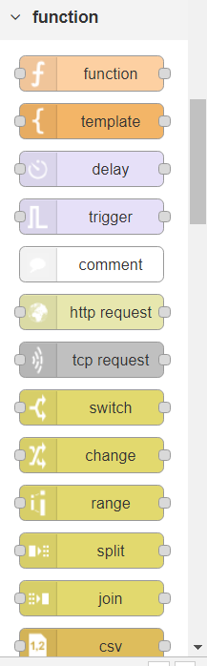
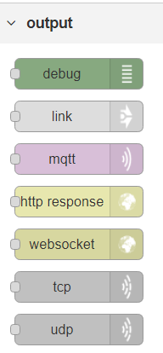

Slide 5
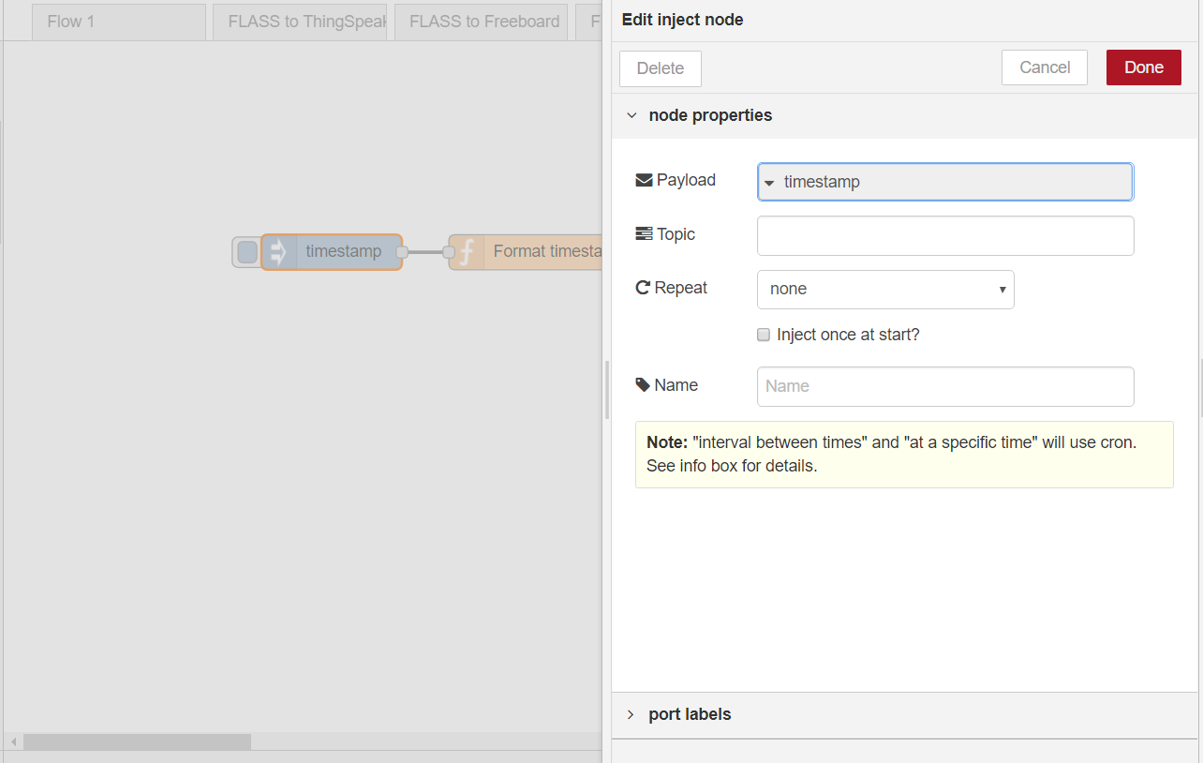
inject

Slide 6
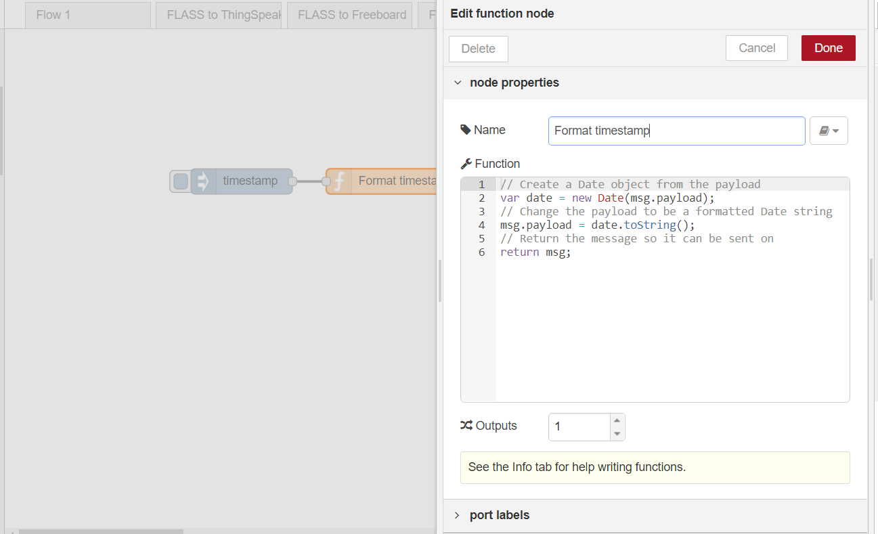
function

Slide 7
Function(二)
// Create a Date object from the payload
var date = new Date(msg.payload);
// Change the payload to be a formatted Date string
msg.payload = date.toString();
// Return the message so it can be sent on
return msg;

Slide 8
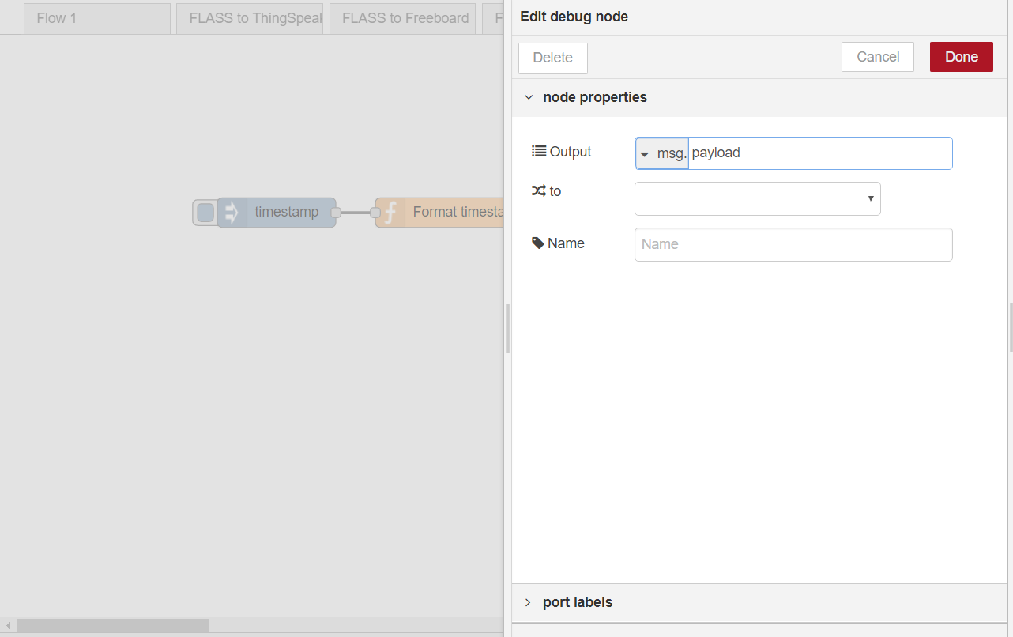
Output -- debug

Slide 9
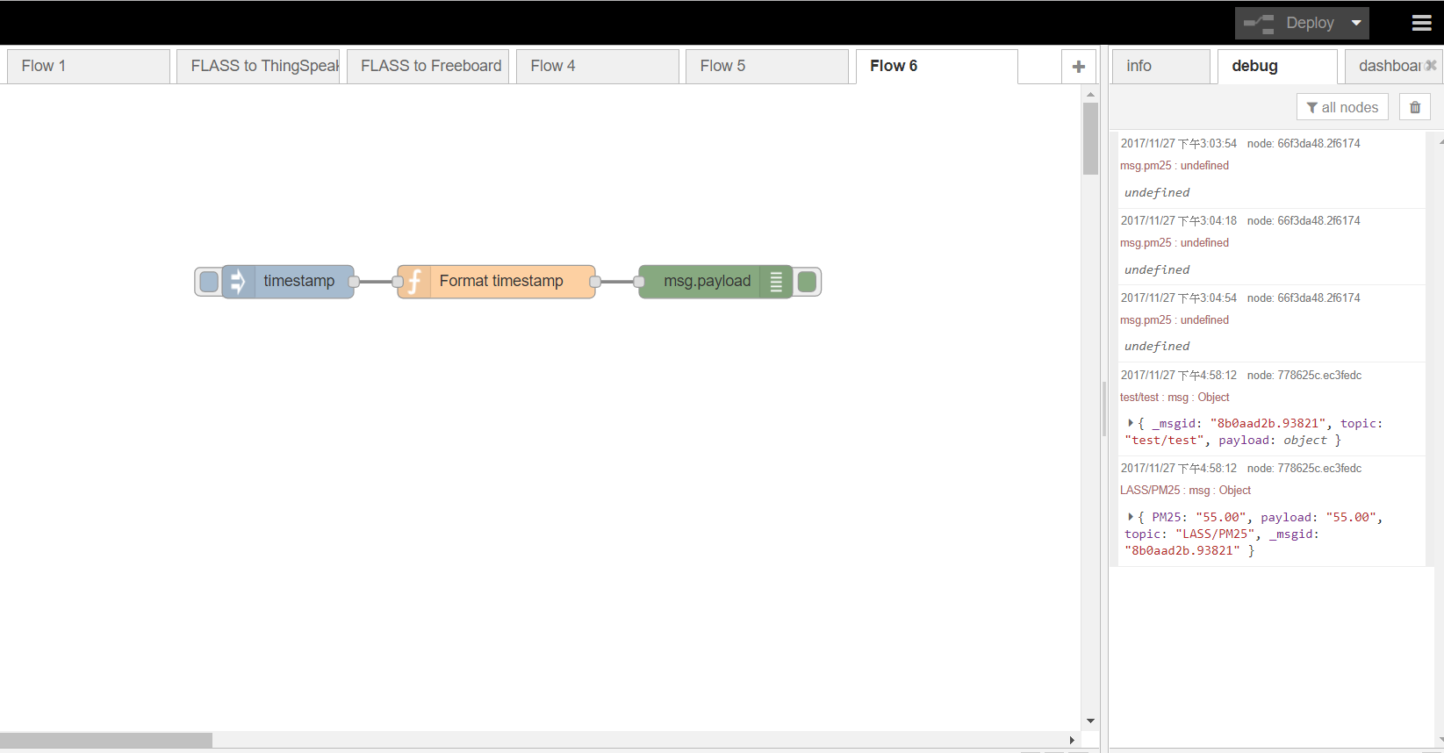
執行

Slide 10
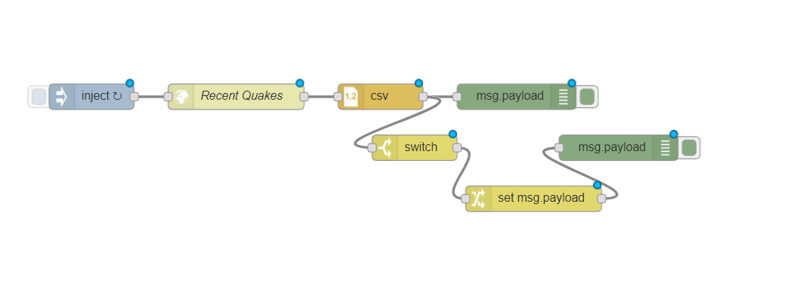
Lab2 – http request

Slide 11
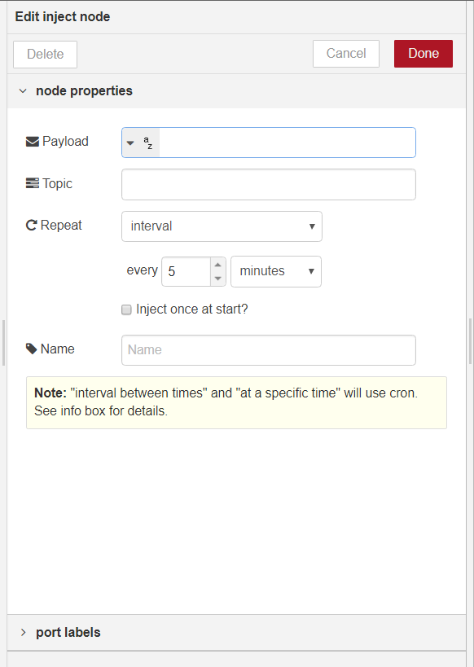


Slide 12
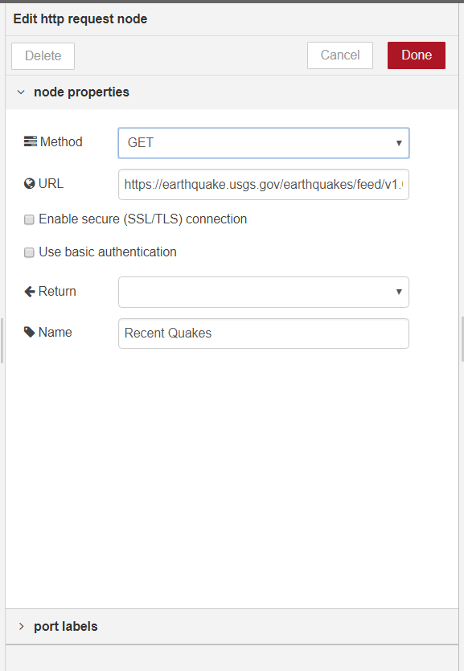

https://earthquake.usgs.gov/earthquakes/feed/v1.0/summary/significant_week.csv

Slide 13
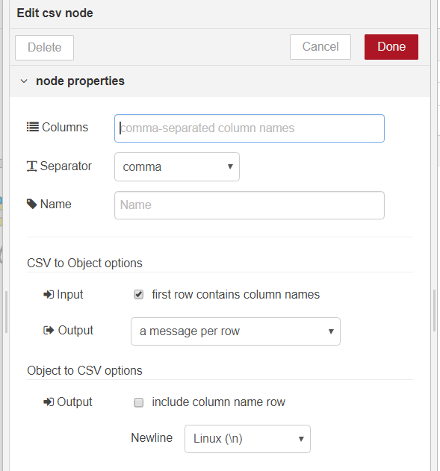


Slide 14
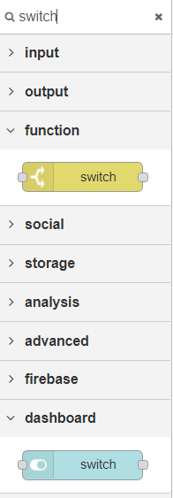
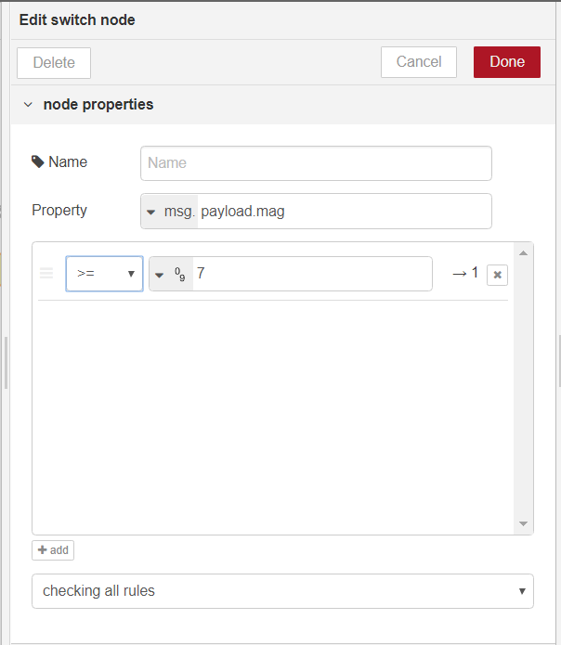

Slide 15
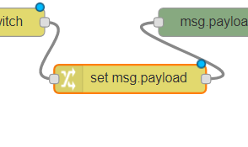
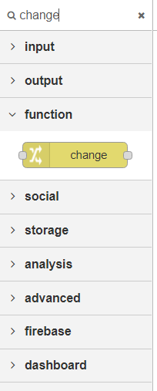
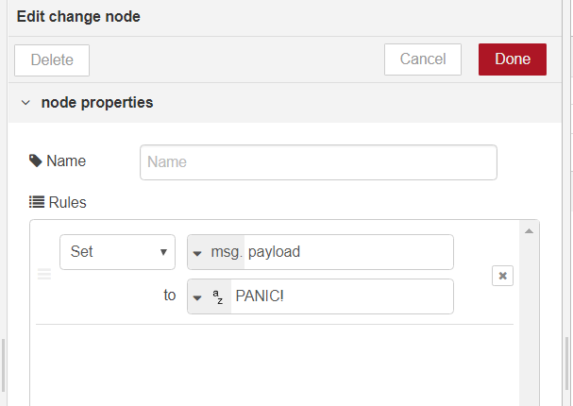

Slide 16
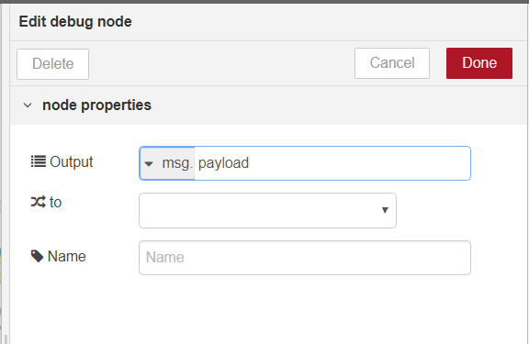
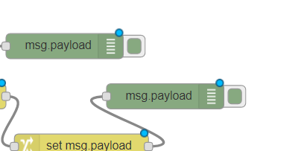

Slide 17
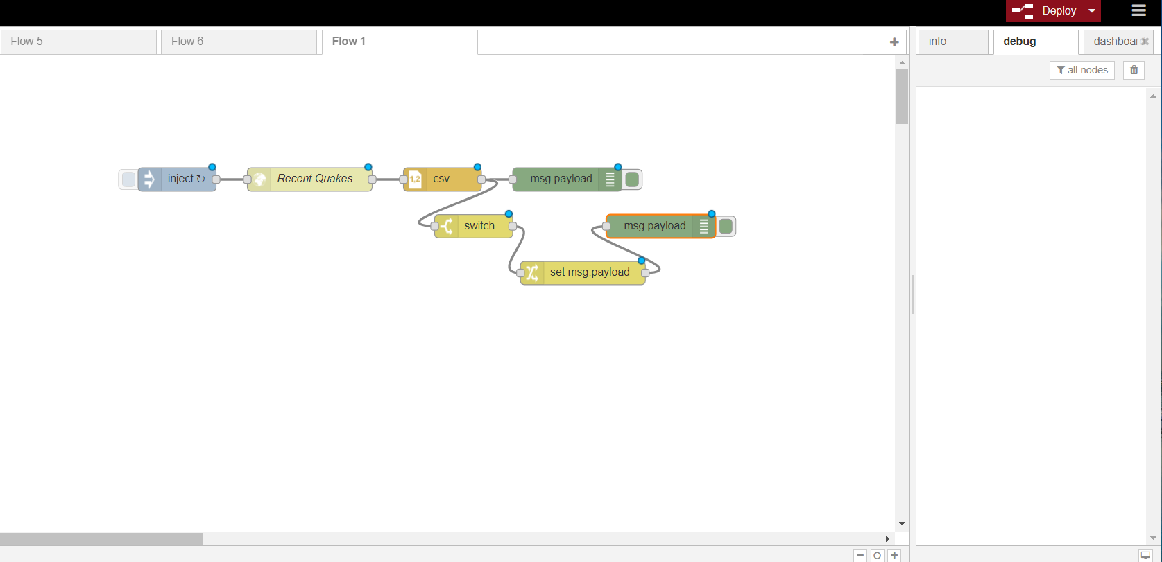

Slide 18
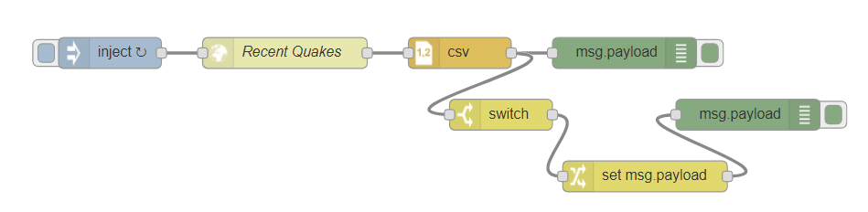
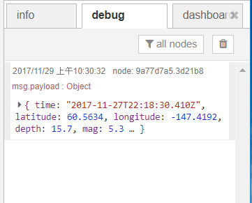
點選按鈕執行flow

Slide 19
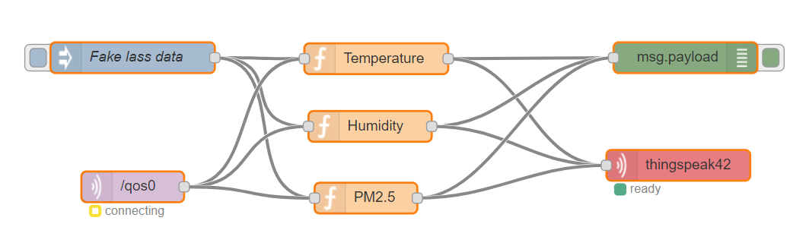
LASS/MQTT to ThingSpeak

Slide 20
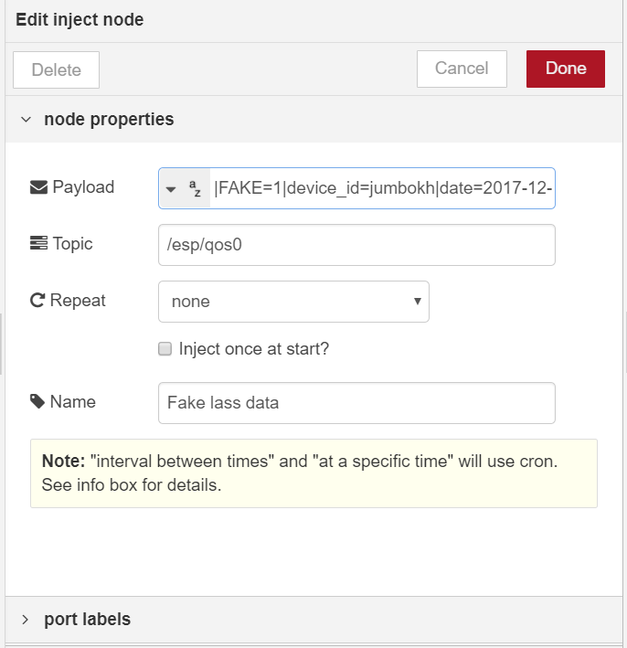
Input: fake data
|FAKE=1|device_id=jumbokh|date=2017-12-1|time=03:43:56|device=Nodemcu|s_d0=60.00|s_t0=23.40|s_h0=80.20

Slide 21
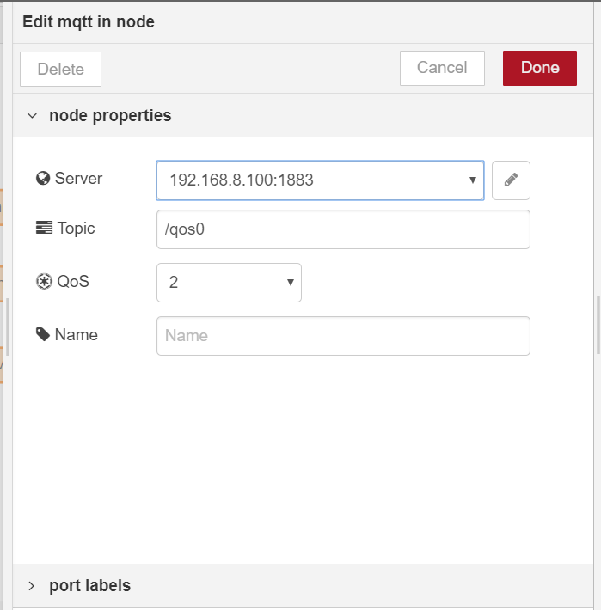
Input: mqtt

Slide 22
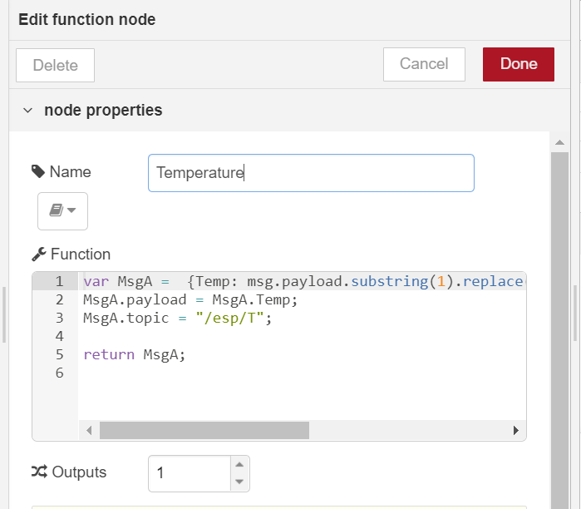
Function: temperature
var MsgA = {Temp: msg.payload.substring(1).replace(/=/gi,"|").split("|").slice(13,14).toString()}; MsgA.payload = MsgA.Temp;MsgA.topic = "/esp/T";
return MsgA;

Slide 23
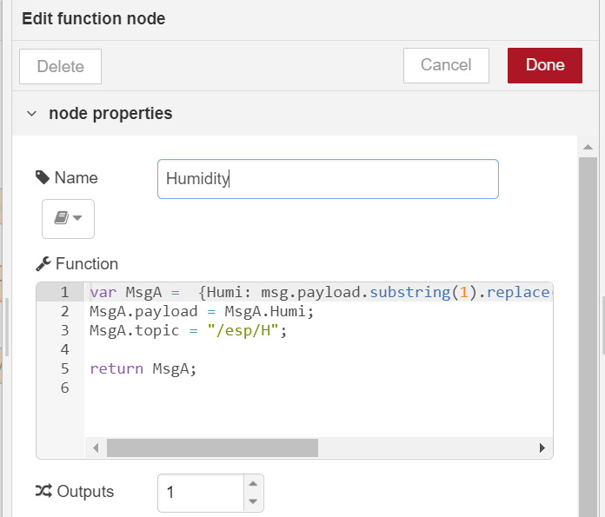
Function: Humidity
var MsgA = {Humi: msg.payload.substring(1).replace(/=/gi,"|").split("|").slice(15,16).toString()};
MsgA.payload = MsgA.Humi;
MsgA.topic = "/esp/H";
return MsgA;

Slide 24
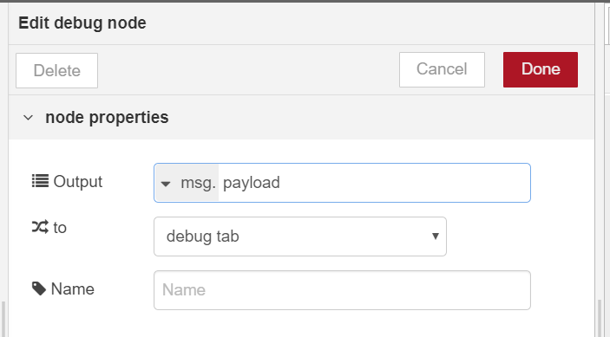
Output: debug

Slide 25
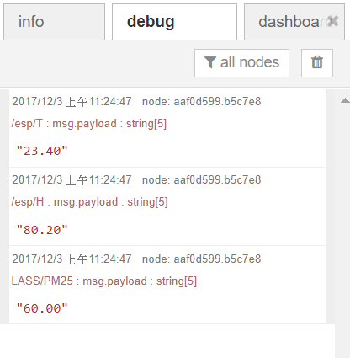
Output: debug

Slide 26
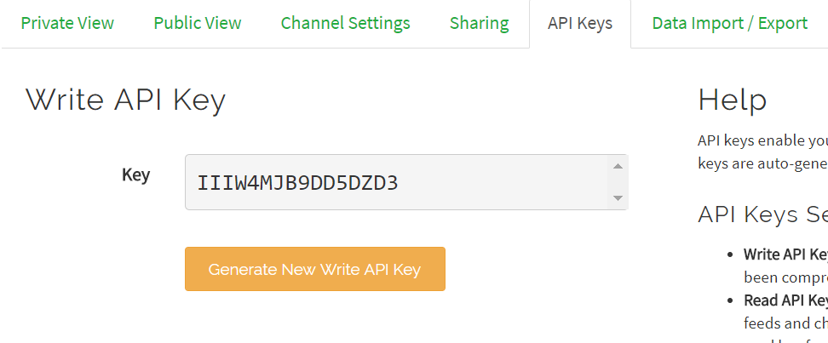
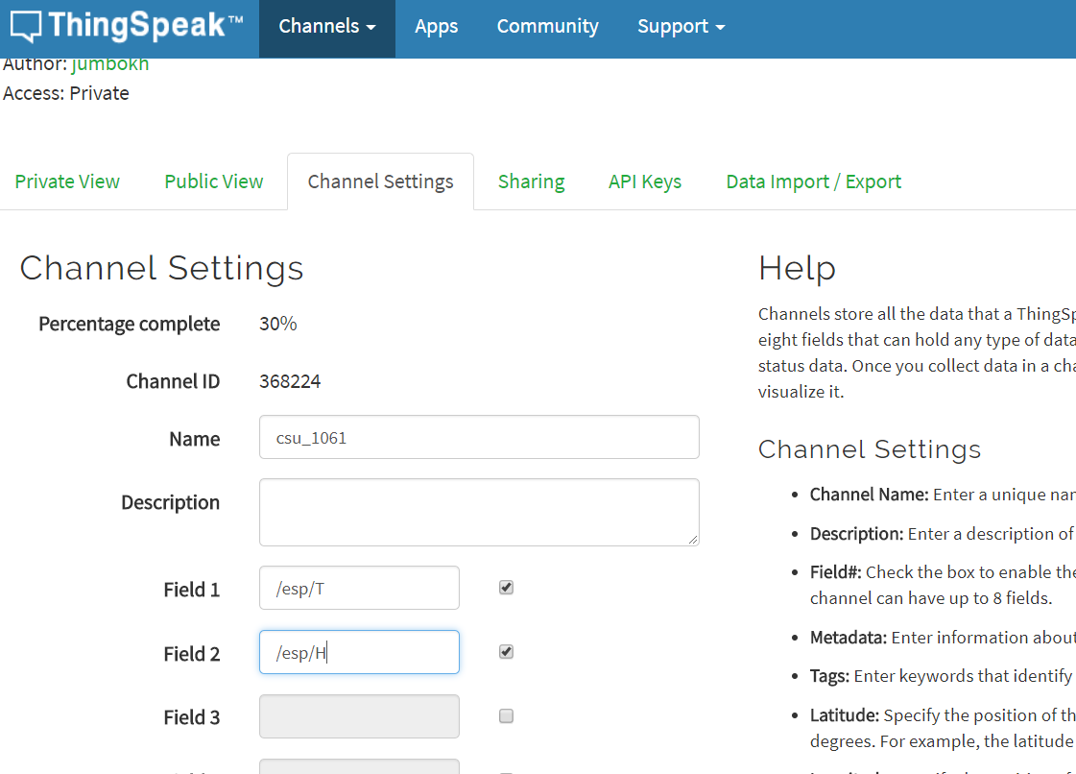
thingSpeak config

Slide 27
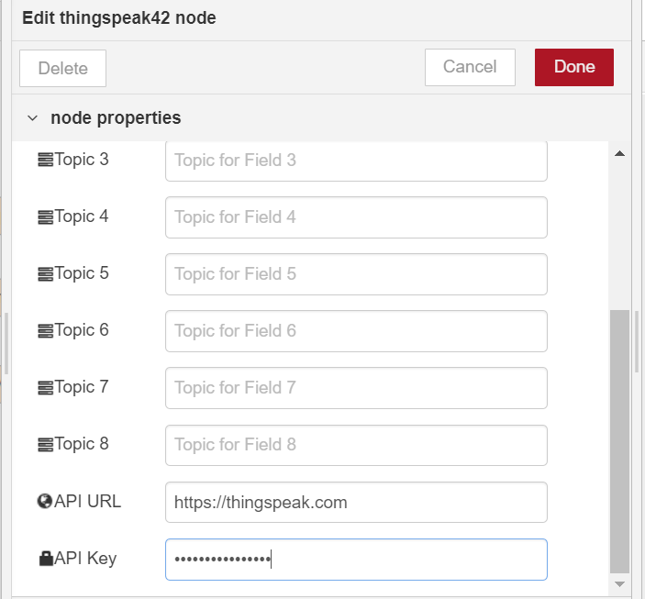
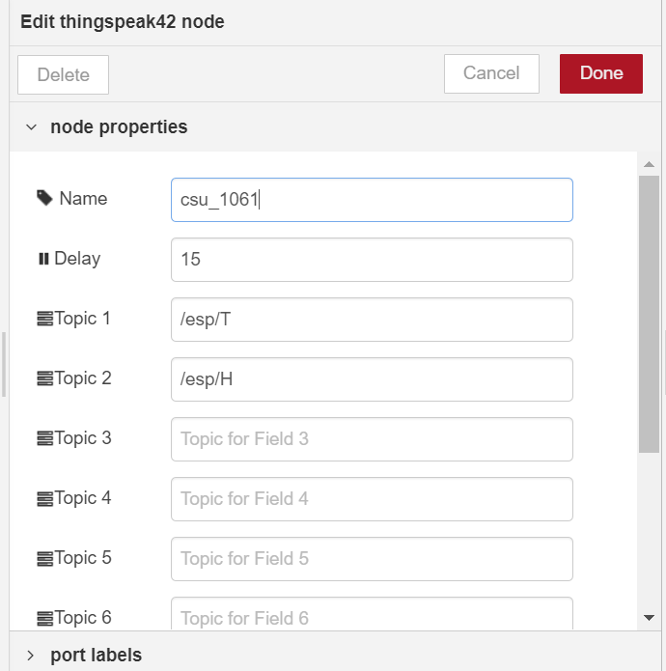
Output: thingspeak

Slide 28
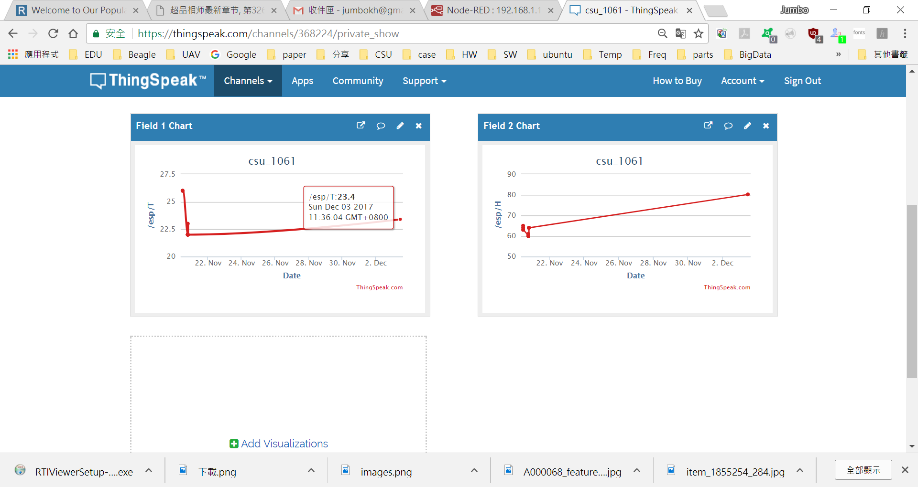
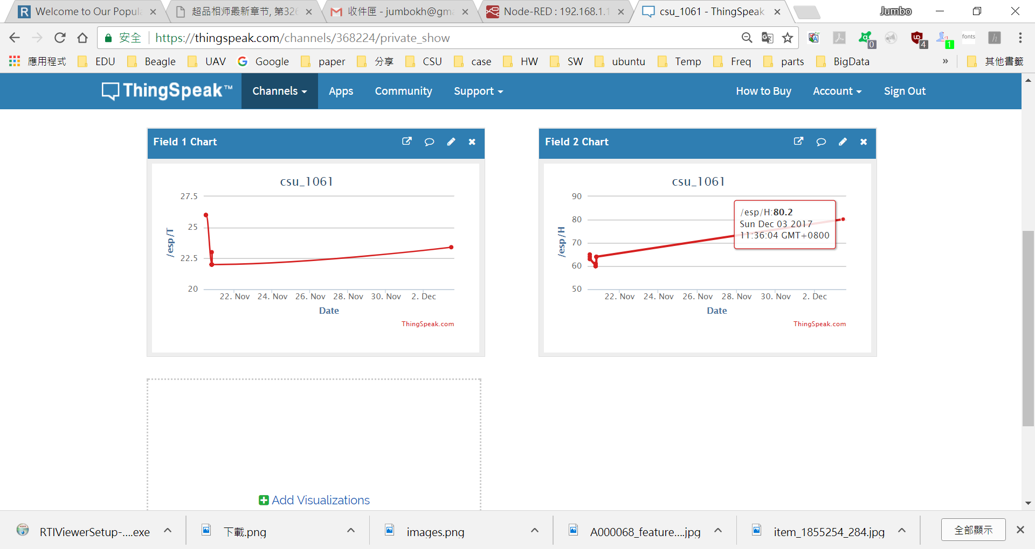

Slide 29
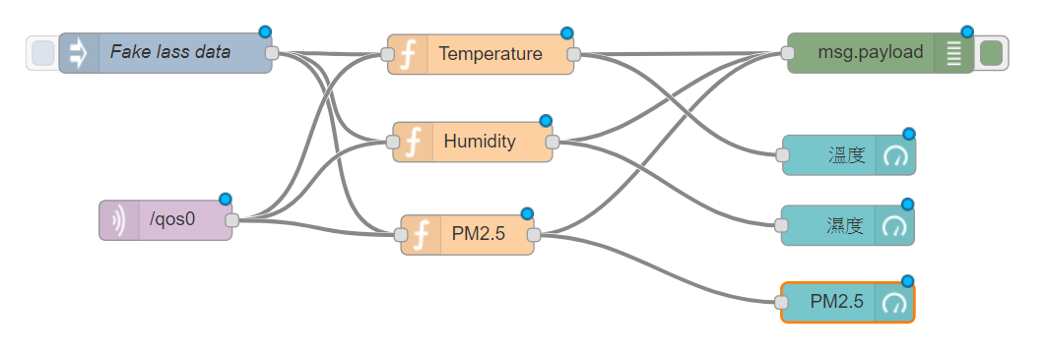
Mqtt to ui

Slide 30
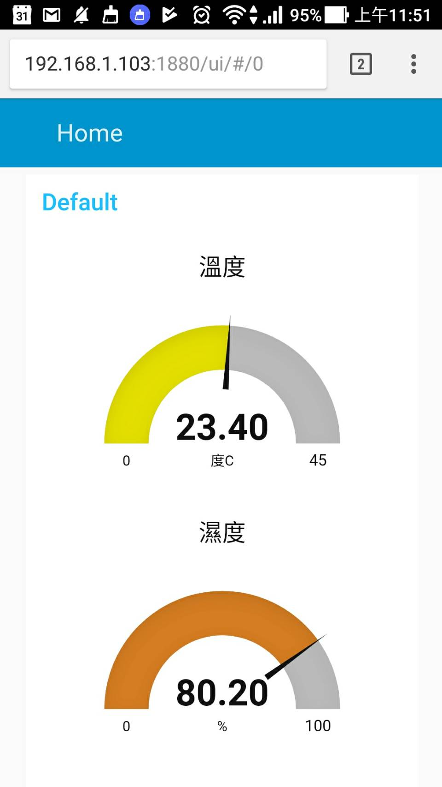

Slide 31
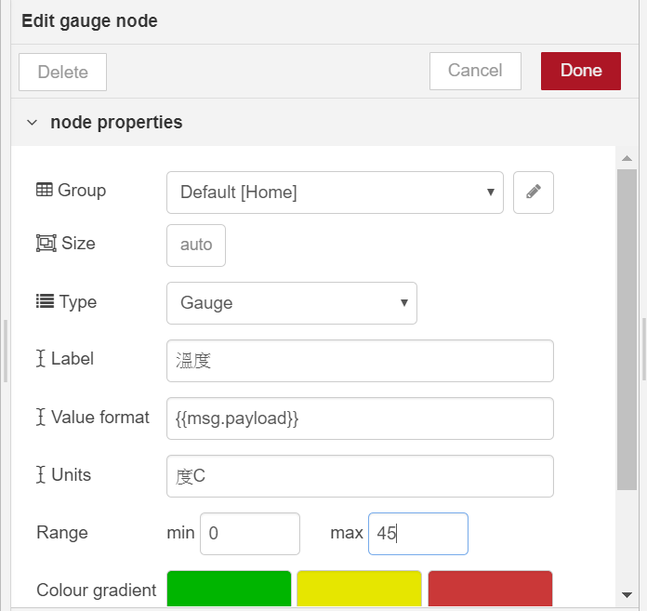
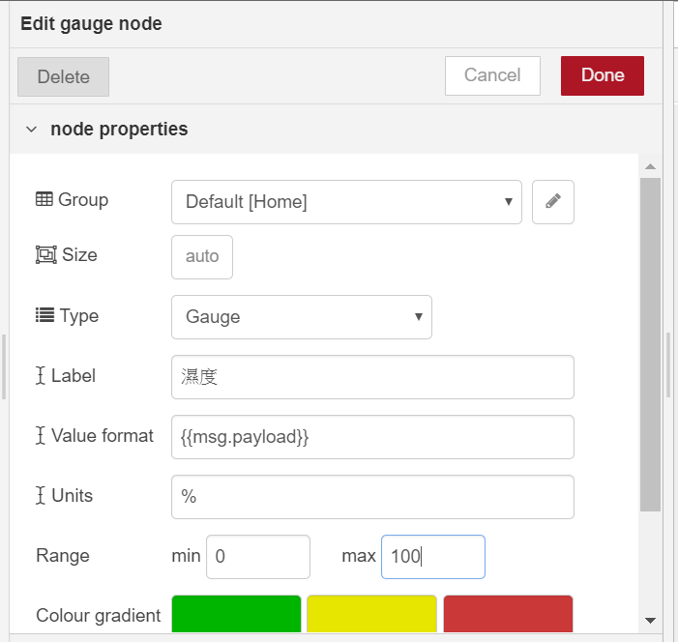

Slide 32
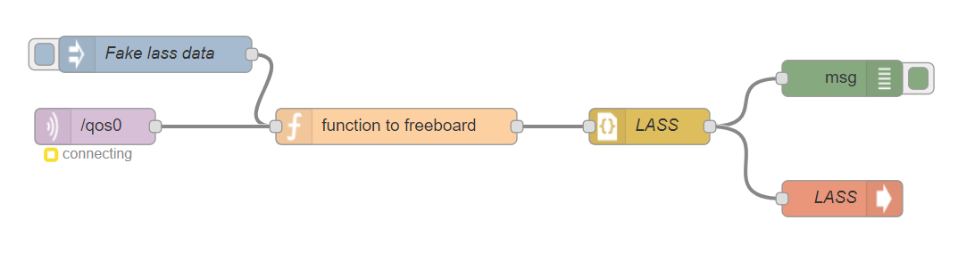
Mqtt to freeboard

Slide 33
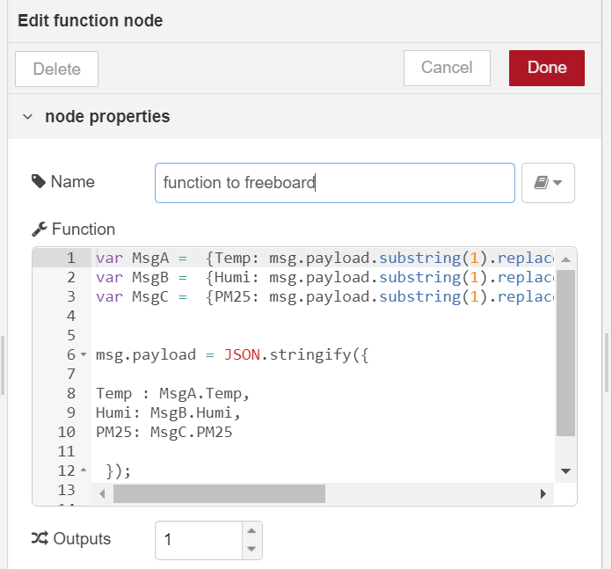
Function node

Slide 34
function
var MsgA = {Temp: sg.payload.substring(1).replace(/=/gi,"|").split("|").slice(13,14).toString()};
var MsgB = {Humi:msg.payload.substring(1).replace(/=/gi,"|").split("|").slice(15,16).toString()};
Var MsgC = {PM25:msg.payload.substring(1).replace(/=/gi,"|").split("|").slice(11,12).toString()};
msg.payload = JSON.stringify({
Temp : MsgA.Temp,
Humi: MsgB.Humi,
PM25: MsgC.PM25
});
return msg;

Slide 35
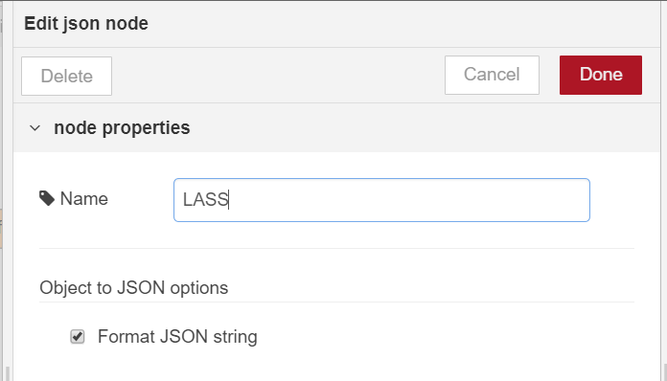
JSON node

Slide 36
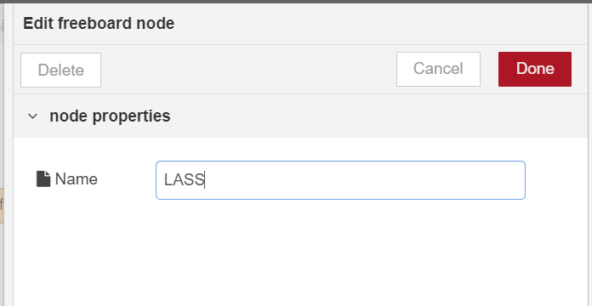
Freeboard node

Slide 37
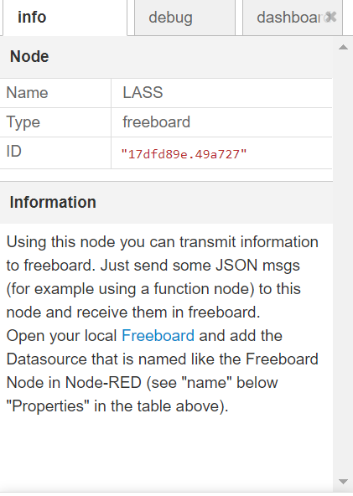
Local freeboard 進入點
Or
http://192.168.1.103:1880/freeboard

Slide 38
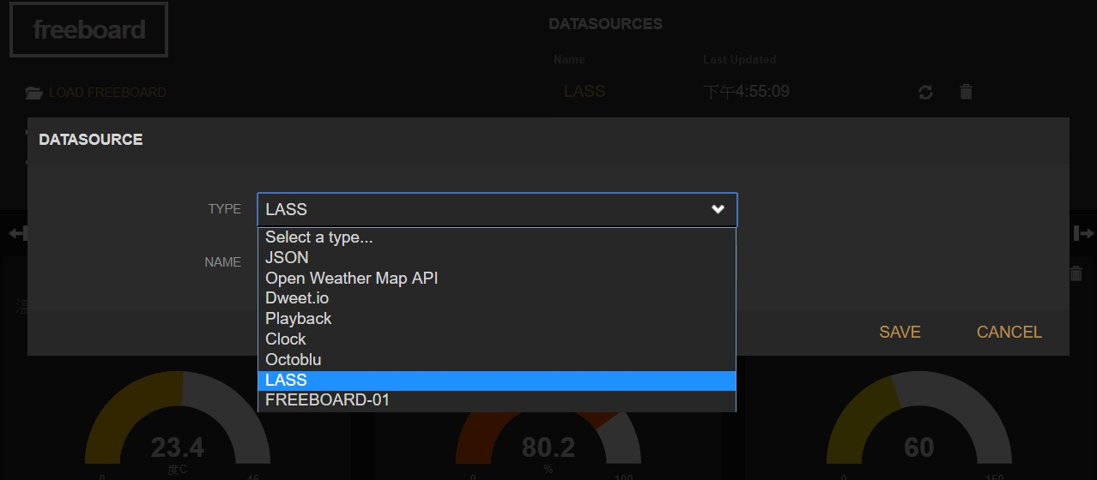
Add datasource

Slide 39
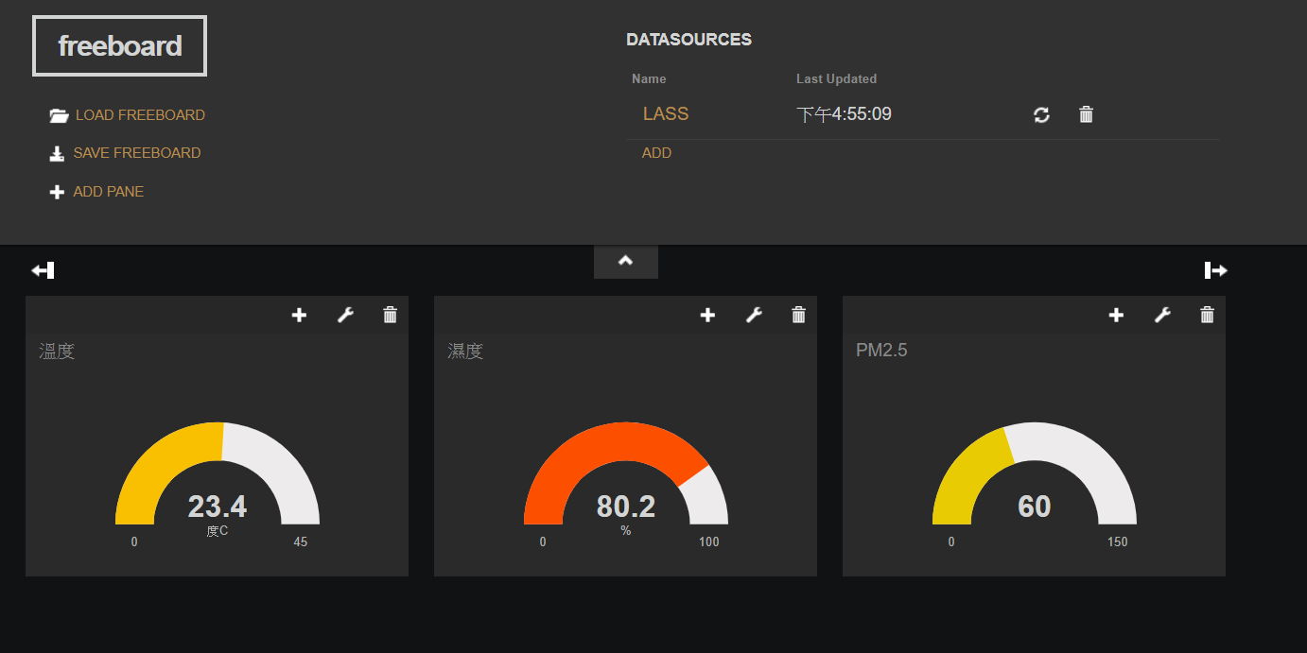
Freeboard layout

Slide 40
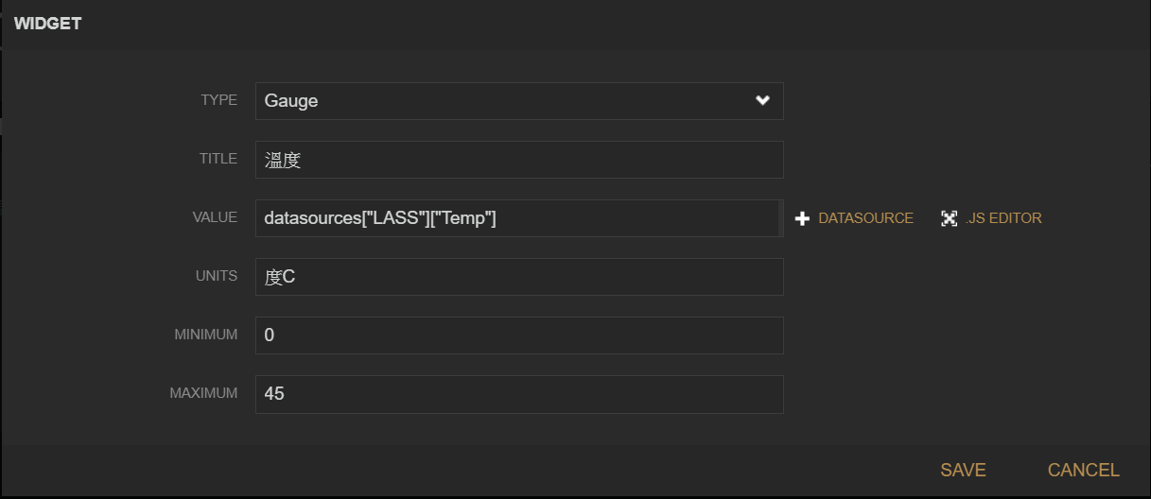
Freeboard widget setup

Slide 41
