Slide 1
實驗二
按鈕及可變電阻

Slide 2
一、實驗目的
了解如何讀取數位輸入
了解如何讀取類比輸入

Slide 3
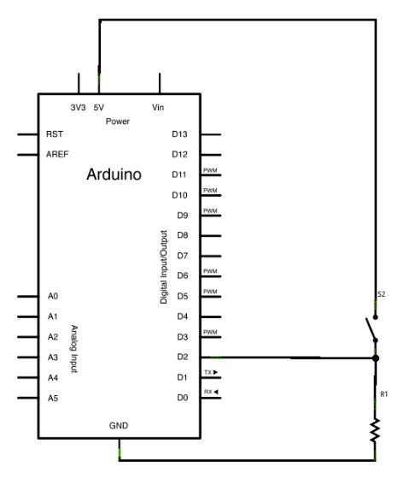
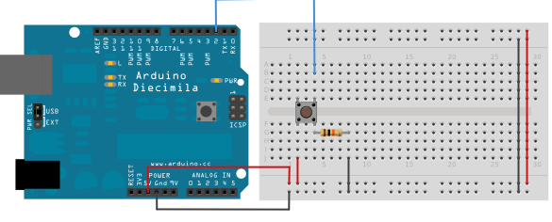
Digital Read Serial

Slide 4
/*
DigitalReadSerial
Reads a digital input on pin 2, prints the result to the serial monitor
This example code is in the public domain.
*/
void setup() {
Serial.begin(9600);
pinMode(2, INPUT);
}
void loop() {
int sensorValue = digitalRead(2);
Serial.println(sensorValue);
}

Slide 5
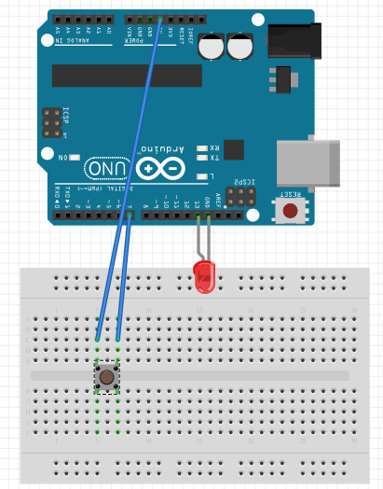
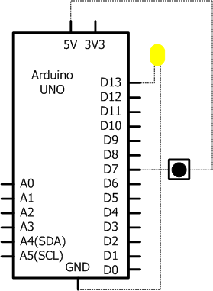

Slide 6
/*********************************************
Book : 最簡單的互動設計Arduino一試就上手
Example : 5-2
Complier: Arduino 0022
Verify : Scott Sun
Date : 2012-08
*********************************************/
#define LED 13 // 定義LED接腳
#define BUTTON 7 // 定義按鈕接腳
int val = 0; // 負責存取數值的變數
int state = 0; // 0 = LED 關閉 ; 1 = LED 開啟
void setup()
{
pinMode(LED, OUTPUT); // 腳位輸出設定
pinMode(BUTTON, INPUT); // 腳位輸入設定
}
void loop()
{
val = digitalRead(BUTTON); // 讀取並儲存按鈕狀態
if (val == HIGH) //若按鈕按下，改變狀態
state = 1 - state;
if (state == 1)
digitalWrite(LED, HIGH); // LED亮燈
else
digitalWrite(LED, LOW);//關閉LED
}

Slide 7
Arduino 的 AD 轉換
6 個 AD 腳位 0 ~ 5 ，皆為 10-bit 解析度
2¹⁰ = 1024 ➔ 1024-1 = 1023
5V / 1023 = 0.0049V
待測訊號 = 量測值/1023 * 5v
= 1023/1023 * 5v = 5v

Slide 8
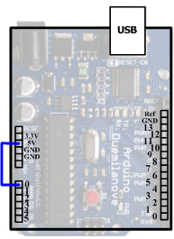
電壓量測

Slide 9
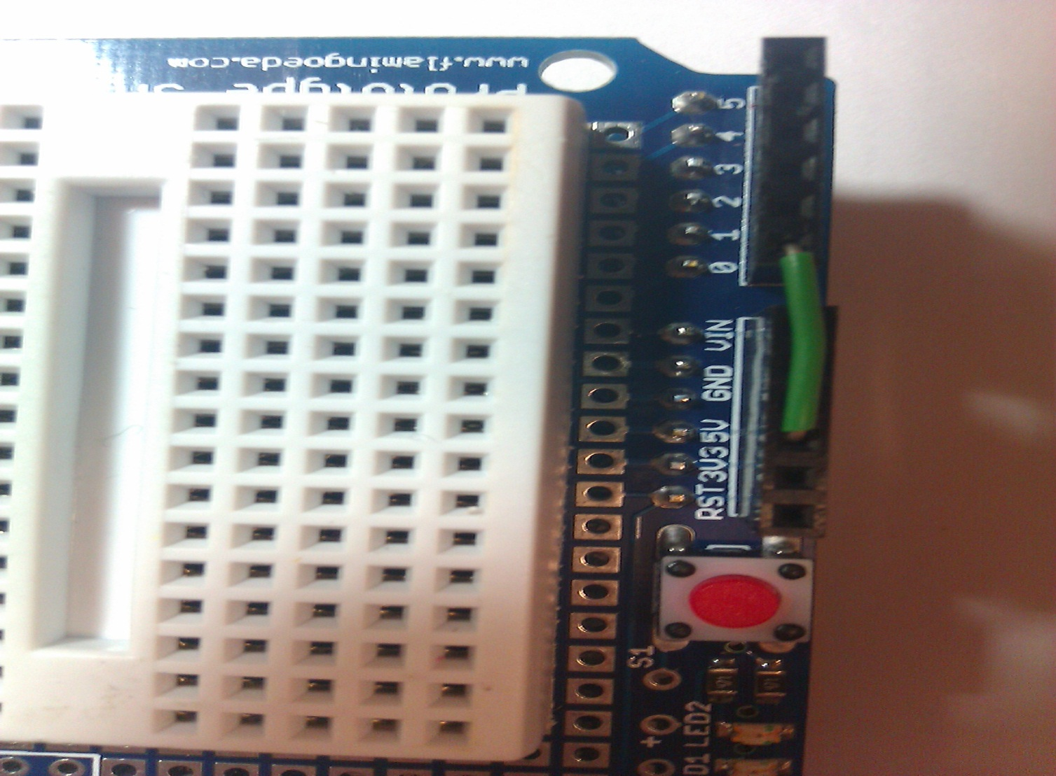
電壓測量

Slide 10
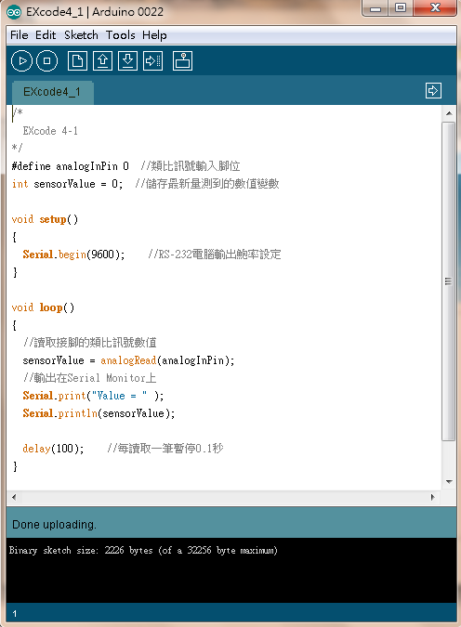

Slide 11
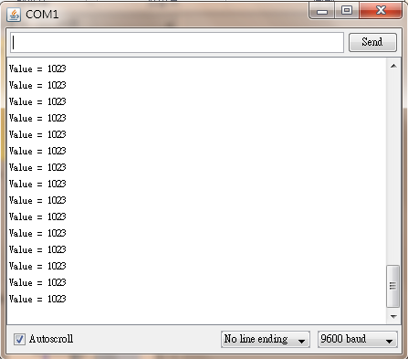

Slide 12
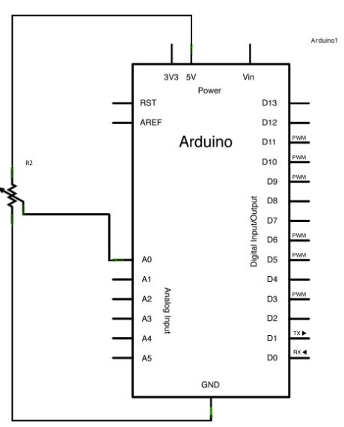
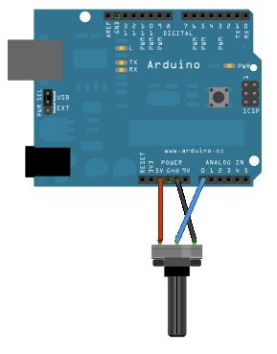
Analog Read Serial

Slide 13
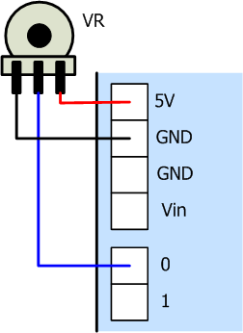
可變電阻量測

Slide 14
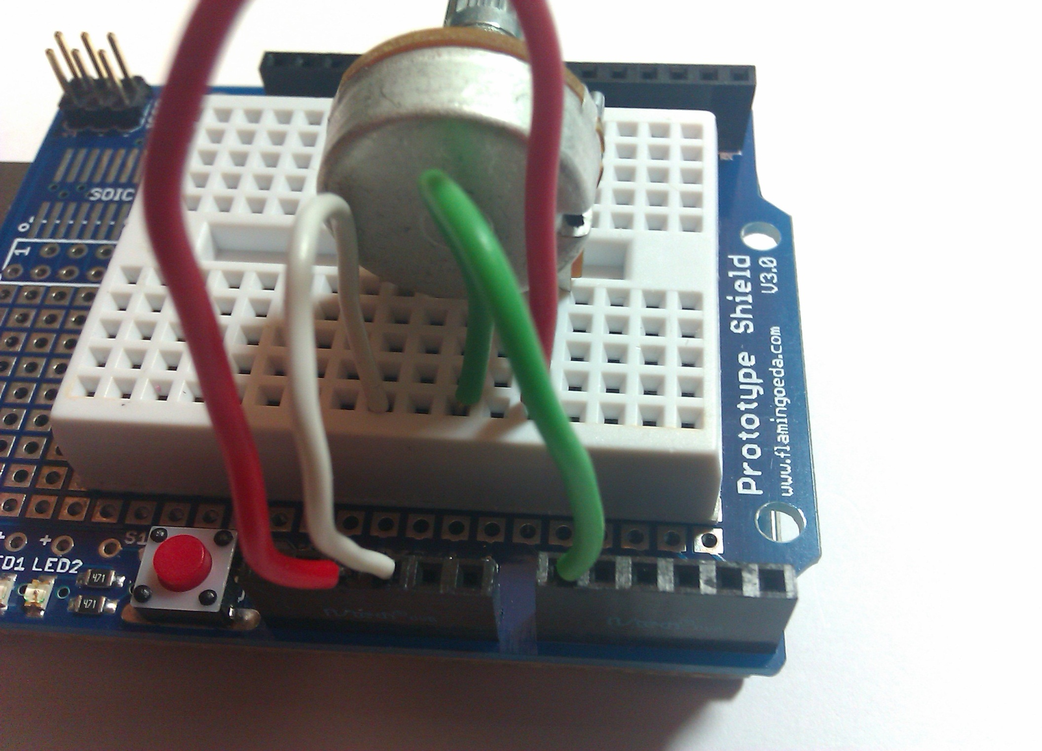

Slide 15
/*
AnalogReadSerial
Reads an analog input on pin 0, prints the result to the serial monitor
This example code is in the public domain.
*/
void setup() {
Serial.begin(9600);
}
void loop() {
int sensorValue = analogRead(A0);
Serial.println(sensorValue);
}

Slide 16
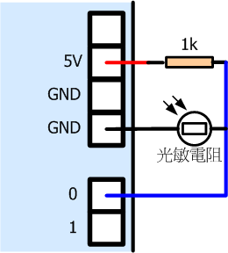
光敏電阻量測

Slide 17
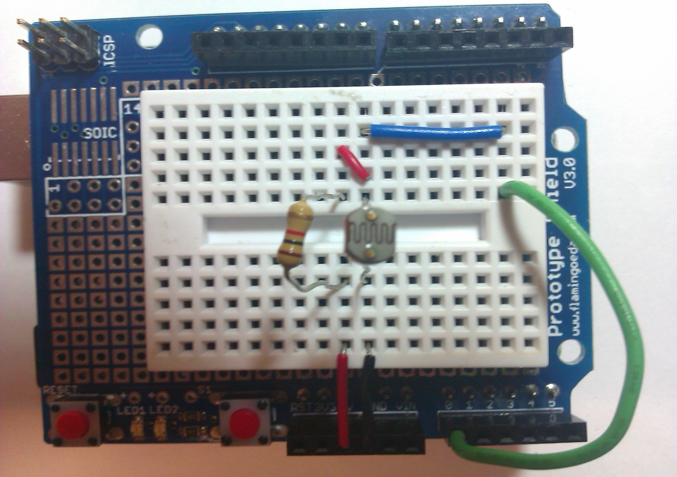

Slide 18
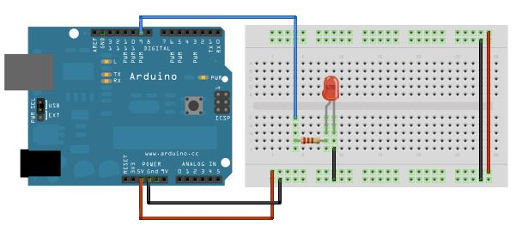
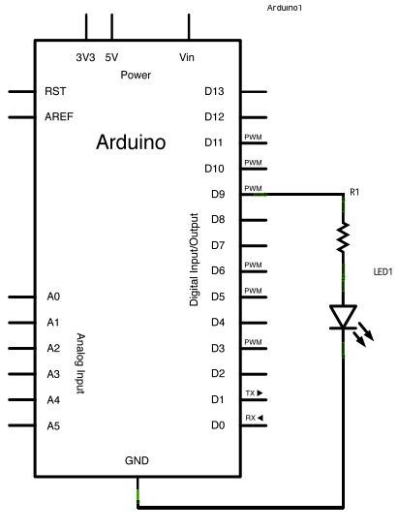
fade

Slide 19
/*
Fade
This example shows how to fade an LED on pin 9
using the analogWrite() function.
*/
int brightness = 0; // how bright the LED is
int fadeAmount = 5; // how many points to fade the LED by
void setup() {
// declare pin 9 to be an output:
pinMode(9, OUTPUT);
}
void loop() {
// set the brightness of pin 9:
analogWrite(9, brightness);
// change the brightness for next time through the loop:
brightness = brightness + fadeAmount;
// reverse the direction of the fading at the ends of the fade:
if (brightness == 0 || brightness == 255) {
fadeAmount = -fadeAmount ;
}
// wait for 30 milliseconds to see the dimming effect
delay(30);
}

Slide 20
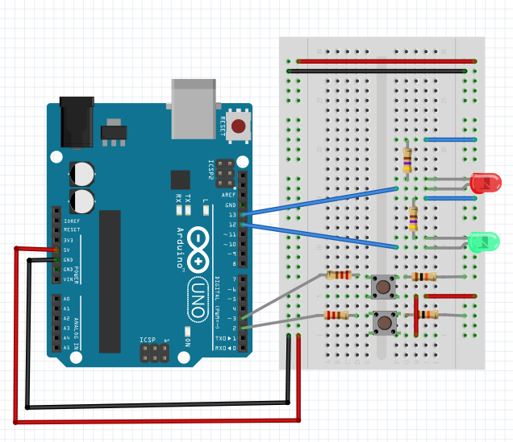

Slide 21
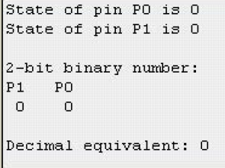
模擬二進位讀取值，
並轉換成十進位值

