Slide 1
TP2 – Sistemas monzónicos
Algunos resultados del paper:
Monsoons Climate Change Assessment
Wang et al. 2020. BAMS. DOI 10.1175/BAMS-D-19-0335.1.

Slide 2
Continued global warming and urbanization over the past century has already caused a significant rise in the intensity and frequency of extreme rainfall events in all monsoon regions (high confidence).
NH land monsoon rainfall as a whole declined from 1950 to 1980 and rebounded after the 1980s, due to the competing influences of internal climate variability and radiative forcing from GHGs and aerosol forcing (high confidence)
The CMIP6 models simulate better global monsoon intensity and precipitation over CMIP5 models.
There is high confidence that the frequency and intensity of monsoon extreme rainfall events will increase, alongside an increasing risk of drought over some regions
Land monsoon rainfall will increase in South Asia and East Asia (high confidence) and northern Africa (medium confidence), and decrease in North America and unchanged in Southern Hemisphere.
The rainy season will likely be lengthened in the Northern Hemisphere due to late retreat (especially over East Asia), but shortened in the Southern Hemisphere due to delayed onset.

Slide 3
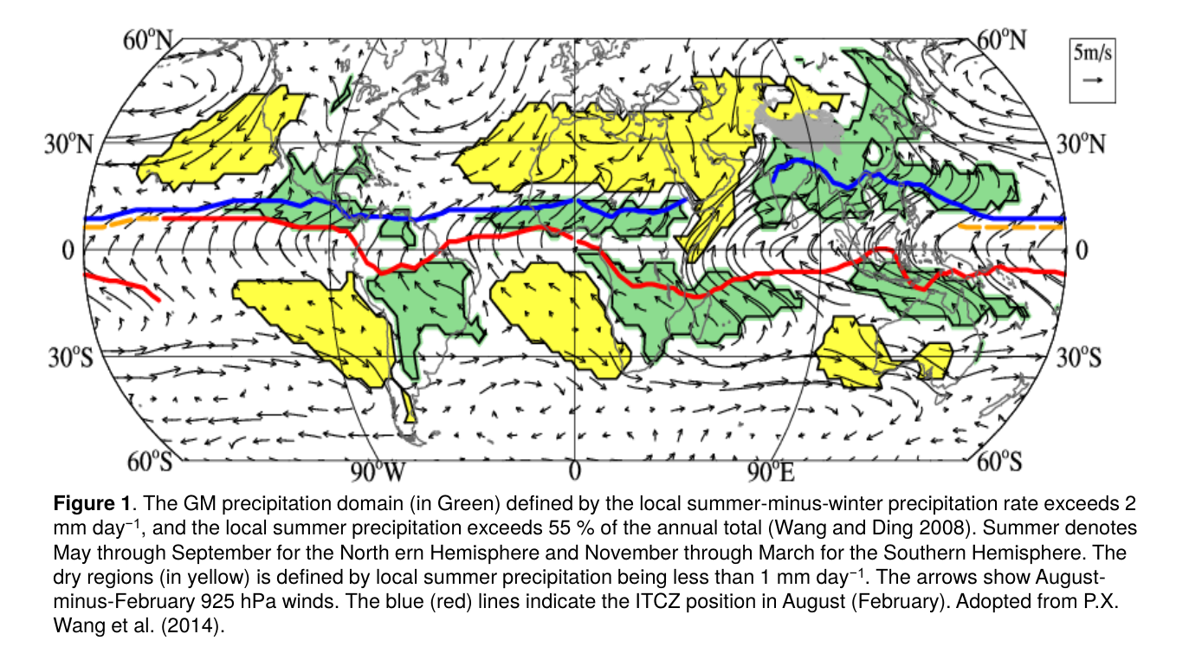

Slide 4
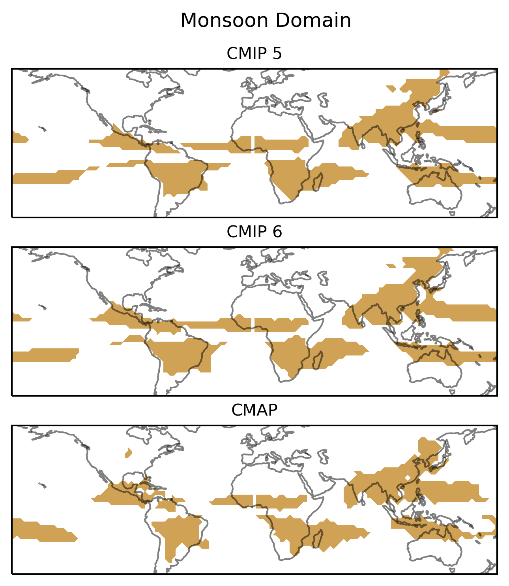

Slide 5
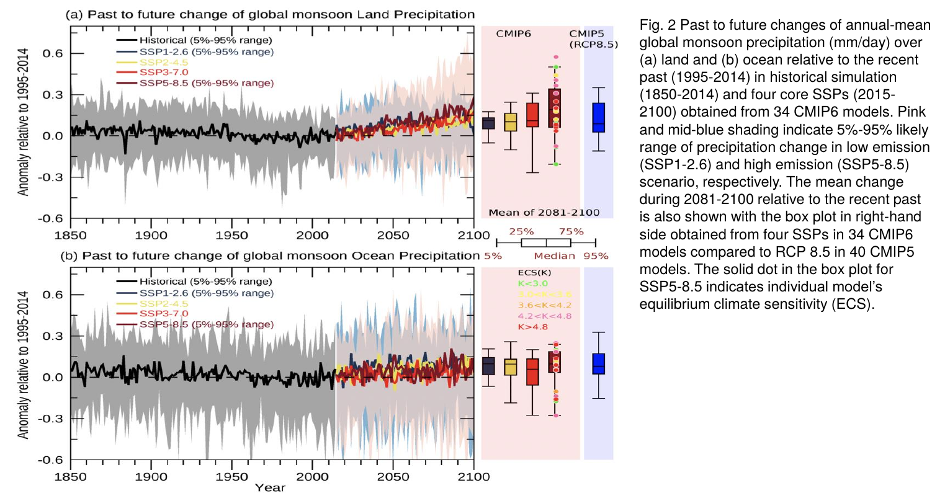
Notes:
The CMIP5 results suggest that GM area, annual range and mean precipitation are likely to increase by the end of the 21st century. The increase will be stronger in the NH, and the NH rainy season is likely to lengthen due to earlier or unchanged onset dates and a delayed retreat (Lee and Wang, 2014). The increase in GM precipitation was primarily attributed to temperature-driven increases in specific humidity, resulting in the “wet-get-wetter” pattern (Held and Soden, 2006). The projected GMP increase over land by the end of the 21st century relative to 1995-2014 in CMIP6 is about 50% larger than in CMIP5. Models with high (>4.2°C) equilibrium climate sensitivity (ECS) account for this larger projection. Note that the forced signal of GMP over land shows a decreasing trend from 1950 to the 1980s, but the trend reversed around 1990, which is consistent with the CMIP5 results (Lee and Wang, 2014).
During 1950-1990, the temperature-driven intensification of precipitation was likely masked by a fast precipitation response to anthropogenic sulfate and volcanic forcing, even though the warming trend due to GHG since the pre-industrial period (1850-1900) is three times larger than the cooling due to aerosol forcing (Lau and Kim, 2017; Richardson et al. 2018;). The recent upward trend may signify the emergence of the greenhouse-gas signal against the rainfall reduction due to aerosol emissions. However, the trend during recent decades can be influenced by the leading modes of multidecadal variability of global SST (Wang et al. 2018). Lee et al. (2019) found that land monsoon precipitation sensitivity (precipitation change per degree of global warming) slightly increases with the level of GHG forcing, whereas the ocean monsoon precipitation has almost no sensitivity (Fig. 2). The GM land precipitation sensitivity has a median of 0.8 %/C in SSP2-4.5, and a median of 1.4%/C in SSP5-8.5. The latter is slightly higher than that simulated by CMIP5 models under RCP 8.5.

Slide 6
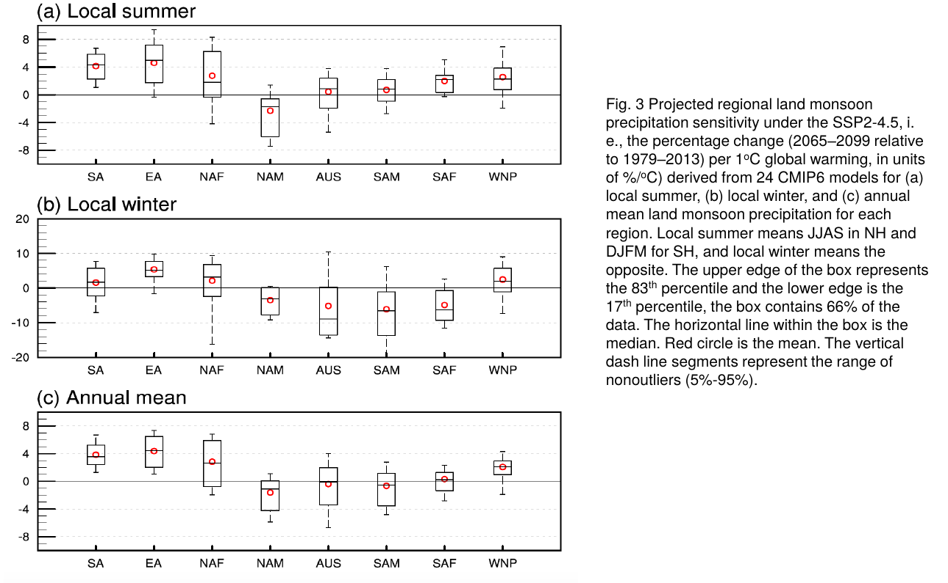

Slide 7
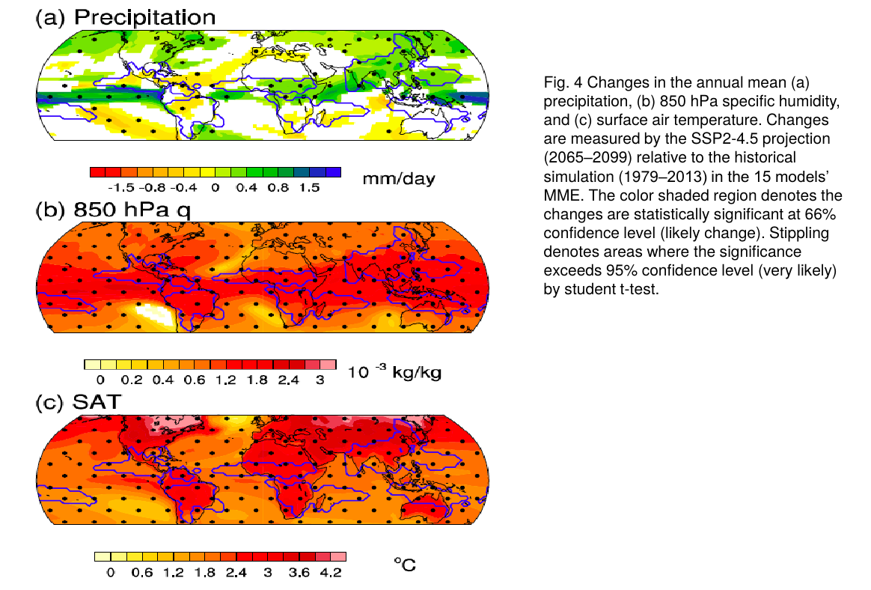
Notes:
Wang et al. (2020) examined the ensemble-mean projection from 15 early-released CMIP6 models, which estimates that under SSP2-4.5 the total NH land monsoon precipitation will increase by about 2.8%/C in contrast to little change in the southern hemisphere (SH; -0.3%/C). In both hemispheres, the annual range of land monsoon rainfall will increase by about 2.6%/C, with wetter summers and drier winters. In addition, the projected land monsoon rainy season will be lengthened in the NH (by about ten days) due to late retreat, but will be shortened in the SH due to delayed onset; the interannual variations of GMP will be more strongly controlled by ENSO variability (Wang et al. 2020). In monsoon regions, increases in specific humidity are spatially uniform (Fig. 4b), but the rainfall change features a robust NH-SH asymmetry and an east-west asymmetry between enhanced Asian-African monsoons and weakened NAM (Fig. 4a), suggesting that circulation changes play a crucial role in shaping the spatial patterns and intensity of GM rainfall changes (Wang et al. 2020). GHG-induced horizontally differential heating results in a robust “NH-warmer-than-SH” pattern (Fig. 4c), which enhances NH monsoon rainfall (Liu et al. 2009, Mohtadi et al. 2016), especially in Asia and northern Africa, due to an enhanced thermal contrast between the large Eurasia-Africa landmass and adjacent oceans (Endo et al. 2018). Those CMIP models that project a stronger inter-hemispheric thermal contrast generate stronger Hadley circulations, more northward positions of the ITCZ, and enhanced NH monsoon precipitation (Wang et al. 2020). The GHG forcing also induces a warmer equatorial eastern Pacific (Fig. 4c), which reduces NAM rainfall by shifting the ITCZ equatorward (Wang et al. 2020). Climate models on average predict weakening ascent under global warming (Endo and Kitoh, 2014), which tends to dry monsoon regions. Weakening monsoon ascent has been linked to the slowdown of the global overturning circulation (Held and Soden 2006). However, a definitive theory for why monsoon circulations broadly weaken with warming remains elusive.

