Slide 1


Practice 4 Hypothesis Testing
ALY 6010
DR. HARPREET SHARMA
By
JOUMANA OBEID Nov30th, 2022

Slide 2
Introduction
Assumptions about the data in this test
The t-test of two samples is done to know if there is a significant difference between the two samples. These two samples can be independent, as seen in the first example. The second two samples are related. We will do the paired test as in the second example.
We will use t-test to because:
The data set record is less than 30
The population standard deviation is not known.
The data is normally distributed.

Slide 3
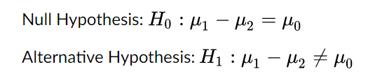
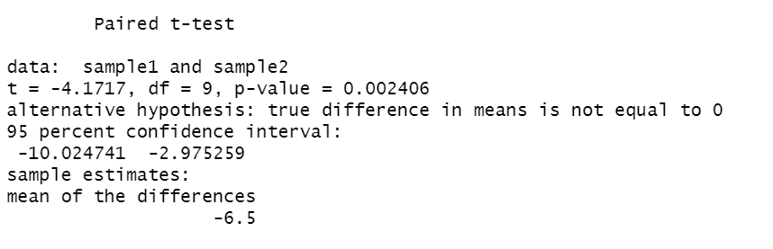
Part 1 Male and Female Cats Body Weight
Introduction and Problem Statement
We want to know if the average male cat's body weight and the average female cat's body weight difference is insignificant. (NULL Hypothesis).
Alternate Hypothesis : The difference is significant.
We reject the null hypothesis because the p-value.0024 <.05 significance level at a 95% confidence interval.
We conclude that the difference is significant between the female cat’s weight and the male cat’s weight at 95% confidence level .

Slide 4
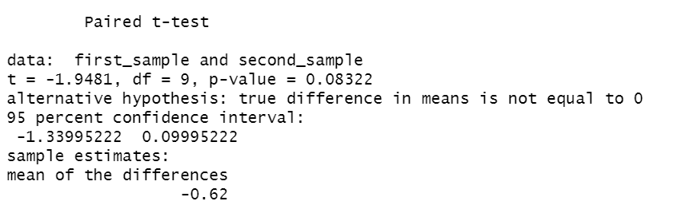
Part 2 Sleep Readings in Two Weeks-Paired Test
Introduction and Problem Statement
We want to know if the meditation influences the sleep quality .
We will assume that the mediation has no effect. (NULL Hypothesis).
Alternate Hypothesis : The meditation affects the sleep quality.
We reject the null hypothesis because the p-value.0833 <.05 significance level at a 95% confidence interval.
The meditation affects the sleeping quality .

Slide 5
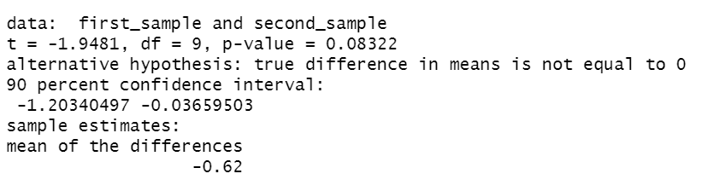
Part 2 Sleep Readings in Two Weeks-Paired Test
Continued
NULL Hypothesis Meditation doesn’t affect the sleeping quality
Alternate Hypothesis: Meditation affects the sleeping quality.
If we choose the confidence level to be 90%.
Our finding will not change because p-value is .08<.1 the significance level.
We reject the null hypothesis at 90% confidence level as well.
The meditation affects the sleeping quality at 90% confidence level.

