Slide 1

The Mesusa Corporation
Comparing Single Sign-On (SSO), OAuth 2.0 and OpenID Connect (OIDC)
CSD 370 03/24/26 Justin Morrow

Slide 2
Authentication (AuthN)
Identity
VS
Authorization (AuthZ)
Access
Asks the question “Who are you”?
It verifies the users identity before allowing access like a Passport at a border crossing.
Asks the question “What can you do”?
Grants limited permissions like a Valet Key that can start the car but not open the trunk.

Slide 3
Brief Description: Single Sign-on (SSO)
Step 3
Step 2
Step 1
No need for multiple username/passwords for each application. As the name says Single Sign-on
Allows users to authenticate once with a central Identity Provider (IdP) and gain access to multiple applications.
Authentication only (AuthN)

Slide 4




Single Sign-On (SSO) User Access
Understanding the implementation process
User Access
IdP Redirect
Token Generation
Access Granted
User attempts to access an application
The application redirects the user to the centralized IdP for the user to log in once.
The IdP verifies the identity of the user and generates a secure token.
The application validates the secure token and grants the user access.

Slide 5
Brief Description: OAuth 2.0
Step 3
Step 2
Step 1
Users maintain control over what data is accessed and can revoke the permissions anytime
Allows users to grant an application limited access to data from another application without providing their password
Authorization only (Authz)

Slide 6

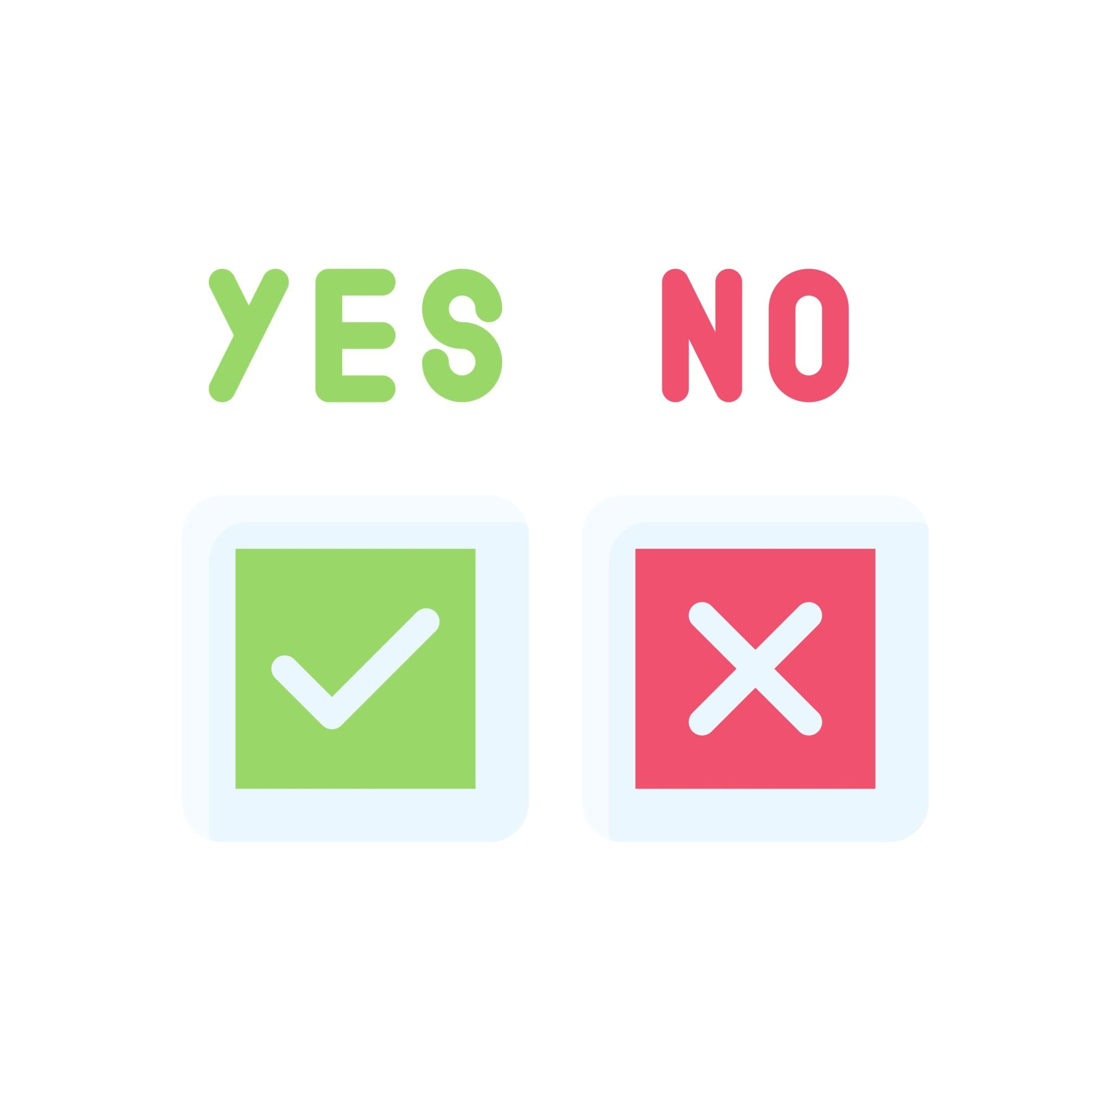

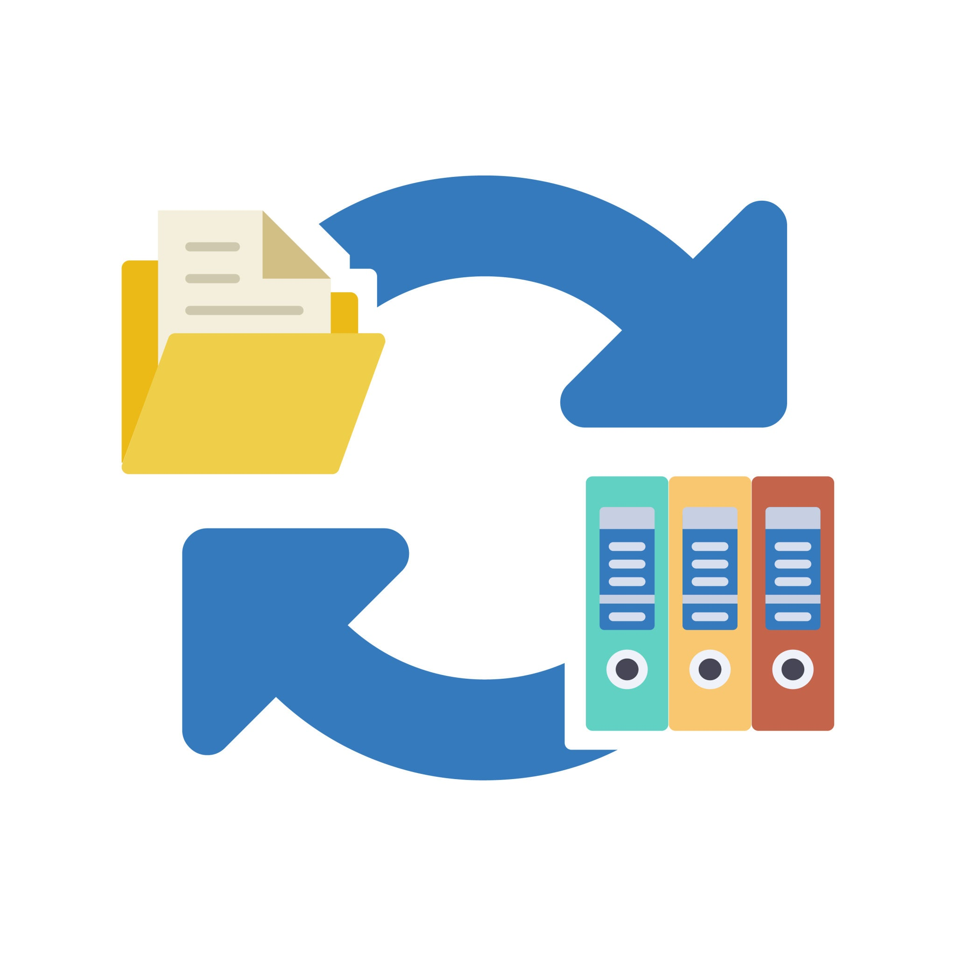
OAuth 2.0 API Authorization
Understanding the implementation process
User Access
IdP Redirect
Token Generation
Access Granted
A 3rd party application requests access to the users resources
The application redirects the user to the Service Provider and prompts the user to Allow or Deny access
Once the user approves the request, the Service Provider issues the Token (JSON/REST) to the 3rd party application
The 3rd party application uses the Token to access the requested user data

Slide 7
Brief Description: OpenID Connect (OIDC)
Step 3
Step 2
Step 1
Provides Identity Verification capabilities of SSO & uses JSON/REST architecture of OAuth 2.0
OIDC is an authentication layer built on top of OAuth 2.0’s framework
Authentication & Authorization

Slide 8

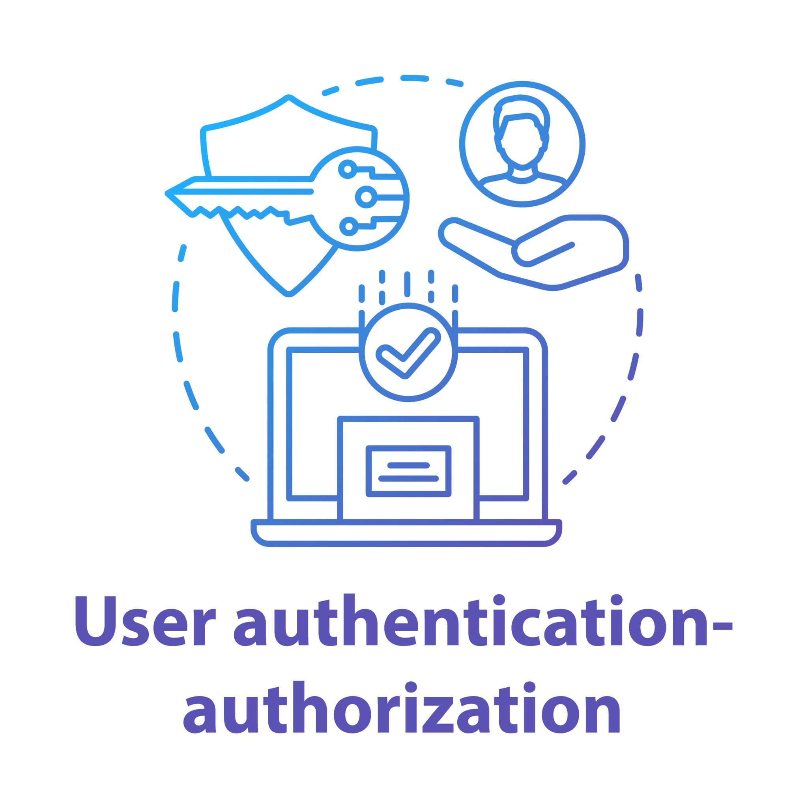


OpenID (OIDC) Identity Verification
Understanding the implementation process
User Access
IdP Redirect
Token Generation
Access Granted
An application redirects a user to the Identity Provider (IdP)
The user then authenticates with the IdP
Dual Tokens are issued via (JSON/REST) to provide an ID Token of who the user is and an Access Token for what the user can do or has access to
The application can log a user in from the ID Token providing the users password as well as access the API resources requests with the Access Token

Slide 9

Advantages/Disadvantages
(Decision Time)
SSO (SAML)
OAuth 2.0
OpenID (OIDC)
Authentication (AuthN): XML
Authentication (AuthZ): JSON/REST
Authentication (AuthZ): JSON Web Tokens
Enterprise Standard for B2B clients
Centralized Control for IT Teams activate/deactivate users from a single point.
Permissions at a granular level to limit access strictly to only the applications a user needs access
Cross-Platform authorization seamlessly across mobile, desktop & web applications
Development using JSON/REST is easier than SAML for most developers
Security is simple with JSON/REST tokens which reduces injection vulnerabilities
Compatibility across most enterprise IdPs and considered the standard for logins
Unified Stack since developers can use the same framework for both OpenID and OAuth
Heavy Implementation due to XML complications
Vulnerabilities from Misconfigurations in SAML can expose XML attacks
Single Point of Failure if the IdP goes down all apps become inaccessible
Vulnerabilities due to misconfigurations with tokens or connections can lead to data breaches
No Verification or authentication about the user is provided. Not used for logins just communications with APIs
Constraints for legacy enterprise customers using SAML

Slide 10

References
Descope. (2025, March 28). SSO vs. OAuth: Understanding the differences. https://www.descope.com/blog/post/sso-vs-oauth
Okta. (2024, September 2). What’s the difference between OAuth, OpenID Connect, and SAML? https://www.okta.com/identity-101/whats-the-difference-between-oauth-openid-connect-and-saml/
Puspasari, P. (2023). OAuth 2.0 vs OpenID Connect vs SSO: Understanding the key differences. Medium. https://medium.com/@puspas99/oauth-2-0-vs-openid-connect-vs-sso-understanding-the-key-differences-cd154da0041b
WorkOS. (2024, June 18). SSO vs OAuth: Key differences you must know. https://workos.com/blog/sso-vs-oauth

