Slide 1

The Technology Value Stream
Defining Lead Time vs Processing Time
Taking Deployment Lead Times from Months to Minutes
J. Morrow
06/06/26
CSD-380
Mod.1.2

Slide 2

Building the Strategic Capability
“Improving daily work is more important than doing daily work.” – Gene Kim
2

Slide 3
LEAD TIME VS. PROCESSING TIME
Lead Time
Processing Time
Starts when the customer request is made and ends when the request is fulfilled.
It represents the total elapsed time as perceived by the customer.
Known as "touch time." The clock starts only when work begins on the request.
It doesn’t count the time the work spends waiting in queues.

Slide 4

Hidden Cost of Queues
90% Lead Time Waste
Waiting vs. Working
In most traditional organizations, the actual work (processing time) is a tiny fraction of the total lead time.
Delays do not come from the work itself, but from the idle time where tickets sit in queues waiting for approvals, environments, or manual testing.

Slide 5

The Struggle:
(Months of Delay)
Monolithic Systems:
Tightly coupled architectures prevent independent deployment.
Manual Testing:
Heavy reliance on manual QA cycles that take weeks.
Approval Gates:
Multiple bureaucratic layers and Change Review Boards.
Scarce Environments:
Long wait times for integration and test environments.
5

Slide 6

Our DevOps Ideal
Deployment Lead Times Measured in Minutes
6

Slide 7

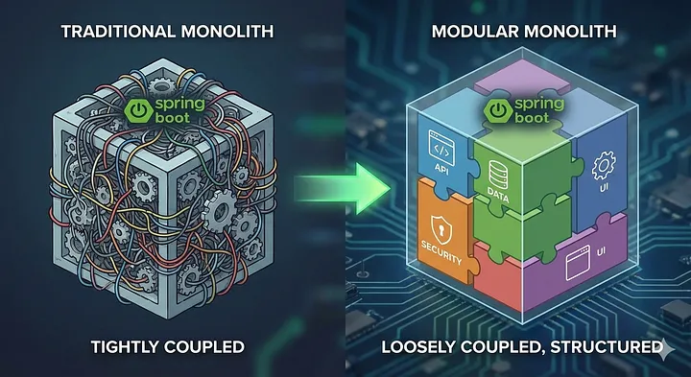
Architecture for Speed
Traditional Monolith (Tightly Coupled)
Failures are global and contained; one small error can break the entire system.
Modular Monolith (Loosely Coupled, Structured)
Small teams work with high autonomy
Continually checking small code changes into version control repositories daily; Automated flows and fast feedback result in high confidence
Failures are isolated and easily corrected
7

Slide 8
Performance Benchmark
Shorter lead times correlate with higher organizational agility
Elite Performers
Lead Time: Under 1 Hour
High Performers
Lead Time: 1 Day – 1 Week
Medium Performers
Lead Time: 1 Week – 1 Month
Low Performers
Lead Time: 1 – 6+ Months

Slide 9
Resources (DevOps Handbook, Online Content, Slides/Templates)
Source Title and Link | Slide(s) Referenced
The DevOps Handbook (pg. 49-58): How to Create World-Class Agility, Reliability, & Security in Technology Organizations | Slides 3, 4, 5, 7
Medium: 5-Minute DevOps: The Strategic Reasons for DevSecOps | Slide 2
Octopus Deploy: Why are there so many definitions of Lead Time? | Slide 3
Azure DevOps: Configure lead time and cycle time widgets | Slides 3, 4
Humanitec: Lead Time – a Key Metrics in DevOps | Slide 4
Medium/Stackademic: Spring Boot is Becoming a Modular Monolith | Slide 7
Axify: Deployment Time: What it is. How to Measure & Improve | Slide 8
DX: What are DORA Metrics? Complete guide to measuring DevOps performance | Slide 8
Power Point Templates: Bright business presentation, Classic corporate teach a course slides | Slides 1 - 10

Slide 10

Thank You
Justin Morrow
06/06/26
CSD 380 – Module 1.2
Professor Mazhata

