Slide 1
Genetic Algorithm in Dogfight Simulation
Andrew Morris

Slide 2


The Project
Evolve a 10-agent population to maximize effectiveness in a space dogfight simulation.
Populations evolve separately.
  Individuals are not mated between teams.
  Do not take into account other teams' genome when evolving.
  Genes affect behavioral traits

Slide 3
Genome
Consists of a size-8 array of integers.
  Ranging from 1-9.
  Affect the behavioral traits of the individuals in each population.
  Dummy gene introduced as a control.
Genome pool starts randomized, the total amount of points allocated to the combined genes cannot be greater than 30.

Slide 4
Genes
Genes will affect:
  Move Speed & Rotation Speed
  Attack FOV
  Attack Speed
  Reload Timing
  Re-targeting Behavior
  Team-Assist Behavior
  Chasing Behavior
  Dodging Sensitivity

Slide 5
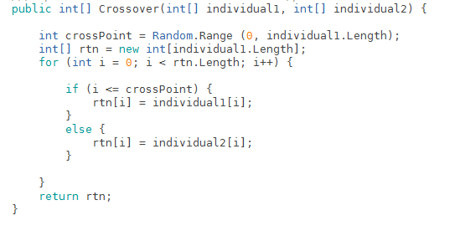
Crossover
Order1 genetic algorithm crossovers are similar to this

Slide 6
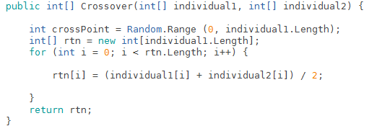
Crossover
Because the genes are integers, I used the following:

Slide 7
Crossover
Crossover takes into account the agent with the highest fitness on each team.
The highest agent is saved in the generation, and crossed with each other member of the team.
  Again, teams are not crossed with each other; each population must grow on their own.

Slide 8
Mutations
Mutations add 1 – 3 to a random gene in the genome.
Because balance must be kept through the genome, I subtract from another gene a counter-mutation to keep it equal
  This is not always a bad thing, some genes allow an agent to perform better.

Slide 9
Base Example
Example of base generation of initial population.

Slide 10
Fitness v1.0
Initial Fitness Calculation
  Float f = 1 – (numTimesHit * 0.05) + (numHits * 0.01) + (numKills * 0.1)
  Hits are easy, Kills are better.

Slide 11
Fight v2
Next version of the population generation.
  Fitness values
  Population Resestting

Slide 12
Results
Ran for 2300 Generations
  Highest Fitness Attained: 1.96
  Max Possible Fitness: 2.00
  Float f = 1 – (numTimesHit * 0.05) + (numHits * 0.01) + (numKills * 0.1)

Slide 13
My (Interesting) Mistake
The Genome for the maximum fitness run was
  [13, 2, 6, 7, 2, -3, 2, 1]
  Which does add up to thirty.
The high values (13, 6, 7) corresponds to attack speed, reload time, and move speed.
The low value (-3) corresponds to assists tendency.
This agent won the highest fitness by being greedy.

Slide 14
We Can Do Better!
Learning from my previous mistake
  I fixed upper and lower limits (1 – 9)
  Edited the fitness algorithm to induce better teamwork.
  Track Win/Loss
  New Fitness = 1 – (numTimesHit * 0.05) + (numHits * 0.01) + (numKills * 0.1) + (numTeammatesSaved * 0.07) – (numTeammatesIgnored * 0.03);

Slide 15
Fight v3
Most recent version of algorithm.

Slide 16
Results
Ran for 1125 Generations
  539/586 (Red/Blue) Wins
  Highest Fitness Attained: 2.01!
  Max Fitness Possible: N/A

Slide 17
Interesting Facts
Agents notice the backside is the weakest approach, and will continually try to get behind their targets.
Some agents will move backwards to dodge while shooting at the same time.
In later generations, agents began targeting a single unit a few seconds after initialization.

Slide 18
Shortcomings & Improvements
This is an implementation of basic GA, but there is no real set 'solution'. As such, it's hard to dynamically determine when to stop.
This implementation does not generate all of the behaviors on its own. As such, there could be things I'm missing.

Slide 19
End
Any Questions?

