Slide 1

Debugging
The why, where && WTF
behind your error messages…
Hunter T.
Phase 1: Day 4

Slide 2
Topics Covered
History
Reading Error messages
Different Strategies for attack
Tools
Cleanup some code (maybe)
Ten most common errors with examples

Slide 3
Why you care
80% of your time as a dev is spent READING CODE
60% of that time is spent DEBUGGING
Good Debugging skills is one of the things that will keep you sane in this jerb…

Slide 4
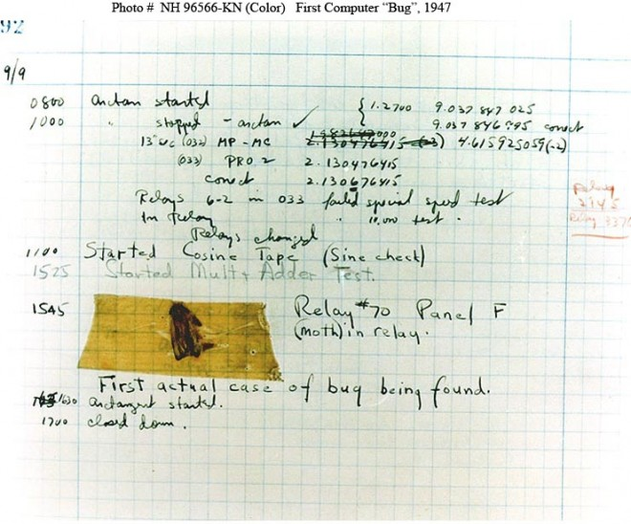
History

Slide 5
Gen Knowledge
BUG: Whenever a program/system is not behaving the way we expect
Debugging is the process of figuring out the source of the error and fixing it.
I think of it as the disconnect between my assumptions and what the code is actually doing.
It's a skill, so you'll need to practice it. This is another great reason to help your peers.

Slide 6
Error Messages

Slide 7
Error Messages
The First rule of debugging:
Read the error message!

Slide 8
Error Messages
The First rule of debugging:
Read the error message!
The Second rule of debugging:
Read the error message!

Slide 9
Error Messages
Errors are your friends!
Analyze the message
Note the line number(s)
stack trace

Slide 10
Stack Trace
Stack Trace (aka stack backtrace or stack traceback) is a report of the active stack frames upon error condition during a program’s execution.
We follow this path back to find the offending code segment and correct it.

Slide 11
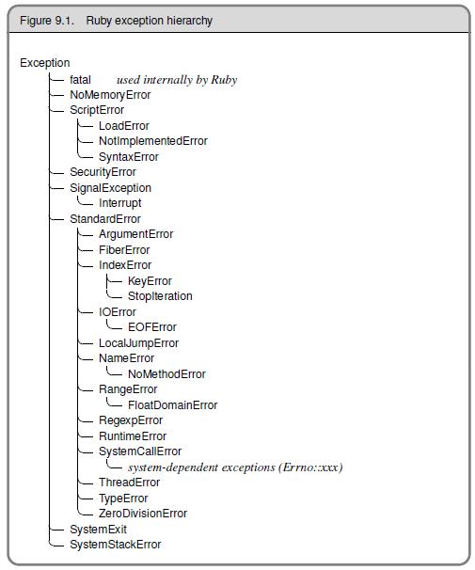
Ruby Exception Classes

Slide 12
Strategies
Read the error messages!
Know what your expected behavior is.
Verify and understand the input(s).
Verify the program / variable state.
Make small incremental changes.
Check your assumptions.

Slide 13
Strategies
Debug “inline”
Use a REPL (irb || pry)
Guess && Check
Raise – Rescue

Slide 14
Debugging “inline”
Use p statements to quickly show variable’s value p @some_variable
Quickly determine if you are reaching a method
def some_method p “HIT: some_method” end

Slide 15
Debugging “inline”
Terrific way to determine flow control around conditional statements if num = 1 p “inside if” else p “inside else” end

Slide 16
Debugging “inline”
Use “signaling code” to easily flag your spot in conjunction with a variable check p “~” * 80
p @variable_in_question
p “~” * 80
This is very useful in larger applications or when p-ing to a server console.
Tip: Use different signal characters when looking at multiple points in your code.

Slide 17

Tools

Slide 18
awesome_print
gem install awesome_print
require ‘awesome_print’
ap some_array
ap some_hash

Slide 19
PRY – The IRB Alternative
Pry is a REPL (Read-Eval-Print-Loop) much like IRB but with 3 additional key features:
Syntax Highlighting
Built in methods
A Debugger
Tabbed completion

Slide 20
PRY – Install
gem install pry
gem install pry-doc
gem install pry-byebug
rbenv rehash

Slide 21
PRY – terminal commands
ls (list methods)
_ (the last output)
? (show-doc)
. (send command to bash)
cat filename (displays the given file)
wtf? (wtf………)

Slide 22
PRY#show-doc

Slide 23
pry-byebug commands
step: Step execution into the next line or method. Takes an optional numeric argument to step multiple times.
next: Step over to the next line within the same frame. Also takes an optional numeric argument to step multiple lines.
finish: Execute until current stack frame returns.
continue: Continue program execution and end the Pry session.
up: Moves the stack frame up. Takes an optional numeric argument to move multiple frames.
down: Moves the stack frame down. Takes an optional numeric argument to move multiple frames.

Slide 24
pry-byebug
gem install pry-byebug
require "pry-byebug”
binding.pry to stop execution and enter the REPL

Slide 25
Exceptions
An instance of the Exception class
A raised exception will propagate through each method in the call stack until it is stopped or reaches the point where the program started
Raising and rescuing exceptions

Slide 26
Raise leads to Rescue
Raise without rescue will always result in an error
Use a rescue to handle the error generated by raise and render useful data back instead of a giant fail whale.

Slide 27
Rescue to the Rescue?
Careful:
Rescue isn’t the bug free savior you might think
Why You Should Never Rescue Exception in Ruby

Slide 28
Debugging Wrapup
Questions?

Slide 29
Sweet Links
Pry Usage (youtube)
Replace IRB with PRY

Slide 30
Final Thought
Just saying; a well tested app
will greatly reduce the
amount of debugging
you do.

