Slide 1

Debugging
The why, where && WTF
behind your error messages…
Hunter T.
Phase 1: Day 4

Slide 2
Lecture Topics
History
Reading Error messages
Different Strategies for attack
Tools
Cleanup some code

Slide 3
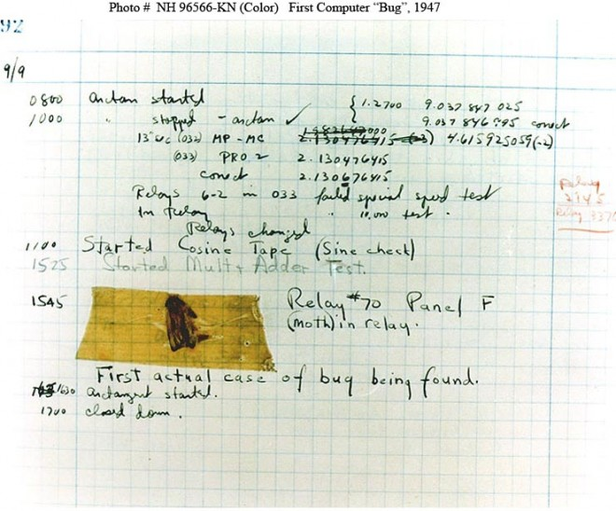
History

Slide 4
Error Messages

Slide 5
Error Messages
The First rule of debugging:
Read the error message!

Slide 6
Error Messages
The First rule of debugging:
Read the error message!
The Second rule of debugging:
Read the error message!

Slide 7
PRY – The IRB Alternative
Pry is a REPL (Read-Eval-Print-Loop) much like IRB but with 3 additional key features:
Syntax Highlighting
Built in methods
A Debugger

Slide 8
PRY – Install
gem install pry
gem install pry-doc
gem install pry-byebug
rbenv rehash

Slide 9
show-doc

Slide 10
Raise an Error
Careful:
Rescue isn’t the bug free savior you might think

Slide 11
Rescue
Careful:
Rescue isn’t the bug free savior you might think

Slide 12
Rescue to the Rescue?
Careful:
Rescue isn’t the bug free savior you might think
Why You Should Never Rescue Exception in Ruby

Slide 13
Debugging Wrapup
Questions?

