Slide 1
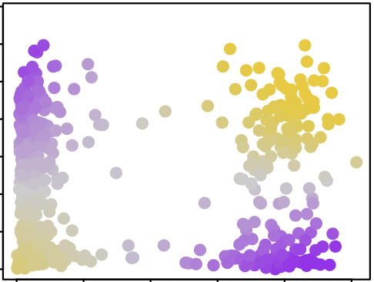
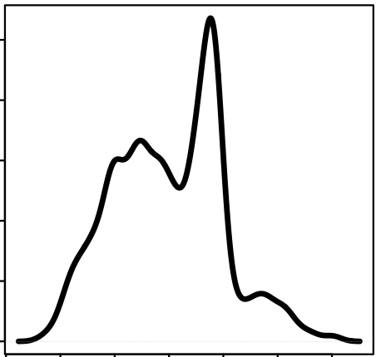
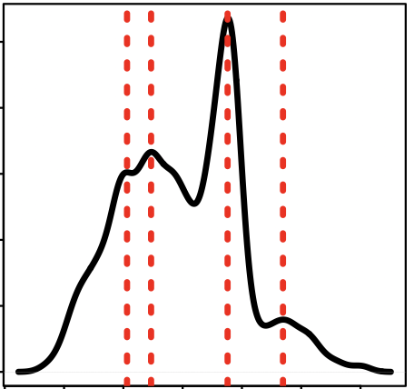
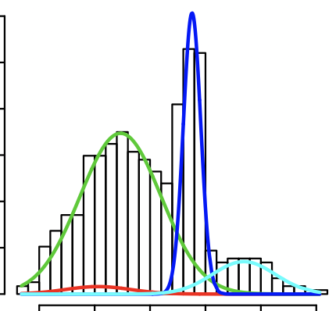
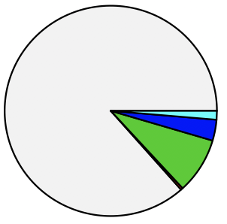
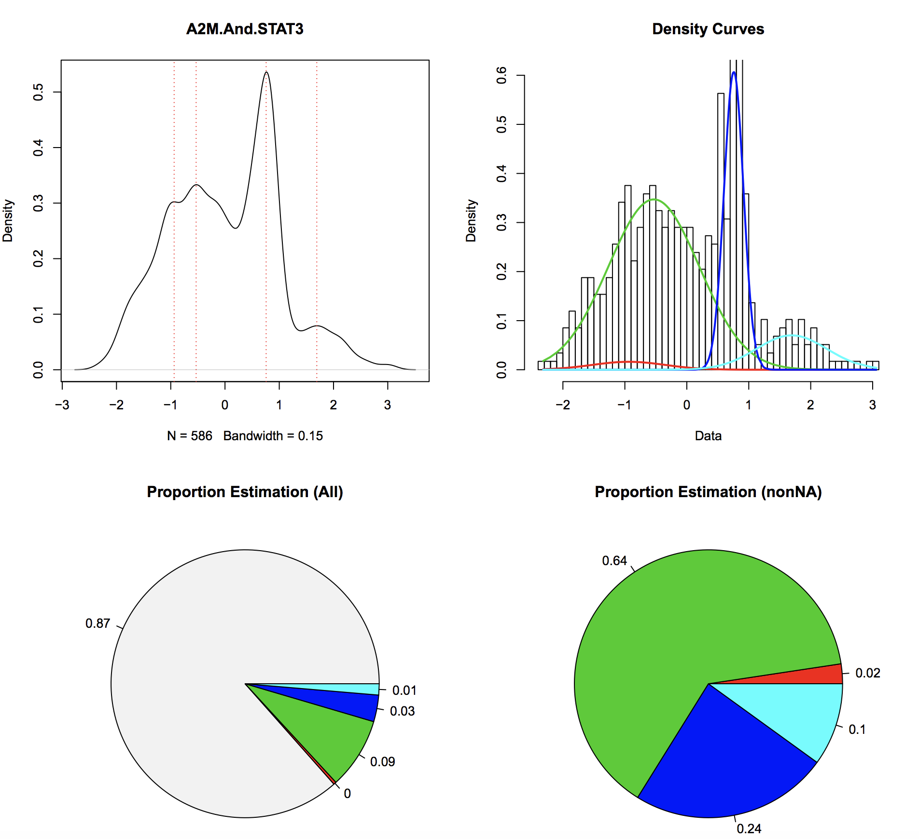
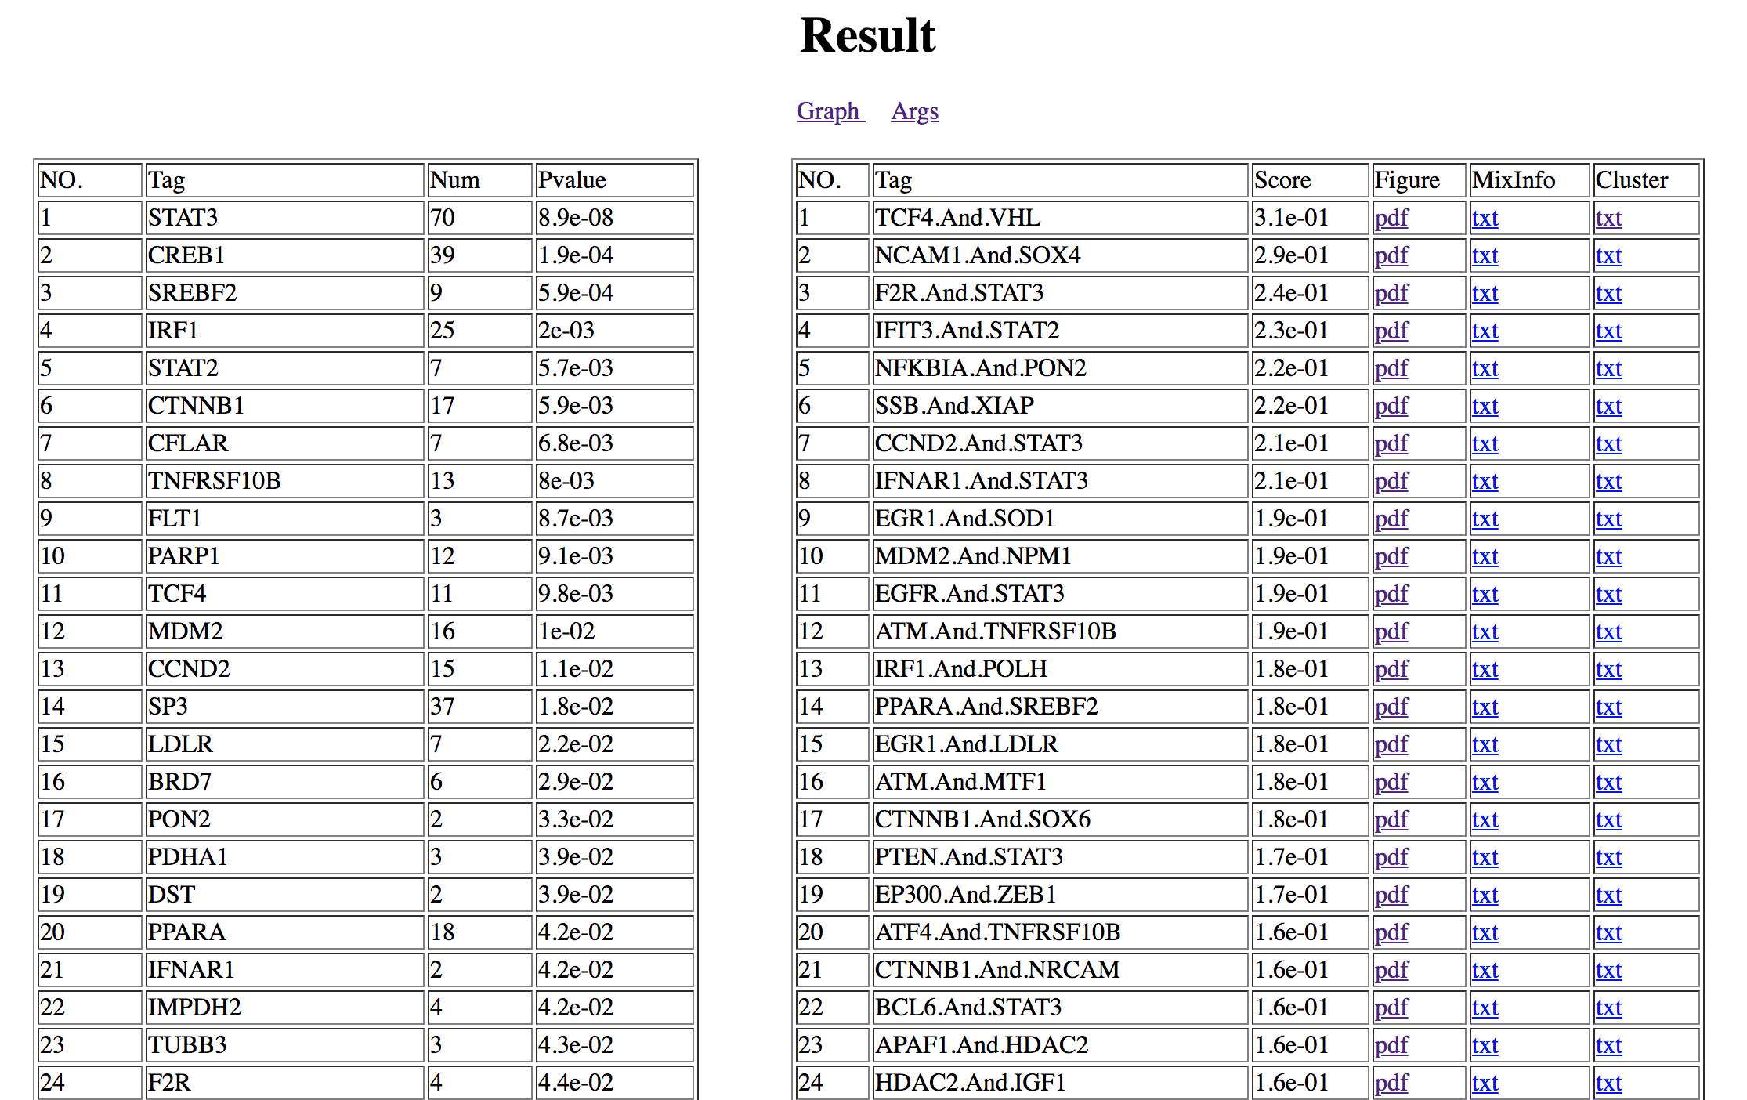
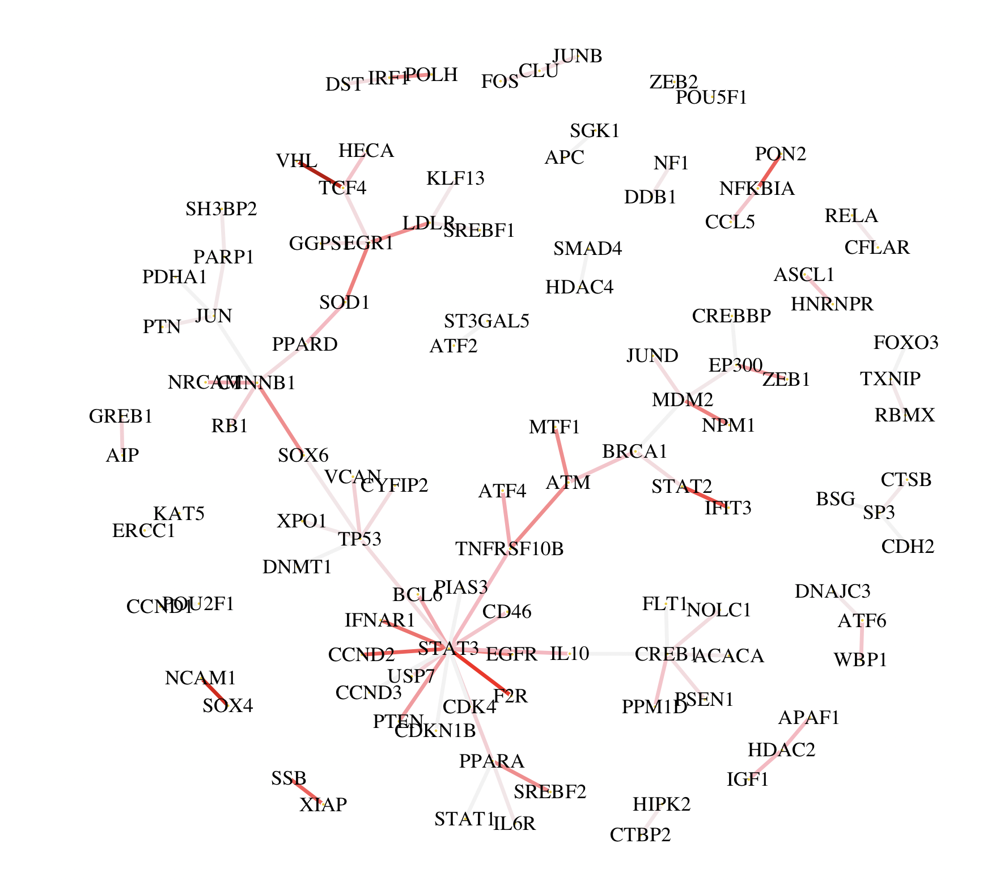




Gene Network
Normalized Expression Matrix
Gene2
Z-value Matrix
 | Cell1 | Cell2 | Cell3 | Cell4
Gene1 | 0.5 | 0.1 | 0.4 | 0
Gene2 | 1.2 | 0 | 3.2 | 1.1
Gene3 | 0 | 0.1 | 0.5 | …
Gene1
 | Cell1 | Cell2 | Cell3
Gene1.And.Gene2 | -0.5 | NA | -1.2
Gene1.And.Gene3 | NA | 0.6 | 0.8
… | NA | NA | …
+2
Expression &
Z-value
Gene2’s expression level
Z-value
$$Z=\frac{{ΔPCC}_{n}}{(1−{{PCC}_{n}}^{2})/(n−1)}$$
-2
Gene1’s expression level
Gene1.And.Gene2
Z-value Distribution
Peaks
The largest sub-group
in all cells (3%)
Main-group
(64%)
The largest sub-group
(24%)
Detect
peaks
Analyze mixture
of models
Calculate
score
$The proportion of$the
$$largest sub group in all cells$$
NAs
$$Score=$$
Gene Network
All scores
Rank
scores
Score1
Process
each gene
Score2
Score2
One-side K-S test
Score1
Gene1
$$Gene1^{′}s Pvalue$$
Gene1
Score3
Score3
Generate
report

Slide 2
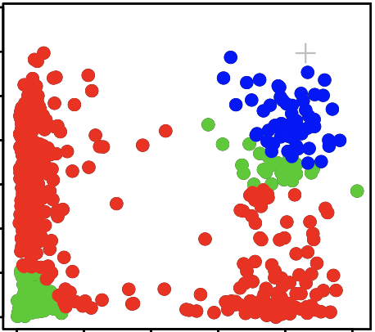
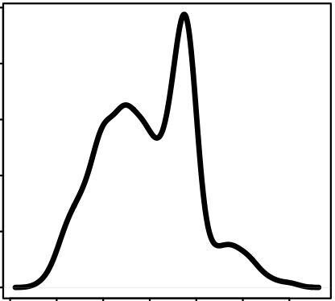
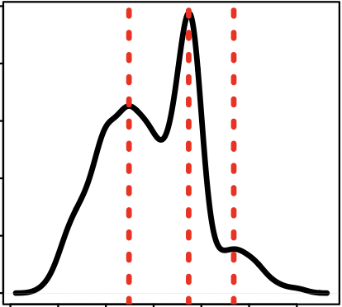
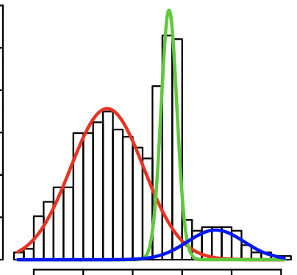
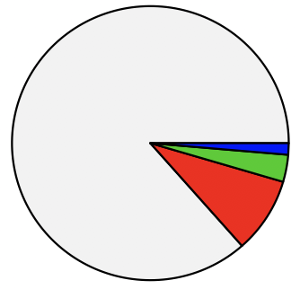
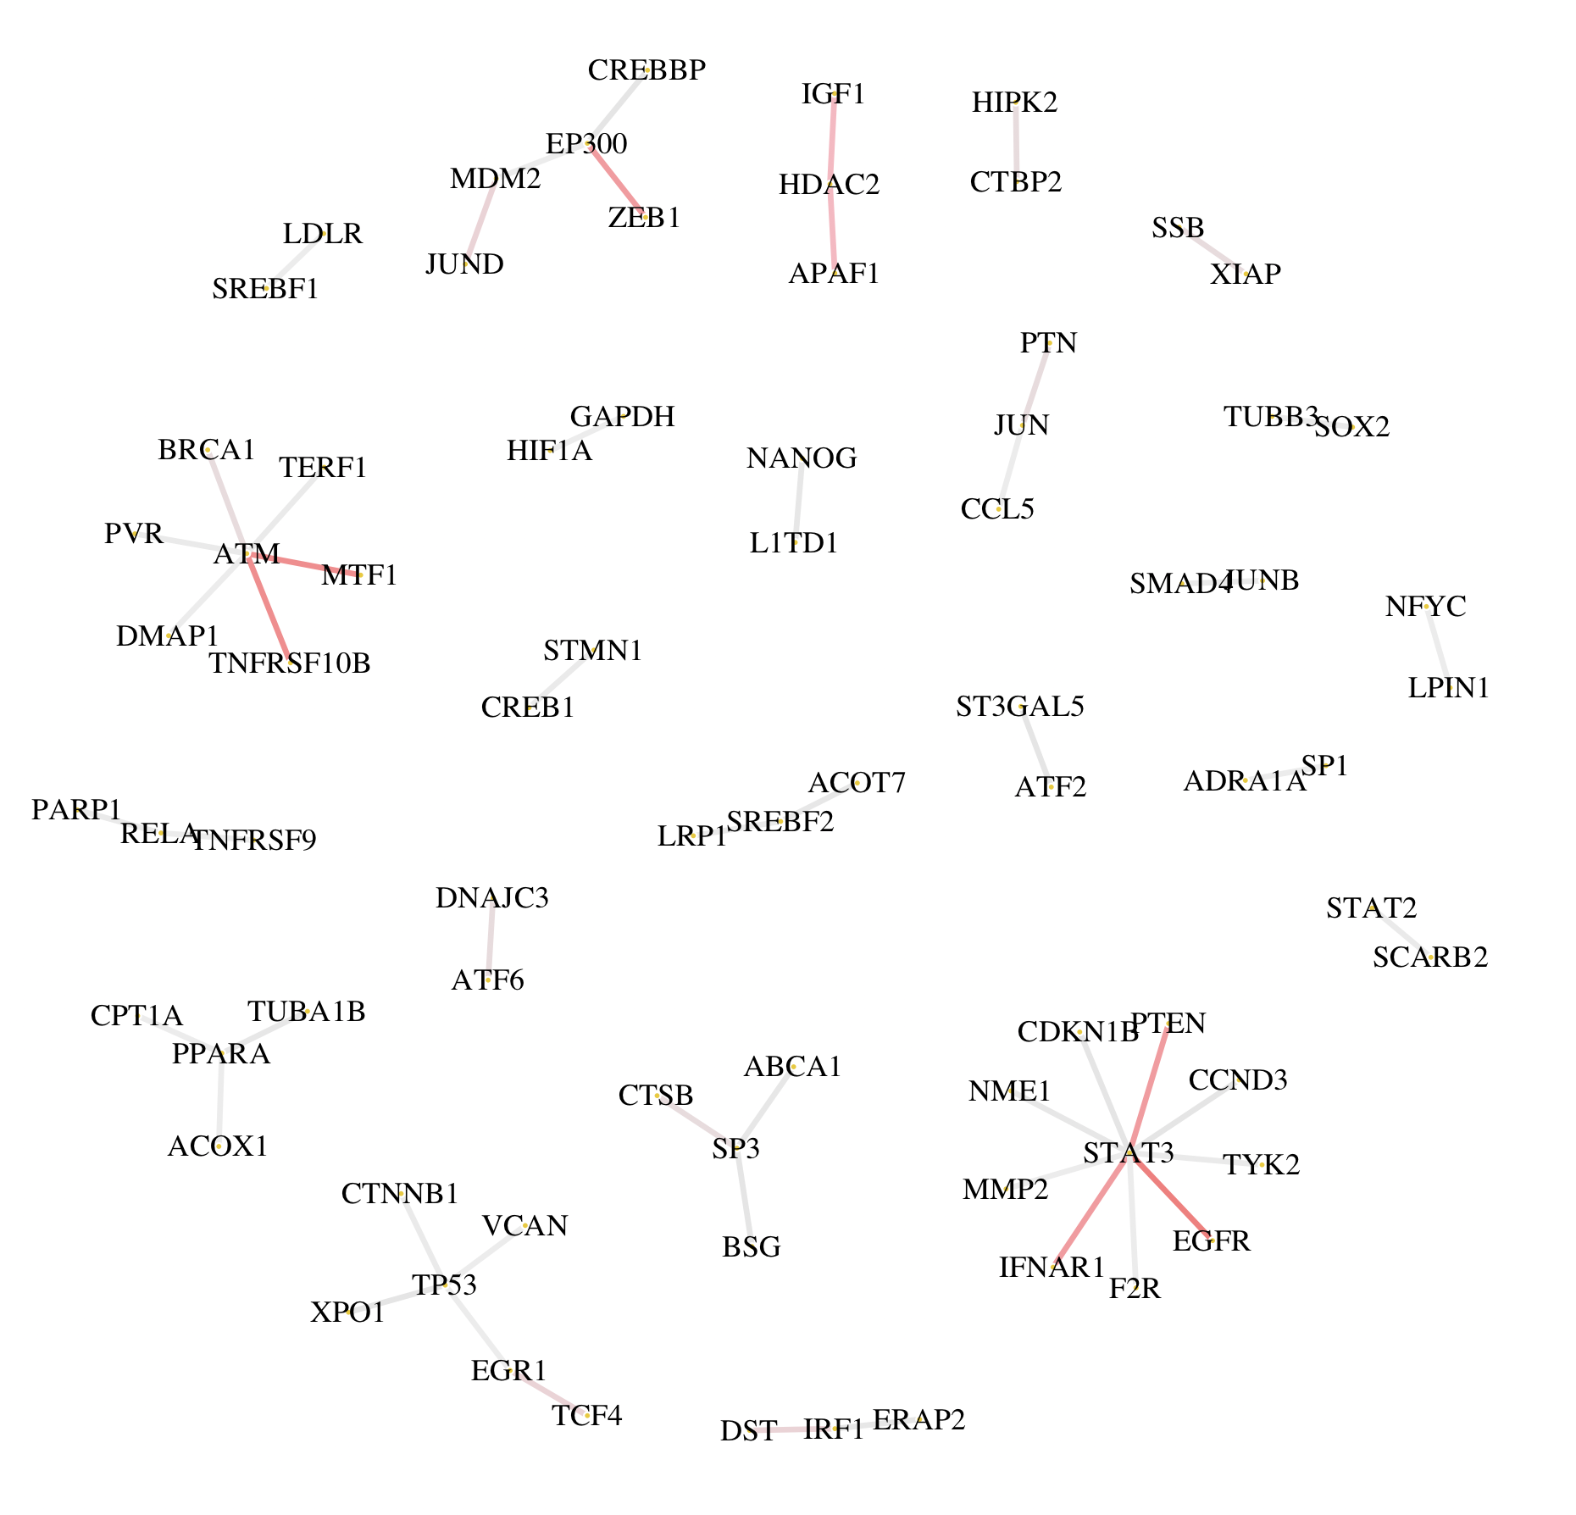
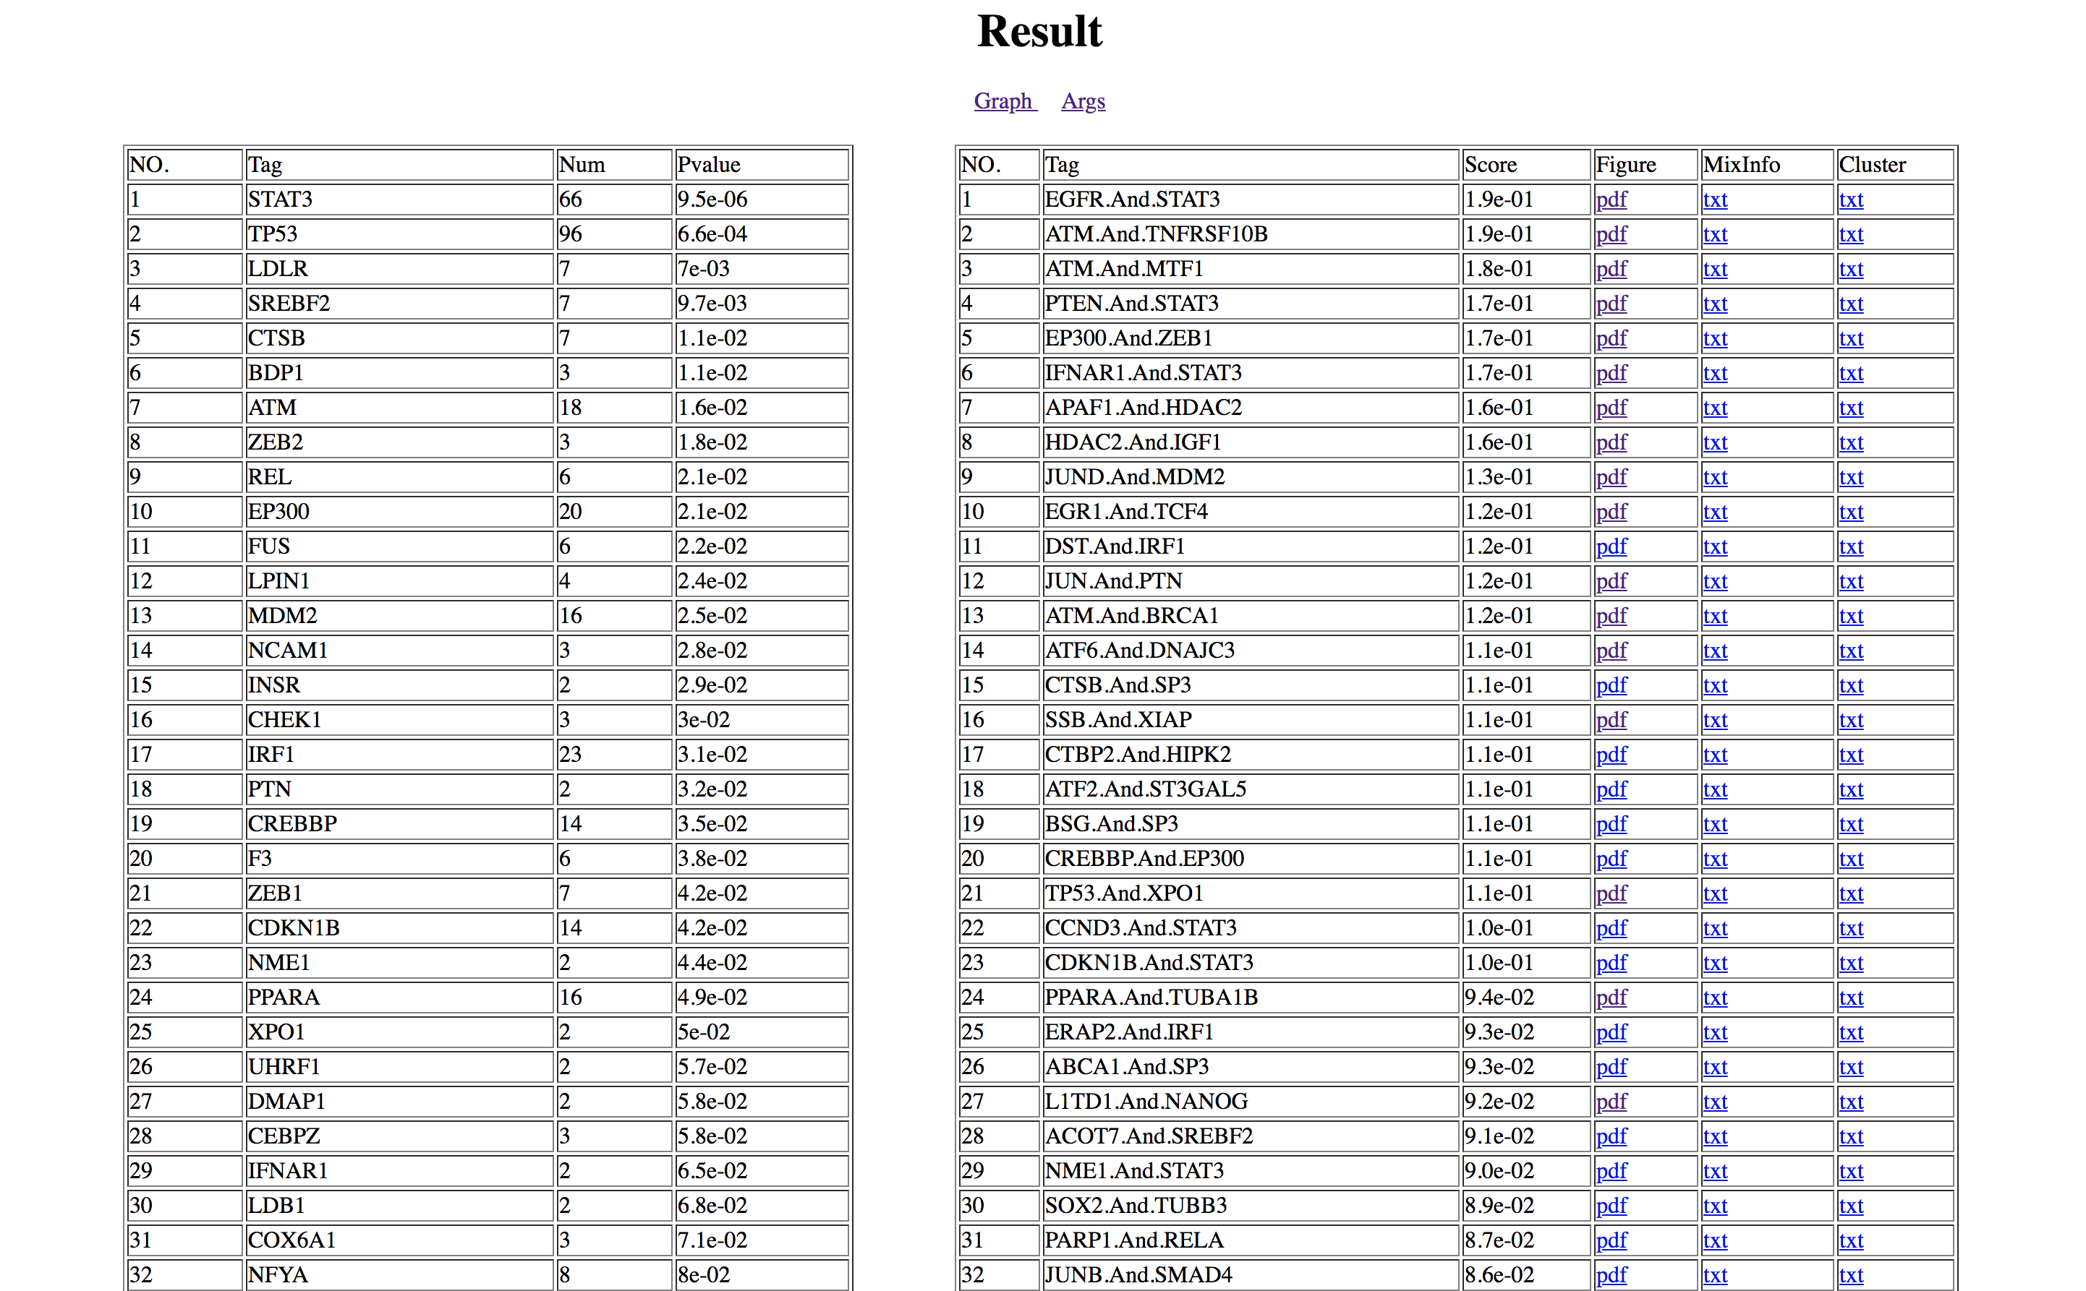
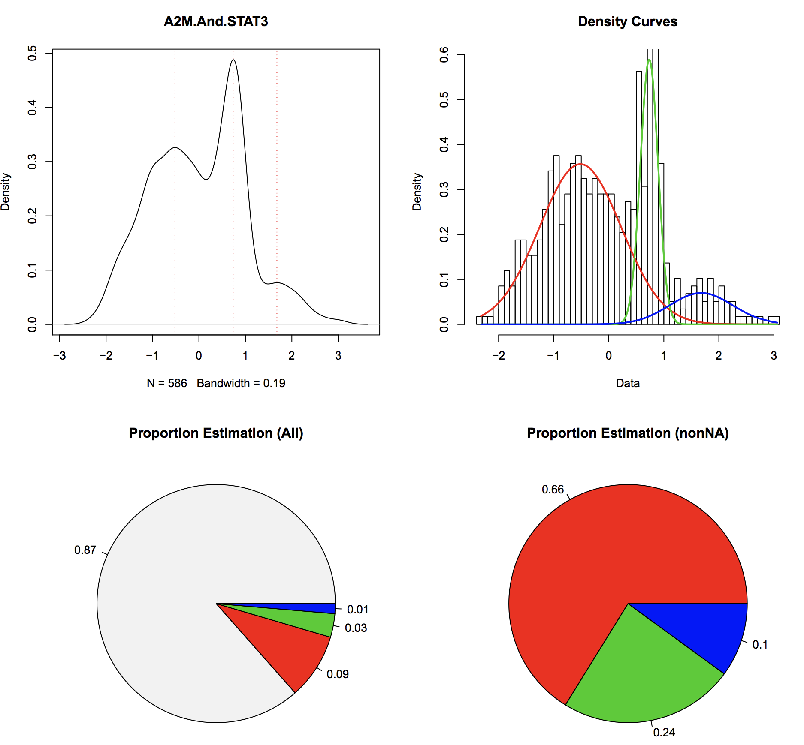


a.
Gene Network
+2
Normalized Expression Matrix
Gene2
Z-value Matrix
 | Cell1 | cell2
Gene1
Gene2 |  | …
Gene1
 | Cell1
Gene1.And.Gene2
… | …
Gene2’s expression level
Z-value
$$Z=\frac{{ΔPCC}_{n}}{(1−{{PCC}_{n}}^{2})/(n−1)}$$
-2
b.
Gene1’s expression level
Gene1
Gene2
Z-value Distribution
Main-group
(66%)
The largest
sub-group
(LSG) (24%)
Get cells in
each group
LSG (3%)
NAs
$$Edge Score= \frac{\# LSG cells}{\# All cells}$$
c.
d.
Gene Network
One-side K-S test
Generate report
Score1
Score2
Score2
Gene
Score1
Score3
Score3

