Slide 1
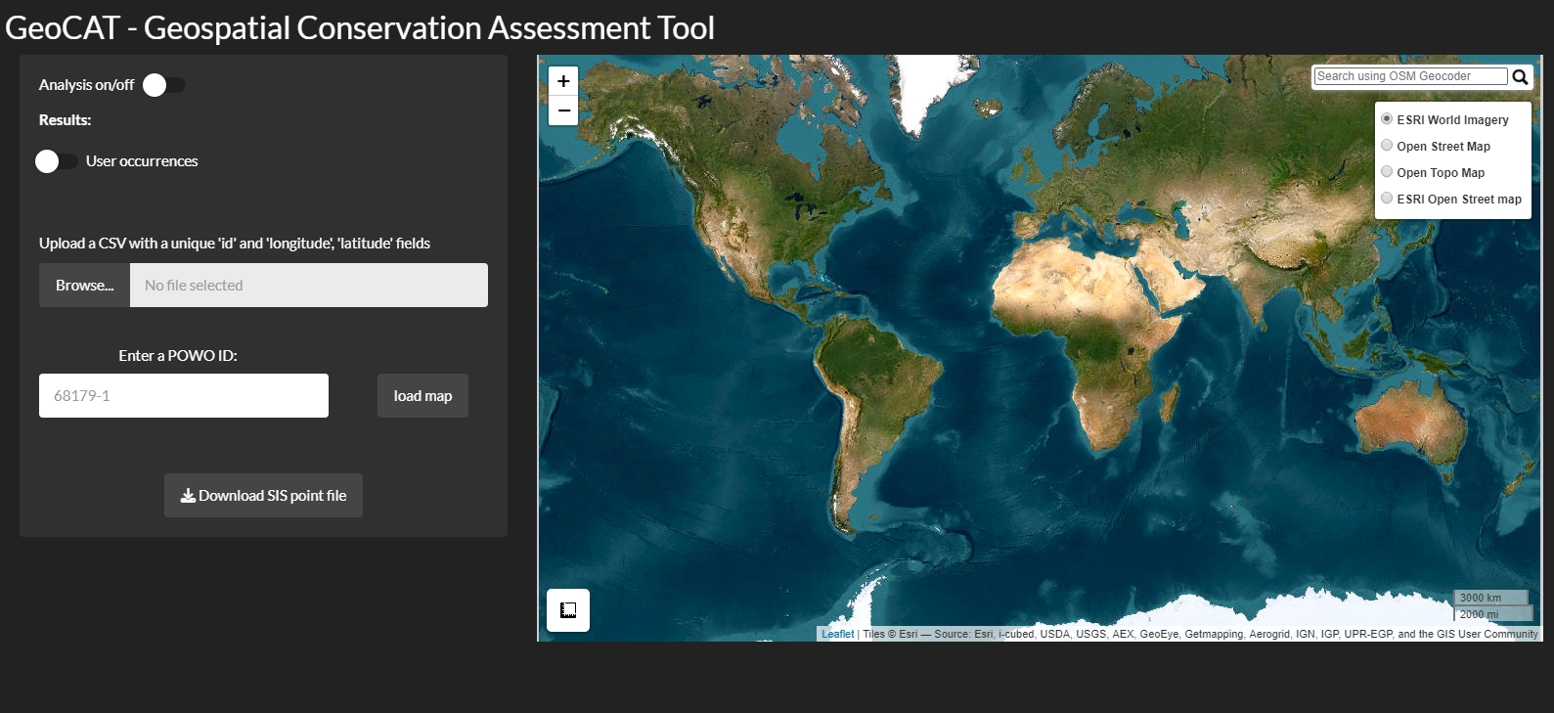
CSV file could be just ‘id’, ‘lat’ and ‘long’, but user could have other fields – how do we handle other fields? Standard set for validation?

Slide 2
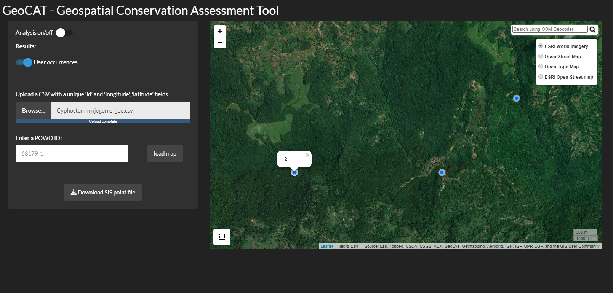
Id used for label popup windows to help identify points you want to edit
Lat and long used to plot points.

Slide 3


CSV only
Button:
Download IUCN points file
Depends on initial input format- if meets correct format then just save what goes in
Download IUCN points file

Slide 4
Map editing
Info window after point click:
I think lat, long, recordedby, recordno, identifiedby, year and catalogue number would be great.
Delete points
Move points
Add native range (POWO code)
Map
Habitat layer – shrubs, grass, forest, desert

