Slide 1
Handling points table in shinyGeoCAT
User CSV
Required: latitude, longitude
Optional: standard fields
GBIF import
Required: latitude, longitude
Optional: standard fields
Standard fields

Slide 2
User CSV
Required: latitude, longitude
Optional: standard fields
Standard fields
Name | Format | Notes
geocat_id | numeric
geocat_source | csv, gbif, user | user is points added to map
geocat_edit_id | numeric | id when edited
geocat_status | char | new_point, moved, deleted

Slide 3
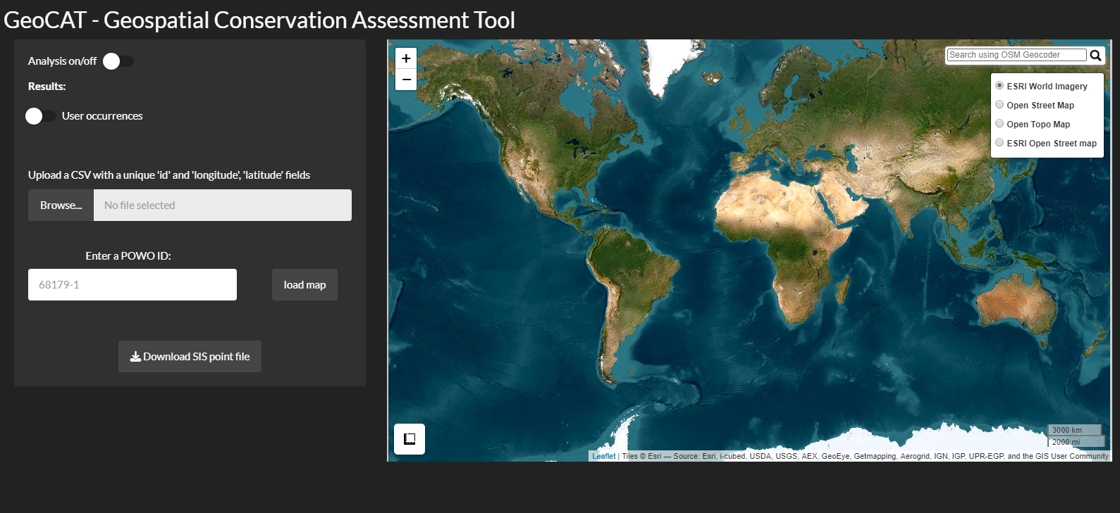
CSV file could be just ‘id’, ‘lat’ and ‘long’, but user could have other fields – how do we handle other fields? Standard set for validation?

Slide 4
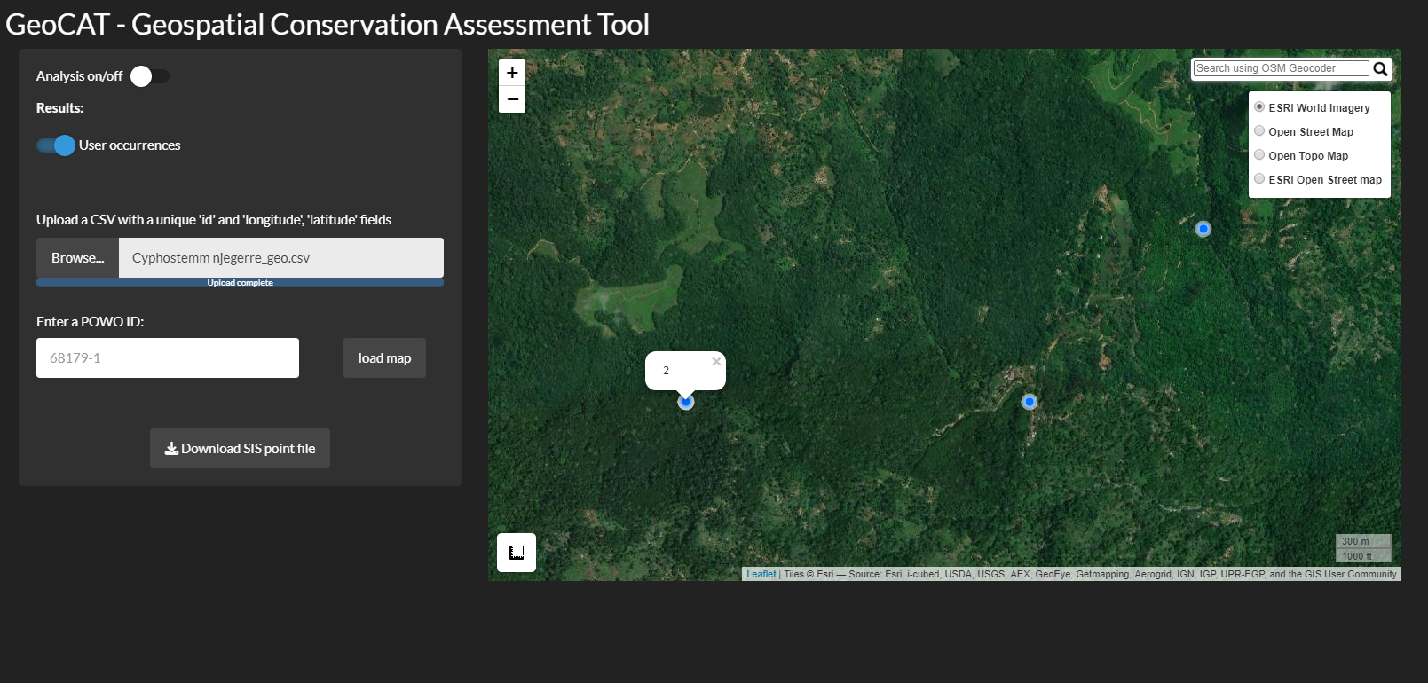
Id used for label popup windows to help identify points you want to edit
Lat and long used to plot points.

Slide 5


CSV only
Button:
Download IUCN points file
Depends on initial input format- if meets correct format then just save what goes in
Download IUCN points file

Slide 6
Map editing
Info window after point click:
I think lat, long, recordedby, recordno, identifiedby, year and catalogue number would be great.
Delete points
Move points
Add native range (POWO code)
Map
Habitat layer – shrubs, grass, forest, desert

