Slide 1
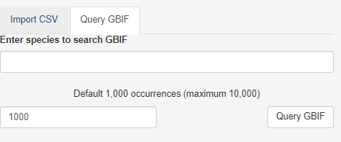
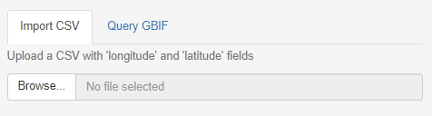
Welcome to GeoCAT
Select option below
Import csv
Query GBIF
Analysis page with CSV loaded on map
Analysis page with GBIF loaded on map

Slide 2



CSV only
GBIF only
Analysis page with GBIF data loaded on map
Keep simplified GBIF format so users can track back to source
Needs points to be clickable to ID
Analysis page with CSV loaded on map
Button:
Download IUCN points file
Button:
Download IUCN points file
Convert GBIF to IUCN format
Depends on initial input format- if meets correct format then just save what goes in
Download IUCN points file

Slide 3
Map editing
Info window after point click:
I think lat, long, recordedby, recordno, identifiedby, year and catalogue number would be great.
Delete points
Move points
Add native range (POWO code)
Map
Habitat layer – shrubs, grass, forest, desert

