Slide 1
Outer Radius
R1
Inner Radius
R2
Outer Radius in Gauge Length
Grip Length
f ( θ )
Gauge Length
Specimen Length
θ
f ( θ )
Grip Length

Slide 2
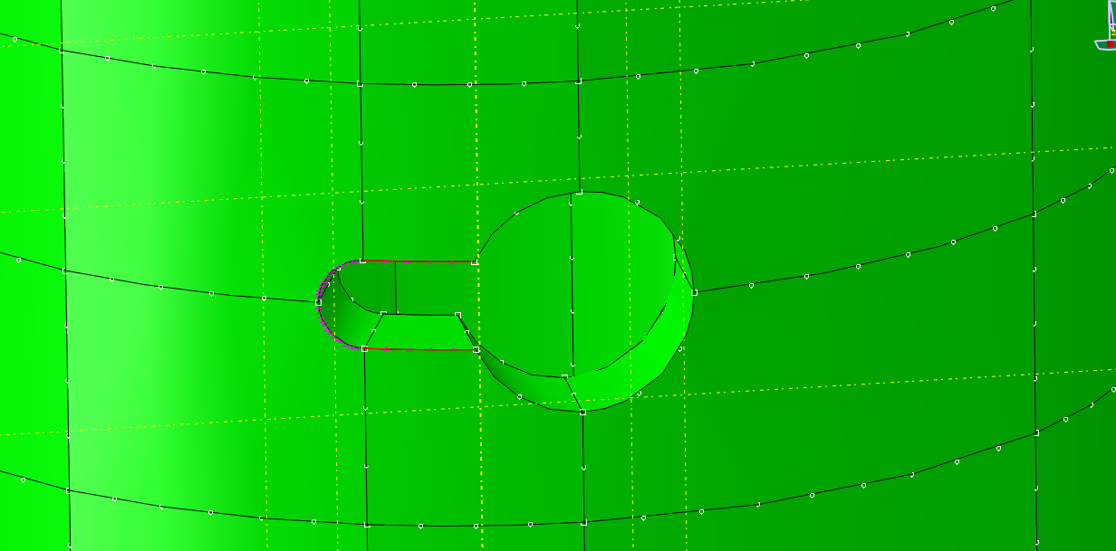
10
12
8
13
11
7
9
3
4
2
14
6
1
5

